Slide 1

Creator of ChatGPT

Slide 2
ChatGPT is an artificial intelligence (AI) chatbot which generates text based on the input given by the user. ChatGPT was launched in November 2022 and it has now become very popular across the globe.
While ChatGPT causes ripples throughout the globe, a 35-year old technology officer has caught global attention. Mira Murati, the Chief Technology Officer (CTO) at at OpenAI, the company behind Artificial Intelligence (AI)-powered chatbot ChatGPT.

Slide 3
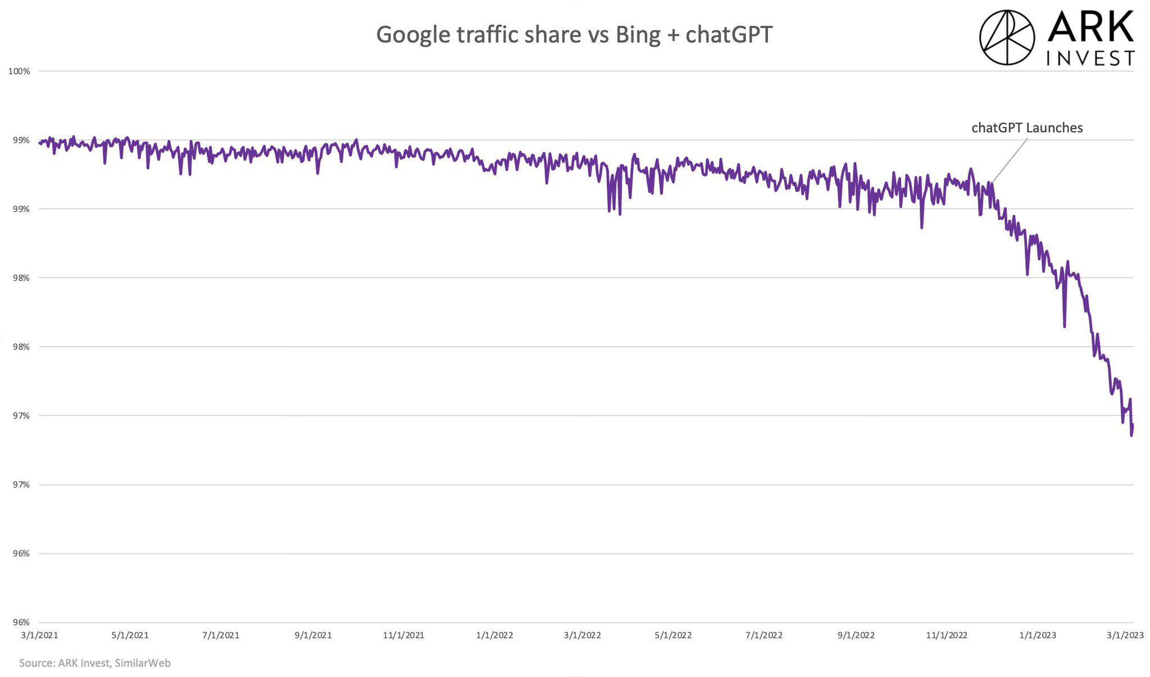

Slide 4
India also represents the second largest source of web traffic for ChatGPT at 11.17%, behind the US, which made up 11.27% of the traffic.
The AI chatbot has also been trained to converse in various languages, expanding its appeal to users in numerous countries.

Slide 5
Advance version of ChatGPT
GPT-4 (Generative Pre-trained Transformer 4) is a multimodal large language model created by OpenAI, the fourth in the GPT series.
It was released on March 14, 2023, and will be available via API and for ChatGPT Plus users.
Purpose of GPT-4
GPT-4 is a large multimodal model it accepting image and text inputs, emitting text outputs.
It can generate, edit, and iterate with users on creative and technical writing tasks such as composing songs, writing screenplays, or learning a user’s writing style.

Slide 6

Creator of RxJS-5
BEN LESH

Slide 7
Any Idea about RxJS?
RxJS is a REACTIVE EXTENSIONS LIBRARY FOR JAVASCRIPT.
RxJS is a library for reactive programming using Observables, to make it easier to compose asynchronous or callback-based code.
This project is a rewrite of Reactive-Extensions/RxJS with better performance, better modularity, better debuggable call stacks, while staying mostly backwards compatible, with some breaking changes that reduce the API surface.

Slide 8
Does Anyone know the person behind the creation of RxJS 5!!
Ben Lesh, is a software engineer and a prominent figure in the JavaScript community. He is best known as the creator of RxJS 5, a reactive programming library for JavaScript that enables developer Angular core team, and has contributed to several open-source projects, including Zone.js and RxJS.
He is a frequent speaker at tech conferences, and is known for his expertise in reactive programming, JavaScript, and front-end development.
Ben worked at Google, where he is a software engineer on the Angular team .He worked as a Senior UI Engineer at Netflix.

Slide 9
When to use RxJS?
RxJS is preferred to use when your project contains lots of async task handling. It is the right choice for these conditions. RxJS is loaded by default with the Angular project.
It has more than 2.4 million dependent repositories on GitHub.
It has more than 16 thousands of dependent packages on NPM.
The number of weekly downloads from NPM has exceeded 22 million.

Slide 10
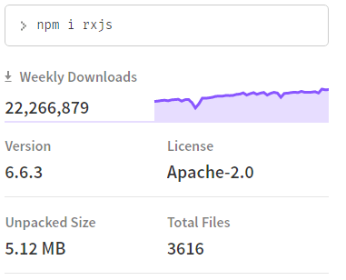
Usage of RxJS

