Slide 1
Flight Price Prediction
Monika
June 2025

Slide 2
Summary of the dataset
Column | Non-Null Count | Meaning
Airline, Date_of_Journey, ..., Additional_Info, Price | 10683 non-null | ✅ No missing values
Route | 10682 non-null | ⚠️ 1 missing value
Total_Stops | 10682 non-null | ⚠️ 1 missing value
Price | dtype: int64 | ✅ This is our target variable for prediction
All others | dtype: object | Mostly strings or mixed (date/time in string form)
Out of 10683 total rows, only 1 row is missing values in Route and Total_Stops.
Since it's just 1 row, it should be dropped to avoid complications during preprocessing.

Slide 3
Feature Created
Feature | Description
Total_Stops | Encoded using LabelEncoder (non-stop = 0, 1 stop = 1, etc.)
Journey_day, Journey_month | Extracted from Date_of_Journey
Dep_hour, Dep_minute | Extracted from Dep_Time
Arrival_hour, Arrival_minute | Extracted from Arrival_Time
Duration_mins | Converted from text format to total minutes
Airline_*, Source_*, Destination_*, Additional_Info_* | One-hot encoded categorical variables

Slide 4
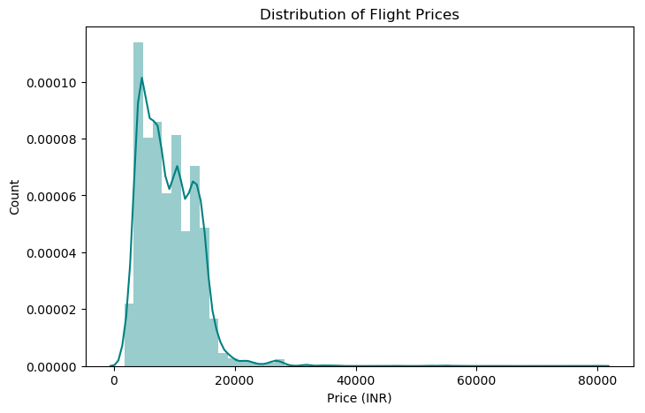
Price Distribution
Right-skewed distribution: Most flight prices fall between ₹2,000 and ₹15,000.
Few high-price outliers: Prices reach up to ₹80,000, indicating premium or business class flights.

Slide 5
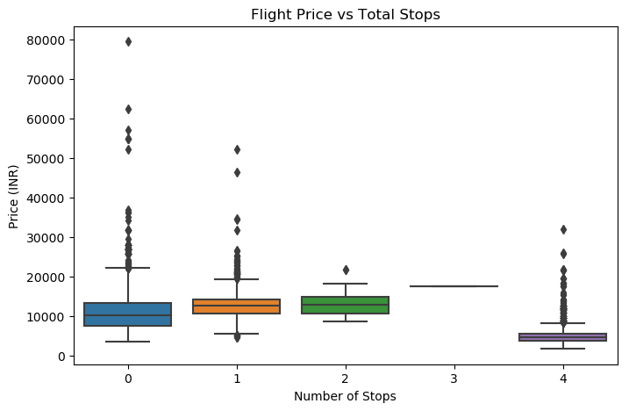
Price vs Total Stops
Direct flights (0 stops) tend to have lower average prices.
1 or 2 stops increase the price.
4 stops seem to be outliers or possibly errors, as the price is unusually low.

Slide 6
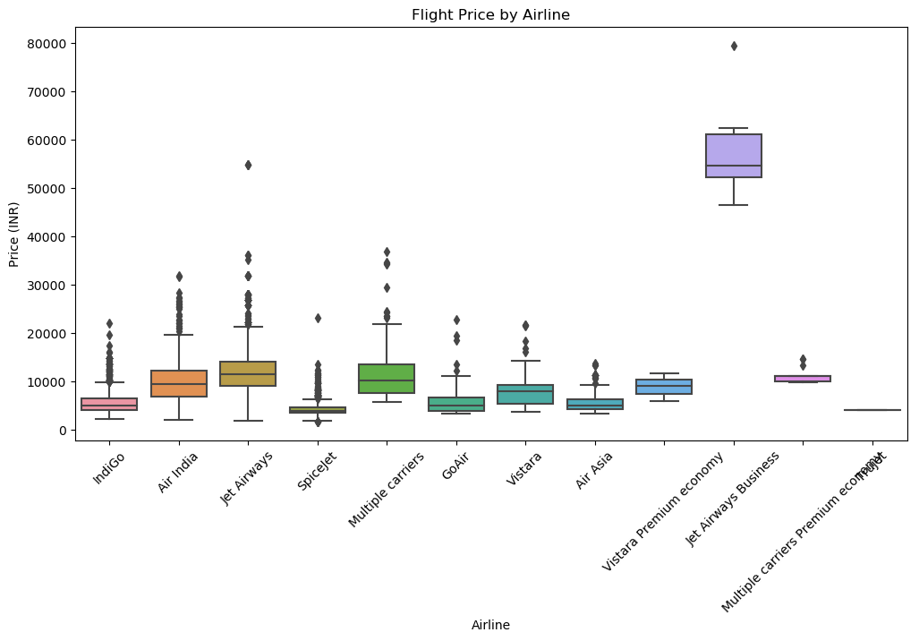
Price by Airline
Jet Airways Business class has the highest median and upper-range prices.
IndiGo, Air Asia, GoAir offer more affordable fares.
Price varies significantly across airlines, which is an important feature.

Slide 7
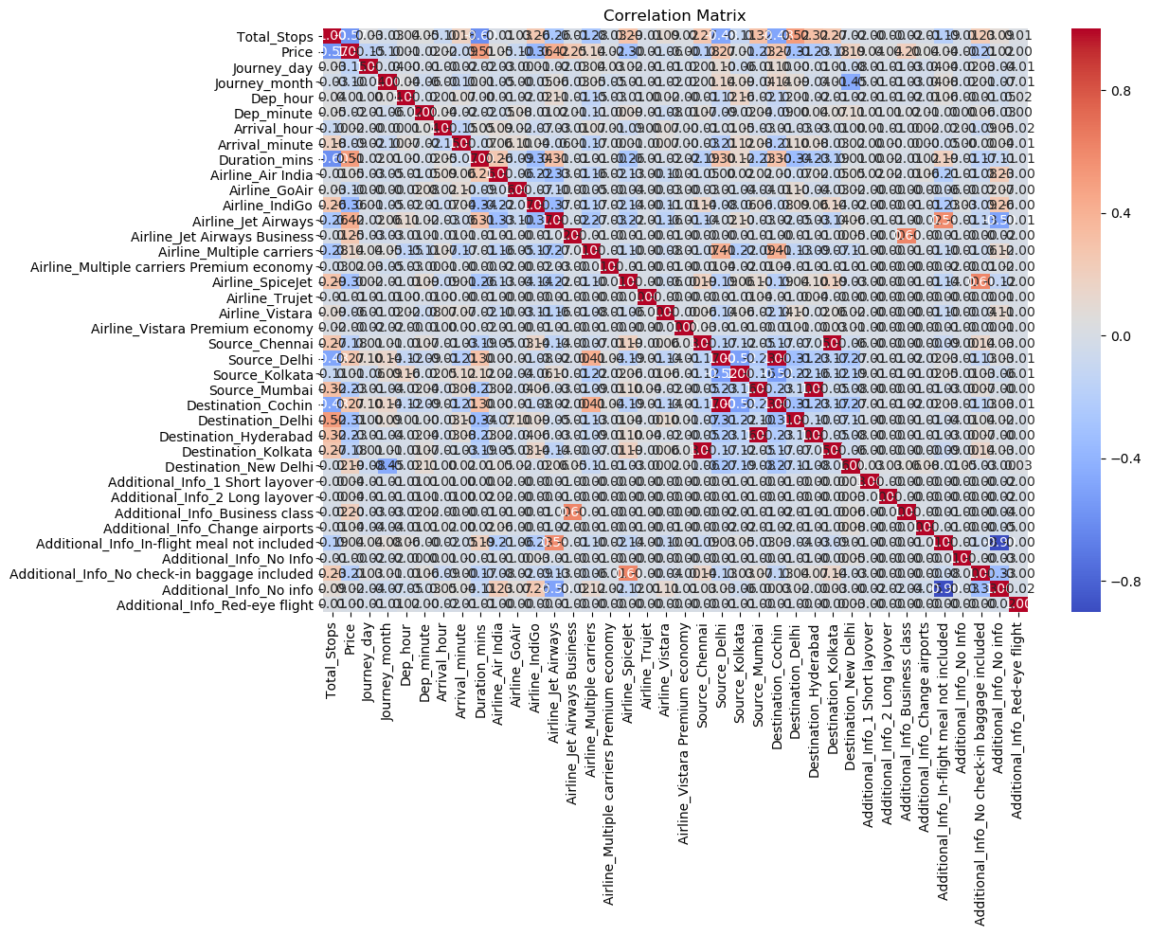
Correlation Matrix
Duration_mins is moderately correlated with Price.
Total_Stops has a positive correlation with Price, as expected.
Other individual encoded features (e.g., Airline, Source, Destination) show less direct correlation but are still useful for modeling.

Slide 8
Model performance summary
Model | RMSE ↓ (lower is better) | R² Score ↑ (higher is better)
Linear Regression | 2641.70 | 0.676
XGBoost | 1573.60 | 0.885
Random Forest | 1466.04 | 0.900
Linear Regression underperforms due to its inability to capture nonlinear patterns in flight pricing.
XGBoost shows significant improvement — powerful for structured/tabular data.
Random Forest performs best overall, suggesting:
It’s capturing interactions between variables effectively.
Possibly less overfitting compared to XGBoost (despite similar results).

Slide 9
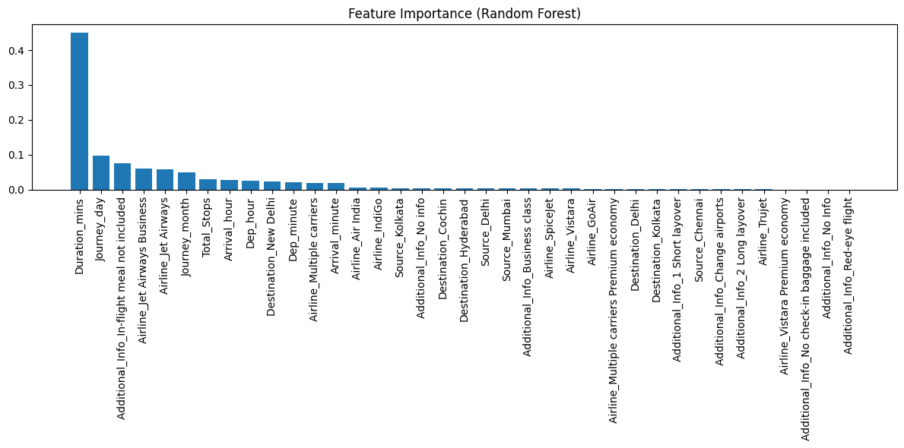
Feature Importance
Rank | Feature | Importance
1️⃣ | Duration_mins | ~0.44 – Dominates model prediction power.
2️⃣ | Journey_day | ~0.08 – Likely reflects weekend vs weekday pricing.
3️⃣ | In-flight meal not included | ~0.07 – May correlate with low-cost carriers.
4️⃣ | Airline_Jet Airways Business | ~0.06 – Business class flights are priced much higher.
5️⃣ | Airline_Jet Airways | ~0.06 – Jet Airways fares seem to be distinguishable.

