Slide 1
Customer Satisfaction Prediction

Slide 2
Summary of the dataset
Step 1: Target Column: satisfaction (categorical → needs label encoding)
Categorical Features: Gender, Customer Type, Type of Travel, Class
Numerical Features: Mostly Likert scale scores (1–5), and continuous ones like Age, Flight Distance, Arrival Delay in Minutes
Missing Values: Only in Arrival Delay in Minutes
Columns to Drop: Unnamed: 0, id (no predictive value)
Step2:
visualize satisfaction distribution Explore relationships between key features and satisfaction Check feature correlations

Slide 3
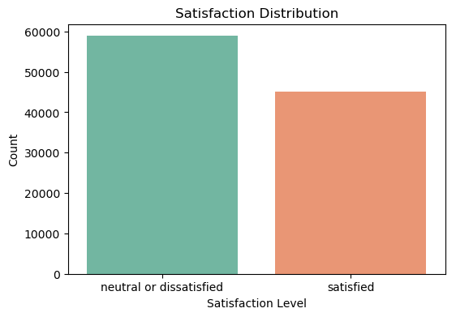
satisfaction distribution
Slight class imbalance: more "neutral or dissatisfied" than "satisfied".

Slide 4
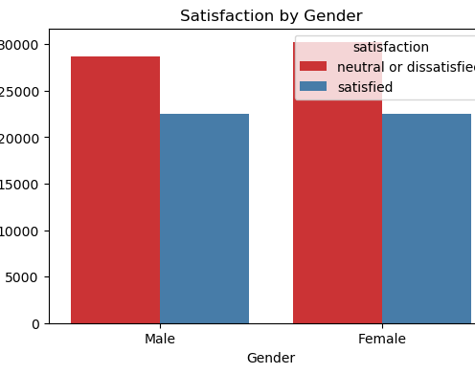
Explore relationships between key features and satisfaction
Both males and females show more dissatisfaction.
No drastic gender effect — model likely won't benefit much from this as a strong feature alone.

Slide 5
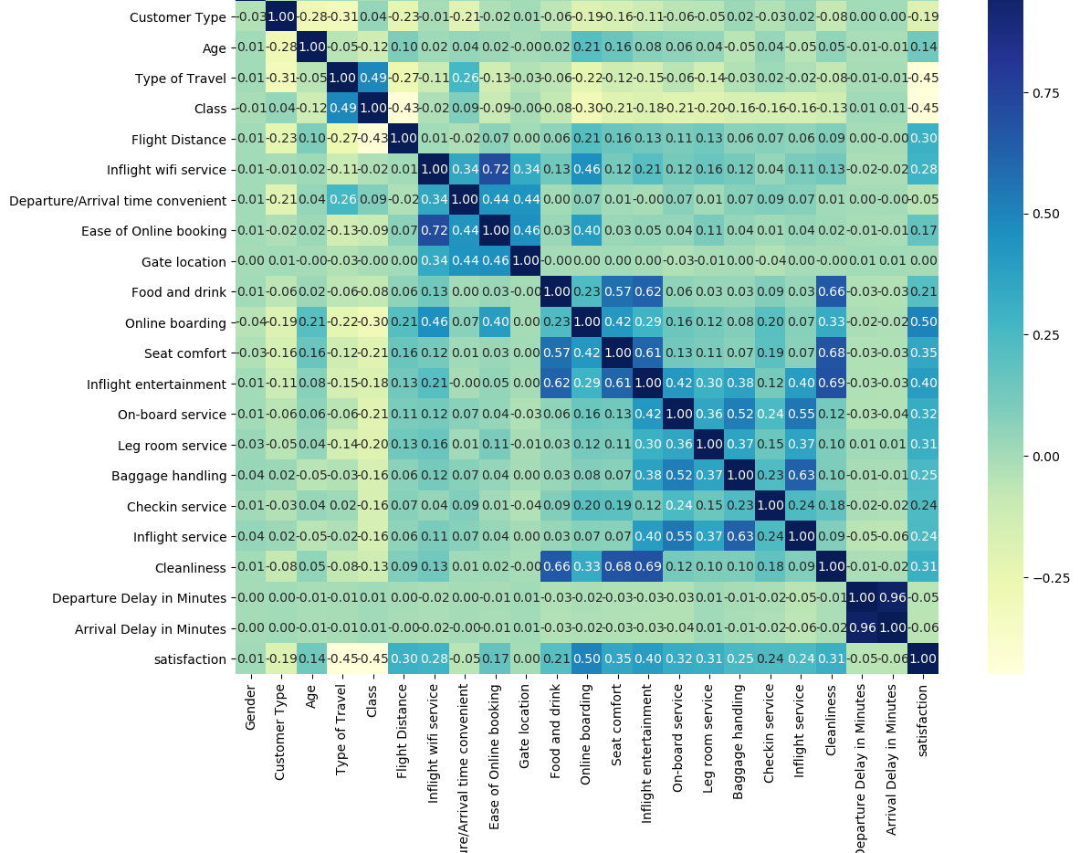
Correlation Heatmap:
Strongly positive correlation with satisfaction:
Inflight entertainment, Online boarding, Seat comfort, Cleanliness
Weak correlation:
Gender, Gate location, Arrival Delay, etc.

Slide 6
Model Training + MLflow Logging
Feature | Logged to MLflow
Model Name | ✅
Accuracy & F1 Score | ✅
Confusion Matrix (as image) | ✅
Trained Model | ✅
Saved to Model Registry | ✅
Model | Accuracy | F1 Score
Logistic Regression | 0.8777 | 0.8569
Random Forest | 0.9621 | 0.9558
Gradient Boosting | 0.9423 | 0.9329
📌 Best Performing Model: Random Forest — Excellent precision and balance.

