Slide 1
Amazon Delivery Time Prediction
A Machine Learning Approach

Slide 2
Introduction
Objective: Predict Amazon delivery time using machine learning models.
Dataset Features:
- Agent age & rating
- Distance
- Weather & traffic conditions
- Vehicle type
- Product category

Slide 3
Data Preprocessing
- Cleaned dataset by removing duplicates & missing values
- Calculated distance using the Haversine formula
- Encoded categorical variables
- Removed outliers using IQR method

Slide 4
Exploratory Data Analysis (EDA)
- Visualized relationships between features and delivery time
- Scatterplots for Distance vs. Delivery Time
- Boxplots for Weather, Traffic, and Vehicle impact
- Bar plots for Product Category effects

Slide 5
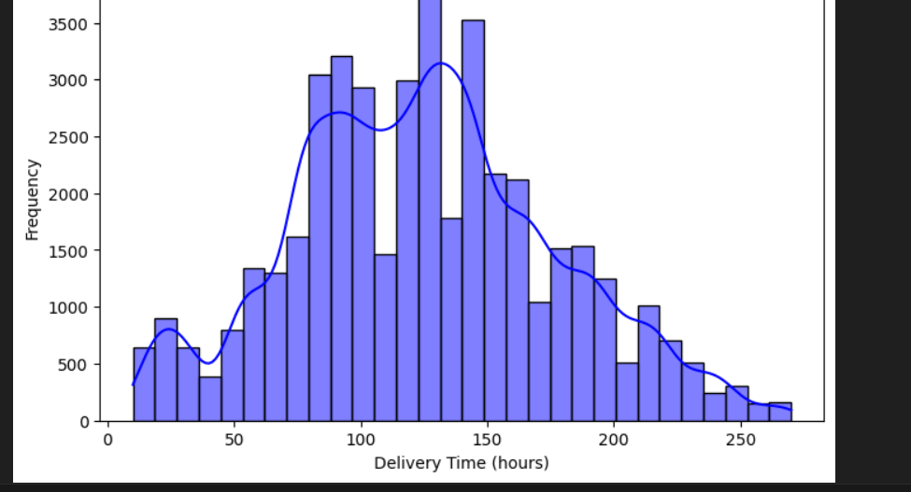
This is a histogram with a KDE (Kernel Density Estimate) plot overlaid, representing the distribution of delivery time (in hours) for Amazon deliveries
Insights:
Most deliveries happen between 50 to 150 hours.
There is a long tail, meaning some deliveries take much longer (outliers).
The bimodal distribution suggests different shipping speeds, possibly standard vs. express delivery.

Slide 6
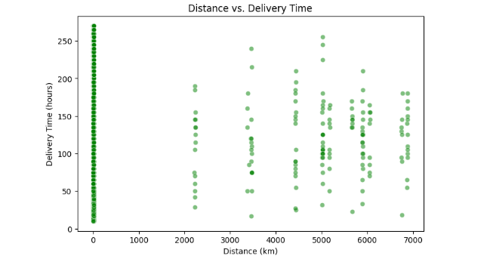
This scatter plot visualizes the relationship between Distance (km) and Delivery Time (hours).
Insights:
No clear linear relationship:
Deliveries with similar distances (e.g., around 5000 km) show a wide range of delivery times, indicating other influencing factors such as shipping method, logistics delays, or location accessibility.
Grouping at specific distances:
There are clusters at certain distances (e.g., 2000 km, 4000 km, and 6000 km), which may correspond to predefined shipping zones or routes.
Possible Data Issues:
The vertical line at 0 km suggests potential data recording issues or local deliveries with missing distance data.
Next Steps:
Check for missing or incorrect data in the dataset.
Analyze other factors (e.g., shipping method, holidays, or regional delays) affecting delivery times.
Use a regression model to identify key variables influencing delivery delays.

Slide 7
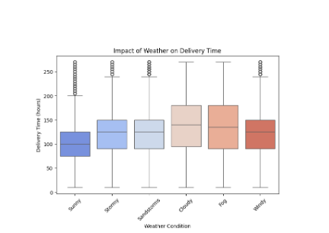
Impact of Weather on Delivery Time
Observations
Sunny conditions: Have a lower median delivery time, meaning deliveries are generally faster.
Stormy, Sandstorms, Cloudy, Fog, and Windy conditions: Show higher median times and more outliers, indicating that adverse weather slows down deliveries and increases variability.
Foggy and Cloudy conditions: Appear to have the widest spread, meaning deliveries under these conditions have highly inconsistent times.

Slide 8
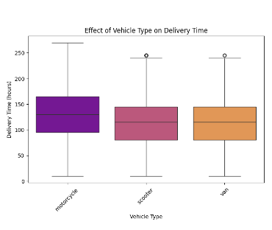
Effect of Vehicle Type on Delivery Time
Key Insights
Scooters and vans tend to have more consistent delivery times than motorcycles.
Motorcycles might be faster in some cases, but they also have more variability, leading to possible delays.
Companies should consider using scooters or vans for more predictable delivery times, especially for time-sensitive deliveries.

Slide 9
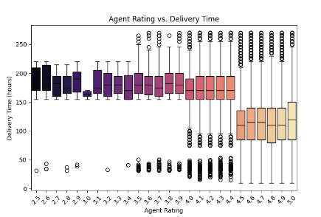
Agent Rating vs. Delivery Time
Key Insights
Higher-rated agents tend to have shorter and more consistent delivery times.
Lower-rated agents exhibit high variability in delivery times, with frequent delays.
Businesses may benefit from assigning more critical deliveries to higher-rated agents for better efficiency.
Ratings seem to correlate inversely with delivery time, meaning as agent ratings increase, delivery time decreases.

Slide 10
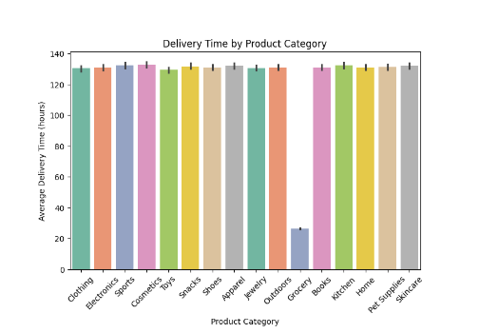
Delivery Time by Product Category
Key Insights
Groceries require the fastest delivery, likely due to perishability.
All other categories have similar delivery times (~130 hours), meaning shipping processes for non-perishable goods may not vary significantly.
Retailers may optimize logistics for different categories by focusing on reducing delivery times where possible.

Slide 11
Feature Engineering
- Standardized numerical features using MinMaxScaler & StandardScaler
- Encoded categorical features
- Selected key features affecting delivery time (Distance, Traffic, Agent Rating)

Slide 12
Model Training & Evaluation
- Tested multiple regression models:
1. Linear Regression
2. Ridge Regression
3. Decision Tree
4. Random Forest (Best)
5. Gradient Boosting
6. SVR & KNN
- Evaluated using RMSE (Root Mean Squared Error)

Slide 13
Best Model Selection & Deployment
- Random Forest Regressor gave the best performance
- Saved trained model using Pickle & Joblib
- Ready for deployment & further optimization

