Slide 1
Gene Knockout Analysis with Embeddings
In-Silico ALS Perturbation · GeneFormer V2 · Motor Cortex Single-Cell Analysis
Task 1
Task 2
Task 3
Task 4
Perturbation
Workflow Design
ALS Gene
Perturbations
Embedding Space
Interpretation
Drug Target
Prioritisation
Model: GeneFormer V2 (gf-12L-95M-i4096) Dataset: Pineda et al. 2024 · BA4 sALS motor cortex · 10-gene panel across 5 ALS pathways
Monika Sekelja · Helical Coding Challenge · 2026

Slide 2
SUMMARY
KEY TAKE AWAYS
Pretrained GeneFormer V2 places sALS and healthy motor neurons at cosine distance 0.003–0.006 insufficient for per-gene target resolution (0/44 FDR-significant).
Despite this: STMN2 restoration is the top rescue signal across all scoring metrics (composite 0.93, bidirectional ✓, dose-response R²=0.99).
A four-gene druggable combination (STMN2 + UNC13A + DCTN1 + DYNC1H1 restore) achieves the only significant synergy
ACTB negative control validates framework specificity.
Fine-tuning is the critical unlock (compute & time constraints were the bottleneck)

Slide 3
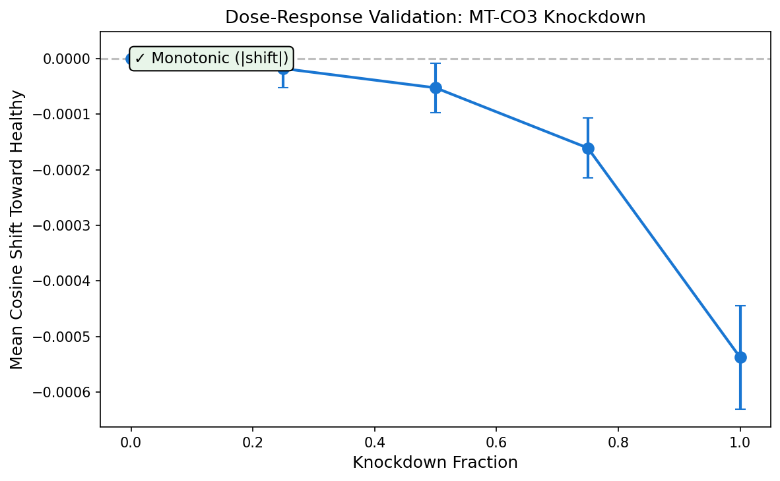
TASK 1
InSilico Perturbation Workflow
OBJECTIVE
Design a scalable framework to simulate gene knock-down and knock-up events in single-cell data, leveraging GeneFormer V2's rank-value encoding to measure perturbation effects in a biologically informed latent space.
InSilicoPerturbation CLASS — CORE METHODS
perturb()
①
Modify expression counts to simulate knock-down (→0) or knock-up (→healthy max) for target genes
embed()
②
Generate GeneFormer V2 embeddings for paired unperturbed & perturbed cells
cosine_shift()
③
Measure directional displacement toward the healthy population centroid
dose_response()
④
Graded perturbation by fraction (e.g. 0%, 25 %, etc) to characterise response curves
null_distribution()
⑤
FDR-corrected significance against 20 random-gene perturbations

Slide 4
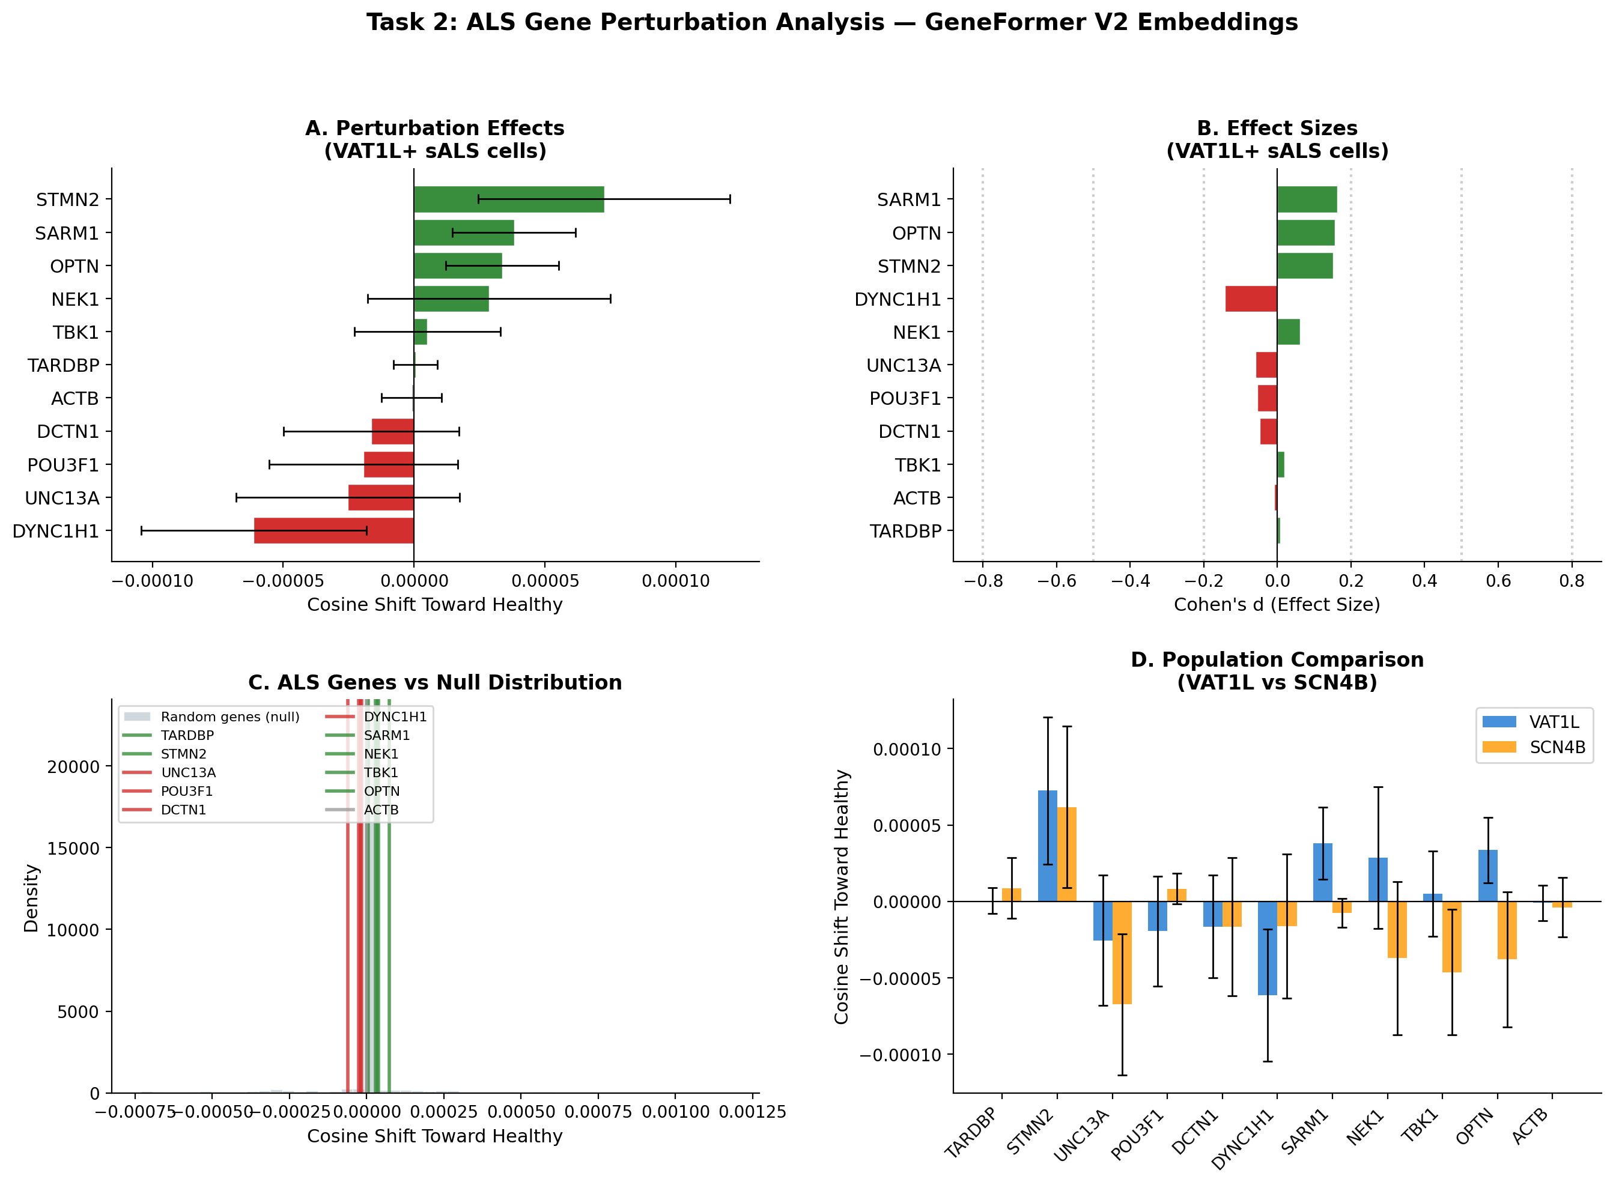
TASK 2
ALS-Specific Gene Perturbations via GeneFormer V2
10-GENE PANEL · 4 POPULATIONS (VAT1L + SCN4B × sALS + PN)
Pretrained model limitation: GeneFormer V2 places sALS and healthy motor neurons at cosine distance 0.003–0.006. All perturbation shifts are bounded to ~10⁻⁴. Fine-tuning on VAT1L+ & SCN4B+ cells would amplify but exceeded GPU memory on g5.xlarge.
Top single-gene signal: STMN2 restore - largest positive shift in disease cells. Bidirectional: healthy cells shift in opposing direction. Dose-response monotonic
Second signal: SARM1 KD - most reproducible non-TDP-43 rescue signal (d = 0.16). Bidirectionally consistent across VAT1L populations.
Mechanism validators:
TARDBP KD ≈ zero shift (TDP-43 is ubiquitously expressed → low rank → invisible to the model). Pathway biology detected through downstream targets (STMN2), not the hub gene.
Only significant combination
TDP43_full_axis (TARDBP KD + STMN2 + UNC13A restore), p = 0.012. Shift = +1.24 × 10⁻⁴, which is 2.6× the sum of individual shifts. The three genes cooperate within the TDP-43 axis — TARDBP and UNC13A contribute nothing alone but amplify the signal in combination.
ACTB control validates framework
near-zero shift in disease cells despite being the most differentially expressed gene in the panel (log2FC = −1.04).
0/44 individual perturbations FDR < 0.05: fine-tuning is required for per-gene significance.

Slide 5
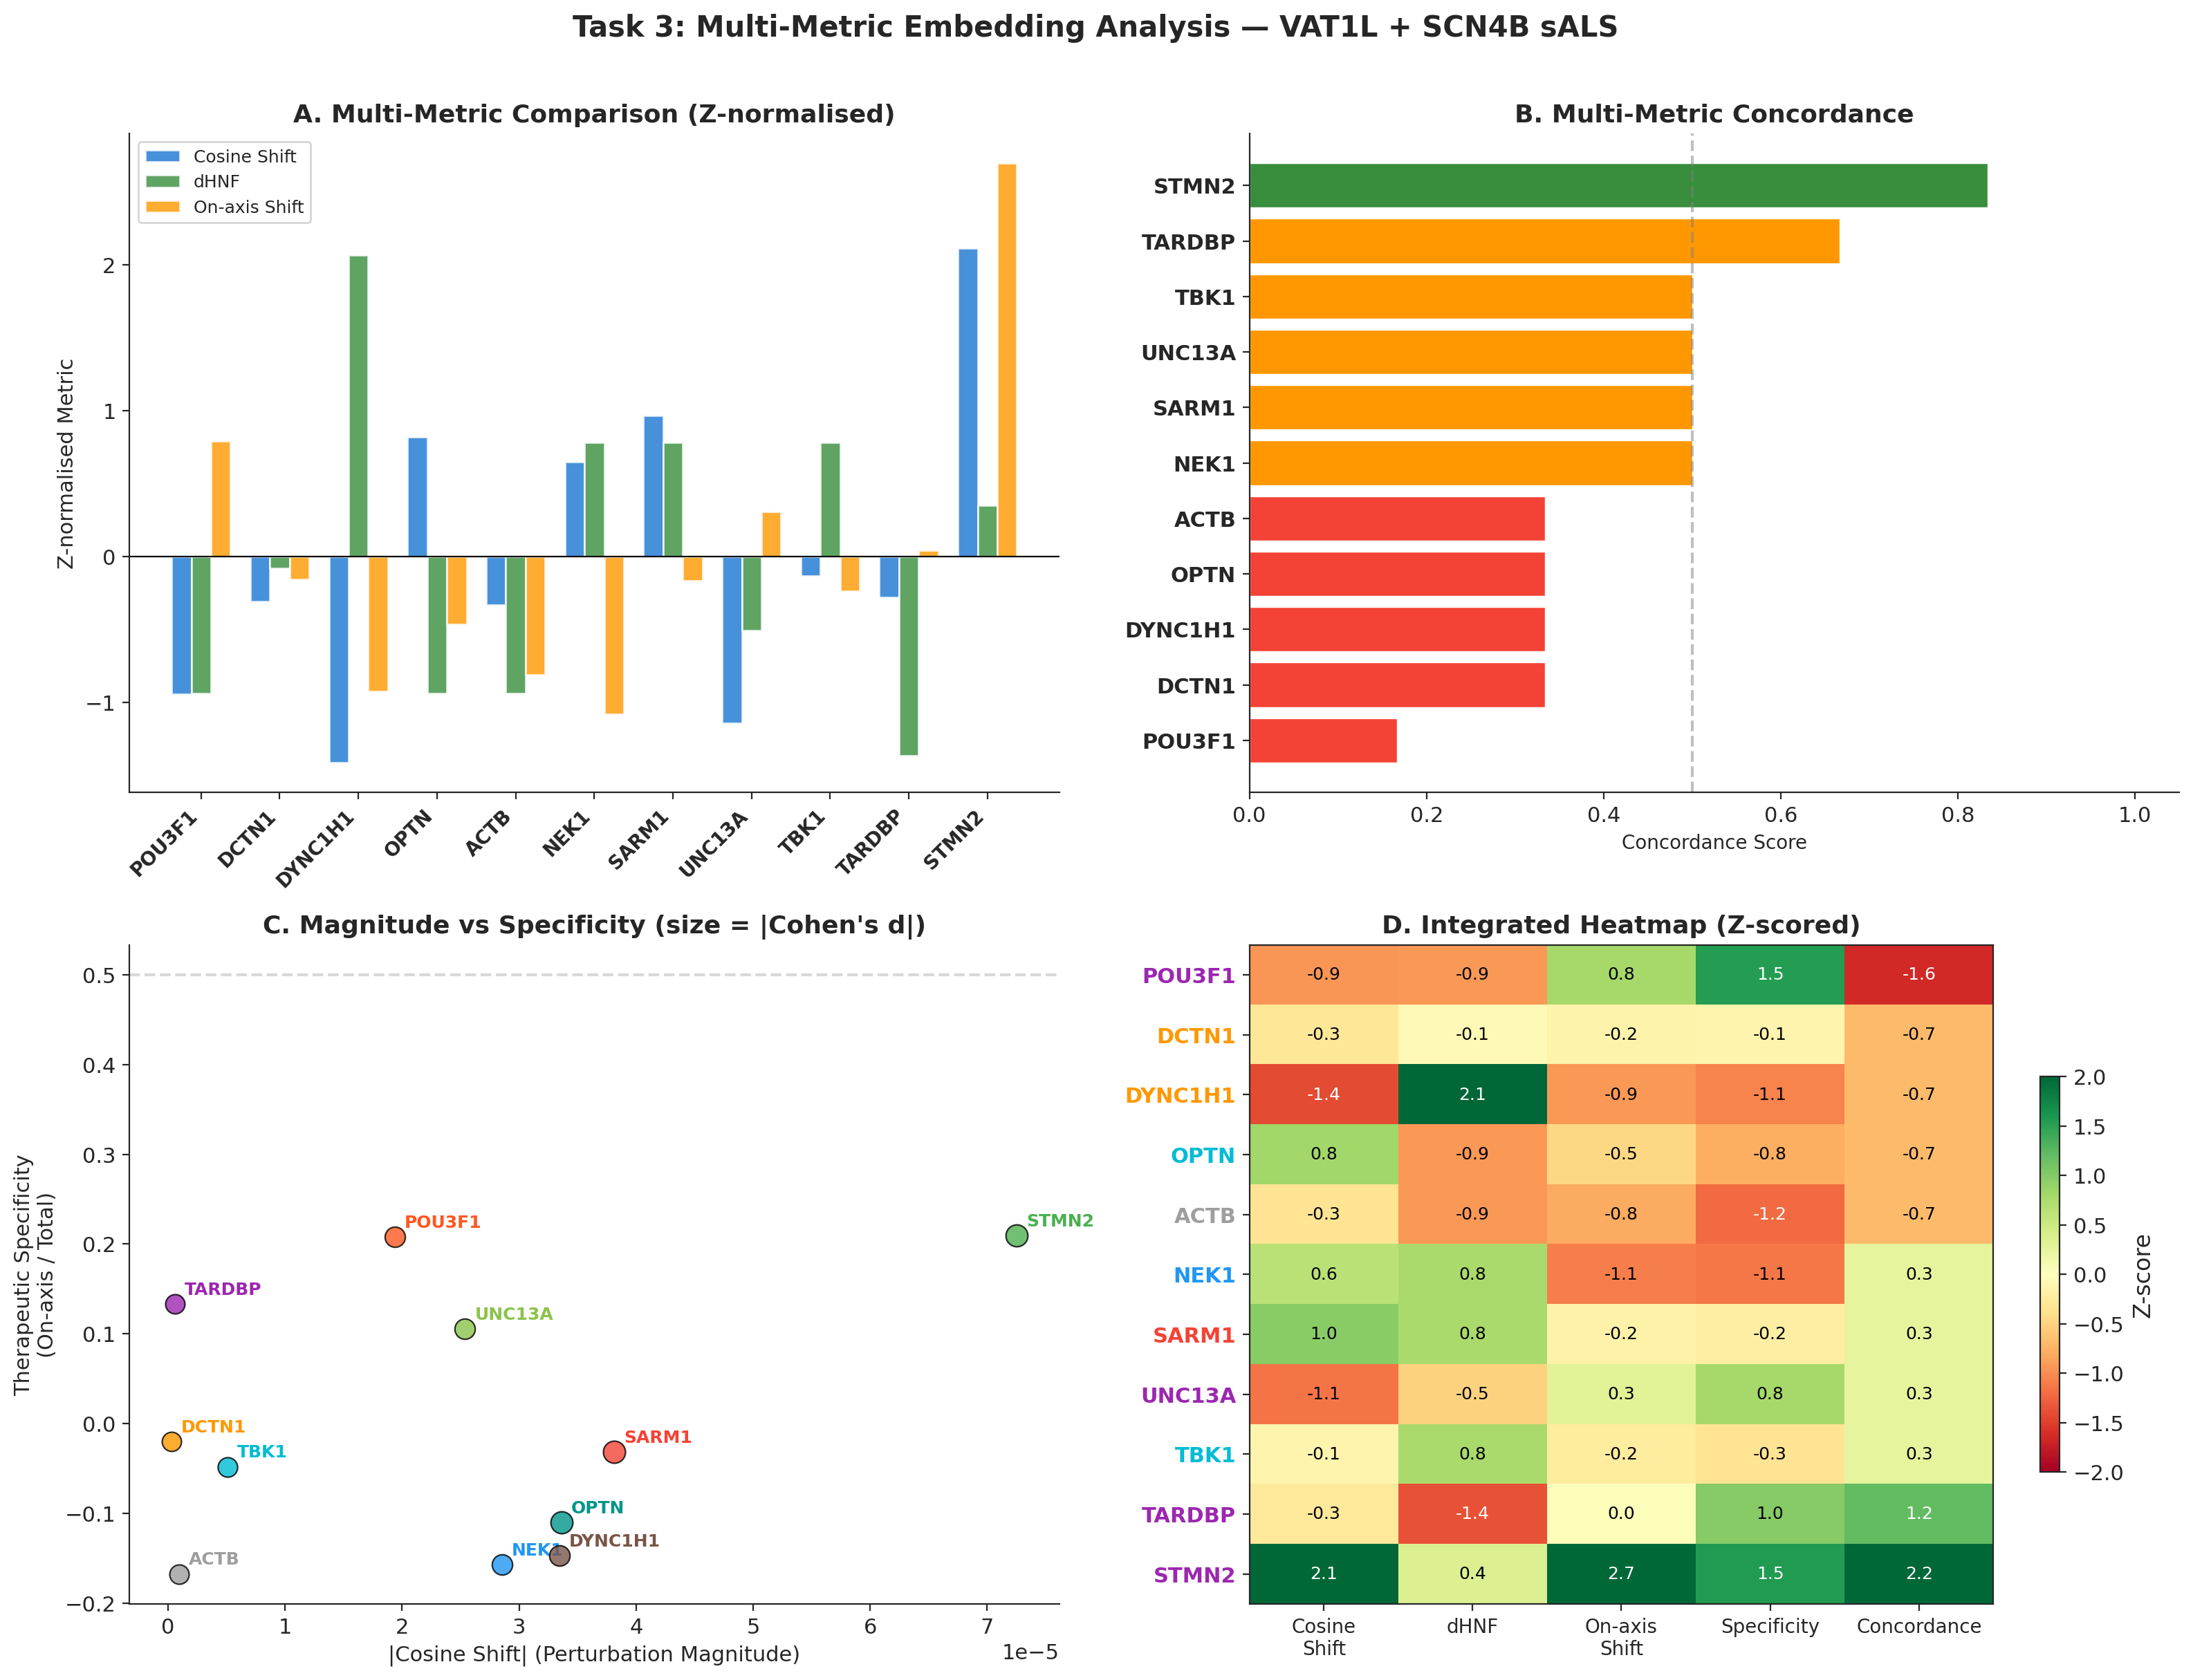
TASK 3
Embedding Space Interpretation
5 ANALYTICAL LENSES ON PERTURBATION EFFECTS (VAT1L + SCN4B sALS)
1 UMAP + Per-Gene Trajectories
1
All perturbations collapse onto the same region as disease/healthy references, which is consistent with pretrained cosine distance of only 0.003–0.006. Per-gene panels show both VAT1L and SCN4B cosine shifts for each gene.
PCA: Disease-to-Healthy Axis (PC1 = 35.4% variance)
2
Panel A: VAT1L perturbation trajectories projected onto population-specific PCA. All genes cluster tightly due to small centroid separation.
Panel B: Therapeutic specificity decomposition with both populations (◆ VAT1L, ■ SCN4B). STMN2 is a clear outlier in the therapeutic + high off-axis quadrant in both populations. Cross-population consistency visible for most genes.
k-NN Neighbourhood Analysis (k=50)
3
Healthy Neighbour Fraction (HNF) computed for both VAT1L and SCN4B disease perturbations against respective baselines. All ΔHNF values near zero (expected at pretrained resolution). Will become informative after fine-tuning.
Hierarchical Clustering of Displacement Vectors
4
STMN2 and SARM1 co-cluster (top rescue candidates). TARDBP clusters with ACTB (both near-zero displacement). Biological axes not cleanly recovered, signal-to-noise limitation of pretrained embeddings.
Bidirectional Consistency
5
Strongest mechanistic signal: 5 genes show opposing shifts in disease vs healthy cells (STMN2, SARM1, OPTN, TBK1, NEK1). 4 genes shift same direction in both conditions (UNC13A, POU3F1, DCTN1, DYNC1H1: context-independent effects). ACTB and TARDBP near-zero in both.
KEY FINDING
STMN2 is the only gene with convergent signal across all analytical lenses: largest on-axis shift, highest concordance, bidirectional consistency, and cross-population replication between VAT1L and SCN4B.

Slide 6
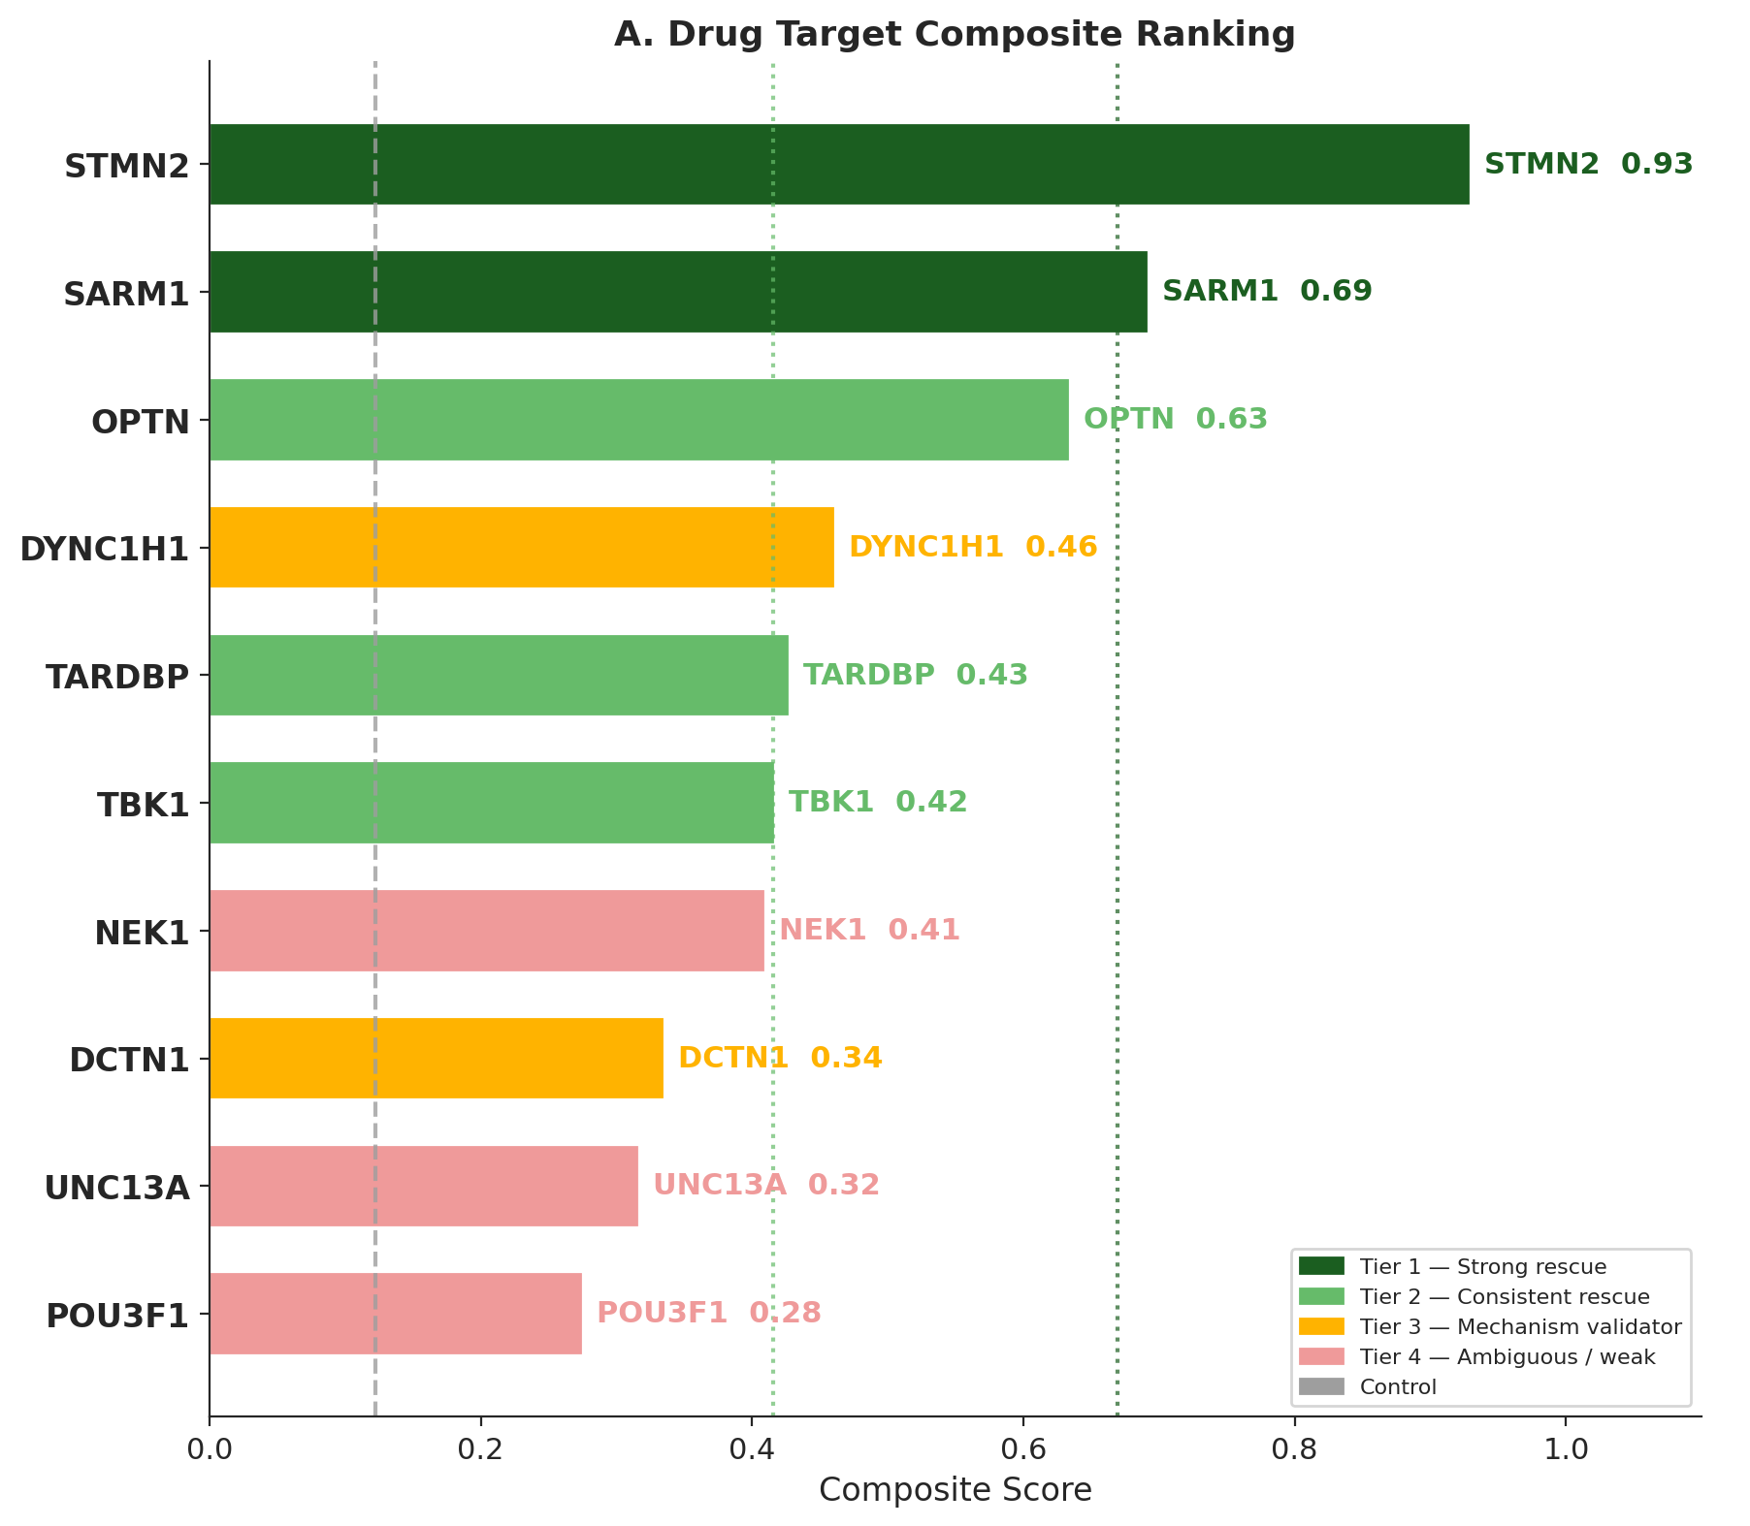
TASK 4
Drug Target Prioritisation / Next Steps
COMPOSITE RANKING — 6 METRICS × 10 GENES
Tier 1: Strong Rescue
#1 STMN2 Largest rescue shift, bidirectional ✓, cross-pop ✓, dose-response. Only gene satisfying all 6 metrics. Near-zero log2FC (−0.13) because pathology is isoform-level (cryptic exon), not total expression. QRL-201 ASO in Phase 1/2.
#2 SARM1 KD (0.692): Highest Cohen's d, bidirectional ✓. Gain-of-function pathology at protein level. Druggable NADase, clinical-stage inhibitors exist.
STMN2 restore
QRL-201 (TDP-43 splicing modulator) in Phase 1/2 clinical trials
Tier 2: Consistent Rescue
OPTN KD (0.634): bidirectional ✓, p=0.038*. TARDBP KD (0.427): bidirectional ✓ but near-zero shift (TDP-43 is invisible to rank encoding (ubiquitous → low rank)). Model detects pathway through STMN2, not the hub gene. TBK1 KD (0.417): bidirectional ✓, additive with OPTN.
Tier 3: Mechanism Validators
DYNC1H1 (0.461), DCTN1 (0.335): KD worsens both disease and healthy cells → context-independent. Confirms axonal transport pathway.
Tier 4: Ambiguous: UNC13A, NEK1, POU3F1. inconsistent across populations.
Control: ACTB: near-zero shift, validates framework specificity.
COMBINATORIAL RESULT
Four-gene druggable combination: STMN2 + UNC13A + DCTN1 + DYNC1H1 restore (p = 0.009). The cross-pathway synergy between TDP-43 downstream restoration and axonal transport restoration is the actionable therapeutic hypothesis: transport genes contribute nothing alone but produce additive effects when combined with TDP-43 downstream targets. TARDBP knockdown was excluded from therapeutic combinations because TDP-43 is an essential protein — all clinical programmes target downstream consequences, not TDP-43 itself.
NEXT STEPS
Fine-tune GeneFormer on VAT1L+ & SCN4B+ cells (disease vs healthy)
Genome-wide perturbation screen post fine-tuning for unbiased target disc.
Cross-model replication: run panel through scGPT + TranscriptFormer (both in Helical package)
Experimental: STMN2 ASO + SARM1 inhibitor in ALS iPSC motor neurons.
Bidirectional consistency: STMN2 uniquely in rescue quadrant (Δcos > 0 & bidirectional ✓). Only gene satisfying all 6 convergence criteria.

