Slide 1
UPI FRAUD DETECTION
Final Project Review | Department of CSE | KL
TEAM MEMBERS
2420030547– T. Monika
2420030308– B. Snigdha
2420040041– P. Mihika
Guide: B. Prathusha| Academic Year: [2026– 2027]
Notes:
Title slide. Replace all bracketed text. Use the full project title, list every team member with registration number, and name your guide. Insert the institution logo in the dashed box.

Slide 2
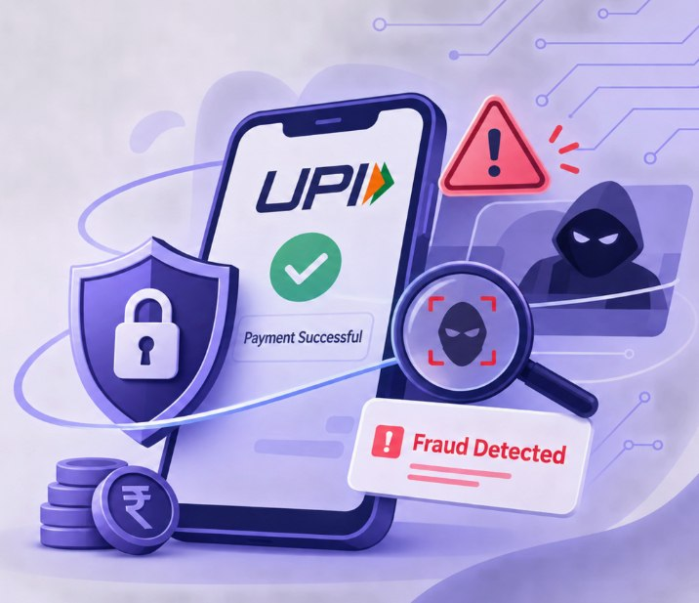



Introduction & Problem Statement
Background
UPI is widely used for fast and easy digital payments in India.
The increasing use of online transactions has also increased the risk of financial fraud.
Machine Learning helps detect suspicious UPI transactions and improve payment security.
Problem Statement
UPI transactions are increasing rapidly, leading to a higher risk of online payment fraud.
Detecting suspicious transactions manually is difficult and may cause financial losses.
Motivation / Need
This project helps UPI users and banks identify fraudulent transactions. It reduces financial losses and improves the safety and security of digital payments.
Notes:
State the domain, the exact problem and why it matters. Keep it to about 2 minutes. Add one real-world statistic if you can, with a citation.

Slide 3


Objectives & Scope
Objectives
1
To develop a UPI fraud detection system using Machine Learning techniques to identify suspicious and fraudulent transactions.
To analyze transaction details such as transaction amount, frequency, and user behavior to detect unusual activities.
2
3
To calculate risk scores and classify UPI transactions into Low, Medium, and High risk levels for better decision-making.
4
To improve transaction security by implementing alerts, OTP verification, and transaction blocking to prevent unauthorized payments.
Notes:
Objectives should be measurable and start with action verbs. The scope slide tells the panel what you did and did not attempt.

Slide 4

Literature Survey
S.No | Author(s) & Year | Method / Technique | Key Findings | Limitation / Gap
1 | Bhattacharyya et al. (2011) | Data Mining and Machine Learning | Studied different techniques for detecting financial fraud. | Focused mainly on credit card fraud.
2 | Dal Pozzolo et al. (2015) | Random Forest and Sampling Techniques | Improved fraud detection using transaction data analysis. | Highly dependent on dataset quality.
3 | Randhawa et al. (2018) | Sequence Classification | Used transaction sequences to identify fraudulent activities. | Requires large amounts of transaction data.
4 | Carcillo et al. (2018) | Real-Time Fraud Detection | Proposed a system for detecting fraud in real-time transactions. | Complex implementation and processing requirements.
Research Gap
Existing systems mainly focus on credit card fraud and lack UPI-specific risk analysis. Our project addresses this by detecting suspicious UPI transactions using Machine Learning, risk scoring, alerts, and OTP verification.
Notes:
Summarise four to six relevant papers or existing systems. End with the research gap, because that gap justifies your project.

Slide 5





Proposed System & Methodology
STEP 1
STEP 2
STEP 3
STEP 4
STEP 5
Define Problem
Collect Data
Design
Implement
Test & Evaluate
Identify UPI fraud risks and the need for real-time transaction monitoring.
Collect UPI transaction data, including amount, time, location and transaction history.
Design the system architecture using machine learning algorithms and anomaly detection techniques.
Develop fraud detection, risk scoring, OTP verification and transaction monitoring modules.
Test the system using different transaction scenarios and evaluate its fraud detection accuracy.
Key Novelty / Contribution
Introduces a risk-based UPI fraud detection system that identifies suspicious transactions using anomaly detection and risk scoring. It provides real-time alerts, OTP verification and transaction blocking to improve payment security.
Notes:
Walk through the five steps left to right. Rename the steps to match your project (for example, Requirement Analysis, Design, Coding, Testing, Deployment). End with your novelty.

Slide 6
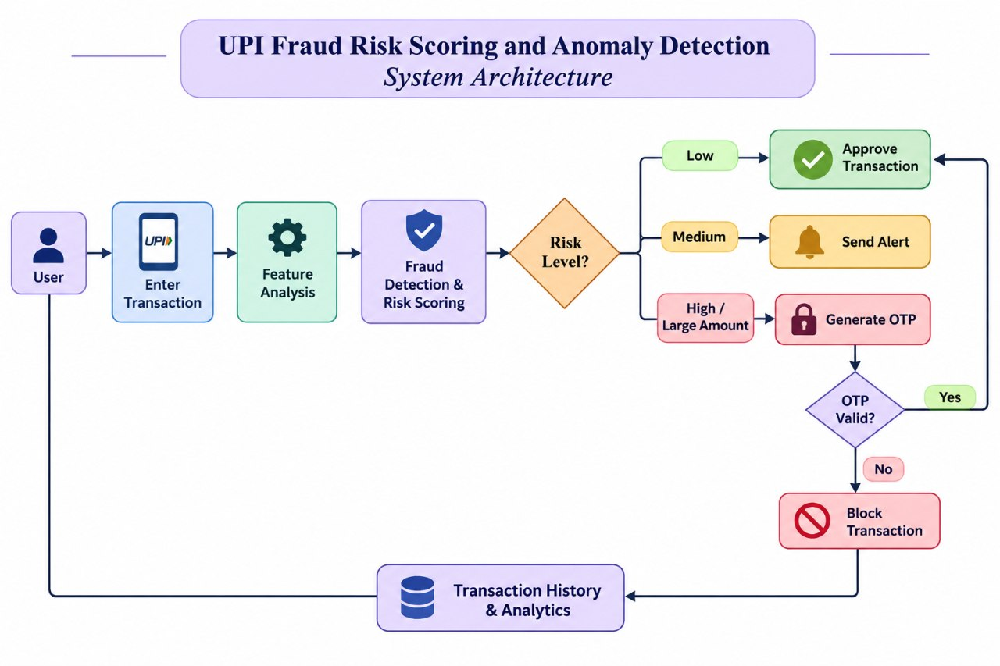
System Architecture
Components
1
Transaction Input:
Accepts UPI transaction details from the user.
2
Feature Analysis:
Extracts important transaction features such as amount, time, location and transaction frequency.
3
Fraud Detection & Risk Scoring:
Uses fraud detection techniques to identify suspicious transactions.
4
Risk-Based Decision & Verification:
Evaluates risk levels and approves, alerts, or blocks transactions based on OTP verification.
Notes:
Insert a clear block diagram: input, processing, storage, output. Number each block and explain them on the right. Redraw the figure yourself rather than copying it.

Slide 7


Hardware & Software Requirements
Hardware
Software & Tools
Libraries / Frameworks
Processor / RAM / GPU: Intel Core i5 or equivalent, 8 GB RAM; GPU optional.
Storage: 256 GB SSD or higher.
Sensors / Boards / Devices: Computer or laptop for system development and execution.
Network / Peripherals: Stable internet connection, Wi-Fi and standard input/output devices.
Operating System: Windows 10/11 or Linux.
Language and Version: Python 3.x.
IDE / Notebook Environment: Visual Studio Code (VS Code) / Jupyter Notebook.
Version Control: Git and GitHub.
Library 1: Pandas 2.x
Library 2: Scikit-learn 1.x
Framework / API: Flask and UPI Payment API (for transaction integration).
Database / Cloud Service: MySQL / Firebase.
Deployment / Platform: local machine for development and testing, with Google Colab for model training and evaluation.
Notes:
List only what you actually used, with versions. For a pure software project, shorten the hardware list and add cloud or deployment resources.

Slide 8
Dataset / Data Understanding
[10,000]
[14]
Records (rows)
Features (columns)
[0]
[2]
Missing values
Target classes
Source: Kaggle – UPI Transaction Fraud Detection Dataset.
Features: Transaction amount, transaction time, location, transaction frequency and transaction type; target variable – Fraud or Legitimate.
Quality: Check for missing values and duplicate records; handle class imbalance using suitable techniques.
Notes:
Explain where the data came from and what it contains. Show a screenshot of the first rows or the info summary. For non-data projects, replace this slide with “Requirement Analysis” or “Input Specification”.

Slide 9
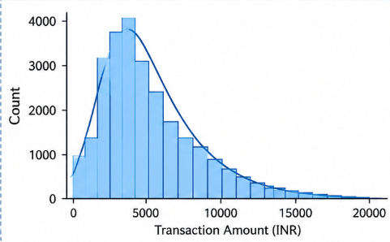
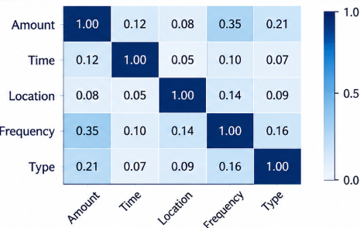



Data Preprocessing & Exploratory Analysis
Cleaning
Transformation
Feature Selection
Handle missing values, remove duplicate records and identify unusual transaction amounts using outlier detection.
Apply encoding to categorical data and normalization or standardization to numerical features.
Select important features such as transaction amount, time, location, transaction type and frequency using feature importance techniques.
Notes:
Show two or three plots that tell a story: distributions, correlations, outliers. Explain what each plot told you and what you did about it.

Slide 10
Module-wise Description
1
Transaction Data Collection
2
Feature Analysis
Purpose: Collects UPI transaction details for fraud detection and analysis.
Input → Output: Transaction details → Structured transaction dataset.
Developed by: Monika Sri
Purpose: Extracts and analyses important transaction features to identify unusual patterns.
Input → Output: Transaction dataset → Analysed transaction features.
Developed by: Snigdha
3
Fraud Detection & Risk Scoring
4
Risk-Based Decision & Verification
Purpose: Detects suspicious transactions using anomaly detection and assigns risk scores.
Input → Output: Analysed transaction features → Fraud risk score (Low, Medium or High).
Developed by: Mikiha
Purpose: Approves, alerts or blocks transactions based on risk levels and OTP verification.
Input → Output: Fraud risk score → Transaction approval, alert or blocking.
Notes:
Divide the project into three to five modules. For each, state its purpose, inputs, outputs and who built it. Duplicate a card if you have more modules.

Slide 11

Algorithms & Technologies Used
[Technique 1]
[Technique 2]
[Technique 3]
Why chosen
[Strength / suitability for your problem]
Key parameters
[e.g. learning rate, depth, kernel, protocol, version]
Why chosen
[Strength / suitability for your problem]
Key parameters
[e.g. learning rate, depth, kernel, protocol, version]
Why chosen
[Strength / suitability for your problem]
Key parameters
[e.g. learning rate, depth, kernel, protocol, version]
Selection criteria: [How the final approach was chosen – metric, cost, speed, simplicity]
Notes:
Name each model, algorithm or technology, say why you chose it, and list the key settings. Then explain how you picked the final one.

Slide 12
Implementation / Model Building
Feature Selection
Code snippet / pseudocode
Amount, time, location and transaction frequency.
from sklearn.model_selection import train_test_split
from sklearn.ensemble import RandomForestClassifier
X = df.drop(columns=['fraud_label', 'risk_label'])
y = df['fraud_label']
X_train, X_test, y_train, y_test = train_test_split(
X, y, test_size=0.30, random_state=42
)
model = RandomForestClassifier(
n_estimators=200,
class_weight='balanced',
random_state=42
)
model.fit(X_train, y_train)
Preprocessing Pipeline
Remove duplicates, handle missing values and encode data.
Data Splitting
70% training, 15% validation, 15% testing.
Configuration
Random Forest with 200 trees and Isolation Forest for anomaly detection.
Notes:
Describe the build in the order you did it. Paste only the most important code or pseudocode, not entire files. For hardware projects, show the circuit or wiring summary instead.

Slide 13
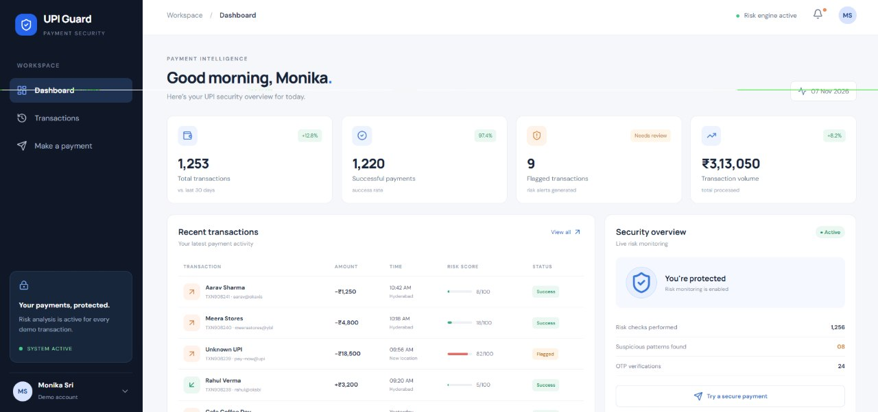
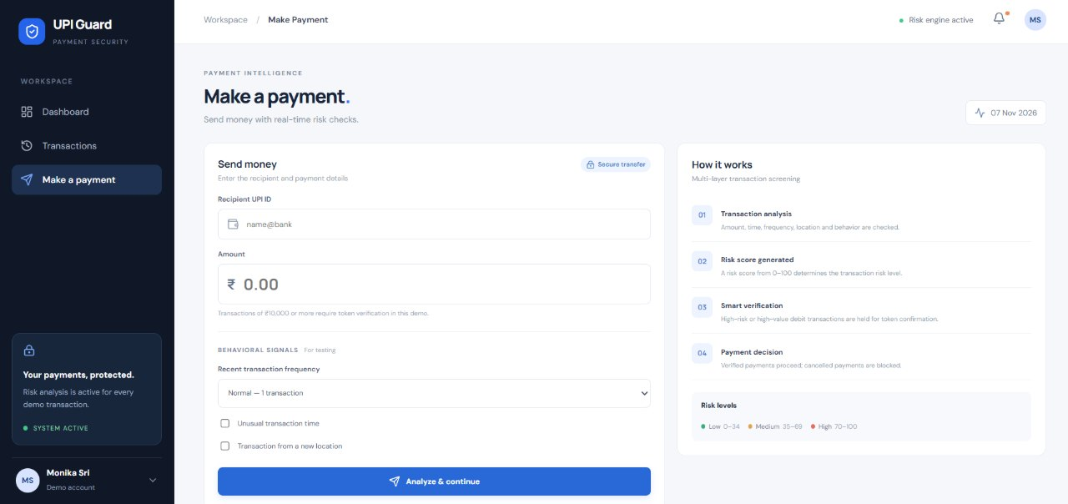
Working Prototype / Output Screens
Notes:
Show real screenshots, photos of the hardware or a short demo video link. Caption each one with what the viewer should notice.

Slide 14
Results & Performance Comparison
Results
Dataset: 5,000 UPI transactions.
Fraud cases: 205 (synthetic records).
Random Forest identifies potentially fraudulent transactions.
Isolation Forest detects unusual transaction patterns.
High-risk transactions trigger OTP verification.
Low-risk transactions proceed normally.
Performance Comparison
Metric | Random Forest | Isolation Forest
Approach | Supervised | Unsupervised
Fraud labels | Required | Not required
Detection | Learns fraud patterns | Finds anomalies
Output | Fraud prediction | Anomaly score
Main use | Fraud classification | Unusual activity detection
Best: [Model] – [metric = value]
Notes:
Right-click the chart and choose Edit Data to enter your real numbers. Replace the metrics with the ones that fit your project (accuracy, latency, power, throughput, user rating). State clearly which option performed best.

Slide 15
Analysis & Key Findings
0-99
Transaction Risk Score
Rule-based risk scoring range
Risk factor | Score added
High transaction amount | +40
Multiple transactions | +20
New location | +15
Unusual transaction time | +12
Increased frequency | +8
Interpretation: Transactions are classified into Low, Medium and High risk based on transaction behavior.
Error analysis: Legitimate high-value transactions may also be flagged and require additional verification.
Key drivers: Transaction amount, frequency, unusual timing and new location.
Notes:
Explain what the numbers mean. Use a confusion matrix, ROC curve, feature-importance chart or output comparison. Be honest about weak results; panels value that.

Slide 16

Testing & Validation
Test ID | Test Description | Expected Result | Actual Result | Status
TC-01 | Normal low-value transaction | Low Risk | Low Risk | Pass
TC-02 | High-value transaction | High Risk | High Risk | Pass
TC-03 | Multiple rapid transactions | Increased Risk Score | Increased Risk Score | Pass
TC-04 | Transaction from new location | High Risk Alert | High Risk Alert | Pass
Functional Testing
Validation Method
Performance Testing
Verified transaction input, risk score calculation, and Low / Medium / High risk classification.
Manual testing with normal, high-value, frequent, and unusual-location transactions.
Manual testing with normal, high-value, frequent, and unusual-location transactions.
Notes:
List representative test cases with expected and actual outcomes. Name the validation methods you used. Delete rows you do not need.

Slide 17


Challenges & Limitations
Challenges Faced
Limitations
Fraud Pattern Identification: Identifying unusual transaction behavior accurately.
Risk Score Calculation: Assigning appropriate weights to different risk factors.
Transaction Variations: Handling different amounts, locations, timings and frequencies.
Real-time Detection: Generating risk alerts without delaying transactions.
Synthetic Dataset: Limited real-world transaction data for testing.
Rule-based Detection: May not identify complex or previously unseen fraud patterns.
False Positives: Genuine transactions may sometimes be flagged as suspicious.
No Bank Integration: Does not directly connect to live UPI or banking systems.
Notes:
Be candid. Pair every challenge with how you solved it, and list limitations that the panel would otherwise spot themselves.

Slide 18
Conclusion
Developed a UPI Fraud Risk Scoring system to identify suspicious transactions using transaction behavior and risk factors
1
Implemented risk classification into Low, Medium, and High categories to support faster fraud identification and alert generation.
2
The project demonstrates how automated risk analysis can improve digital payment security and help prevent potential financial fraud.
3
Notes:
Revisit each objective and say whether you met it. Quote your headline result with numbers. Do not introduce new material here.

Slide 19



Future Scope & Applications
Improve Performance
Use advanced ML models to improve fraud detection accuracy and reduce false alerts.
Applications
Digital Payments: Detect suspicious UPI transactions.
Banking Systems: Monitor unusual customer activities.
E-commerce: Identify fraudulent online payments
Financial Institutions: Help banks and payment providers prevent financial fraud
Expand Data / Features
Integrate larger real-time UPI datasets, device details, GPS location and transaction history.
Deploy & Build an Interface
Develop a user-friendly web/mobile application with live fraud alerts and transaction monitoring
Scale & Secure
Integrate cloud deployment, secure APIs, data encryption and scalable processing.
Notes:
Give concrete next steps, ideally tied to the limitations. Then name two or three real-world uses.

Slide 20
Team Contribution
Reg. No. | Name | Contribution / Modules Handled
2420030547 | Monika Sri | Frontend development, UI design and dashboard implementation.
2420030308 | Snigdha | Risk scoring logic, fraud detection and transaction classification.
2420040041 | Mihika | Dataset analysis, testing, validation and project documentation.
Notes:
Show that work was planned and shared. Every member should be able to explain their own module.

Slide 21

References
1. NPCI – Unified Payments Interface (UPI) Statistics
NPCI Official Website
2. Reserve Bank of India (RBI) – Annual Report and Digital Payment Fraud Information
RBI Annual Report
3. Scikit-learn – Random Forest Algorithm Documentation
Random Forest Documentation
4. Scikit-learn – Isolation Forest Algorithm Documentation
Isolation Forest Documentation
5. RBI – Fraud Risk Management Guidelines
RBI Official Guidelines
Project Links
GitHub:
Monika - https://github.com/monikasri04/DS_S4_T21_UPI-Fraud-Risk/upload/main
Snigdha –
https://github.com/Snigdha308/DS_S7_T22_UPI-FRAUD_RISK
Mihika –
https://github.com/Mihika13-mihi/DS_S7_22_UPI-Fraud-Risk-Scoring-
Notes:
Use IEEE style, numbered in order of first citation in the deck. Include datasets, documentation and code repositories.

Slide 22
THANK YOU
Notes:
Leave this slide up during questions. Make sure every team member can answer questions about their own module.

