Slide 1

DA 227o: Data Mining
Course Project Proposal
Customer Churn Prediction Using Machine Learning
Monika Tyagi, IISC, monikatyagi@iisc.ac.in
Sourajit Bhar, IISC, sourajitbhar@iisc.ac.in

Slide 2
Problem Statement
Subscription services suffer revenue loss due to churn
Identifying at-risk customers enables targeted retention
ML helps early detection using customer behavior patterns

Slide 3
Project Objectives
Build
Build reproducible ML pipeline
Compare
Compare multiple models
Identify
Identify key churn drivers
Evaluate
Evaluate using ROC, F1, confusion matrices

Slide 4
Dataset Overview
Telco Customer Churn dataset (Kaggle)
7,043 customers
Demographics, contract type, payment, usage
Target: Churn (Yes/No)

Slide 5
Data Preprocessing
Handle missing values
Convert feature types
One-hot encoding
Scaling numerical features
Stratified train-test split

Slide 6
Exploratory Data Analysis (EDA)
Churn distribution
Correlation heatmap
High-risk groups: month-to-month, high charges, low tenure

Slide 7
Modeling Approach
Models Used:
Logistic Regression
Decision Tree
Random Forest
SVM (RBF)
Combines linear & non-linear approaches

Slide 8
Evaluation Metrics
Accuracy
Precision
Recall
F1-score
ROC Curve
Confusion Matrix

Slide 9
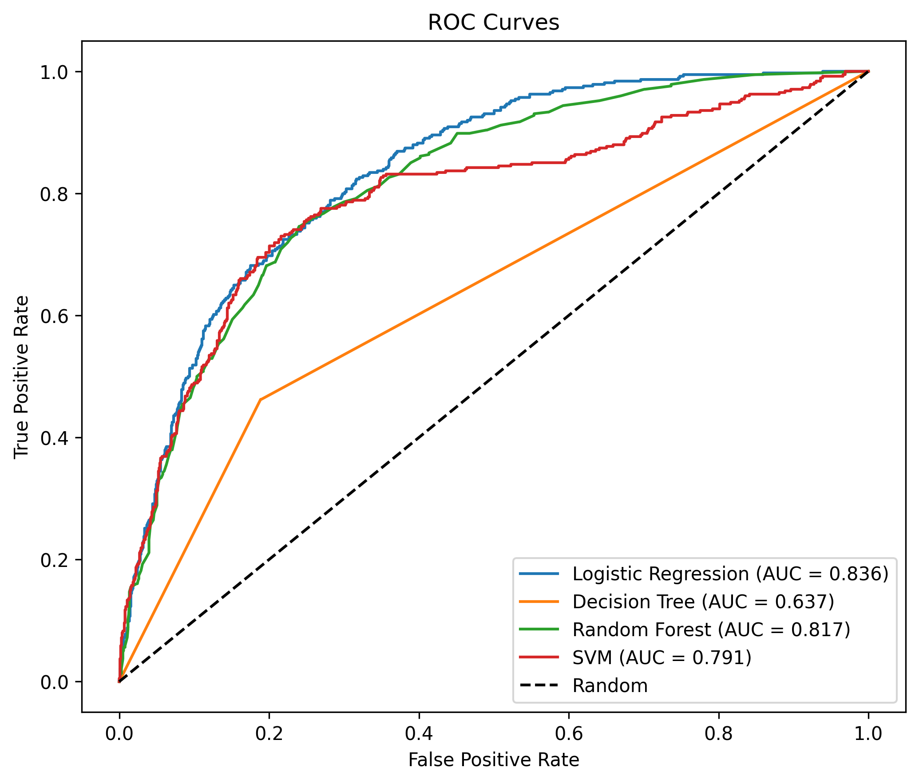

ROC Curves

Slide 10
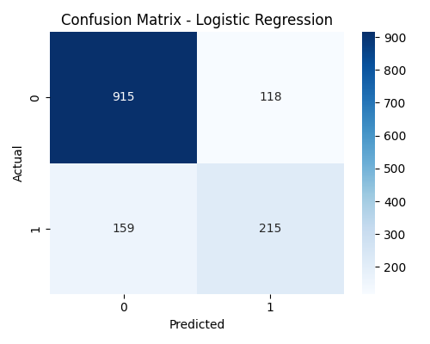
Confusion Matrix – Logistic Regression

Slide 11
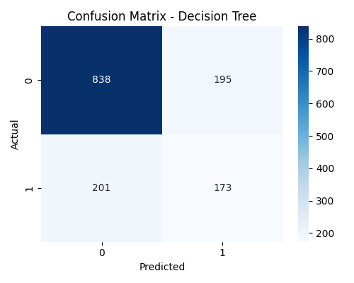
Confusion Matrix – Decision Tree

Slide 12
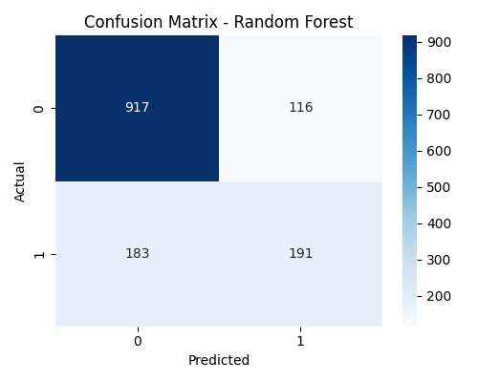
Confusion Matrix – Random Forest

Slide 13
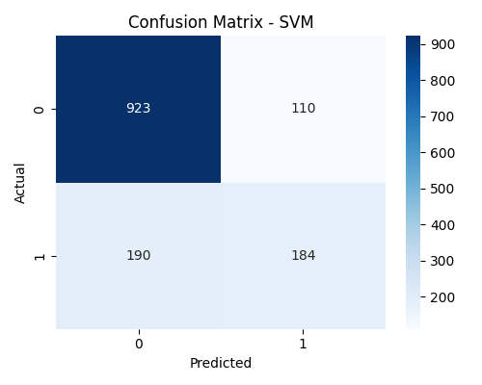
Confusion Matrix – SVM (RBF)

Slide 14
Model Performance Summary
Random Forest performs best
High recall + strong generalization
Balanced precision–recall

Slide 15
Feature Importance
Top drivers:
• Tenure
• Contract type
• Monthly charges
• Internet service

Slide 16
Discussion
• Trees capture non‑linear patterns
• Random Forest reduces overfitting
• SVM precise but lower recall

Slide 17
Limitations & Future Work
• Class imbalance
• Only one provider dataset
Future:
• XGBoost/LightGBM
• Cost-sensitive models
• Ensemble stacking

Slide 18
Conclusion
• End‑to‑end churn pipeline built
• Random Forest is best overall
• Practical for real retention systems

Slide 19
Thank you!

