Slide 1

DA 231o Data Engineering at Scale Course Project Presentation Grid optimization with weather
Chandan Kumar Singh, IISC, chandansingh@iisc.ac.in
Monika Tyagi, IISC, monikatyagi@iisc.ac.in
Mukesh Kumar Yadav, IISC, mukeshyadav@iisc.ac.in
Rishabh Mehrotra, IISC, rishabhmehro@iisc.ac.in

Slide 2
Introduction
The optimization of energy grids is a critical challenge as power demand fluctuates significantly based on factors like weather conditions, economic activity, and changing energy sources. This project focuses on using weather forecasting and big data analytics to optimize grid performance.

Slide 3
Problem Definition
The project aims to optimize the energy grid by forecasting electricity demand using historical weather data and power consumption patterns. Accurate forecasting enables better grid management, reduces energy waste, and balances demand-supply distribution.

Slide 4
Problem Motivation
Energy consumption is influenced by weather conditions such as temperature, humidity, and wind. Efficient grid optimization relies on precise demand forecasting to prevent energy shortages or overproduction.

Slide 5
Design Goals and Features
- Accurate Power Demand Forecasting
- Scalability
- Resilience and Fault Tolerance
- Energy Efficiency Optimization
- Energy Source Optimization
- Seasonal Adjustments

Slide 6
Approach and High-Level Design
The solution follows a three-stage pipeline: data ingestion, real-time processing, and predictive modeling.

Slide 7
Data Ingestion
Data ingestion involves collecting historical weather data, real-time weather updates, and power consumption information from multiple sources, stored in distributed systems for efficient handling.

Slide 8
Real-Time Processing
The system uses Apache Spark Streaming for real-time data processing, ensuring the latest weather changes are factored into demand forecasts immediately.

Slide 9
Prediction Models
Prediction models use machine learning algorithms, including ARIMA, Prophet, Gradient Boosting, Random Forests, and Neural Networks for enhanced performance.

Slide 10
Evaluation Approach
The machine learning models are trained on historical data and tested on unseen data. Baseline comparison with traditional models helps quantify improvements.

Slide 11
Performance Metrics for Success
- Prediction Accuracy (RMSE, MAPE)
- Latency
- Scalability

Slide 12
Feature Metrics for Success
- Real-Time Adaptability
- Energy Optimization
- Cost-Efficiency

Slide 13
System Design Considerations
- Resilience Measures: Fallback strategies and periodic retraining
- Data Processing Techniques to Avoid Shuffling

Slide 14





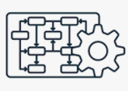


Slide 15
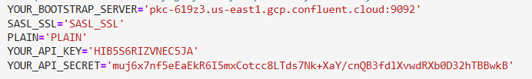
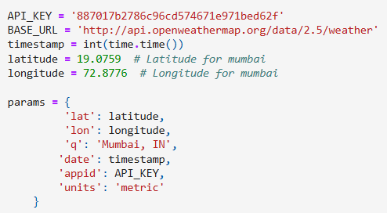

Kafka to load data to Topic
Git Code Repo :Link
hit openweater API each timestamp with below parameter :
Kafka Config :
from confluent_kafka import Producer
Producer send data to topic- ‘weather_0’
Create topics state wise . ( help scale)

Slide 16
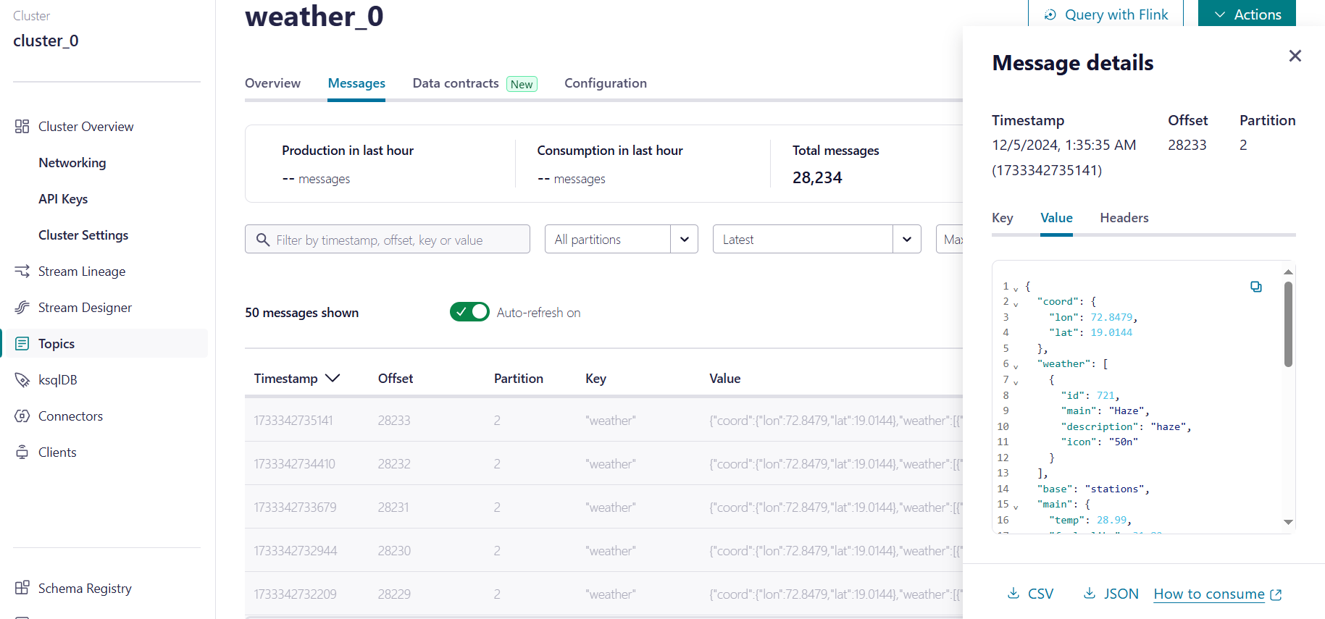
It Actually start sending data to weather_0

Slide 17
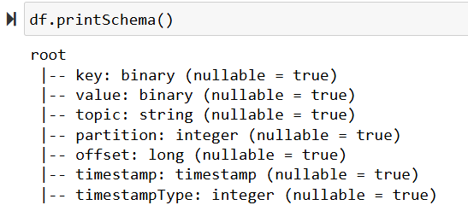
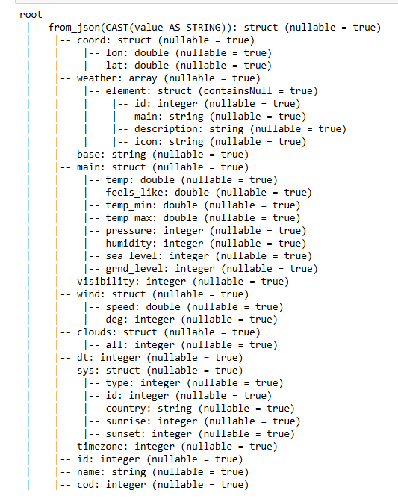
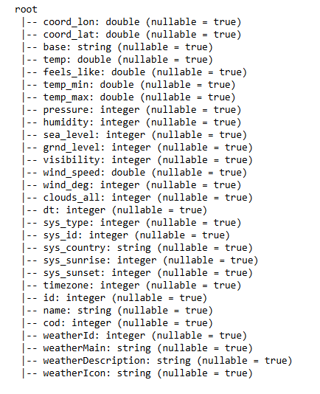
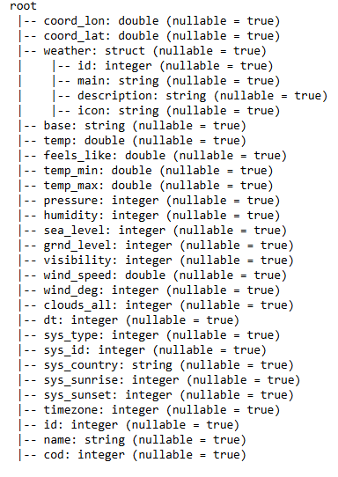

Slide 18
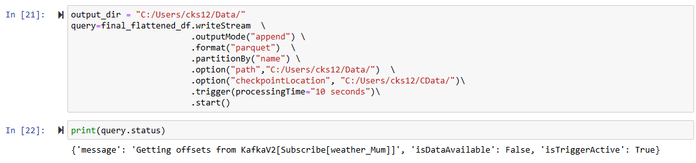
Read data from topic using spark streaming
While reading using format parquet ( help scale)
Also partition by city name ( help scale)
Git Code Repo :Link

Slide 19
Problem faced
Solution to the Problem
Failed to create new KafkaAdminClient
getting error -Py4JJavaError: An error occurred while calling o39.load.
Main Data was stored only in value .
While creating spark session set jar config("spark.jars.packages", "org.apache.spark:spark-sql-kafka-0-10_2.12:3.2.0,org.apache.kafka:kafka-clients:3.5.2") \
Also pass right Kafka bootstrap.servers and kafka topic while spark.readStream
Cast value to string and then use from_jsom to take Json data and use explode to flatten the json

Slide 20





Grid Data Weather Data
Missing Values
Missing Values Check: We analysed both datasets (electricity and weather) to ensure data completeness.
Observation: No missing values were found in any columns, indicating that both datasets are complete and ready for further preprocessing.
Significance: Accurate data is critical for reliable forecasting models, and this step validates the integrity of our datasets.

Slide 21
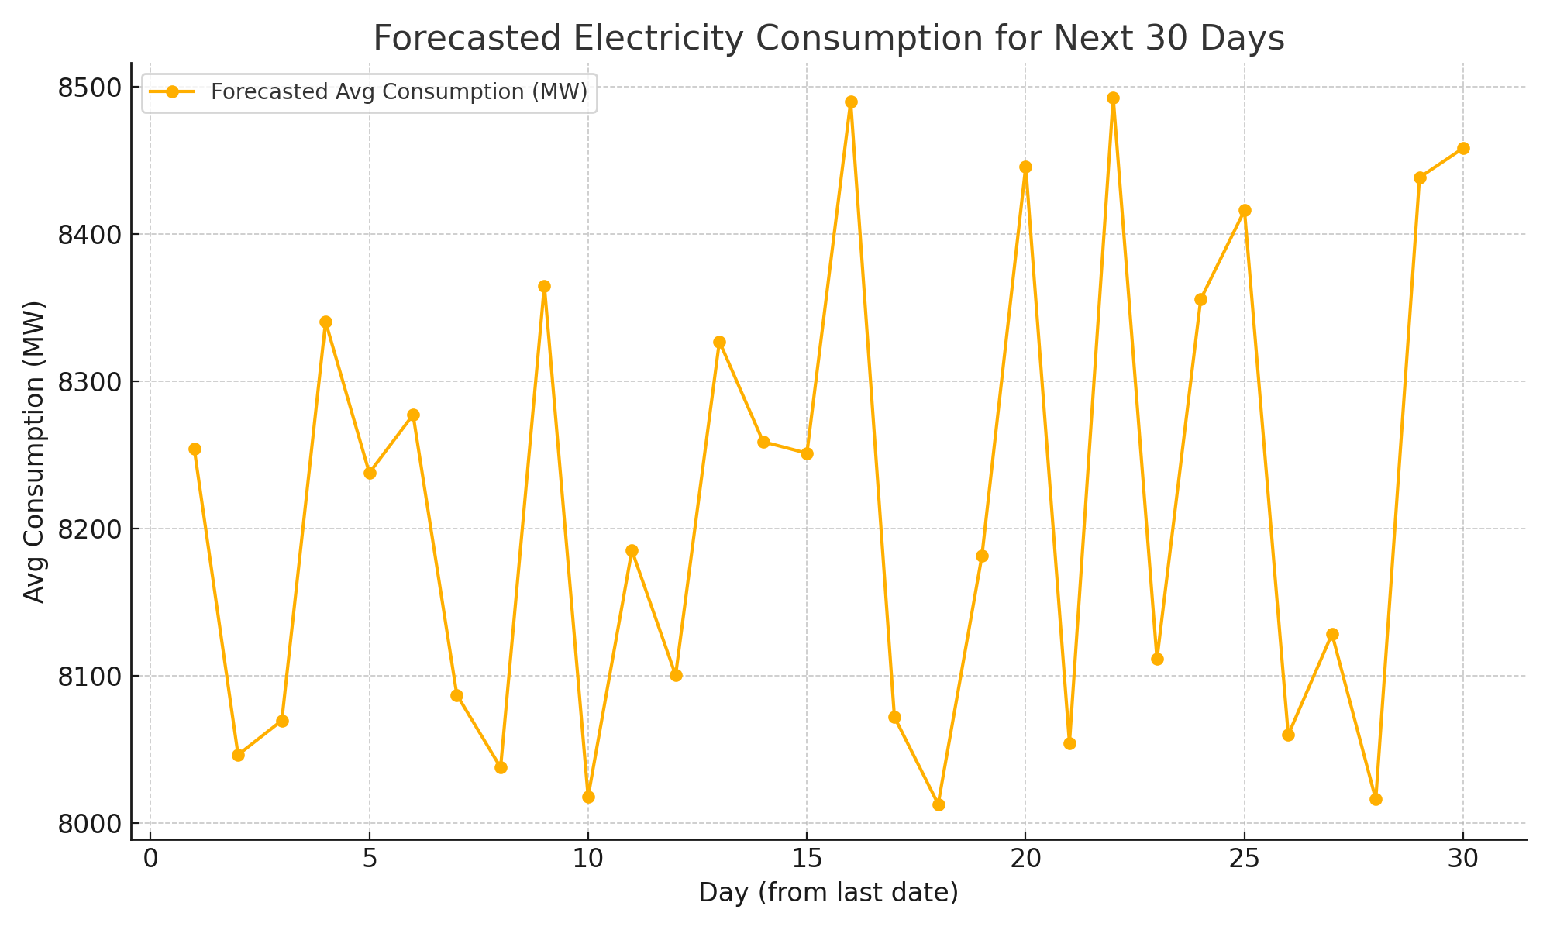
Forecasting Model Overview
1. Historical Data Preparation:
Data includes features like Temperature, Humidity, Wind Speed, and Consumption.
Target variable: Avg Consumption (MW).
2. Model Training:
Split historical data into Train (80%) and Test (20%).
Trained Gradient Boosted Tree (GBT) Regressor.
3. Forecasting:
Generated future dates and derived features (e.g., Year, Month).
Predicted Avg Consumption for the next 30 days using trained model.

Slide 22
LSTM time series Model
Git Code Repo: Link
Used tensorFlow as spark doesn’t have LSTM avlb in it’s ml library, Future scope to try running same code using tensorFlowonspark as that is available to handle scale.
Convert spark dataframe to panda for making date as index as didn’t find anything in spark for the same.
Used TimeseriesGenerator to get data which we can input to model with multivariant analysis of temp and grid.

Slide 23

1
2
3
1
2
3
4
n

Slide 24
1
2
3
P
1
2
3
n

Slide 25
1
2
3
P
P
1
2
3
n-1
n
Replace P with Original Data coming from spark stream

Slide 26
Conclusion
The integration of weather forecasting and big data analytics for energy grid optimization shows promise in addressing current energy management challenges by providing reliable, scalable, and efficient energy demand forecasts.

Slide 27

Questions ?
Thank You !!

