Slide 1





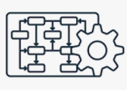


Slide 2
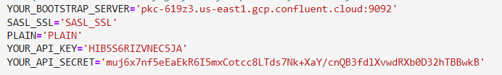
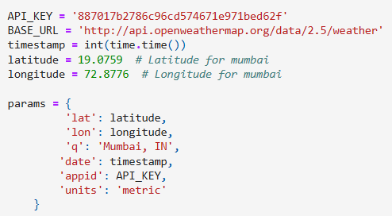

Kafka to load data to Topic
Git Code Repo :Link
hit openweater API each timestamp with below parameter :
Kafka Config :
from confluent_kafka import Producer
Producer send data to topic- ‘weather_0’
Create topics state wise . ( help scale)

Slide 3
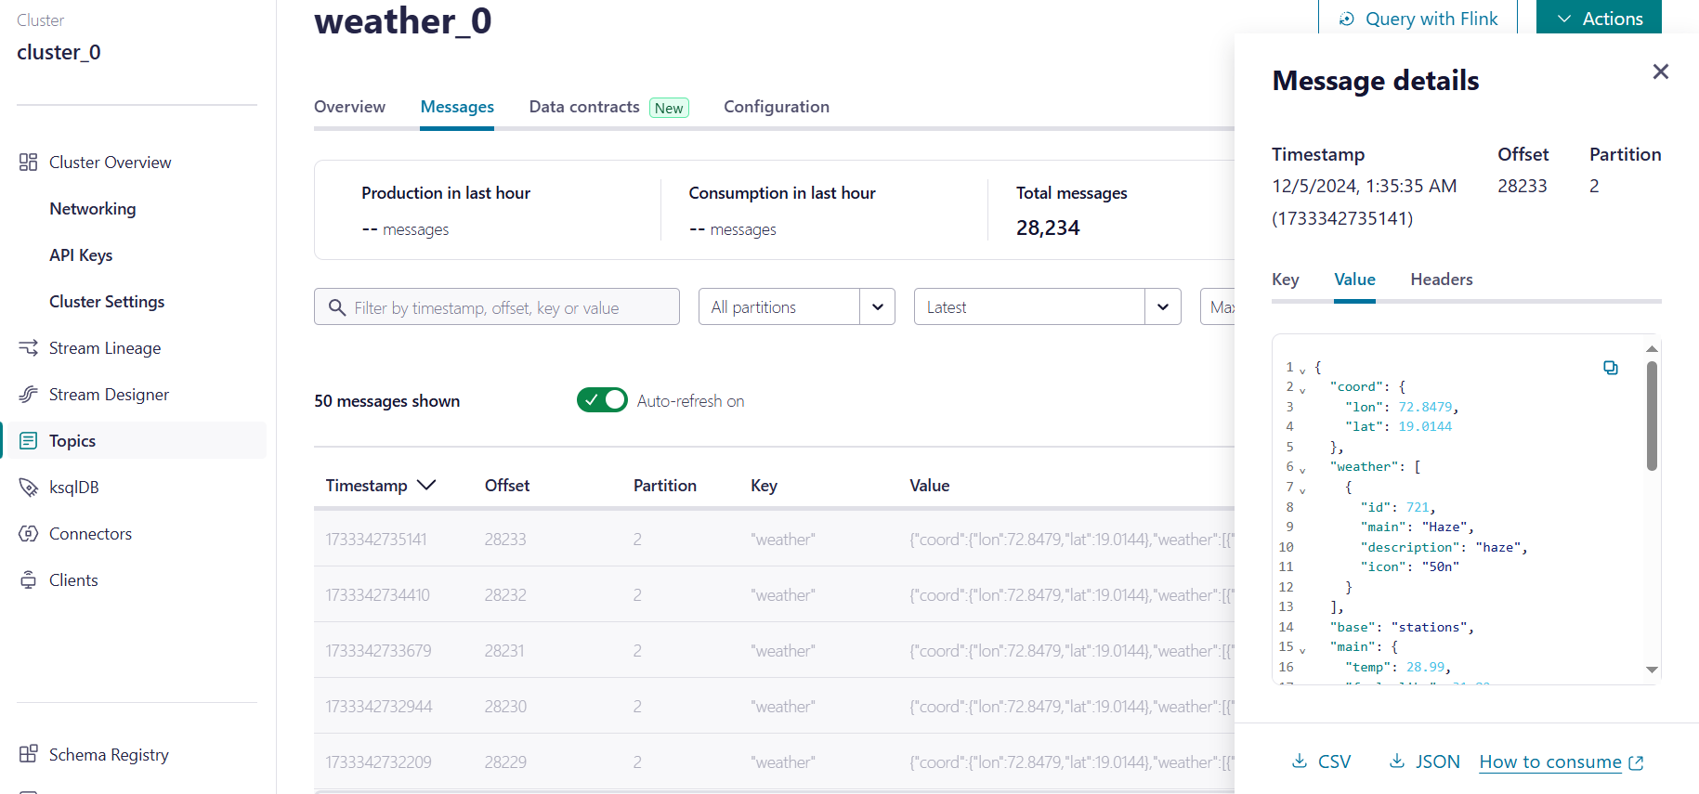
It Actually start sending data to weather_0

Slide 4
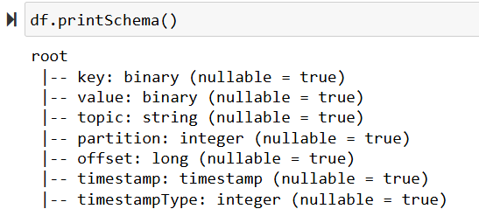
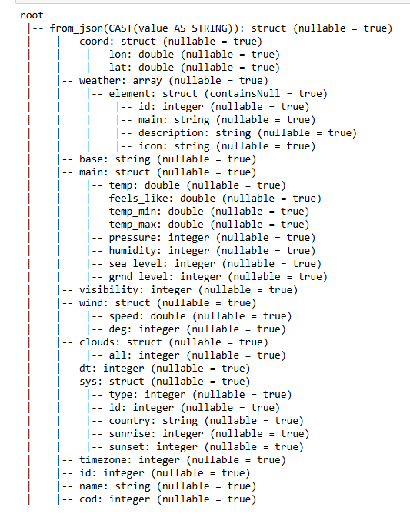
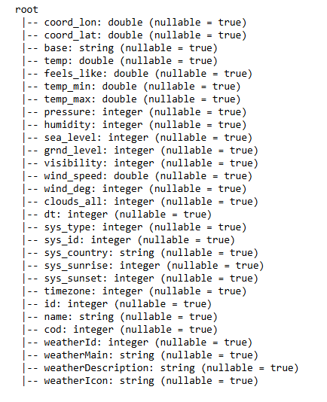
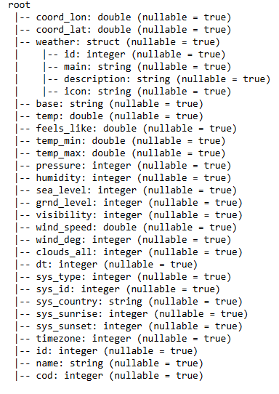

Slide 5
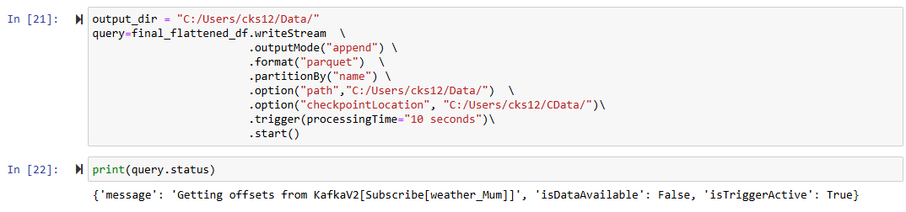
Read data from topic using spark streming
While reading using format parquet ( help scale)
Also partition by city name ( help scale)
Git Code Repo :Link

Slide 6
Problem faced
Solution to the Problem
Failed to create new KafkaAdminClient
getting error -Py4JJavaError: An error occurred while calling o39.load.
Main Data was stored only in value .
While creating spark session set jar config("spark.jars.packages", "org.apache.spark:spark-sql-kafka-0-10_2.12:3.2.0,org.apache.kafka:kafka-clients:3.5.2") \
Also pass right Kafka bootstrap.servers and kafka topic while spark.readStream
Cast value to string and then use from_jsom to take Json data and use explode to flatten the json

