Slide 1
Grid optimization with weather
DA 231o Data Engineering at Scale Course Project Presentation
Chandan Kumar Singh, IISC, chandansingh@iisc.ac.in
Monika Tyagi, IISC, monikatyagi@iisc.ac.in
Mukesh Kumar Yadav, IISC, mukeshyadav@iisc.ac.in
Rishabh Mehrotra, IISC, rishabhmehro@iisc.ac.in

Slide 2





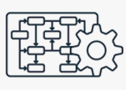


Slide 3
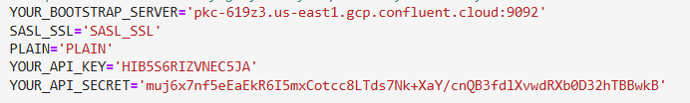
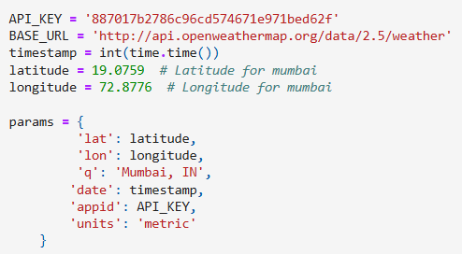

Kafka to load data to Topic
Git Code Repo :Link
hit openweater API each timestamp with below parameter :
Kafka Config :
from confluent_kafka import Producer
Producer send data to topic- ‘weather_0’
Create topics state wise . ( help scale)

Slide 4
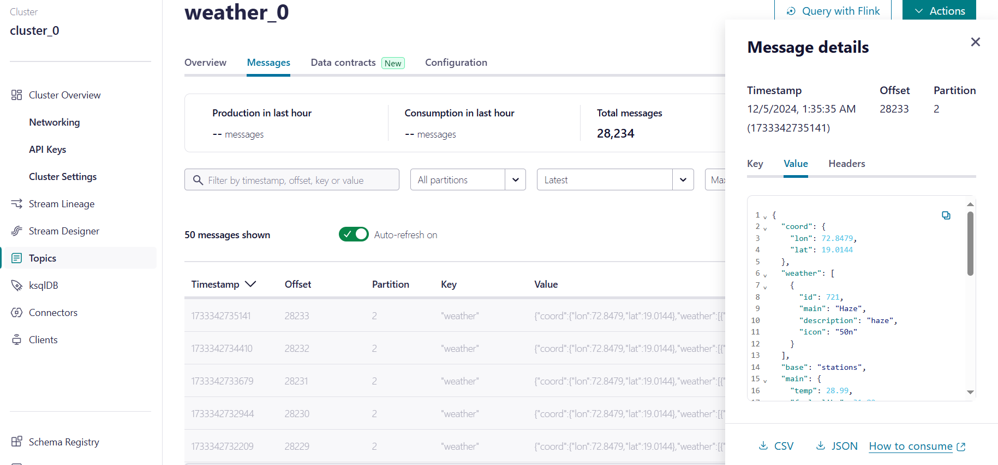
It Actually start sending data to weather_0

Slide 5
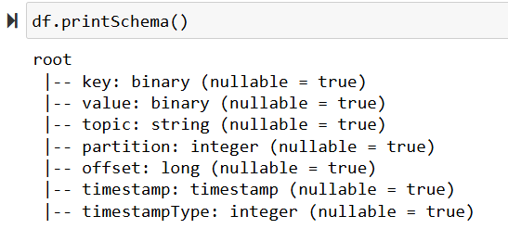
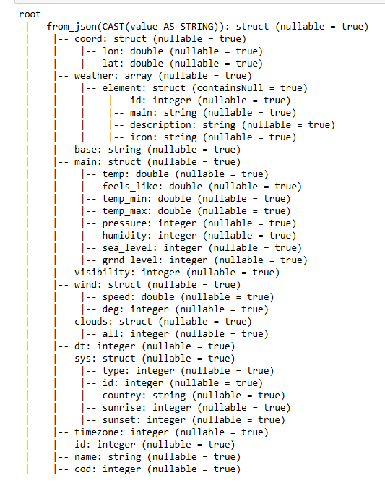
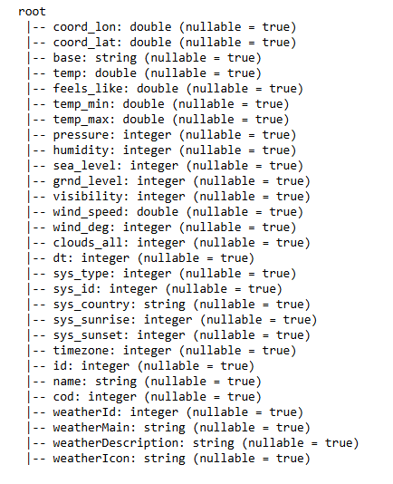
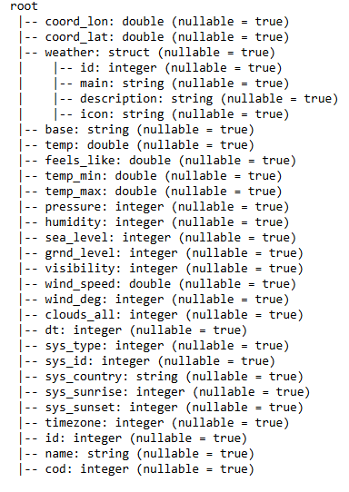

Slide 6
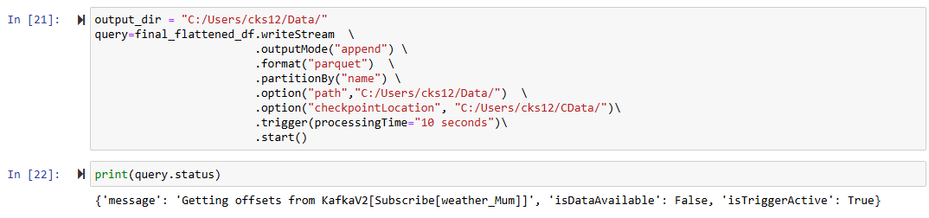
Read data from topic using spark streaming
While reading using format parquet ( help scale)
Also partition by city name ( help scale)
Git Code Repo :Link

Slide 7
Problem faced
Solution to the Problem
Failed to create new KafkaAdminClient
getting error -Py4JJavaError: An error occurred while calling o39.load.
Main Data was stored only in value .
While creating spark session set jar config("spark.jars.packages", "org.apache.spark:spark-sql-kafka-0-10_2.12:3.2.0,org.apache.kafka:kafka-clients:3.5.2") \
Also pass right Kafka bootstrap.servers and kafka topic while spark.readStream
Cast value to string and then use from_jsom to take Json data and use explode to flatten the json

Slide 8
LSTM time series Model
Git Code Repo: Link
Used tensorFlow as spark doesn’t have LSTM avlb in it’s ml library, Future scope to try running same code using tensorFlowonspark as that is available to handle scale.
Convert spark dataframe to panda for making date as index as didn’t find anything in spark for the same.
Used TimeseriesGenerator to get data which we can input to model with multivariant analysis of temp and grid.

Slide 9

1
2
3
1
2
3
4
n

Slide 10
1
2
3
P
1
2
3
n

Slide 11
1
2
3
P
P
1
2
3
n-1
n
Replace P with Original Data coming from spark stream

Slide 12
Questions ?
Thank You !!

