Slide 1
Hospital Emergency Room Triage System
Team No: 30
Mutyala Lakshmi Vinaya | Roll No: 2620030498
Monika Vaishnavi | Roll No:
Guide: K. Sree Ram Murthy
26SC1101E Problem Solving Using Programming (JAVA) | KLH, A.Y 2026-27 Trimester I

Slide 2
Abstract
Register & assess
1
On arrival, patients are registered and their symptoms, vital signs and medical history are recorded. Triage then ranks each case by urgency so critical patients are treated first.
Manage & track
2
One central platform shows the patient queue, assigns patients to doctors or departments, tracks treatment status, raises alerts for critical cases and reports free beds and resources.
Faster, safer care
3
Automating paperwork and routine steps cuts waiting time, improves resource use and reduces errors, helping doctors, nurses and administrators decide in time.

Slide 3
Understanding the Problem Statement
The problem
Our Java solution
Emergency rooms receive more patients than they can see at once
Manual paperwork slows registration and invites errors
Critical cases can wait behind minor ones without clear prioritisation
Staff lack a live view of queues, beds and resources
Register patients and store vitals, symptoms and history
Score severity and assign a triage priority automatically
Serve the queue in priority order and assign doctors
Track beds and treatment status; alert on critical cases

Slide 4
CO1 – From Problem to Program
Register patient
Record vitals
Score severity
Assign priority
Treat & update
Data types & expressions
Input / output
String name, symptoms
int age, heart rate, severity score
double temperature, SpO₂
boolean isCritical, bedAssigned
Scanner reads patient details from the console
Arithmetic expressions combine vitals into a severity score
Formatted output prints queue and patient summary

Slide 5
CO2 – Loops and Conditions
Selection: if / else-if / switch sets priority
Repetition & termination
1
Critical
do-while main menu repeats until the user chooses Exit
while re-prompts until valid vitals are entered
for scans the queue to find the highest priority
break / continue stop at first match, skip treated patients
Immediate care
2
Urgent
Within minutes
3
Semi-urgent
Wait is safe
4
Non-urgent
Routine care

Slide 6
CO3 – Applying Methods and Arrays
registerPatient()
calculateSeverity()
Why methods & arrays
adds a new patient
returns a score from vitals
Each task is a separate method, so the code is modular and reusable
Methods take parameters and return values
Arrays hold the patient queue and the bed list
A recursive helper can traverse structures such as the queue
nextPatient()
assignDoctor()
picks highest priority
matches patient to doctor
updateBedStatus()
displayQueue()
occupies or frees a bed
prints the waiting list

Slide 7
CO4 – Exception Handling
try → catch → finally
Failing safely
InputMismatchException
Invalid input is caught and the user is asked again
Custom exceptions give clear messages to staff
The program keeps running instead of crashing
Private fields with getters and setters protect patient data
text typed where a number is expected
InvalidVitalsException
custom: vitals outside a realistic range
BedUnavailableException
custom: no free bed for the patient
ArrayIndexOutOfBounds
guards queue and bed array access

Slide 8
CO5 – Constructors and Polymorphism
Person
OOP in the project
name, age
Person(name, age)
Constructors initialise Patient and Doctor objects; overloaded versions accept different details
Inheritance Patient and Doctor extend Person
Overriding each patient type defines its own getPriority()
Polymorphism one Person/Patient reference works with every subtype
Patient
Doctor
vitals, priority
getPriority()
department
getRole()
CriticalPatient
getPriority() → 1

Slide 9
CO6 – Project Quality, GitHub and Deployment
Code quality
GitHub repository
Deployment
Meaningful names and comments
Separate classes per role
Input validation and tested scenarios
Source code under version control
Regular commits show progress
Link and commit count on review form
Compiled and packaged as a runnable JAR
Runs with java -jar on any JDK system
README explains setup and use

Slide 10
Conclusion
What we achieved
Future scope
A Java triage system that registers patients and ranks them by severity
Queue, doctor and bed management in one place
Input validation and exception handling for safe operation
Applies all six course outcomes in a single project
Database storage for permanent patient records
Graphical interface for hospital staff
Real-time alerts to doctors and nurses
Analytics on waiting times and resource use

Slide 11
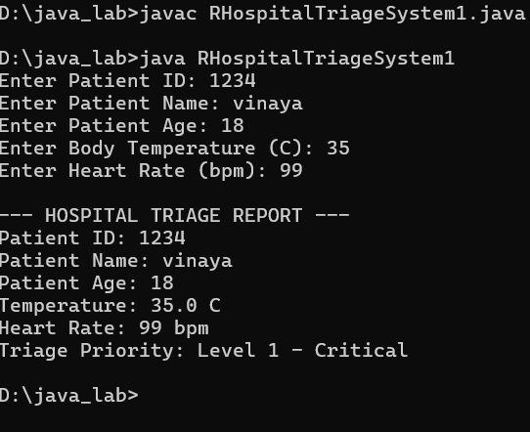

Slide 12
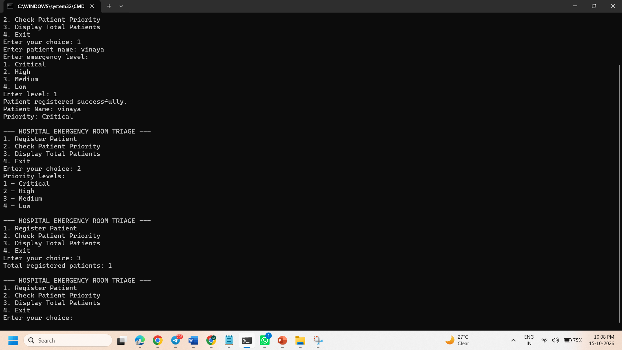

Slide 13
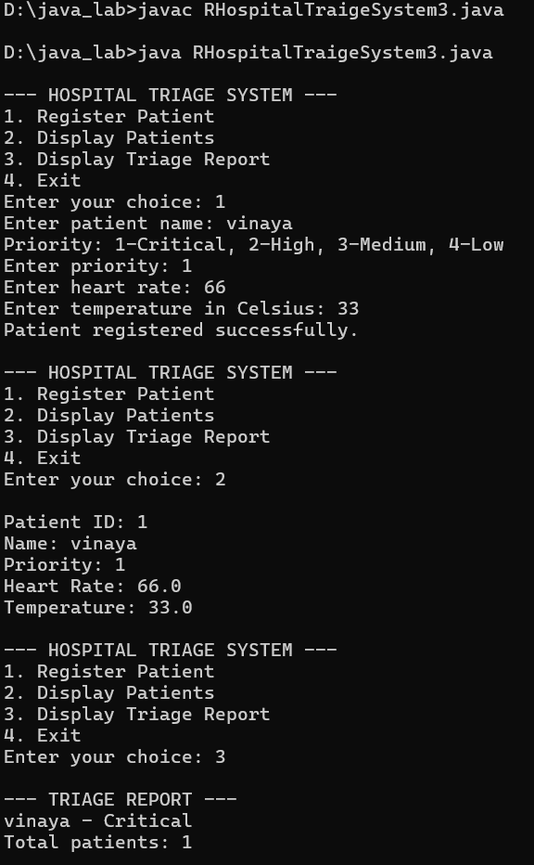

Slide 14
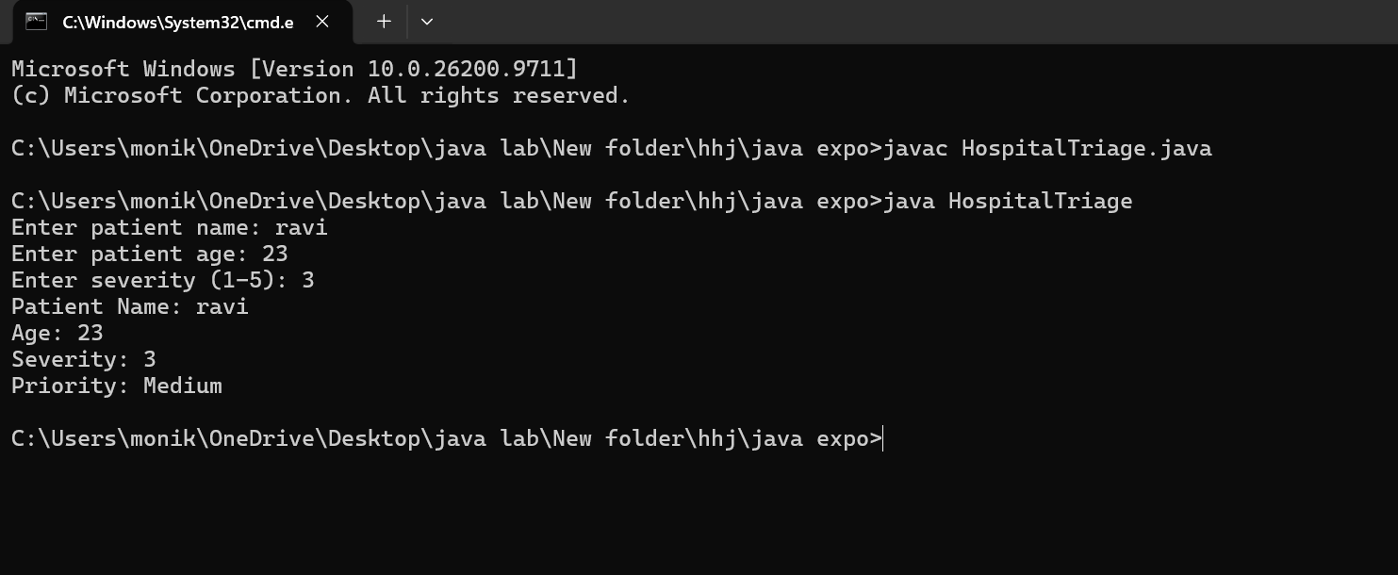

Slide 15
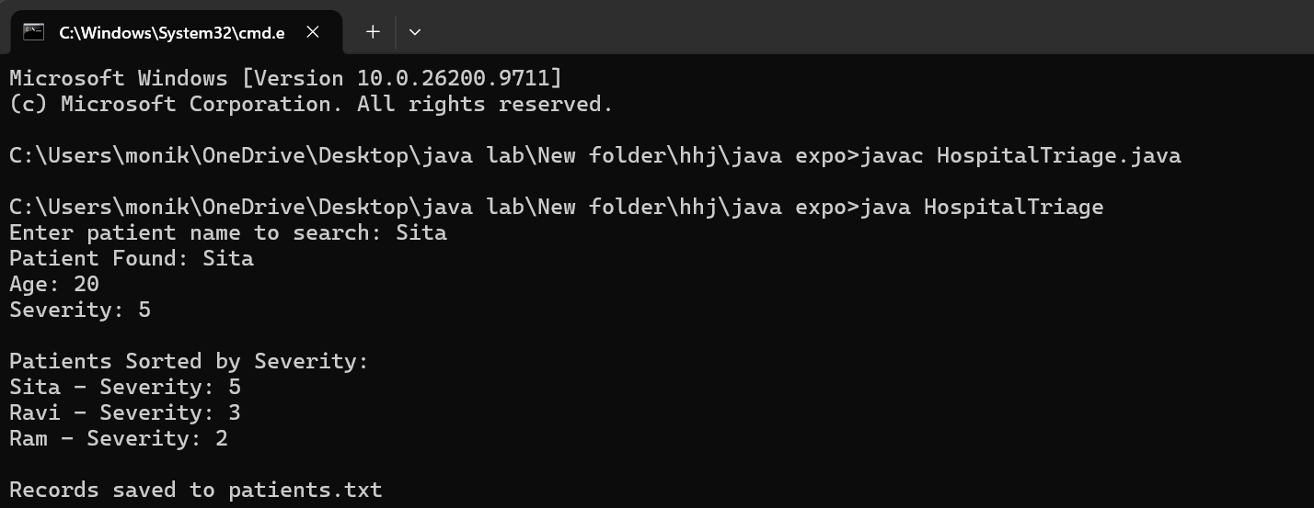

Slide 16
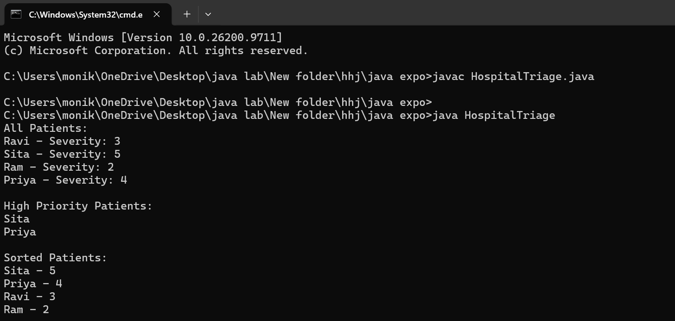

Slide 17


