Slide 1
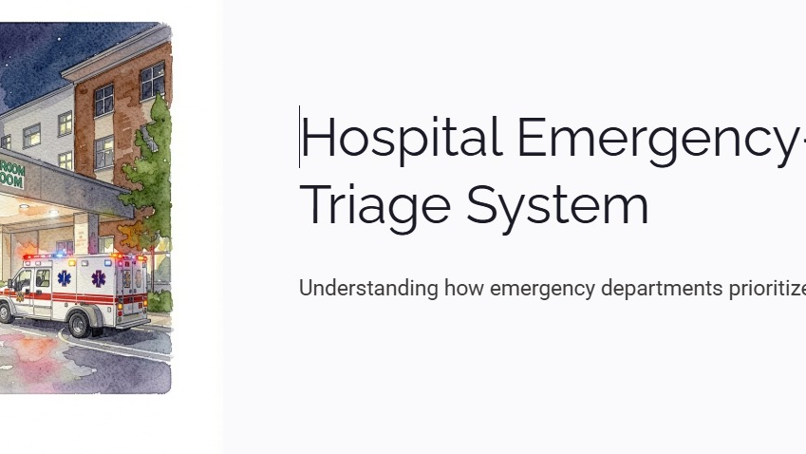
KLH
UNIVERSITY
BACHUPALLY
PROJECT PRESENTED BY
M.MONIKAVAISHNAVI | 2620030544
MUTYALA LAKSHMI VINAYA | 2620030498

Slide 2
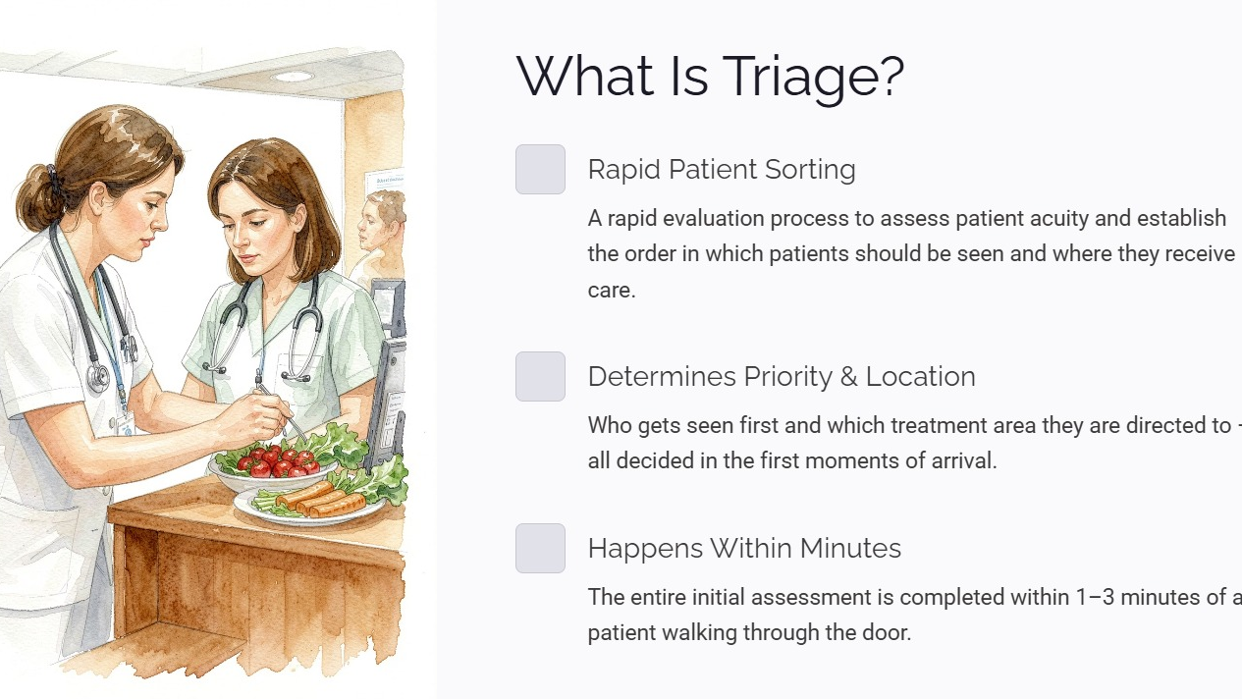

Slide 3
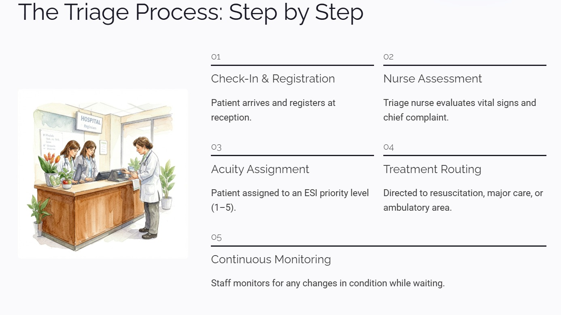

Slide 4
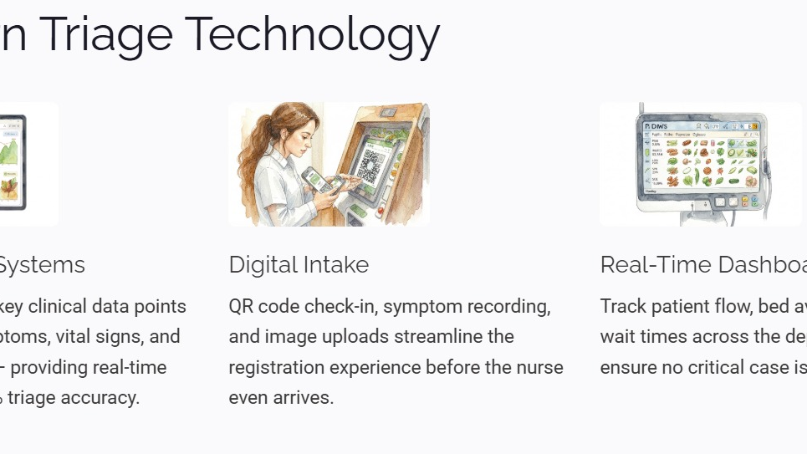

Slide 5
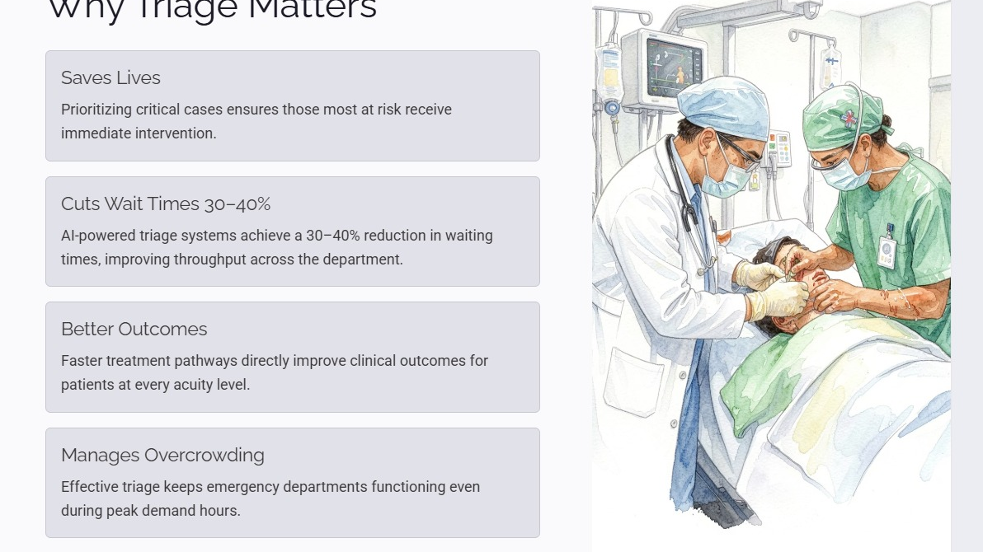

Slide 6
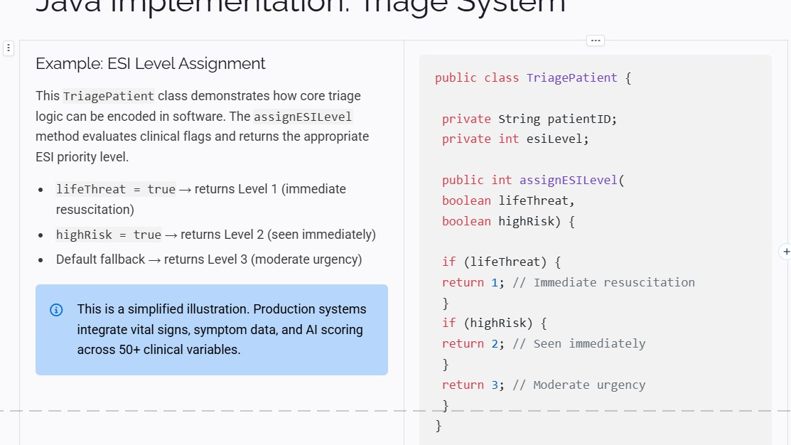

Slide 7
Java Implementation: Sample Output
Sample Method Calls & Output
lifeThreat = true, highRisk = false
Output: ESI Level = 1
lifeThreat = false, highRisk = true
Output: ESI Level = 2
lifeThreat = false, highRisk = false
Output: ESI Level = 3
Note: The given code has no main() method, so the exact code
by itself produces no console output until assignESILevel() is called.
M.MONIKAVAISHNAVI (2620030544) • MUTYALA LAKSHMI VINAYA (2620030498) • KLH UNIVERSITY

Slide 8
Conclusion
KLH
UNIVERSITY
BACHUPALLY
• Triage is the first step in organizing emergency care.
• It helps identify patients who need immediate attention.
• The process uses quick assessment, acuity levels, and treatment routing.
• Java can model basic triage rules using conditions and methods.
• Modern digital tools can support faster and more organized patient flow.
KEY TAKEAWAY
Fast + structured triage
supports safer emergency
care and better patient flow.
M.MONIKAVAISHNAVI (2620030544) • MUTYALA LAKSHMI VINAYA (2620030498)

