Slide 1
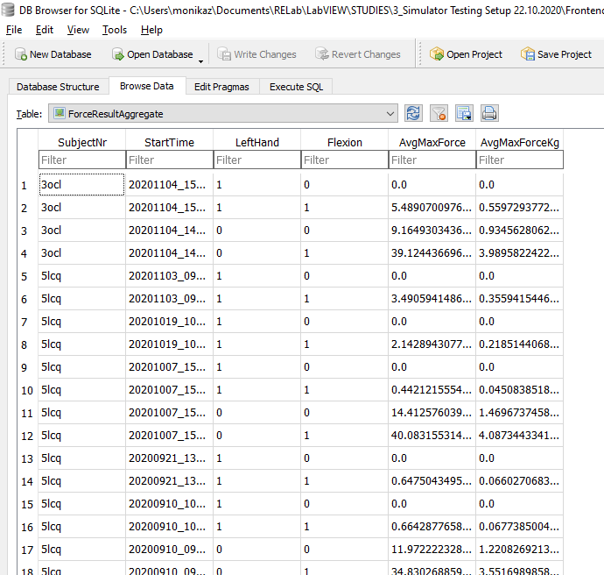
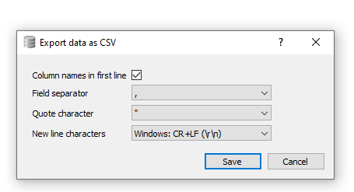
1) Select this first to browse through the SQL database
2) Select TaskName_Aggreggate to get the summary metric per task for all subjects in the database (example here: average maximum force over 3 trials in flexion/extension)
3) Export the SQL database as CSV for further analysis (e.g. in R), click save below.

