Slide 1
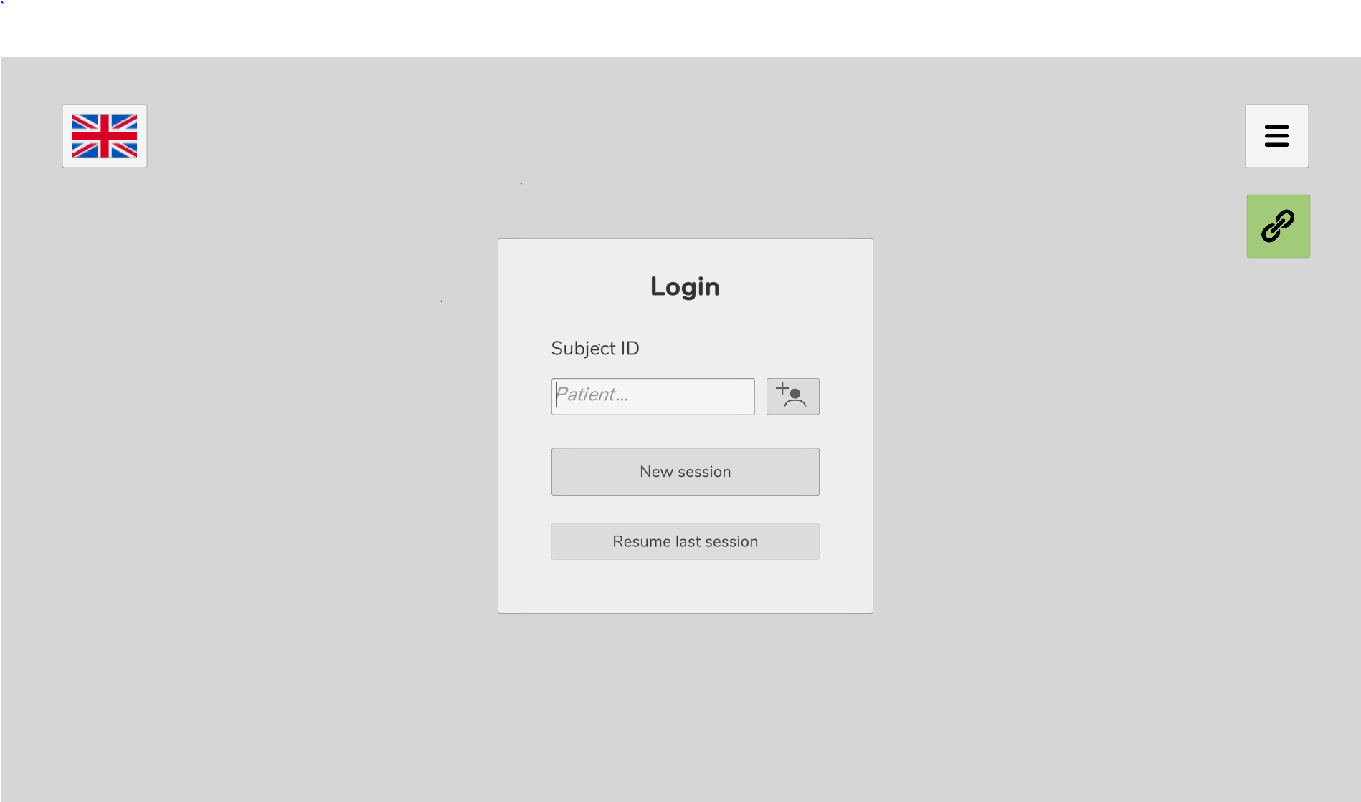
Menu - close the application from here
Change langauge
Connection is
established (if turns
red – restart the
hardware)
Create a new
subject login

