Slide 1
Secure Data Transfer using Star Graph Encryption
A Novel Graph Theory Based Approach
Presented By Raghav Kumar (23BIT073) Monil Babariya (23BIT074)
Harshal Gondaliya (23BIT077) Om Rana (23BIT080)
Information Security Lab Project

Slide 2
Overview
Introduction
Motivation
Aim
Program structure
Encryption Process
Decryption Process
Applications
Advantages
Conclusion

Slide 3
Motivation
Research Reference
The paper introduces Corona, Complete Bipartite, and Star Graph (Kₙ₊₁ = K₁ ε Kₙ) encryption schemes.
Our work implements the Star Graph Encryption model (Section 5) for practical visualization and prime-based encoding in MATLAB.
Inspired by:
Ali, N. et al. (2024). “Secure Communication in the Digital Age: A New Paradigm with Graph-Based Encryption Algorithms.”
Frontiers in Computer Science, 6, 1454094.
DOI: 10.3389/fcomp.2024.1454094

Slide 4
Aim
Project Aim
To implement and demonstrate a secure data encryption technique using Star Graphs that provides enhanced protection against traditional and modern cyber attacks.
Motivation: Traditional encryption methods face constant threats from brute force and frequency analysis attacks
Innovation: Using graph theory principles adds mathematical complexity that makes decryption without the key extremely difficult
Advantage: Star graphs provide a simple yet powerful structure for hiding data relationships

Slide 5
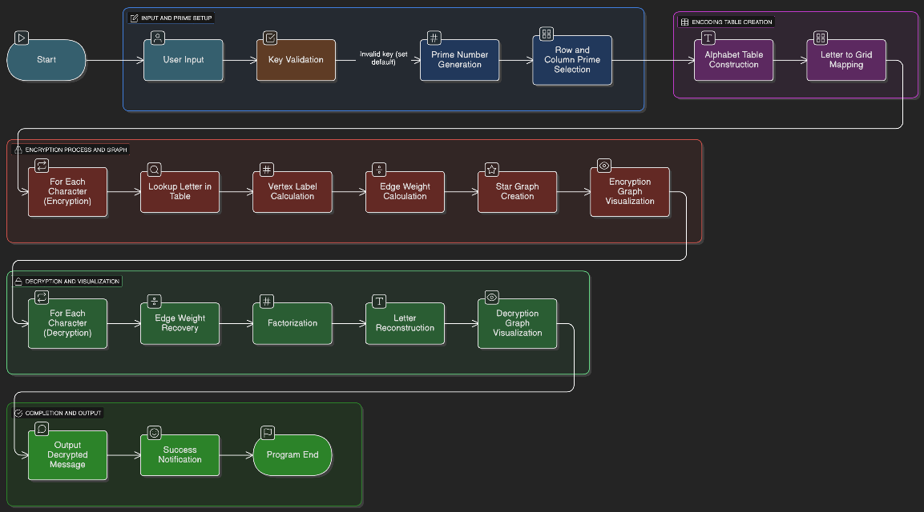
Program Structure

Slide 6
Encryption Process - Step by Step
Key Setup: Choose a secret number between 3-12 that determines the encryption table size
Prime Generation: Generate a list of prime numbers based on the key value
Table Creation: Create an encoding table where each cell represents a letter-position combination
Message Mapping: Convert each letter to its position in the table (row prime and column prime)
Vertex Creation: Multiply the row and column primes to create unique vertex labels
Graph Construction: Build a star graph with a central node and leaf nodes containing the vertex labels
Edge Weighting: Transform vertex labels into edge weights using mathematical operations to hide the original data

Slide 7
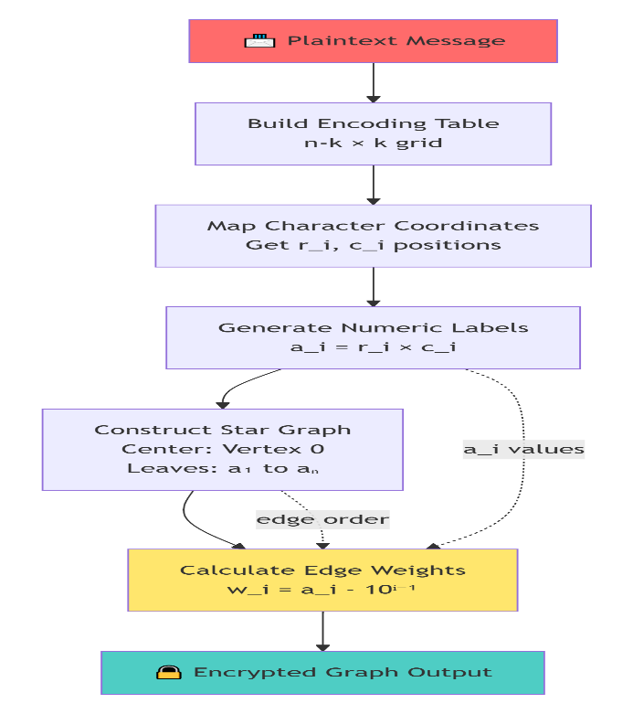
Encryption Visualization

Slide 8
Decryption Process - Step by Step
Receive Graph: Obtain the encrypted star graph with weighted edges
Sort Weights: Arrange the edge weights in proper order for processing
Reverse Transformation: Apply the reverse mathematical operation to recover original vertex labels from edge weights
Prime Factorization: Break down each vertex label into its two prime factors (row and column primes)
Table Lookup: Use the prime pairs to locate the corresponding letters in the decoding table
Message Reconstruction: Combine all retrieved letters to form the original plaintext message
Verification: Confirm the decrypted message matches the original sent message

Slide 9
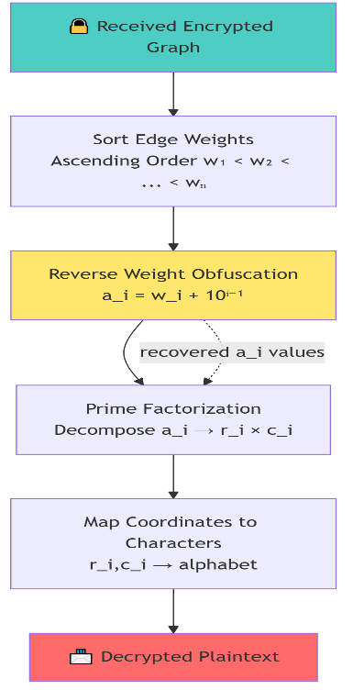
Decryption Visualization

Slide 10
Real-World Applications
Practical Uses of Star Graph Encryption
Financial Transactions: Securing payment processing systems and banking data transfers
Confidential Messaging: Protecting sensitive internal communications within organizations
Command Systems: Securing short, critical commands in control systems
Data Hiding: Digital watermarking and steganography applications
Keyword Security: Private keyword searches in confidential documents
Key Advantage
Provides strong security for short messages while maintaining reasonable computational efficiency compared to other graph-based methods.

Slide 11
Key Advantages
Strengths
Enhanced Security through mathematical complexity
Resistance to traditional attacks
Simple Structure easy to implement
Scalable for different message sizes
Fast Processing compared to other graph methods
Characteristics
Uses shared secret key
Based on prime number properties
Leverages graph theory principles
Suitable for short messages
Balance of security and performance

Slide 12
Conclusion
Summary
The Star Graph Encryption technique provides a novel approach to data security by:
Leveraging mathematical properties of graphs and prime numbers
Creating complex relationships that are hard to break without the key
Offering practical implementation for real-world secure communication
Maintaining efficiency while providing strong encryption
Future Enhancement
This method can be further strengthened by combining with public key cryptography and implementing in various programming environments.

Slide 13
Thank You
Questions?

