Slide 1
HawkEye
Monil Shah (mds747)
Tabish Sada (mts480)
Samvid Jhaveri (snj268)

Slide 2
Motivation
Ball tracking and trajectory reconstruction
Used in Basketball, Soccer, Tennis, Cricket etc
Several ball tracking cameras
Better refereeing decisions, reviews
Tennis - To identify whether a ball has bounced in or out, electronic review
Soccer - Goal line technology
Cricket - Smart Replay LBW decisions

Slide 4
Methodology
Divide the Video in frames
Detect the moving object i.e ball .
Vector Field Calculation to find Optical Flow
Track the trajectory of the ball
Use Kalman filters to get more precise estimates.

Slide 5
Approach 1 : Using Lucas-Kanade algorithm
Video or Image Sequence as Input.
Three Images or Frames used at a time.
Use Color Detection to find Salient Features of Green Ball.
Iteratively Track the detected ball points.
Lucas and Kanade Algorithm
Farneback Algorithm
Get the measured detection Points

Slide 6
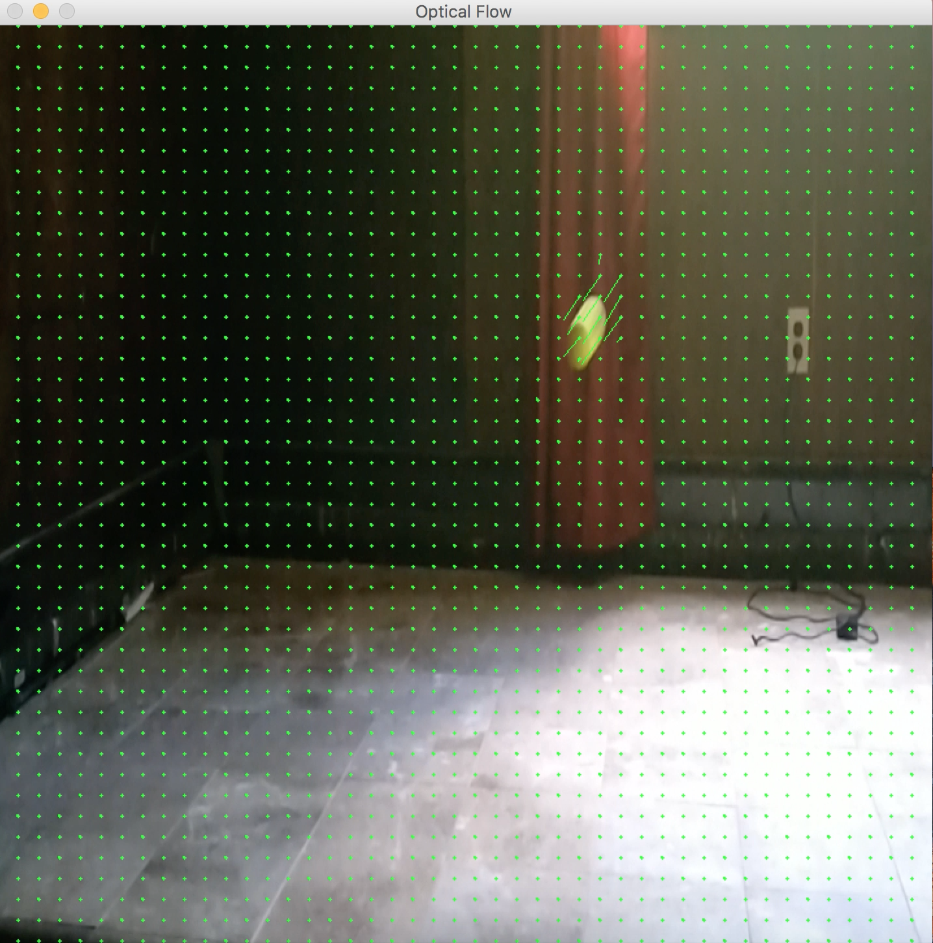
Results (Approach: 1)

Slide 7
Approach 2 : HSV tracking and Kalman Filtering
Ball Tracking through HSV values
Linear Quadratic Estimation
Trajectory Optimization
Precise and accurate Trajectory estimates

Slide 8
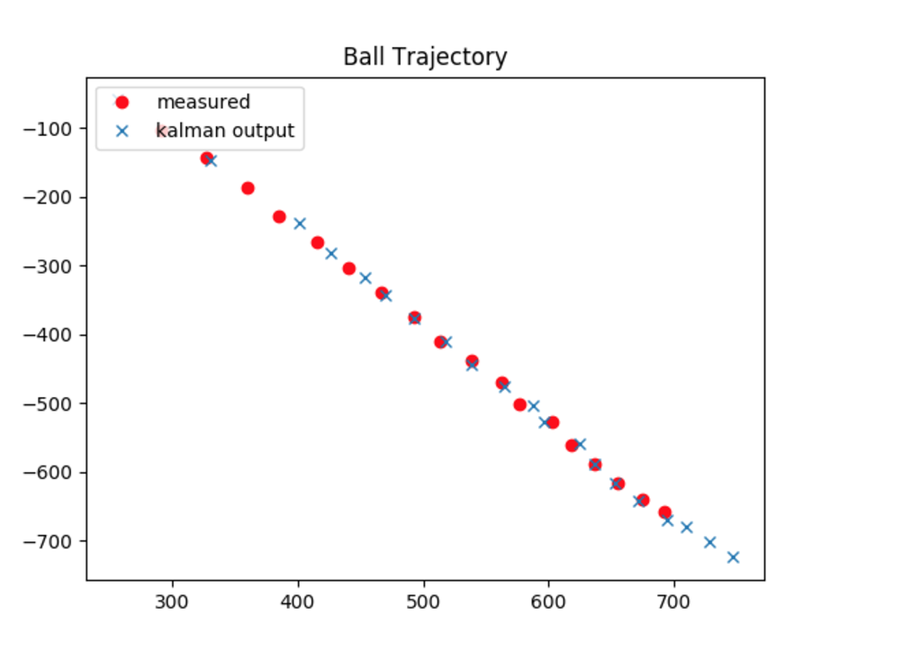
Results (Kalman Filtering)

Slide 9
Challenges
Interfering BackGround
Rapid Movement of Objects across frames.
Change in Object Orientation
Changing illumination

Slide 10
References
Kalman Filter Based Tracking in an Video Surveillance System - Caius SULIMAN1 , Cristina CRUCERU2 , Florin MOLDOVEANU3
Estimation from Stereo Image Sequences in Real-Time - Clemens Rabe, Thomas M¨uller, Andreas Wedel, and Uwe Franke Daimler Research, Sindelfingen
A New Approach to Linear Filtering and Prediction Problem - R.E.Kalman

Slide 11
Thank you!
Questions/Suggestions?

