Slide 1
Beyond RAG
Constructing Context Graphs and Multi Agent System hands on with AWS
A story of reconciling $100B+ in AWS CapEx transactions
Presented By: Monil Shah – Senior SDE, AWS
Vivek Ghatala – Senior SDE, AWS
Hands-On Workshop | 90 Minutes

Slide 2
The Story: AWS CapEx Financial Integrity
The Domain
The Systems
💰 $100B+ in infrastructure transactions
flowing through Veritas automation annually
📊 Multiple disconnected systems:
Purchase Orders, Data Centers, Invoices, Accounting Subledgers
👥 Accounting and Finance teams
all need reconciliation metrics
🔄 1.5M transactions reduced to ~150K
open items...but still requires manual investigation
Supply Chain
Procurement & ordering
AP
Accounts payable
SL
Sub-Ledger
FS
Fixed-asset System
DataLake
Redshift analytics

Slide 3
The Problem: Three Pain Points
❌ Fragmented Knowledge
❌ Lost Decision Context
❌ Manual Investigation
No single source of truth
No record of WHY
Can't act on insights
Policy docs, metric definitions, reconciliation rules, and system configs scattered across wikis, Alteryx workflows, and tribal knowledge. New analyst asks: "What's the PO aging threshold for the LLE category?" — nobody knows where the answer lives.
Why was the PO aging threshold set to 90 days? Why did we switch from OFA-only to FASL+? Why are certain asset categories excluded? Decisions made during month-end close are lost. Next quarter, same questions resurface.
150K open transactions still need manual review. Analysts copy-paste between DataStudio, Excel, and email to investigate discrepancies. "Show me POs aging >90 days not yet invoiced for EMEA" requires 4 manual steps.

Slide 4
Our Journey: Build an AI-Powered Metrics Assistant
We'll build an agent that understands AWS financial system metrics, knows WHY decisions were made, and can act
Knowledge Base + Custom Chunking
Ingest metric definitions, reconciliation rules, and policy docs into a Bedrock KB with structure-preserving chunking
30 min
1
Context Graph
Build a Neptune Analytics graph of systems, metrics, decisions, and relationships — the event clock for financial operations
30 min
2
Agentic AI with Strands
Build a Strands agent that queries KB + graph, runs Athena queries, classifies discrepancies, and records decision traces
30 min
3

Slide 5
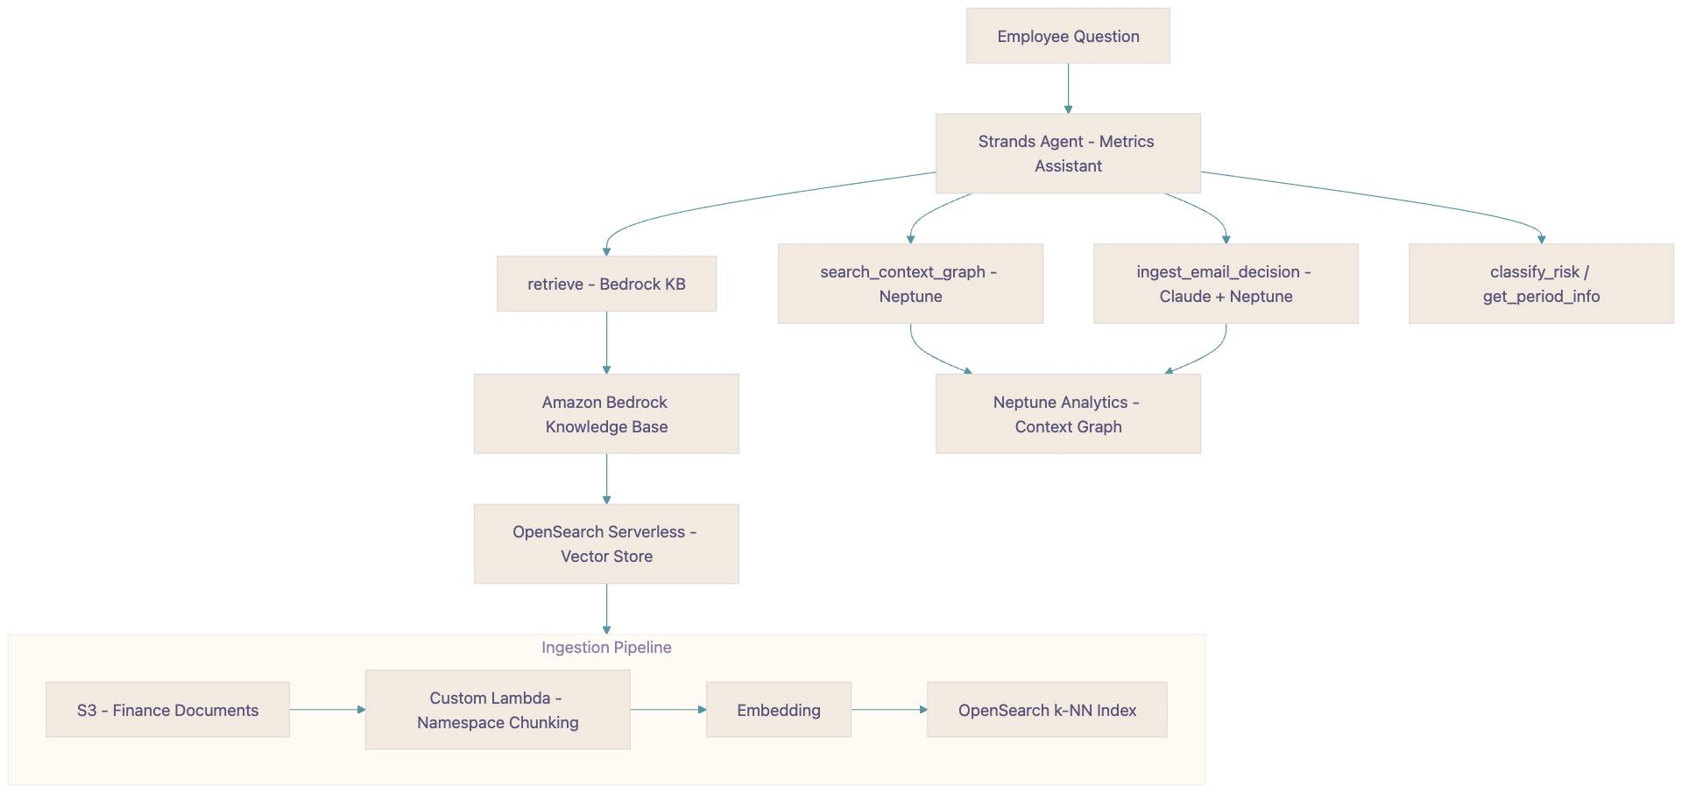
What We're Building

Slide 6
The Two Clock Problem in Financial Ops
AFS teams have a state clock but no event clock
⏰ State Clock (what exists today)
⏰ Event Clock (what's missing)
Current metric definitions in JSON configs
"PO aging threshold is 90 days"
"categories: AHU, GENERATOR"
"MTD period for po_total_spend"
Current reconciliation rules
"Match GL to sub-ledger"
"Filter po_amount > 300"
✅ KB handle this
WHY was the threshold set to 90 days?
"Q4 2024 audit found 60-day was too aggressive"
WHY are AHU and GENERATOR in category?
"Finance reclassified in FY2024 per GAAP update"
WHY did last month's reconciliation fail?
"DataLake query returned stale data — fixed"
❌ No infrastructure for this!
✅ Context graphs solve this

Slide 7
Demo Scenario: Month-End Close
It's March 31st. FBI CapEx analyst needs to close the books.
"What is the total PO spend for EMEA this month, broken down by currency?"
Agent searches KB for metric definition → finds po_total_spend namespace → returns: EUR €2.5M, GBP £500K
1
"Why did we change the PO aging threshold from 60 to 90 days last quarter?"
Agent queries context graph → finds Decision: Q4-2024-AUDIT → "60-day was flagging too many false positives during audit"
2
"Show me POs aging >90 days not yet invoiced — and classify the risk level"
Agent calls query tool → Athena → retrieves 47 POs totaling $3.2M → classifies: 12 high-risk (>$500K) → records decision trace
3
"Compare this month's failed asset creates vs last month. What changed?"
Agent searches KB + graph → 23 failures this month vs 8 last → graph shows: new GENERATOR category onboarded March 15th
4

Slide 8
MODULE 1
Knowledge Base + Custom Chunking
Ingesting metric definitions, reconciliation rules, and policy docs

Slide 9
Why Chunking Matters for Financial Docs
❌ Fixed-Size Chunking (300 tokens)
✅ Custom Chunking (by Namespace)
AFS Metric Definition doc: ┌─── Chunk 1 ────────────────────┐ │ Metric: po_total_spend │ │ Type: SUM │ │ Value: po_amount │ │ Breakdown: currency │ │ Dimensions: │ │ - entity │ │ - region │ └─────────────────── CUT ────────┘ ┌─── Chunk 2 ────────────────────┐ │ - cost_center │ │ Filters: │ │ po_amount > 300 │ │ line_category IN [AHU, GEN] │ │ Periods: MTD, QTD, YTD │ └────────────────────────────────┘ Agent gets Chunk 1 → answers without filters or periods. WRONG answer.
Same doc, namespace-aware chunking: ┌─── Chunk (complete namespace) ──┐ │ Namespace: veritas_po_metrics │ │ │ │ Metric: po_total_spend │ │ Type: SUM │ │ Value: po_amount │ │ Breakdown: currency │ │ Dimensions: entity, region, │ │ cost_center │ │ Filters: po_amount > 300, │ │ line_category IN [AHU, GEN] │ │ Periods: MTD, QTD, YTD │ │ │ │ metadata: │ │ namespace: veritas_po_metrics │ │ metric: po_total_spend │ │ type: metric_definition │ └─────────────────────────────────┘ Complete definition + metadata ✅

Slide 10
AFS Knowledge Base: What We Ingest
📊
📋
📄
🔧
Metric Definitions
Reconciliation Rules
Policy & Compliance
System Configs
14 P0 metrics
Matching logic
Audit requirements
Namespace definitions
po_total_spend, po_aging_not_invoiced, invoice_variance, asset_value_mismatch, asset_create_count, failed_creates, etc.
GL ↔ sub-ledger matching, invoice ↔ PO receipt matching, asset value ↔ GL reconciliation
PCI data retention, SOX controls, period close procedures, GRC controls, threshold configurations
po_metrics, asset_metrics, reconciliation — JSON configs with query, dimensions, filters, periods

Slide 11
Bedrock KB Pipeline
S3 (metric docs) → Parsing → Custom Lambda Chunking → Titan Embeddings V2 → OpenSearch Serverless
Custom chunker: split by namespace + metric definition
Query Example
# Lambda chunker preserves metric structure def chunk_by_namespace(text, source): """Split on namespace boundaries, keep each MetricDefinition intact.""" sections = re.split( r'\n(?=##+ |\{\s*"name")', text ) chunks = [] for section in sections: chunks.append({ "content": section, "metadata": { "namespace": extract_ns(section), "metric_name": extract_metric(section), "doc_type": classify_doc(section), "source": source, }, }) return chunks
💬 "What metrics track PO aging?" Agent retrieves: [0.94] po_aging_not_invoiced Type: COUNT + SUM Threshold: >90 days Dimensions: entity, currency Periods: MTD, QTD [0.87] po_total_spend Type: SUM Filter: po_amount > 300 Complete definitions with all filters, dimensions, periods ✅

Slide 12
Hands-On: Build the AFS Knowledge Base
1
Upload docs to S3
Metric defs, recon rules, policies, configs
2
Create Bedrock KB
Titan Embeddings V2 + OpenSearch Serverless
3
Query with default chunking
See the split-definition bug in action
4
Deploy custom Lambda chunker
Namespace-aware splitting + metadata
5
Re-query — complete answers
"What metrics track PO aging?" → full definition
6
Compare retrieval quality
Side-by-side: fixed vs semantic vs custom

Slide 13
MODULE 2
Context Graph
Building the event clock: WHY metrics are defined the way they are

Slide 14
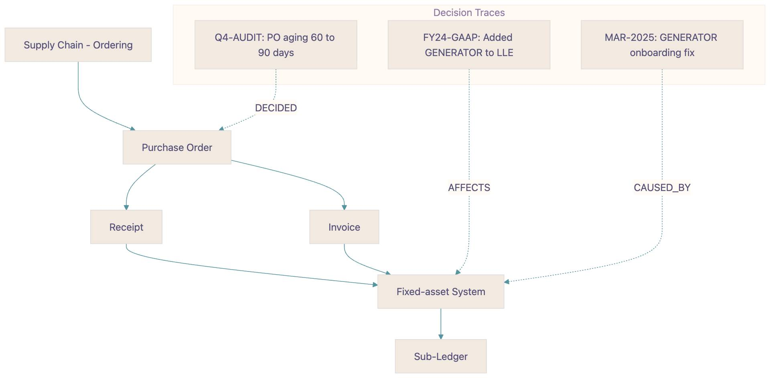
Financial Operations as a Graph

Slide 15
Neptune Analytics: AFS Graph Schema
Node Types
Relationship Types
🏗️
System
Supply Chain, Invoice, GL, SL, FS
FEEDS_INTO
Supply Chain → PO → Invoice → FS → SL
📊
Metric
po_total_spend, asset_create_count, etc.
DEFINES
Namespace → Metric definitions
📁
Namespace
po_metrics, asset_metrics
HAS_DIMENSION
Metric → entity, region, currency
🏷️
Dimension
entity, region, cost_center, currency
RECONCILES
GL ↔ SL matching rules
DECIDED
Decision → changed threshold/config
⚖️
Decision
Q4-AUDIT, FY24-GAAP, threshold changes
CAUSED_BY
Metric change → audit finding
📅
Period
2025-03 MTD, 2025-Q1 QTD, FY2025 YTD
CONSIDERED
DecisionTrace → entities evaluated
📝
DecisionTrace
Agent reasoning captured at runtime
REPLACES
New config → old config

Slide 16
GraphRAG: Why Vector Search Alone Fails for AFS
"Why did we change the PO aging threshold from 60 to 90 days?"
🔍 Vector Search Only
🔗 Graph + Vector (GraphRAG)
Returns similar text: [0.91] "PO aging threshold: 90 days" [0.84] "Filter: po_amount > 300" [0.79] "Periods: MTD, QTD, YTD" Knows the current value (90 days) but NOT why it changed ❌
Returns relationships + decisions: Decision: Q4-2024-AUDIT ──DECIDED──▶ PO aging = 90 days ──CAUSED_BY──▶ "60-day threshold flagged 40% false positives" ──REPLACES──▶ PO aging = 60 days Knows WHAT and WHY ✅
Decision Traces for Month-End Close
Every month-end decision gets recorded: "Approved 47 POs as low-risk because all <$100K and within 120-day window" → Next quarter's analyst finds this trace and understands the precedent without asking anyone → The system builds institutional memory — like case law for financial operations

Slide 17
Hands-On: Build the Fixed Asset System Context Graph
1
Create Neptune Analytics graph
32 GB with vector search (1024-dim)
2
Extract entities from AFS docs
Claude extracts systems, metrics, decisions, relationships
3
Populate graph with openCypher
Nodes: System, Metric, Namespace, Decision + edges
4
Query: vector + graph hybrid
"Why 90-day PO aging?" → decision trace + current config
5
Record a decision trace
Simulate month-end: classify POs, record reasoning
CALL neptune.algo.vectors.topKByNode({queryVector: {embedding}, topK: 5}) YIELD node, score OPTIONAL MATCH (node)-[r]-(connected) RETURN node.name, type(r), connected.name

Slide 18
FS MetricOutput in the Graph
MetricOutput: po_total_spend (March MTD)
Graph Captures the Context
{ "metric_id": "po_total_spend", "period_type": "mtd", "period": "2025-03", "metric_value": { "total": "5,000,000.00", "group_by": { "USD": "2,000,000.00", "EUR": "2,500,000.00", "GBP": "500,000.00" }, "items": ["PO001","PO002",...] }, "breakdown": { "EMEA": { "total": "3,000,000.00", "EU_WEST": { "CC123": "1,500,000.00", "CC124": "1,000,000.00" } }, "NA": { "total": "2,000,000.00", "US_WEST": { "CC126": "2,000,000.00" } } } }
📊 Metric node: po_total_spend
→ HAS_DIMENSION → entity, region, CC
→ BELONGS_TO → veritas_po_metrics
📅 Period node: 2025-03 MTD
→ SNAPSHOT → $5M total
→ BREAKDOWN → EMEA $3M, NA $2M
⚖️ Decision: Q4-2024-AUDIT
→ DECIDED → filter: po_amount > 300
→ CAUSED_BY → false positive reduction
📝 DecisionTrace: MAR-2025-CLOSE
→ APPROVED → 47 POs as low-risk
→ REASONING → all <$100K, <120 days
This is the event clock —
every number has a story behind it

Slide 19
The Complete AFS Agent: Four Tools
📚
🔗
📝
📧
retrieve
search_context_graph
record_decision
ingest_email_decision
Bedrock KB
Neptune Analytics
Neptune Write
Claude + Neptune
State Clock
Event Clock
Builds Memory
Captures Email Decisions
Metric definitions, recon rules, namespace configs, compliance policies
System relationships, decision history, threshold rationale, email decisions
Captures agent reasoning as decision traces — audit trail for future queries
Extracts decisions from email threads, creates Decision nodes, links to affected entities
Agent flow: Search KB (WHAT) → Search Graph (WHY) → Act → Record Decision → Ingest Emails

Slide 20
Capturing Decisions from Emails
Most financial decisions happen in email — they're the biggest source of lost context
📧 Input: Email Thread
🔗 Output: Decision Node in Graph
From: Sarah Chen (CapEx Lead) Date: 2024-10-15 Subject: RE: PO Aging Threshold Review After reviewing the Q4 audit findings, I'm approving the change to increase the PO aging threshold from 60 days to 90 days. The 60-day threshold was generating approximately 40% false positives during the Q3 close cycle. The audit team confirmed that 90 days better reflects actual procurement timelines for infrastructure equipment. Expected to reduce false positive alerts by ~35%.
ingest_email_decision(email_text) → Claude extracts structured decision: Decision: Q4-2024-AUDIT Title: PO aging threshold 60→90 days Date: 2024-10-15 Decided by: Sarah Chen, CapEx Lead Rationale: 40% false positives at 60d Impact: ~35% reduction in false alerts → Creates Decision node with embedding → Links to affected entities: AFFECTS → po_aging_not_invoiced AFFECTS → po_metrics → Searchable forever via graph queries
Context graph captures decisions from: 📄 Documents • 🤖 Agent interactions • 📧 Email threads

Slide 21
MODULE 3
Agentic AI with Strands
From manual investigation to an agent that queries, classifies, and records decisions

Slide 22
From Manual Investigation → Intelligent Agent
Before: Manual Month-End Close
After: Strands Agent
1. Open DataStudio, write SQL query
for PO aging report
2. Export to Excel, filter by region
3. Cross-reference with Alteryx output
for reconciliation status
4. Email finance team with findings
5. Manually classify risk levels
6. Document decisions in... nowhere
(lost by next quarter)
⏱️ 4-6 hours per analyst per close
💬 "Show me PO aging for EMEA"
→ Searches KB for metric definition
→ Queries graph for thresholds + context
→ Returns structured breakdown ✅
💬 "Classify risk on these POs"
→ Calls classify_risk tool
→ 12 high-risk (>$500K), 35 low-risk ✅
💬 "Why is this threshold 90 days?"
→ Graph: Q4-2024-AUDIT decision ✅
💬 "Approve the low-risk POs"
→ Records decision trace with reasoning
→ Available for next quarter's close ✅
⏱️ 15 minutes with full audit trail

Slide 23
AFS Metrics Agent: The Code
integrated_agent.py
Agent's Toolkit
from strands import Agent, tool from strands.models.bedrock import BedrockModel from strands_tools import retrieve from tools.graph_tools import ( search_context_graph, record_decision, ) @tool def classify_risk(po_count: int, total_amount: float, threshold: float ) -> str: """Classify PO risk based on amount and aging threshold.""" if total_amount > threshold: return f"HIGH RISK: {po_count} POs,"\ f" ${total_amount:,.0f} total" return f"LOW RISK: {po_count} POs,"\ f" ${total_amount:,.0f} total" agent = Agent( model=BedrockModel( model_id="anthropic.claude-3-5- sonnet-20241022-v2:0" ), tools=[ retrieve, # KB: metrics search_context_graph, # Graph: WHY record_decision, # Audit trail classify_risk, # Take action ], system_prompt= "You are the AFS Metrics Assistant." " Search KB for metric definitions." " Query graph for decision history." " Record your reasoning as traces.", )
📚
retrieve
Bedrock KB
Metric definitions, recon rules, policy docs, namespace configs
🔗
search_context_graph
Neptune
System relationships, decisions, threshold change history
📝
record_decision
Neptune
Captures month-end decisions for future audit trail
🚨
classify_risk
Business logic
Classifies PO risk based on amount and aging thresholds

Slide 24
Demo: Month-End Close with the Agent
"What metrics track PO aging for the LLE category?"
→ retrieve: finds po_aging_not_invoiced metric → Returns: COUNT + SUM, threshold >90 days, dimensions: entity, currency, cost_center
KB retrieval
1
"Why is the threshold 90 days and not 60?"
→ search_context_graph: finds Q4-2024-AUDIT → Returns: "60-day flagged 40% false positives. Changed to 90 per audit recommendation."
Graph search
2
"Show me EMEA POs aging >90 days. Classify the risk."
→ retrieve: gets metric definition + filters → classify_risk: 12 HIGH ($3.2M), 35 LOW ($800K) → record_decision: saves classification reasoning
Action + trace
3
"Compare March vs February failed asset creates. What changed?"
→ retrieve: asset_create_failures metric → search_context_graph: finds MAR-15 onboarding → "GENERATOR category added March 15 — 15 of 23 failures are new GENERATOR assets"
KB + Graph
4

Slide 25
Hands-On: Build the AFS Metrics Agent
1
Simple agent + KB retrieval
agent("What metrics track PO aging?") → full definition
2
Add classify_risk tool
agent("Classify these 47 POs") → HIGH/LOW risk with amounts
3
Add graph tools
agent("Why 90-day threshold?") → Q4-2024-AUDIT decision trace
4
Full integrated agent
KB + graph + classify + record_decision — complete assistant
5
Interactive month-end demo
Walk through the 4 demo scenarios as the FBI CapEx analyst

Slide 26
AFS Metrics: Before vs After
Question
Before (Manual)
After (Agentic RAG)
"What are the PO aging metrics for LLE?"
Search wiki, ask colleague, find Alteryx workflow ❌
Agent retrieves full metric definition with filters, dimensions, periods ✅
"Why is the PO aging threshold 90 days?"
"It's always been 90 days" (tribal knowledge) ❌
Graph: Q4-2024-AUDIT changed from 60 → 90 due to false positives in audit ✅
"Classify risk on 150K open transactions"
Export to Excel, manually filter and categorize (4-6 hours) ❌
Agent classifies in seconds, records reasoning as decision trace ✅
"Why did asset creates fail this month?"
Check logs, email team, piece together timeline (days) ❌
Graph: GENERATOR category onboarded Mar 15 — root cause in 30 seconds ✅
KB fixes knowledge fragmentation • Graph fixes lost context • Agent fixes manual investigation

Slide 27
Key Takeaways
Custom chunking preserves financial document structure
Namespace-aware chunking keeps metric definitions intact — the difference between a partial answer and a complete one with all filters, dimensions, and periods
Context graphs are the event clock for financial ops
Every threshold change, audit finding, and category reclassification becomes a searchable decision node — institutional memory that survives team turnover
The two clock problem is acute in finance
Reconciliation rules change every quarter but the WHY is lost — context graphs give analysts the case law behind every number
Agentic AI turns investigation into conversation
150K open transactions go from 4-6 hours of manual Excel work to a 15-minute chat with full audit trail via Strands @tool decorator
Decision traces compound across close cycles
March's month-end decisions become June's precedent — the system builds the institutional knowledge that Alteryx can't capture

Slide 28
Thank You!
Github: https://github.com/monil-shah/KGC-Workshop-2026-ContextGraph/tree/main
What's Next ?
🛡️ Bedrock Guardrails for financial data compliance
📊 Connect to DataLake Redshift for live metric queries
🔄 Auto-ingest Namespace Definition changes from S3/DDB
📈 QuickSuite dashboards powered by agent-generated insights
🤖 Multi-agent: separate specialists for PO, Invoice, Asset, Recon

