Slide 1
Extra Learn Project
Classification and Hypothesis Testing
2024-01-06 Author: Monique Boudreau

Slide 2
Contents / Agenda
Business Problem Overview and Solution Approach
Data Overview
EDA Results - Univariate and Multivariate
Data Preprocessing
Model Performance Summary
Conclusion and Recommendations

Slide 3
Business Problem Overview and Solution Approach
A large number of leads are being generated regularly, one of the issues faced by Extra Learn is to identify which of the leads are more likely to convert so that they can allocate resources accordingly.
Methodology
Analyze and build an ML model to help identify which leads are more likely to convert to paid customers,
Find the factors driving the lead conversion process
Create a profile of the leads which are likely to convert

Slide 4
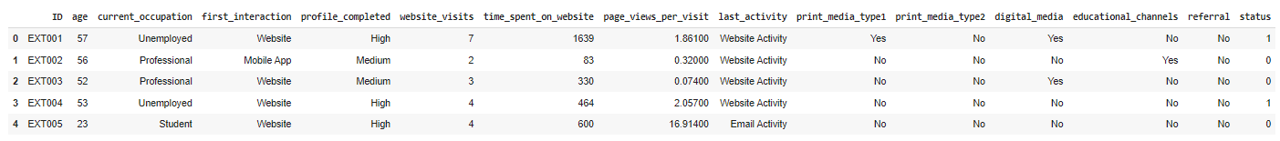
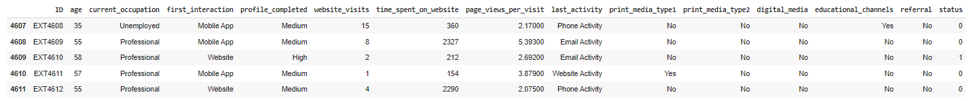
Data Overview
The data contains the different attributes of leads and their interaction details with Extra Learn. The detailed data dictionary is given below.
Sample data.

Slide 5
Data Overview
There are 15 columns and 4612 rows of data (order entries)
The following Data Types are present for each attribute: 0 ID 4612 non-null object 1 age 4612 non-null int64 2 current_occupation 4612 non-null object 3 first_interaction 4612 non-null object 4 profile_completed 4612 non-null object 5 website_visits 4612 non-null int64 6 time_spent_on_website 4612 non-null int64 7 page_views_per_visit 4612 non-null float64 8 last_activity 4612 non-null object 9 print_media_type1 4612 non-null object 10 print_media_type2 4612 non-null object 11 digital_media 4612 non-null object 12 educational_channels 4612 non-null object 13 referral 4612 non-null object 14 status 4612 non-null int64

Slide 6
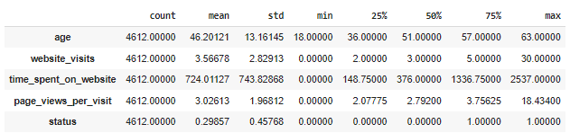
Data Overview
There are no duplicates in the data
Statistical summary provided by df.describe()

Slide 7
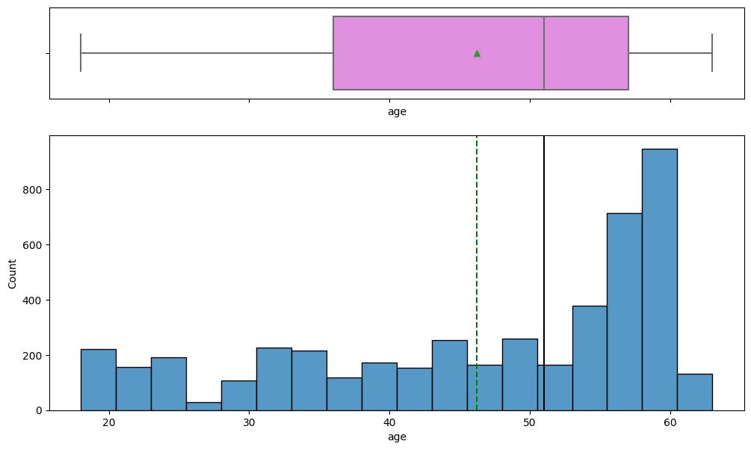
EDA Results
Age
Age is left left-skewed but almost looks uniformly distributed within the Q1-Q2 range.
The Age of most leads is between 36 and 57.

Slide 8
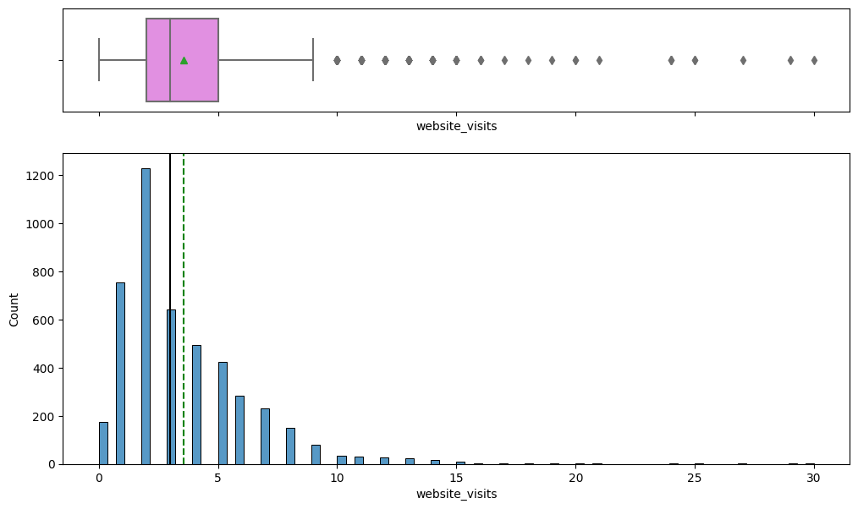
EDA Results
Website Visits
The distribution for the website visits is right-skewed.
The range of website visits are mostly between 2 – 5.
There are several observations that can be considered as outliers as they are spread outside of the whiskers of the box plot.
174 leads have not visited the web-site

Slide 9
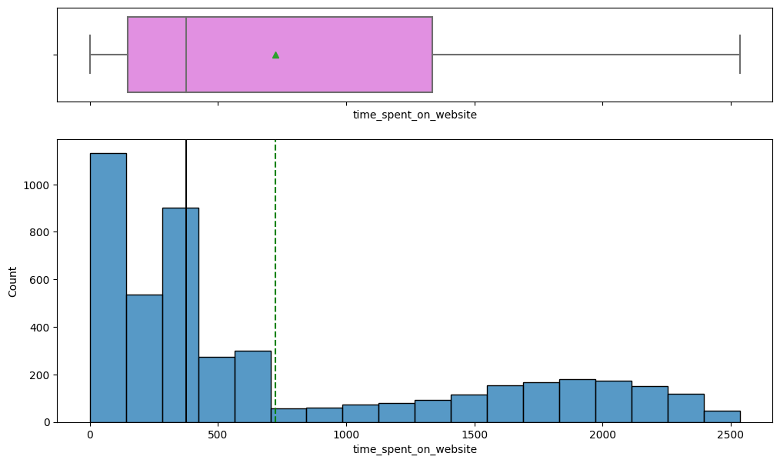
EDA Results
Time spent on Website.
The distribution for the time spent on the website is right-skewed.
The time spent on the website is mostly between 149 and 1337.

Slide 10
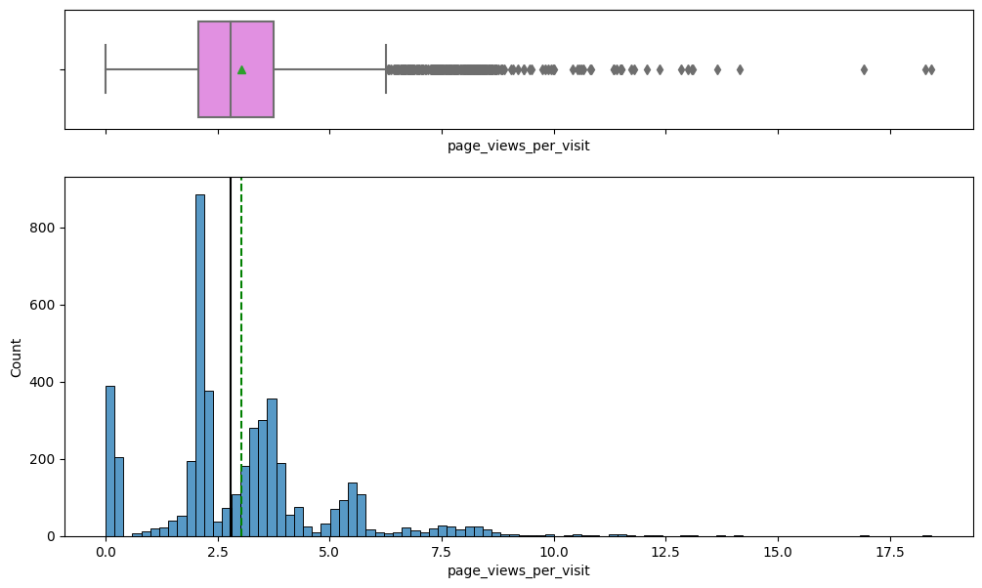
EDA Results
Page views per visit
Pages viewed per visit is mostly between 2 and 4.
The distribution for the time spent on the website appears right-skewed. There are a few visits with a very high number of page views which are seen as outliers.

Slide 11
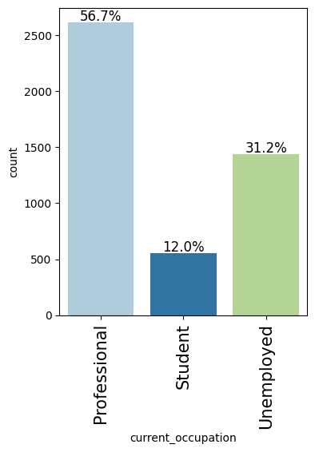
EDA Results
Observations about current occupation
56.7 % of leads are currently occupied as Professionals.
12.0 % of leads are Students
31.2 % of leads are Unemployed

Slide 12
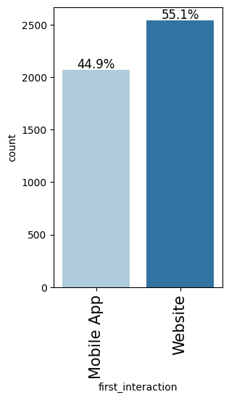
EDA Results
Observations about number of first_interaction
44.9 % of leads first interactions with Extra Learn were on a Mobile App
55.1% of leads first interactions with Extra Learn were on a Website

Slide 13
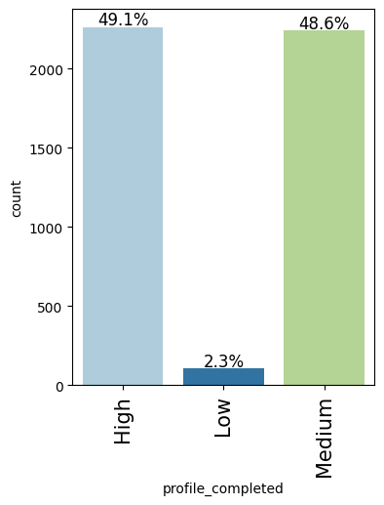
EDA Results
Observations about profile completed
49.1 percentage of leads filled out High (75-100%) of the profile on the website/mobile app.
2.3 percentage of leads filled out Low - (0-50%), of the profile on the website/mobile app.
48.6 percentage of leads filled out Medium - (50-75%) of the profile on the website/mobile app.

Slide 14
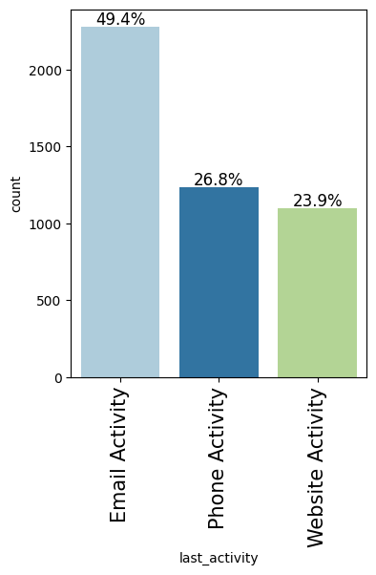
EDA Results
Observations on last_activity
49.4% of last interactions between the lead and ExtraaLearn were through email activity.
26.8% of last interactions between the lead and Extra Learn were through phone activity.
23.9% of last interactions between the lead and Extra Learn were through website activity.

Slide 15
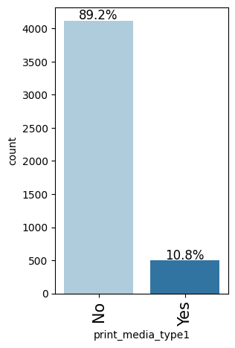
EDA Results
Observations on print media type1
10.8% of leads had seen the ad of Extra Learn in the Newspaper

Slide 16
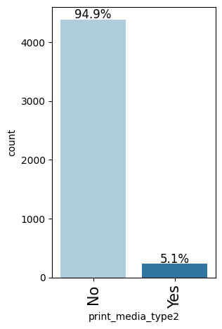
EDA Results
Observations on print media type 2
5.1% of leads had seen the ad of Extra Learn in the Magazine

Slide 17
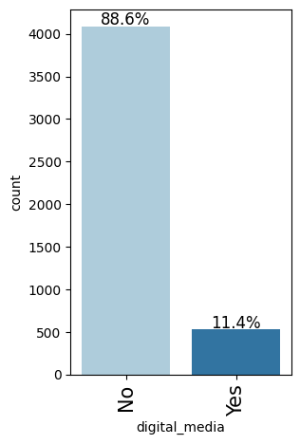
EDA Results
Observations about digital media
11.4% of leads had seen the ad of Extra Learn on the digital platforms.

Slide 18
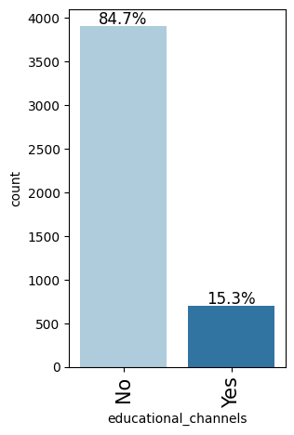
EDA Results
Observations on educational channels
15.3% of leads had heard about Extra Learn in the education channels like online forums, discussion threads, educational websites, etc.

Slide 19
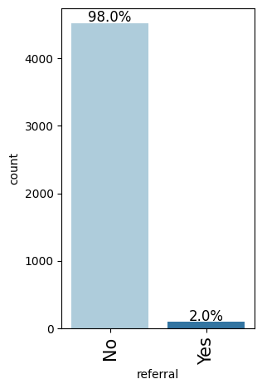
EDA Results
Observations on referral
2% of leads had heard about Extra Learn through reference.

Slide 20
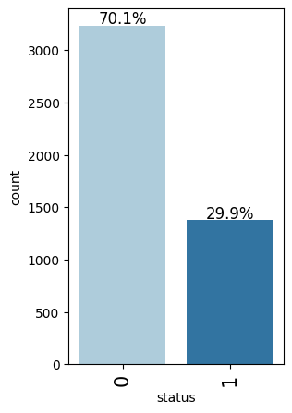
EDA Results
Observations on status
29.9% of leads converted to a paid customer.

Slide 21
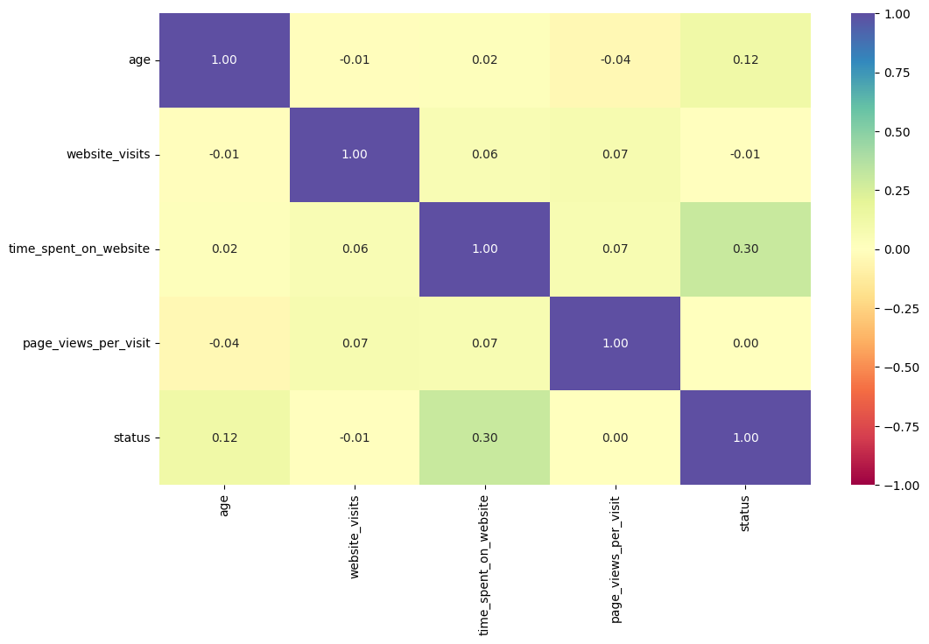
EDA Results
Bivariate Analysis as per the heatmap correlation:
Time spent on the website and status have a positive correlation, which makes sense given as someone reads and spends time contemplating/working for it they will convert to a paid customer.
There is a weak positive correlation between status and age.
No other variables have a high correlation among them.

Slide 22
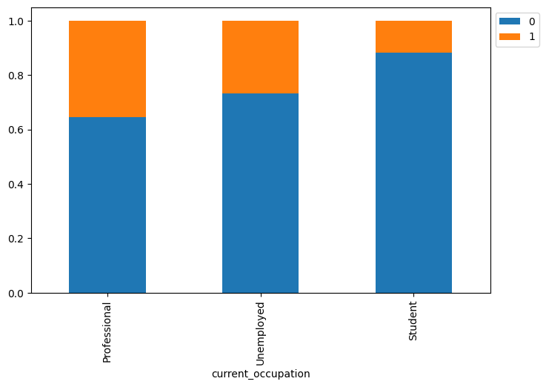
EDA Results
The current occupation may play a key role for them to convert to a customer. The conversion rate is higher for professionals, unemployed and lowest for students. The company can leverage this information and target this customer base and modify packages for these.

Slide 23

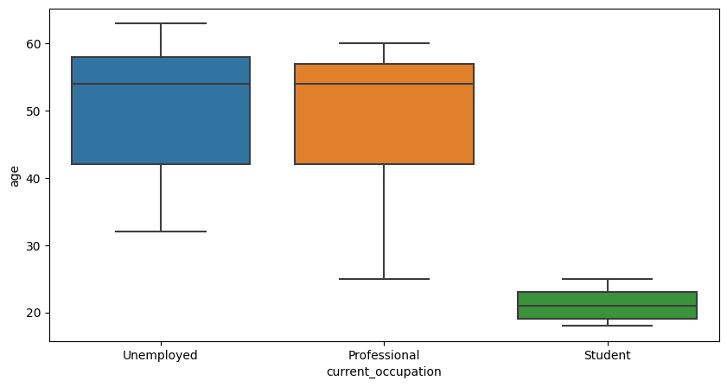
EDA Results
The age of professionals are more likely to be between 42 and 57 to help us differentiate between our leads. Unemployed between 42 and 58 and students between 19-23.

Slide 24
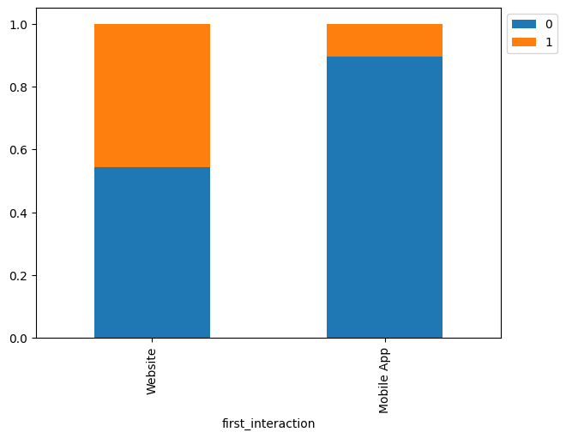
EDA Results
The channels of the first interaction have an impact on the conversion of leads on a website more then on a mobile app.

Slide 25
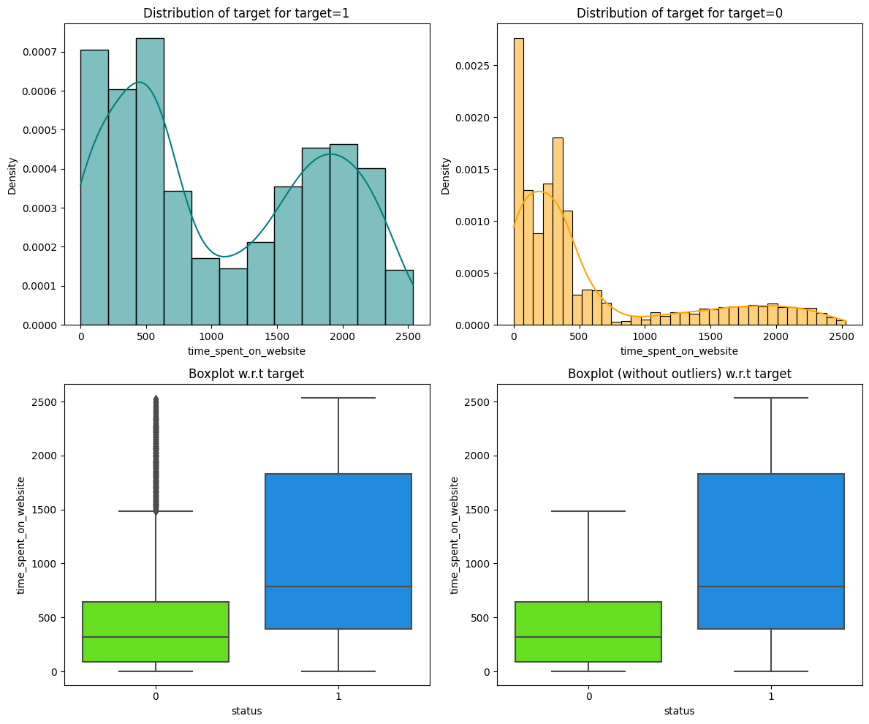
EDA Results
Time spent on website for status of 0 the distribution is skewed on the right. And for a status of 1 is more symmetric with lighter tails.
Again, time spent on website is a higher for folks who converted to a paid customer at a median of 789 seconds.

Slide 26
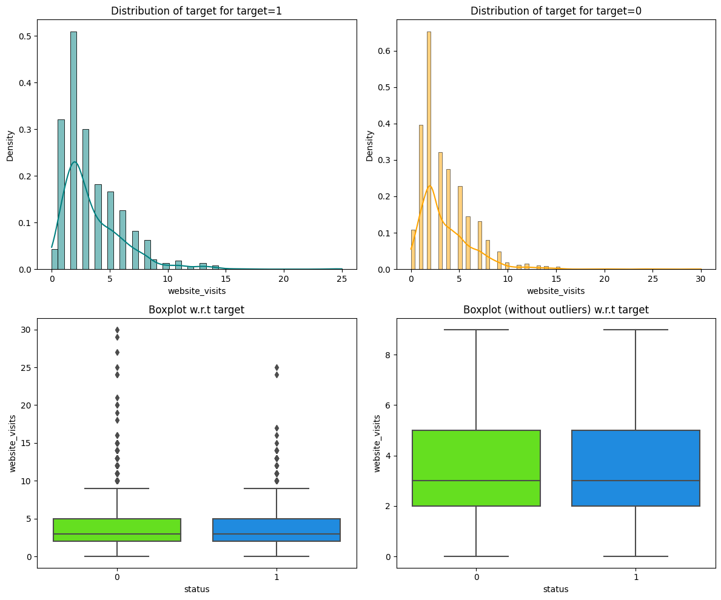
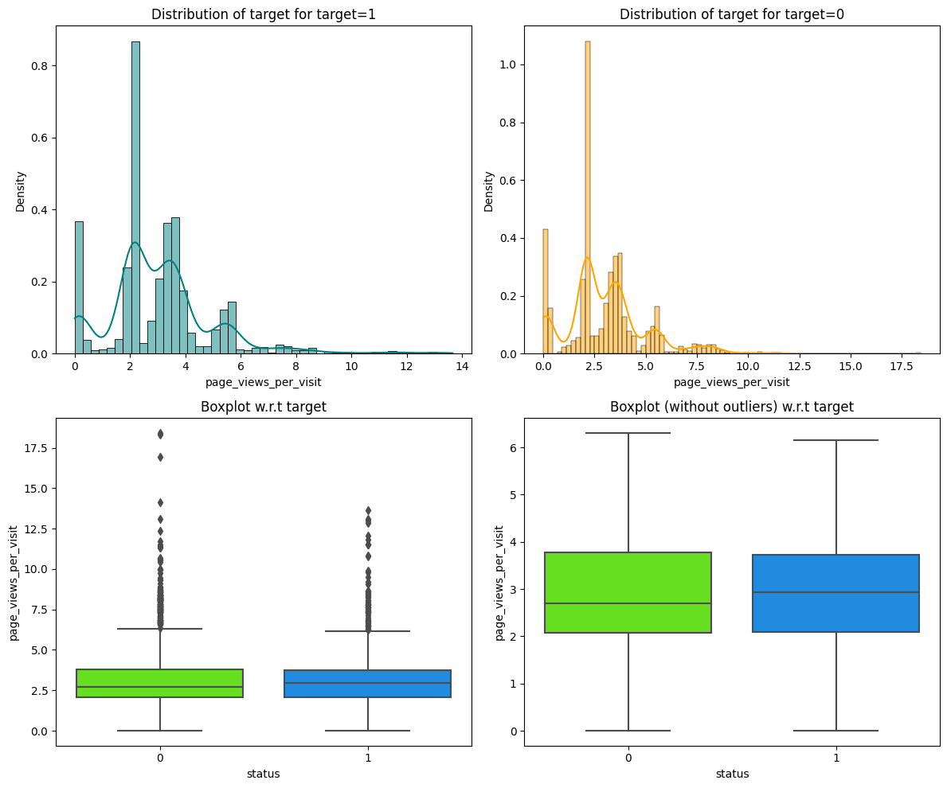
EDA Results
Website visits Both 0 and 1 and skewed to the right and similarly distributed with a similar IQR.
There were no notable differences regarding page views per visiting.

Slide 27
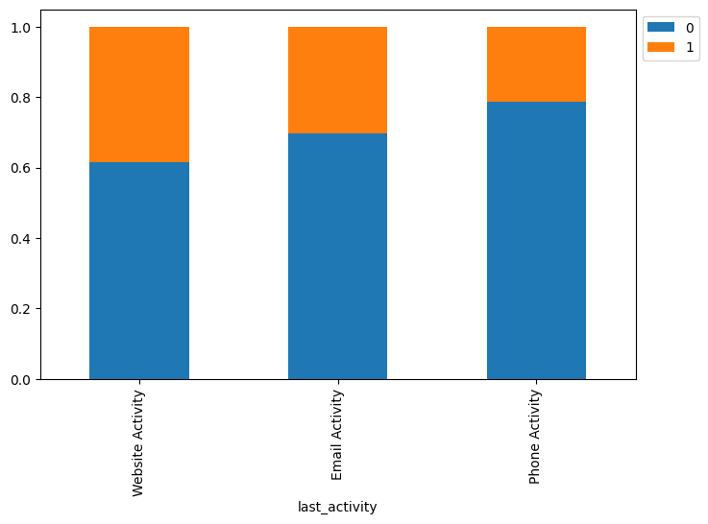
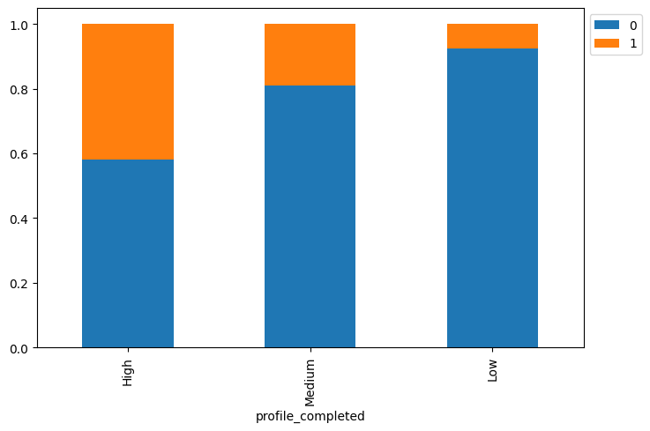
EDA Results
A higher percentage of leads that convert also have a higher percentage of their profile filled. (75-100%) After a lead shares their information by creating a profile, website activity and email activity are more likely to happen then phone activity to proceed with the process of enrollment.

Slide 28
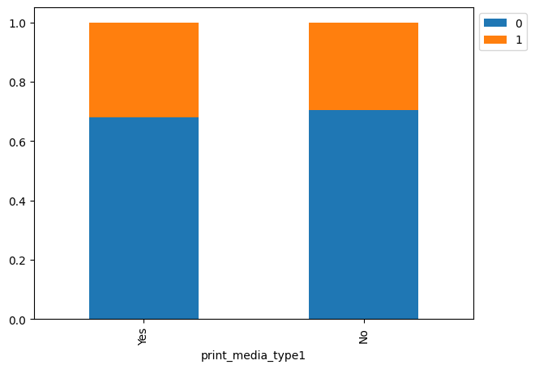


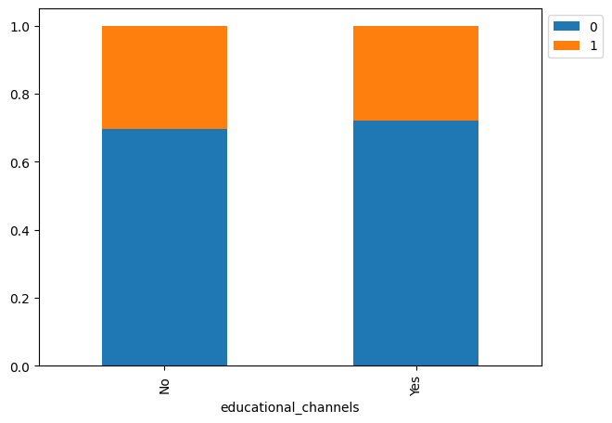
EDA Results
There isn’t a noticeable difference of conversion for print media type 1 (ad in the newspaper) or print media type 2 (ad in the Magazine) or digital media or educational channels.

Slide 29
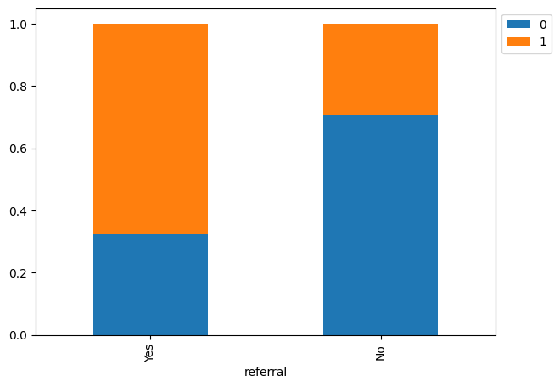
EDA Results
Of the leads that were referred, they had a notably higher rate of conversion.

Slide 30
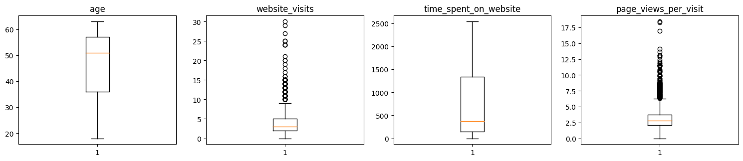
EDA Results
Age and time_spent_on_website have no outliers. Website_visits and page_views_per_visit have a noticeable amount of outliers.

Slide 31
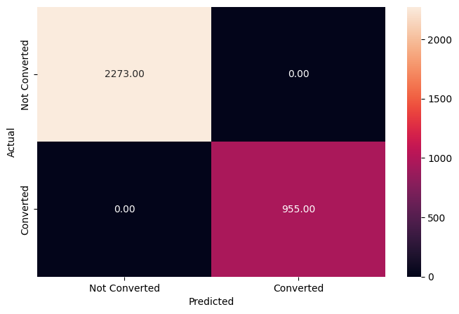
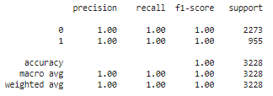
Model Building
As per the Decision Tree Classifier
Almost 0 errors on the training set, each sample has been classified correctly. Model has performed very well on the training set. As we know a decision tree will continue to grow and classify each data point correctly if no restrictions are applied as the trees will learn all the patterns in the training set.

Slide 32
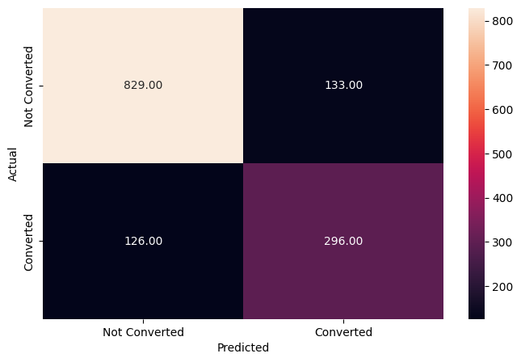
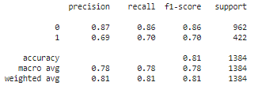
Model Building
The decision tree model is clearly overfitting. And didn't perform as well as the training. We will have to tune the decision tree to reduce the overfitting.

Slide 33
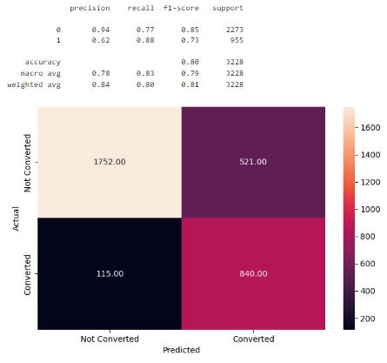
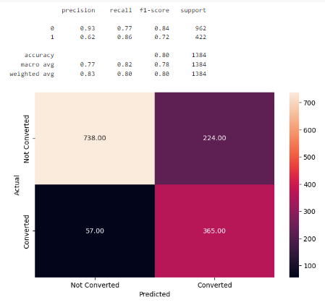
Model Building
Once we tune the hyperparameter using GridSearchCV.
The Decision tree model with default parameters is overfitting the training data. The recall is 0.88.
The recall is 0.86. On the test data and isn't much different then the training data.

Slide 34
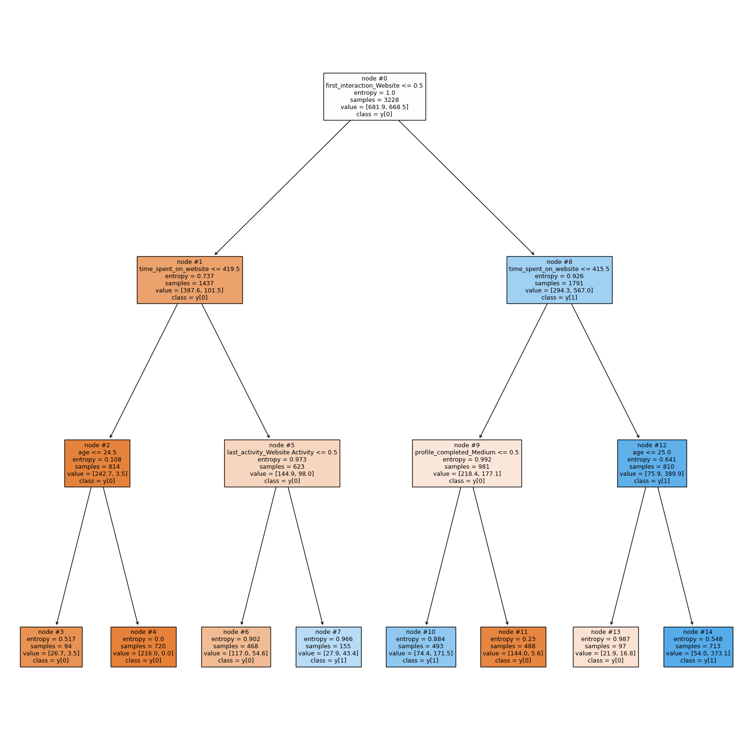
Model Building
Note: Blue leaves represent the converted leads, i.e., y[1], while the orange leaves represent the not converted leads, i.e., y[0]. Also, the more the number of observations in a leaf, the darker its color gets.
*Observations: We can see with more certainty that leads younger than 24.5 who spend less then 420 seconds on our website won't convert given that the entropy (measure of uncertainty is low 0.108). The other features have high entropy so there is no information gain there. *

Slide 35
Model Building
Once we tune the hyperparameter using GridSearchCV.
The Decision tree model with default parameters is overfitting the training data. The recall is 0.88.
The recall is 0.86. On the test data and isn't much different then the training data.

Slide 36
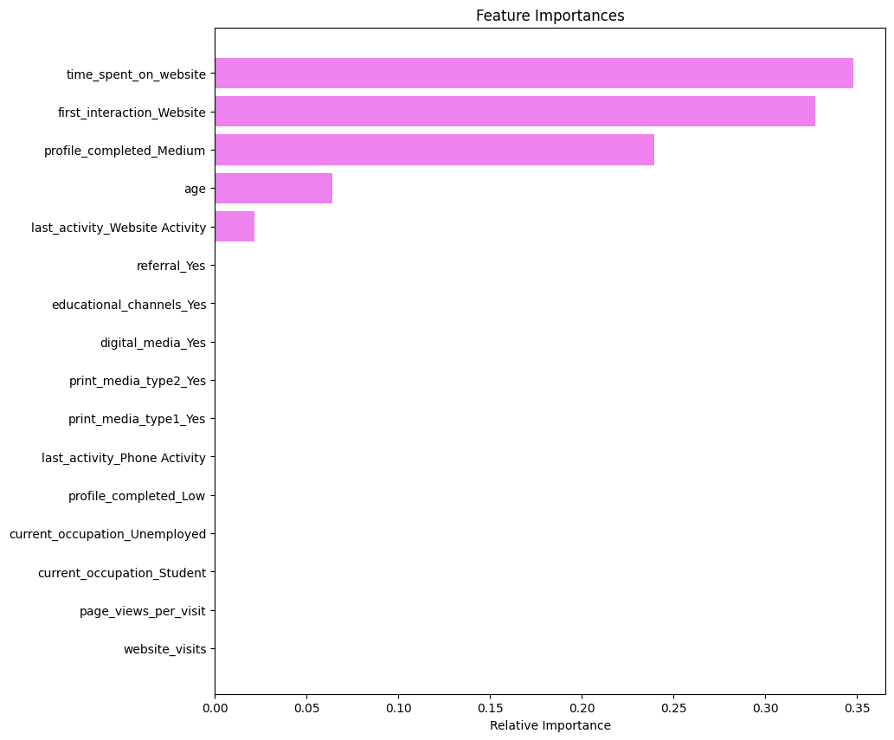
Feature Importance
The Feature Importance of Tuned Decision Tree:
Time spent on the website and first_interaction_website are the most important features followed by profile_completed, age, and last_activity.
The rest of the variables have no impact in this model, while deciding whether a lead will be converted or not.

Slide 37
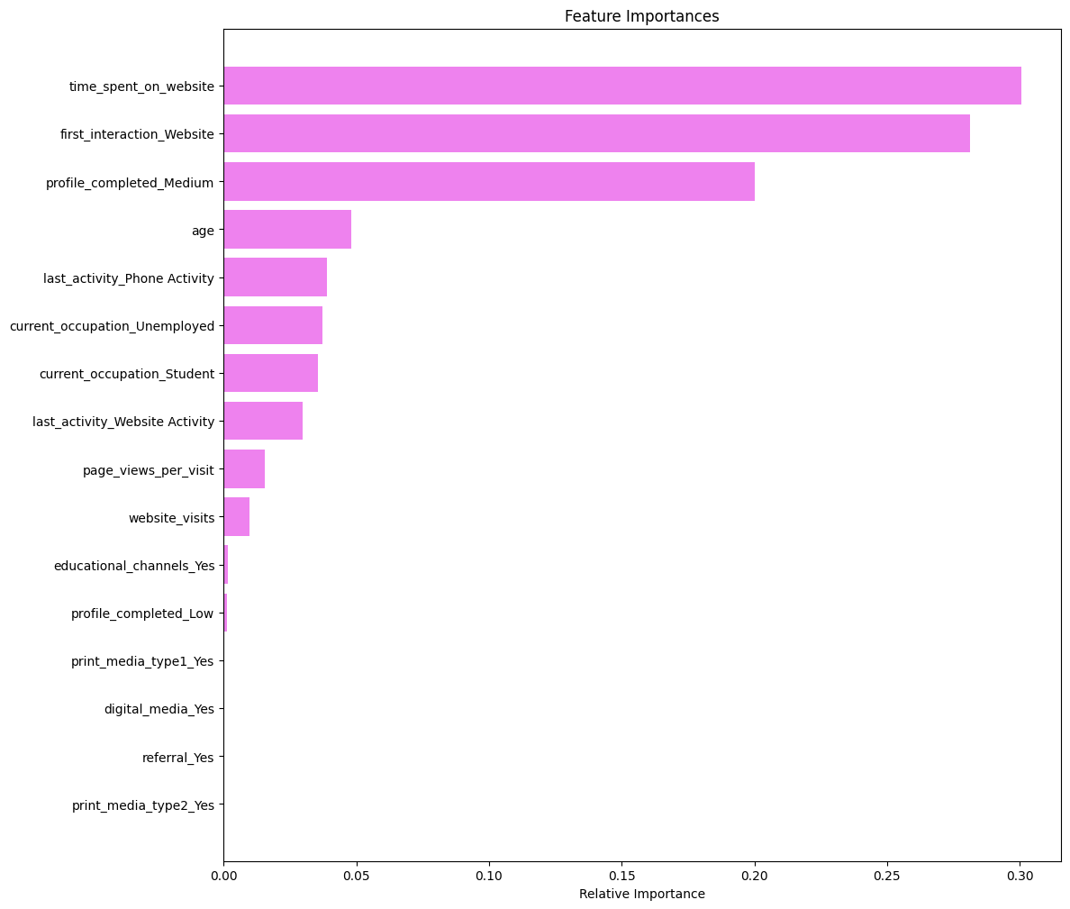
Feature Importance
The Feature Importance of Tuned Random Forest
Similar to the decision tree model, time spent on website, first_interaction_website, profile_completed, and age are the top four features that help distinguish between not converted and converted leads.
Unlike the decision tree, the random forest gives some importance to other variables like occupation, page_views_per_visit, as well. This implies that the random forest is giving importance to more factors in comparison to the decision tree.

Slide 38
Model Performance Summary
Create a table to show the performance for all the models and provide insights on the same.
Model | Decision Tree Classifier |  | Decision Tree Classifier with class_weight hyperparameter | with the value equal to {0: 0.3, 1: 0.7} opposite of the imbalance in the original data. | Random Forest Model |  | Random Forest Classifier with Hyperparameter Tuning
 | Training data | Test data | Training data | Test data | Training data | Test data | Training data | Test data
Precision | 1 | 0.69 | 0.62 | 0.62 | 1 | 0.78 | 0.68 | 0.68
Recall | 1 | 0.70 | 0.88 | 0.86 | 1 | 0.68 | 0.87 | 0.85
F1-score | 1 | 0.70 | 0.73 | 0.72 | 1 | 0.73 | 0.76 | 0.76

Slide 39
Model Performance Summary
Conclusions:
The Decision Tree Classifier and Random Forest Classifier with keel Hyperparameter Tuning has performed a little better than the other models but not with balanced metrics.
We have been able to build a predictive model that can be used by the tourist company to predict the customers who are likely to accept the new package with the recall score of 0.85 formulate marketing policies accordingly.

Slide 40
Model Performance Summary
Business Recommendations:
Our analysis shows that leads that have referrals are more likely to convert to a paid customer. After we identify a potential customer, the company should pitch more referral prompts and options to attract more such customers.
We have Professional and Unemployed customers but few students. The company should expand its marketing strategies to increase the number of customers from younger student populations.
We saw in our analysis leads are more likely to convert through websites then mobile apps. The company should expand their advertisement to more mobile apps to reach a wider audience.
Most leads were between the ages of 36 and 57. The company can offer discounts or customize the advertisements to attract students, and leads under the age of 36 and above 57 years of age.

Slide 41
APPENDIX

Slide 42
Slide Header
Please add any other pointers or screenshots (if needed)

