Slide 1
FoodHub Data Analysis
Foundations for Data Science Statistics and Data Science Course
2023-11-02 Author: Monique Boudreau

Slide 2
Contents / Agenda
Executive Summary
Business Problem Overview and Solution Approach
Data Overview
EDA - Univariate Analysis
EDA - Multivariate Analysis
Appendix

Slide 3
Executive Summary
Conclusions for cuisine type:
Given our count plot for cuisine type, we can see that the majority of orders were American, Japanese, Italian and Chinese cuisine. All other cuisines had less than 100 orders.
Given further analysis we can determine the most popular cuisine ordered on weekends is American.
The "Cuisine vs Cost of the order" box plot shows how cost of the order varies per cuisine type. We can see that the median cost of French cuisine is the highest. While Korean and Vietnamese are the lowest.
As per the "Cuisine vs Food Preparation time" box plot we can see that the median food prep time is the highest for Italian and Thai food. While Korean and Vietnamese are the quickest to prepare.

Slide 4
Executive Summary
Conclusions for customer ratings:
Out of the ratings that were given the highest rating of 5 was given the most overall, the results were positive.
The “Rating vs Delivery” time point plot shows how ratings are impacted by the span of delivery times of the order. Of the orders which we received ratings for, the lowest rating (3) is given longer delivery times.
The “Rating vs Food preparation time” point plot shows how ratings are impacted by the span of food preparation times of the order. The lowest rating (3) is given to highest preparation time and spans to the lowest range of time as well.
Note: of the top 4 restaurants that received the most ratings, the meatball shop has the highest mean rating of 4.5.

Slide 5
Executive Summary
Recommendations:
To enhance customer experience and shorten delivery times it could be beneficial to place more drivers closer to the most popular cuisines.
Given the popularity of the meatball shop, as a promotion, offer a discount at the meatball shop for new customers and for holidays to increase the customer base.
The current business model allows the delivery driver to deliver one order at a time. In order to decrease delivery times, it may be beneficial to have the app calculate weather or not the delivery time can be reduced by delivering more than one order at a time especially for our high demand American cuisines.

Slide 6
Business Problem Overview and Solution Approach
The number of restaurants are increasing day by day and Food Hub would like to enhance their customer experience and improve the business.
Our approach to aid Foodhub is by analyzing their food order delivery data from their app and providing a Data Scientist view.

Slide 7
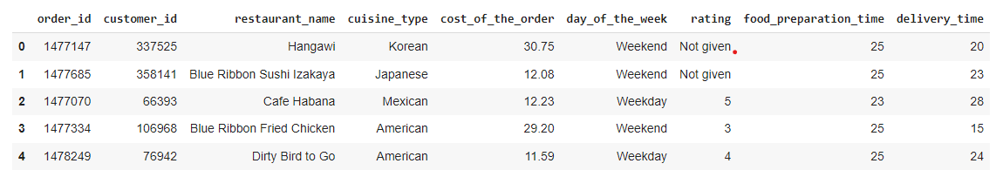
Data Overview
Data has been provided by the food aggregator company
The source of data is from the Food Hub app
The data contains online order and delivery information
Sample data:

Slide 8
Data Overview
There are 9 columns and 1898 rows (order entries)
The following Data Types are present for each attribute:
0 order_id int64
1 customer_id int64
2 restaurant_name object
3 cuisine_type object
4 cost_of_the_order float64
5 day_of_the_week object
6 rating object
7 food_preparation_time int64
8 delivery_time int64

Slide 9
Data Overview
There are no null values in the data
However there are 736 of the 1898 orders that have not given a rating.

Slide 10
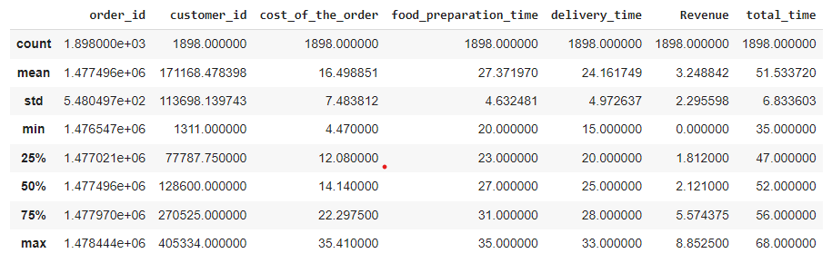
Data Overview
Statistical summary provided by df.describe()

Slide 11
Univariate Analysis
As per reviewing the stored data from Foodhub we can determine:
All orders have a unique id (there are no duplicates) a total of 1898
There are 1200 customers
178 Restaurants
And 14 Cuisine Types

Slide 12
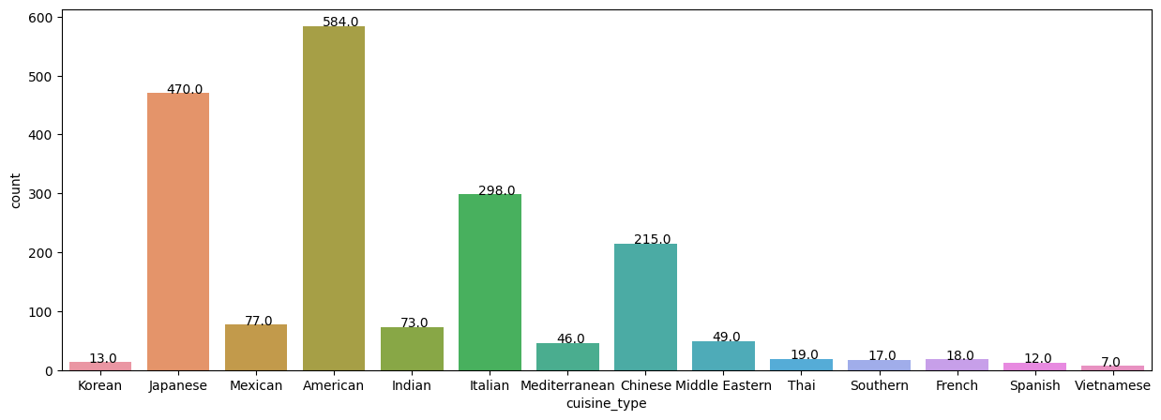
Univariate Analysis
The cuisine that was order the most is American
The cuisine that was ordered the least is Vietnamese
Most ordered to least ordered American 584
Japanese 470 Italian 298 Chinese 215 Mexican 77 Indian 73 Middle Eastern 49
Mediterranean 46 Thai 19 French 18 Southern 17 Korean 13 Spanish 12 Vietnamese 7

Slide 13
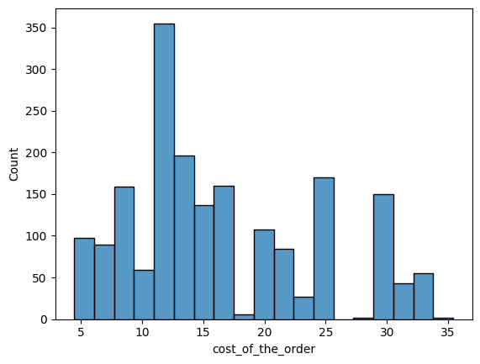
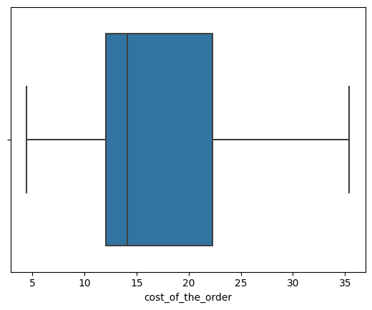
Univariate Analysis
We have discovered the cost of the orders:
Are roughly mostly 12 dollars.
And 25% - 75% are within the IQR range of 12 to 22 dollars.

Slide 14
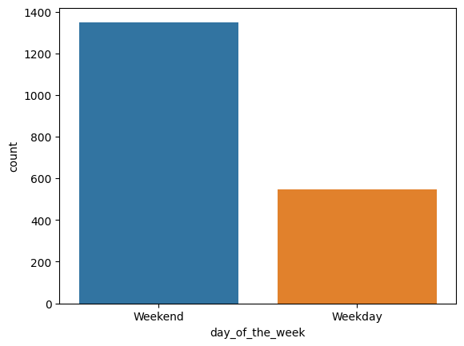
Univariate Analysis
Most Orders are placed on the weekends.

Slide 15
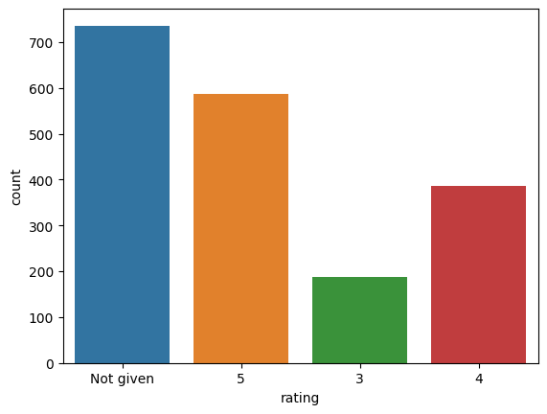
Univariate Analysis
Out of the ratings that were given the highest rating of 5 was given the most, overall the results were positive.

Slide 16
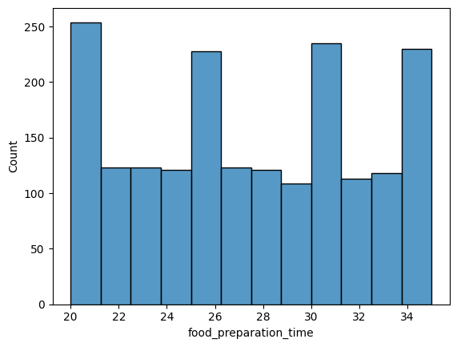
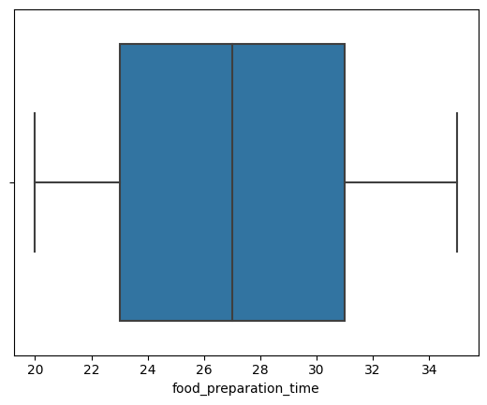
Univariate Analysis
We have discovered the food preparation times:
Are on average 27.
Have a uniform distribution
And 25% - 75% are within the IQR range of 23 to 31 minutes.

Slide 17
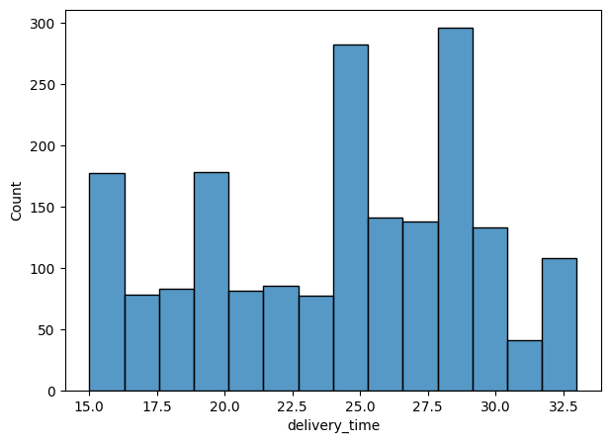
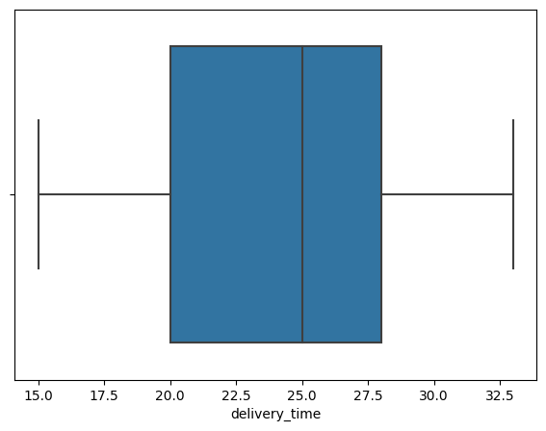
Univariate Analysis
We have discovered the delivery times:
Are roughly mostly 25 and 28 minutes.
And 25% - 75% are within the IQR range of 20 to 28 minutes.

Slide 18
Univariate Analysis
The top 5 restaurants with the most orders are:
Shake Shack 219
The Meatball Shop 132
Blue Ribbon Sushi 119
Blue Ribbon Fried Chicken 96
Parm 68
The most popular cuisine on the weekend is American (315 Orders out of 1898)
The percentage of orders above 20 dollars: 29.24 %
The mean delivery time of orders is 24.16 minutes
A 20% discount voucher should go to the top 3 most frequent customers. Their IDs and # of orders:
52832 13
47440 10
83287 9

Slide 19
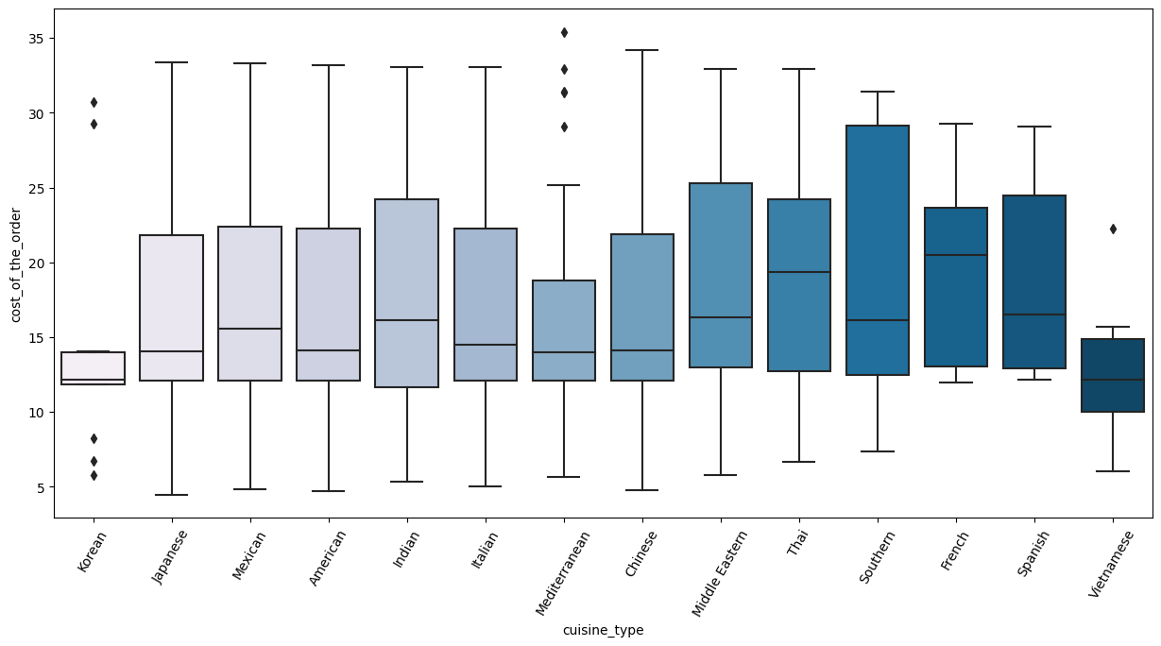
Multivariate Analysis
The "Cuisine vs Cost of the order" box plot shows how cost of the order varies per cuisine type. We can see that the median cost of French cuisine is the highest. While Korean and Vietnamese are the lowest.

Slide 20
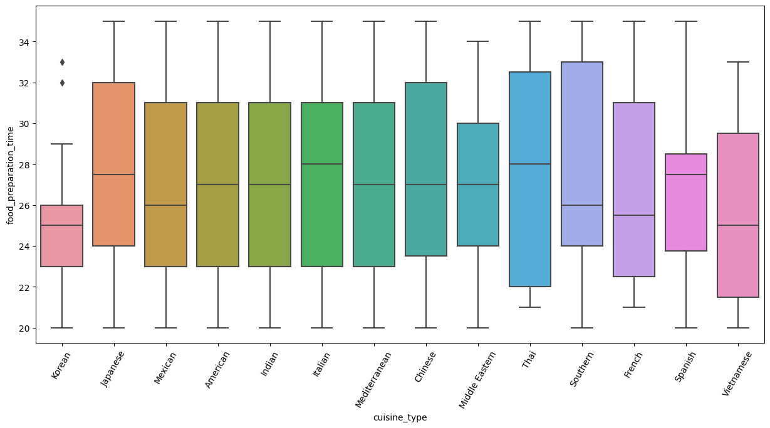
Multivariate Analysis
As per the "Cuisine vs Food Preparation time" box plot we can see that the median food prep time is the highest for Italian and Thai food. While Korean and Vietnamese are the quickest to prepare.

Slide 21
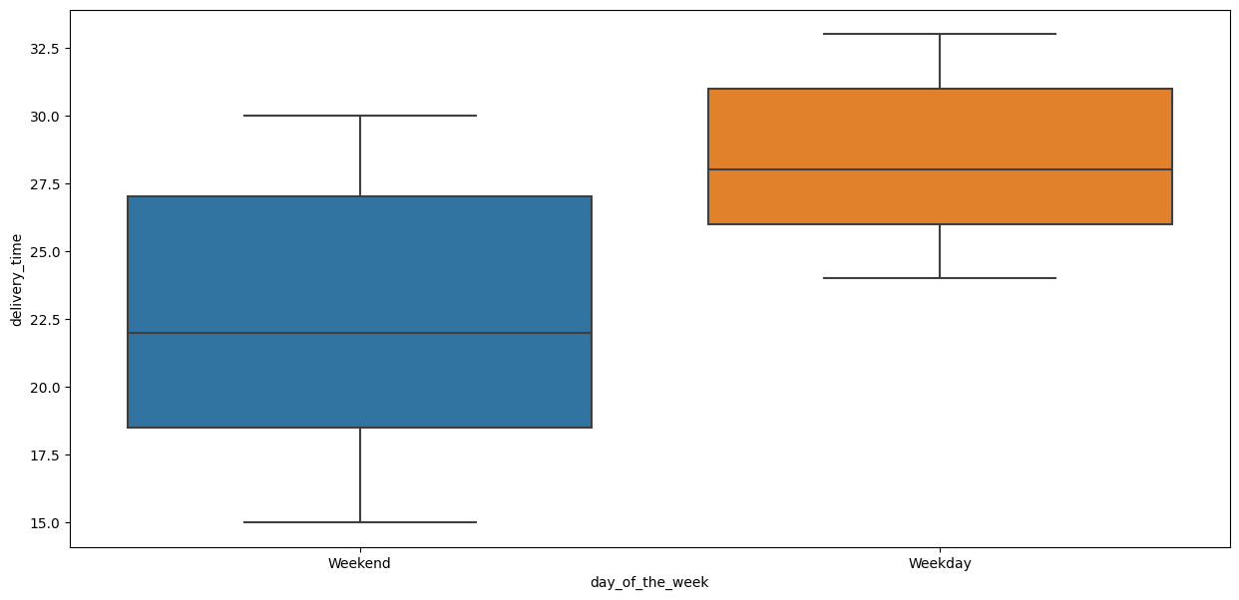
Multivariate Analysis
The "Day of the Week vs Delivery time" shows a symmetric distribution for both weekend and weekday orders
We can see the median value of week day delivery times are longer than weekend delivery times.

Slide 22
Multivariate Analysis
Of the 178 restaurants Shake Shack has the highest Revenue of 3579.53.
The mean revenue per restaurant is 175.93.
This implies Shake Shack has earned 20.35 times more revenue than the average revenue per restaurant.
Highest revenue restaurants Shake Shack 3579.53 The Meatball Shop 2145.21 Blue Ribbon Sushi 1903.95 Blue Ribbon Fried Chicken 1662.29 Parm 1112.76 RedFarm Broadway 965.13 RedFarm Hudson 921.21 TAO 834.50 Han Dynasty 755.29 Blue Ribbon Sushi Bar & Grill 666.62 Rubirosa 660.45 Sushi of Gari 46 640.87 Nobu Next Door 623.67 Five Guys Burgers and Fries 506.47

Slide 23
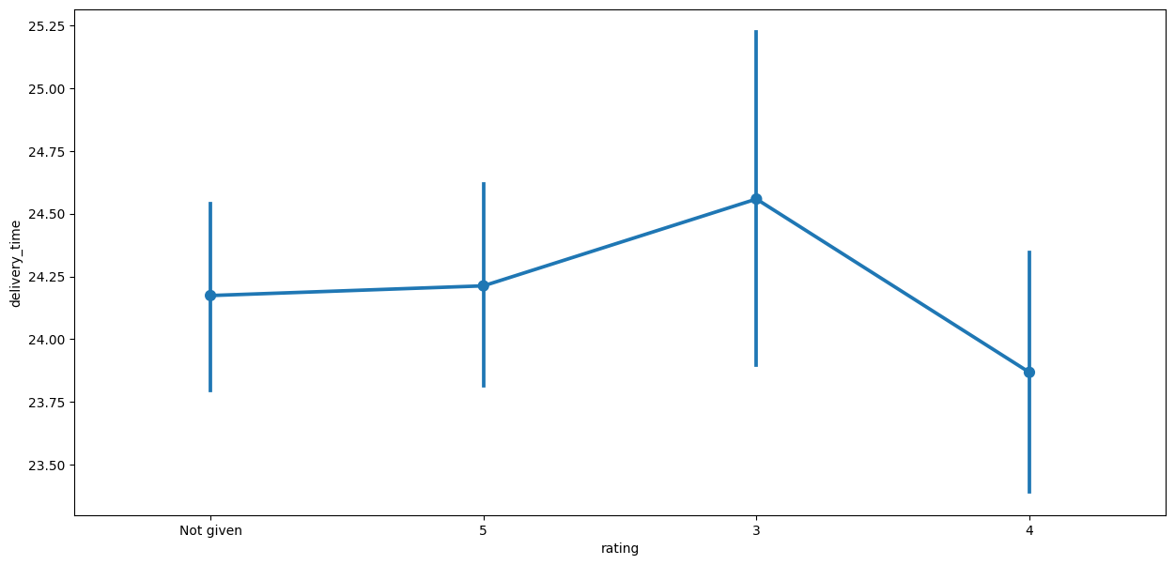
Multivariate Analysis
The “Rating vs Delivery time” point plot shows how ratings are impacted by the span of delivery times of the order. Of the orders which we received ratings for, the lowest rating (3) is given longer delivery times.

Slide 24
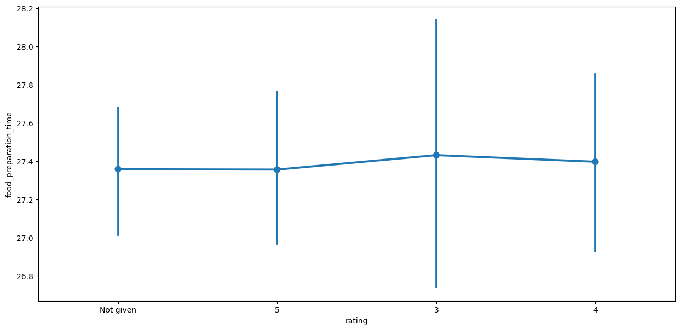
Multivariate Analysis
The “Rating vs Food preparation time” point plot shows how ratings are impacted by the span of food preparation times of the order. The lowest rating (3) is given to highest preparation time and spans through to the lowest range of time as well.

Slide 25
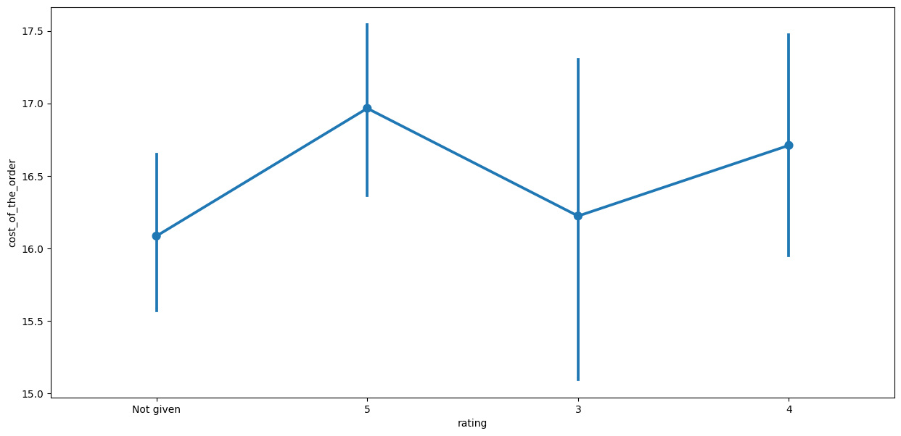
Multivariate Analysis
The “Rating vs Cost of the Order” point plot shows how ratings are impacted by the range of cost of the order. Given the plot we can see the lowest rating (3) spans over the lowest cost of orders. The highest rating (5) spans over the highest cost of orders.

Slide 26
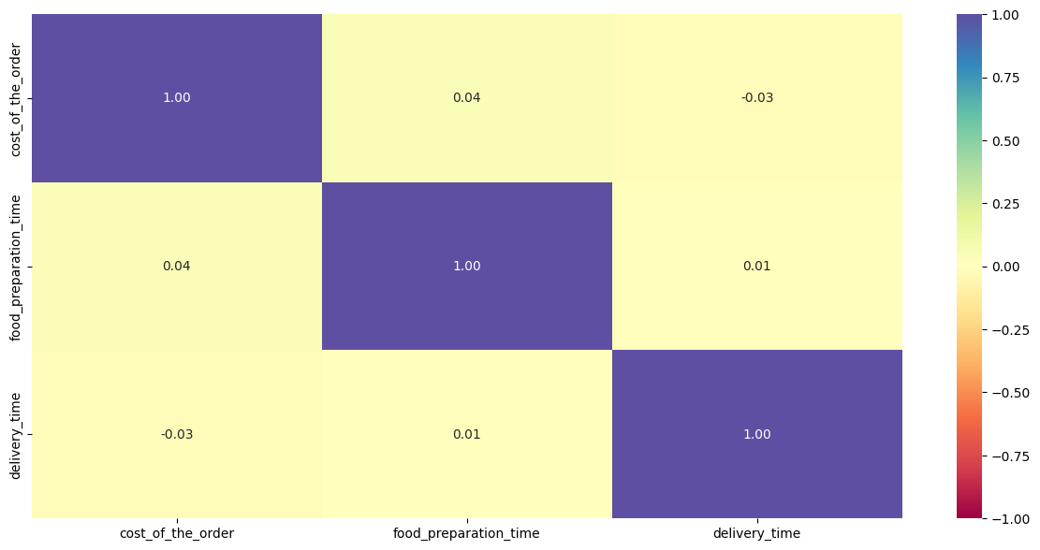
Multivariate Analysis
This heatmap shows the correlation coefficient between three variables:
cost of the order
food preparation time
delivery time
The plot shows cost of order is negatively correlated mildy with delivery time.
Food preparation time is positively correlated ,mildly with cost of the order.

Slide 27
Multivariate Analysis
A promotional offer advertised by the restaurants should be notified to customers visiting the sites of the restaurants that have more than 50 ratings.
These restaurants and amount of ratings are:
Shake Shack 1331 … Mean rating of 4.38
The Meatball Shop 842 … Mean rating of 4.51
Blue Ribbon Sushi 733 … Mean rating of 4.22
Blue Ribbon Fried Chicken 644 … Mean rating of 4.33
RedFarm Broadway

Slide 28
Multivariate Analysis
The company charges the restaurant 25% on the orders having cost greater than 20 dollars and 15% on the orders having cost greater than 5 dollars
The total net revenue is $6,166
Please add answers for all question from 12 till 16

Slide 29
Multivariate Analysis
Time required to deliver food:
10.54% of orders have more than 60 minutes of total delivery time
The mean delivery time on weekdays is around 28 minutes
The mean delivery time on weekends is around 22 minutes

Slide 30
APPENDIX

Slide 31
Slide Header
Please add any other pointers (if needed)

