Slide 1
Amazon Product Recommendation System
Course Recommendation Systems
Date: January 27th 2024

Slide 2
Contents / Agenda
Business Problem and Data Overview
Exploratory Data Analysis
Rank Based Model
User-User Similarity-based Model
Item-Item Similarity-based Model
Matrix Factorization based Model
Conclusion and Recommendations

Slide 3
Business Problem
Task to building a recommendation system to recommend products to customers based on their previous ratings for other products.
We have a collection of labeled data of Amazon reviews of products.
The goal is to extract meaningful insights from the data and build a recommendation system that helps in recommending products to online consumers.

Slide 4
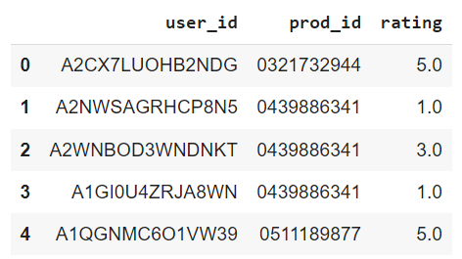
Data Overview
The Amazon dataset contains the following attributes:
userId: Every user identified with a unique id
productId: Every product identified with a unique id
Rating: The rating of the corresponding product by the corresponding user
timestamp: Time of the rating. We will not use this column to solve the current problem
Sample data.

Slide 5
Data Overview
As this dataset is very large and has 7,824,482 observations, it is not computationally possible to build a model using this. Moreover, many users have only rated a few products and also some products are rated by very few users. Hence, we can reduce the dataset by considering certain logical assumptions.
The rating electronics data originally contains 7824481 observations and 3 columns.
Here, we will be taking users who have given at least 50 ratings:
The rating electronics data will then be reduced to 125871 observations and 3 columns.
And will take the products that have at least 5 ratings, as when we shop online we prefer to have some number of ratings of a product.
The rating electronics data has then been reduced to 65290 observations and 3 columns.

Slide 6
Exploratory Data Analysis
The rating electronics data contains 65290 observations and 3 columns.
The 'rating' column is of a float64 numeric data type. The 'prod id' and 'user id' have the data type object.
There are no NA or Null values for any of the columns.
There is also no value of zero string length.

Slide 7

Exploratory Data Analysis
Summary statistics of 'rating' variable and provide observations
The average rating is 4.3
Rating range from 1 to 5
Most of the ratings lie between 4 and 5. (25% - 75%, IQR)

Slide 8
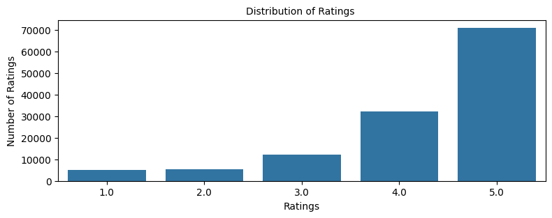
Exploratory Data Analysis
As per the bar plot, the rating 5 has the highest count of ratings (~36K) and accounts for the majority of the ratings. There are no missing values or zero values.
Following this, Rating '4' and '3' with ~18 and ~6K observations, respectively.

Slide 9
Exploratory Data Analysis
There are 1540 users in the dataset.
There are 5689 products in the dataset.
As per the number of unique users and products, there is a possibility of 1540 * 5689 = 8,761,060 ratings in the dataset.
We have 5 ratings, every user has rated every product in the dataset.
The user with user_id: ADLVFFE4VBT8 has interacted with the most number of products, i.e., 295. But still, there is a possibility of 5689-295 = 5,394 more interactions as we have 5689 unique products in the dataset.

Slide 10
Rank Based Model
The approach we took to build the Rank-based Model was:
By calculating the average rating per product
Calculating the count of rating per product
Created a dataframe with calculated average and count of ratings
We then sorted by average of ratings in the descending order
Then we took a look at the first five records of the rating dataset
We then defined a function to get the top n products based on the highest average rating and minimum interactions

Slide 11
Rank Based Model
Observations about the recommendations made using Rank-based Model.
Top 5 products with 50 minimum interactions based on popularity 'B002E6R7NG', 'B004I763AW', 'B003J9QQWU', 'B0043ZLFXE', 'B000TMFYBO'
Top 5 products with 100 minimum interactions based on popularity 'B00GMRCAC6', 'B008I6RVZU', 'B00CG70K78', 'B000053HC5', 'B008VGCT9K'

Slide 12
User-User Similarity-based Model
Observations about the model performance for the model with default parameters
We have calculated RMSE to check how far the overall predicted ratings are from the ratings.
Intuition of Recall - We are getting a recall of 0.70, which means out of all the relevant products, 70% are recommended.
Intuition of Precision - We are getting a precision of almost 0.867, which means out of all the recommended products, 86.7% are relevant.
Here F_1 score of the baseline model is almost 0.775. It indicates that most recommended products were relevant and relevant products were recommended. We will try to improve this later by using GridSearchCV by tuning different hyperparameters of this algorithm.
Observations post hyperparameter tuning. Compare the performance.
After tuning hyperparameters, RMSE for the test set has reduced from 1.03 to 0.97. We can observe that after tuning the hyperparameters, the tuned model's F-1 score stayed relatively the same reduced from 0.775 to 0.78 in comparison to the baseline model. As a result, we can say that the model's performance improved slightly after hyperparameter tuning.

Slide 13
User-User Similarity-based Model
We didn’t see any difference in the predictions of both models.
userId | productId | Already interacted with the product | Model with hyperparameters tuning | Predicted rating | Actual rating
A3LDPF5FMB782Z | 1400501466 | Yes | - | 4.29 | 5
A3LDPF5FMB782Z | 1400501466 | Yes | Yes | 4.29 | 5
A34BZM6S9L7QI4 | 1400501466 | No | - | 4.29 | -
A34BZM6S9L7QI4 | 1400501466 | No | Yes | 4.29 | -

Slide 14
Item-Item Similarity-based Model
Observations about the model performance for the model with default parameters:
The baseline model is giving a good F_1 0.761 (Greater than .70) score. We try to improve this by using GridSearchCV by tuning different hyperparameters of this algorithm.
Observations post hyperparameter tuning. Compare the performance.
We observe that after tuning hyperparameters, RMSE for the test set has reduced to 0.9748 from 1.0232. F_1 score of the tuned model is also slightly better than the baseline model to 0.762 from 0.761. So, the model performance has improved slightly after hyperparameter tuning.

Slide 15
Item-Item Similarity-based Model
We didn’t see any difference in the predictions of both models.
userId | productId | Interaction with the product | Model with hyperparameters tuning | Predicted rating | Actual rating
A3LDPF5FMB782Z | 1400501466 | Yes | - | 4.29 | 5
A3LDPF5FMB782Z | 1400501466 | Yes | Yes | 4.29 | 5
A34BZM6S9L7QI4 | 1400501466 | No | - | 4.29 | -
A34BZM6S9L7QI4 | 1400501466 | No | Yes | 4.29 | -

Slide 16
Matrix Factorization based Model
Observations about the model performance for the model with default parameters:
We observe that the baseline F_1 score for the matrix factorization model on the test set is slightly higher (0.781) in comparison to the F_1 score for the user-user similarity-based recommendation system (0.775) and the same in comparison to the optimized user-user similarity-based recommendation system (0.78).
The result for SVD is better than both baseline and optimized item-item similarity-based recommendation systems.
Observations post hyperparameter tuning. Compare the performance.
We observe that after tuning hyperparameters, the model performance has not improved by much. F_1 score is (0.783).

Slide 17
Matrix Factorization based Model
We saw a slight difference in the predictions of both models but they are generally similar in value.
userId | productId | Interaction with the product | Model with hyperparameters tuning | Predicted rating | Actual rating
A3LDPF5FMB782Z | 1400501466 | Yes | - | 4.24 | 5
A3LDPF5FMB782Z | 1400501466 | Yes | Yes | 4.25 | 5
A34BZM6S9L7QI4 | 1400501466 | No | - | 4.52 | -
A34BZM6S9L7QI4 | 1400501466 | No | Yes | 4.50 | -

Slide 18
Conclusion and Recommendations
In this case study, we built recommendation systems using four different algorithms. They are as follows: - Rank-based using averages - User-user similarity-based collaborative filtering - Item-item similarity-based collaborative filtering - Model-based (matrix factorization) collaborative filtering

Slide 19
Conclusion and Recommendations
To demonstrate user-user similarity-based collaborative filtering, item-item similarity-based collaborative filtering, and model-based (matrix factorization) collaborative filtering, surprise library has been used. For these algorithms, grid search cross-validation is used to find the optimal hyperparameters for the data, and improve the performance of the model.
For performance evaluation of these models, precision@k and recall@k are used. Using these two metrics, the F_1 score is calculated for each working model.
Overall, the The improved Matrix Factorization with tuned hyperparameters has given the best performance in terms of the F1-Score (~0.783)

Slide 20
Conclusion and Recommendations
Collaborative Filtering searches for neighbors based on similarity of products (example) preferences and recommend products that those neighbors rate while Matrix factorization works by decomposing the user-item matrix into the product of two lower dimensionality rectangular matrices.
Matrix Factorization has the lowest RMSE (0.8950) due to the reason that it assumes that both products and users are present in some low dimensional space describing their properties and recommend a product based on its proximity to the user in the latent space. Implying it accounts for latent factors as well.

Slide 21
Conclusion and Recommendations
We can try to further improve the performance of these models using hyperparameter tuning.
We can also try to combine different recommendation techniques to build a more complex model like hybrid recommendation systems.

Slide 22
APPENDIX

Slide 23
Slide Header
Please add any other pointers or screenshots (if needed)

