Slide 1

ffl
Field force tracking

Slide 2

FFL
Field force tracking

Slide 3
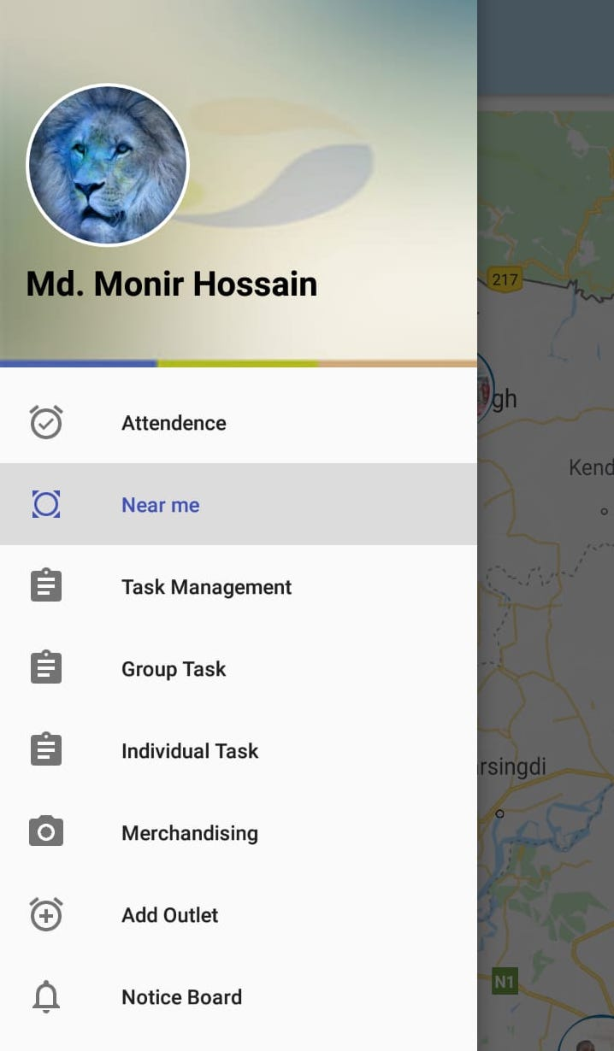
Features
Attendance
Merchandising
Add outlets
Near me search
Task Assign
Individual Task
Group Task
Notice Board

Slide 4
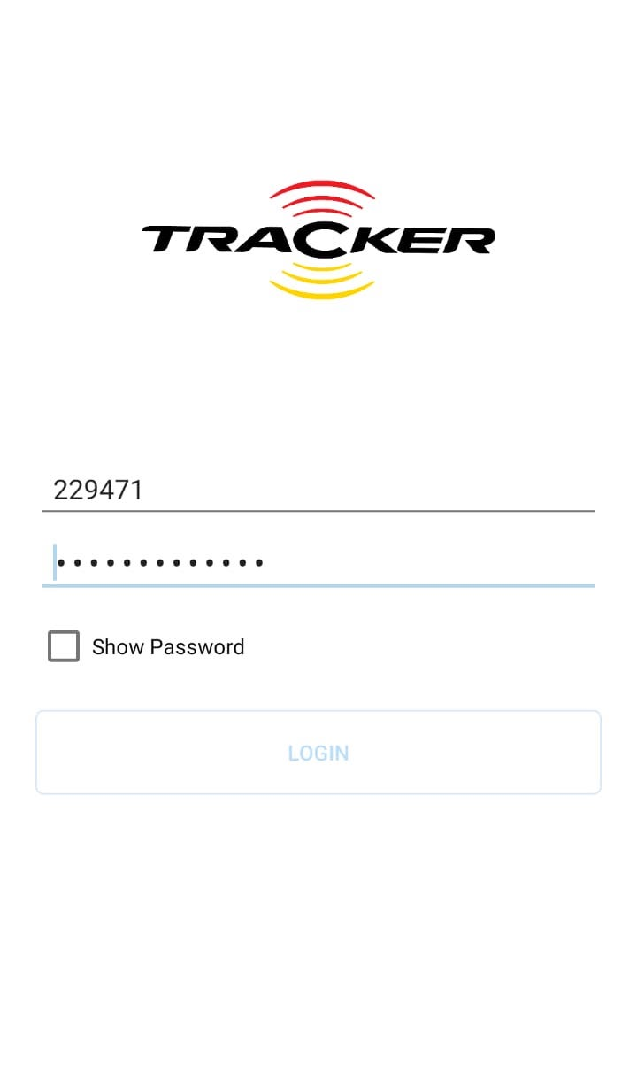
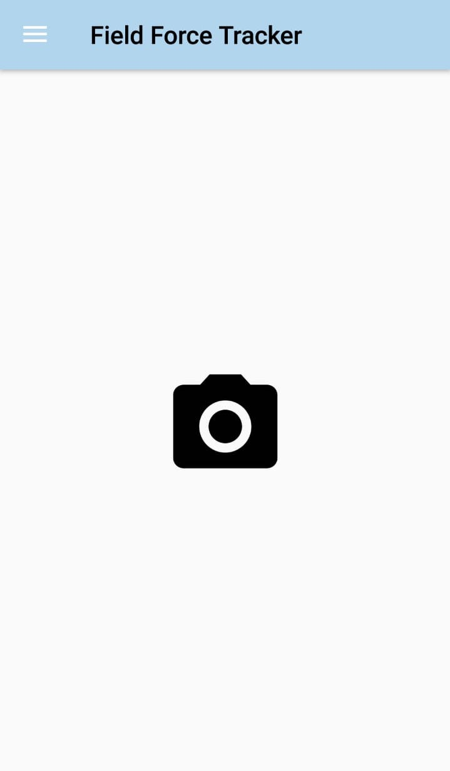
Login
Staff_id
HRIS Password
Click Login

Slide 5
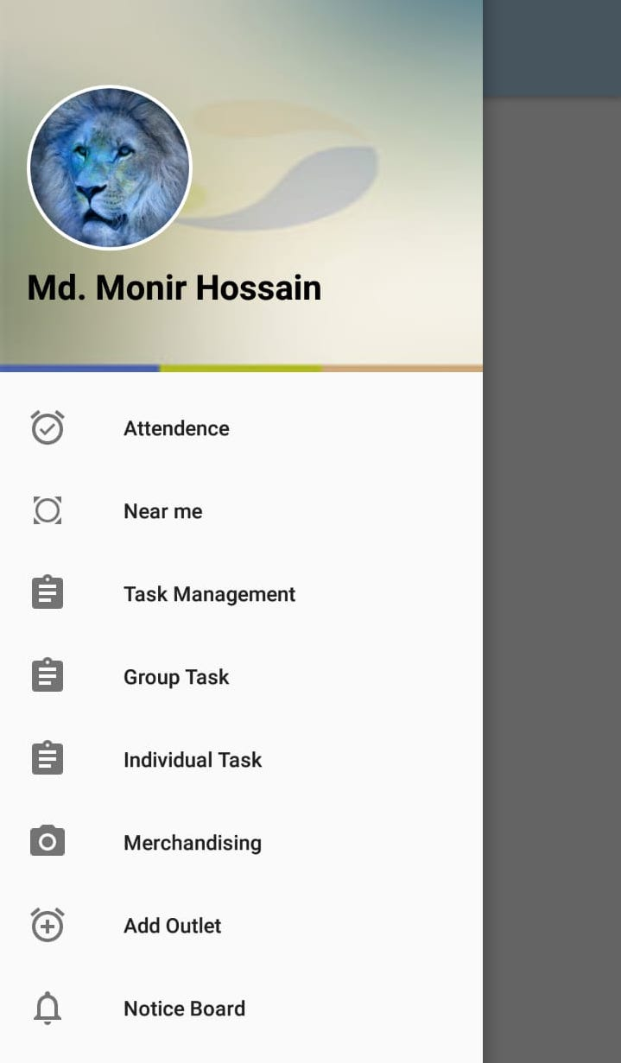
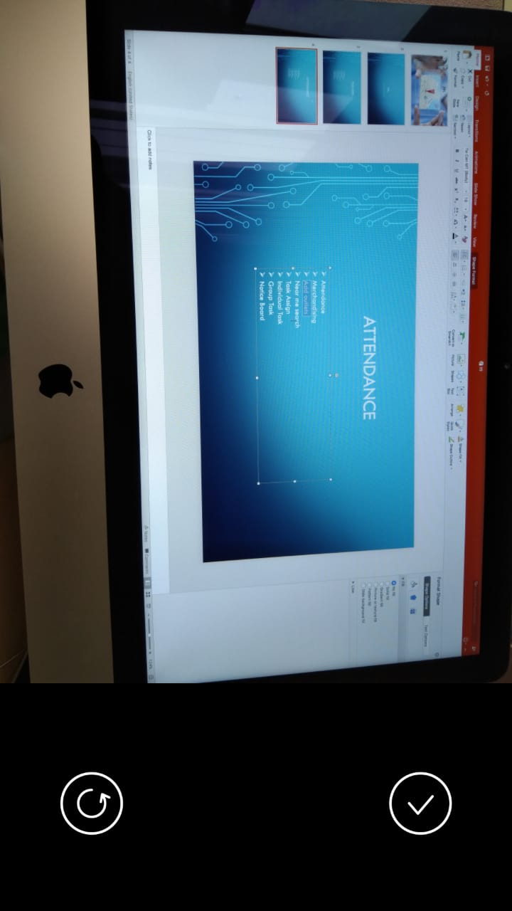
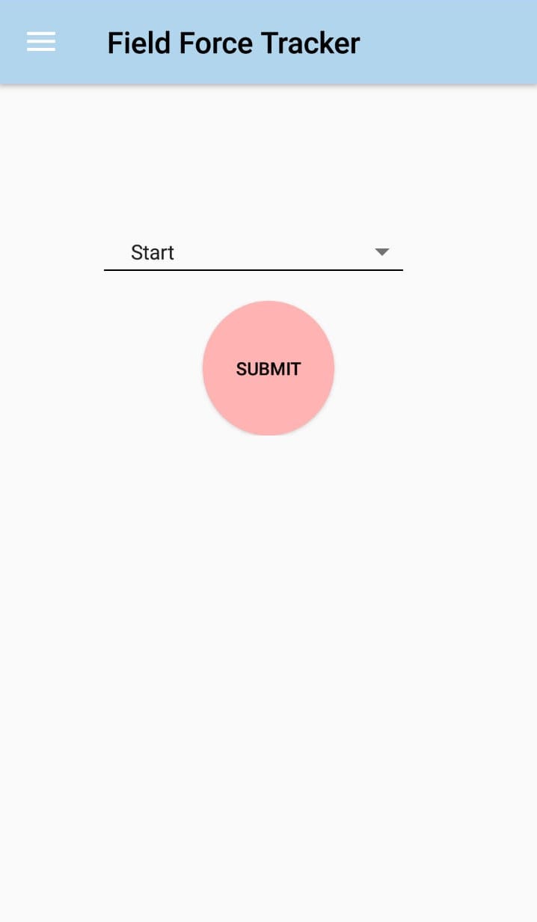
Attendance
Select Attendance
Confirm Picture
Click Submit
Tack a Picture

Slide 6
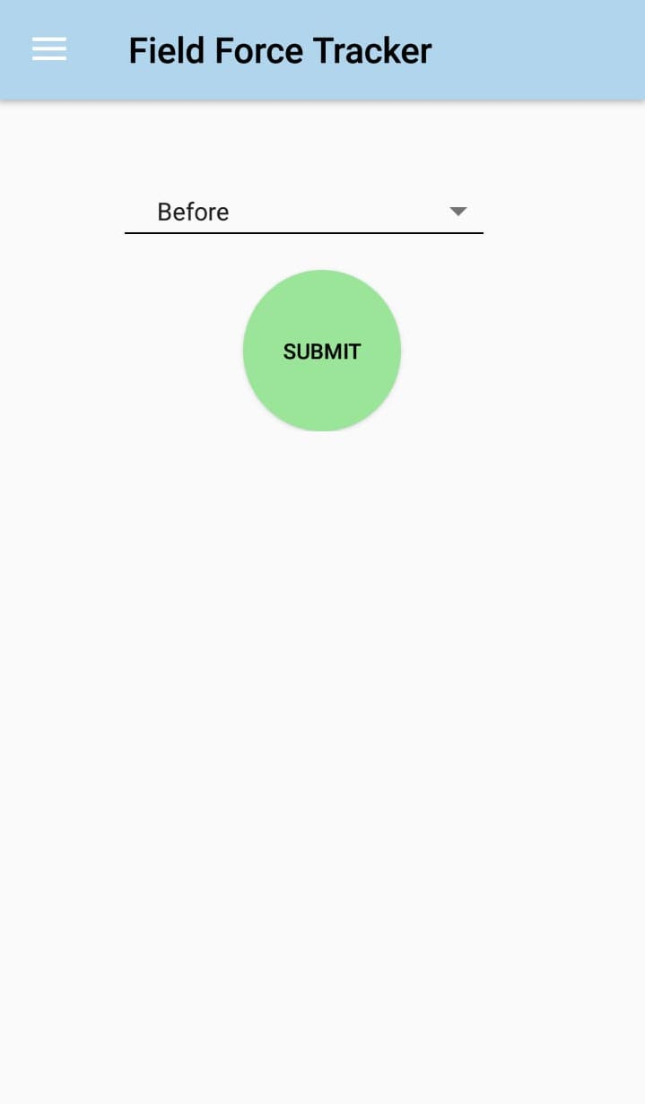
Merchandising
Select Merchandising
Confirm Picture
Click Submit
Tack a Picture

Slide 7
Add outlets
Select
Add Outlet
Confirm Picture
Click Submit
Tack a Picture

Slide 8
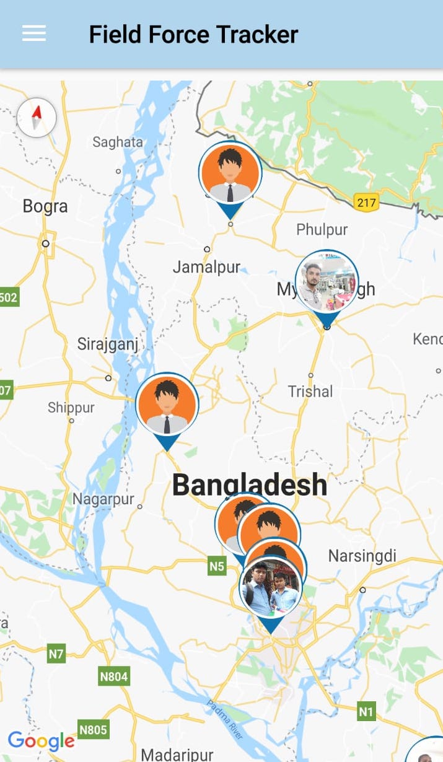
Near me search

Slide 9
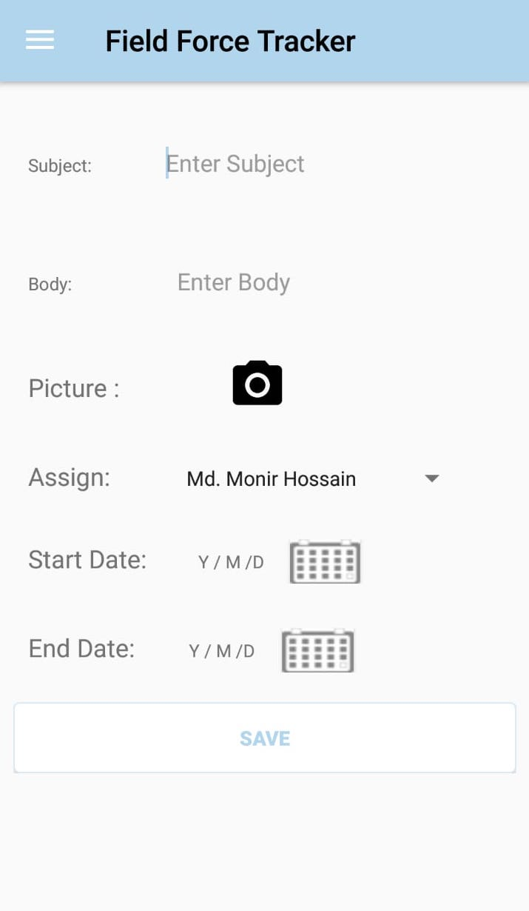
Task Assign

Slide 10
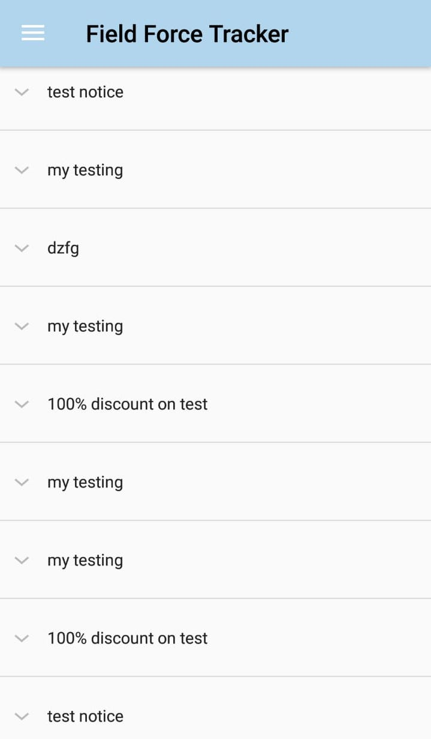
Individual & Group Task

Slide 11
Notice Board

Slide 12

Download Link: http://fs.prangroup.com/Download/Token/hy48HY382458

