Slide 1
SMART PARKI
NG
SYSTEM
By:
R.Monika

Slide 2
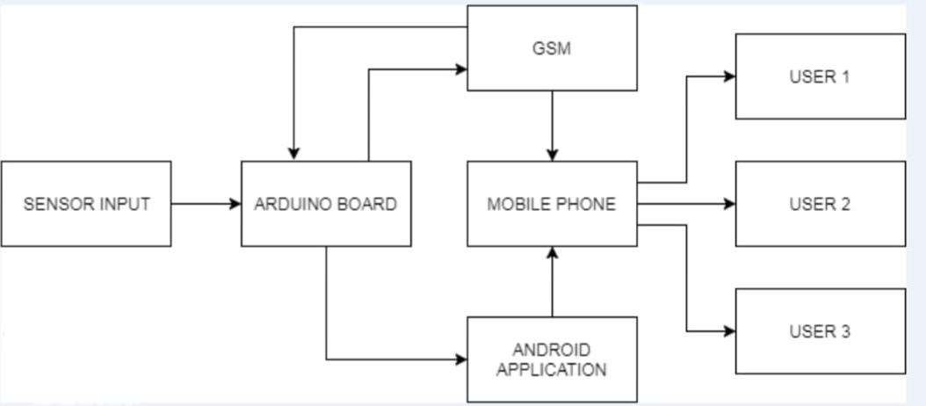
Block diagram

Slide 3
Working:
Sensor Integration :
Infrared sensors are installed at parking spaces to detect the presence of vehicles. These sensors can measure the distance between the sensor and the vehicle.

Slide 4
Data Collection:
Arduino microcontrollers are used to collect data from the sensors. The sensors send signals to the Arduino to indicate whether a parking spot is occupied or vacant.
Data Processing:
The Arduino processes the sensor data to determine the status of each parking space. It calculates if a vehicle is parked or not by analyzing the distance measurements from the sensors.

Slide 5
Display:
The system often includes LED
.
displays or LCD screens to show real-time information about parking space availability. Green lights might indicate vacant spaces, and red lights occupied ones.

Slide 6
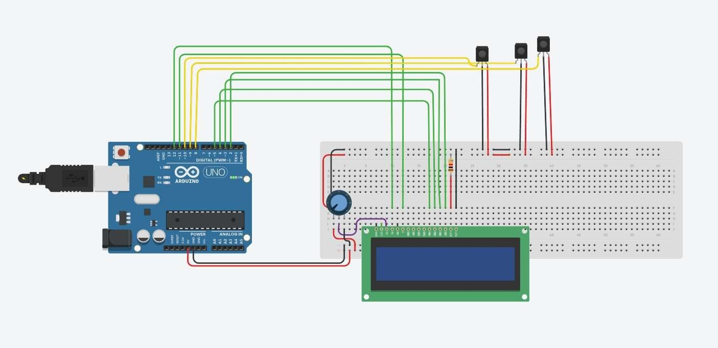
Before Simulation:

Slide 7
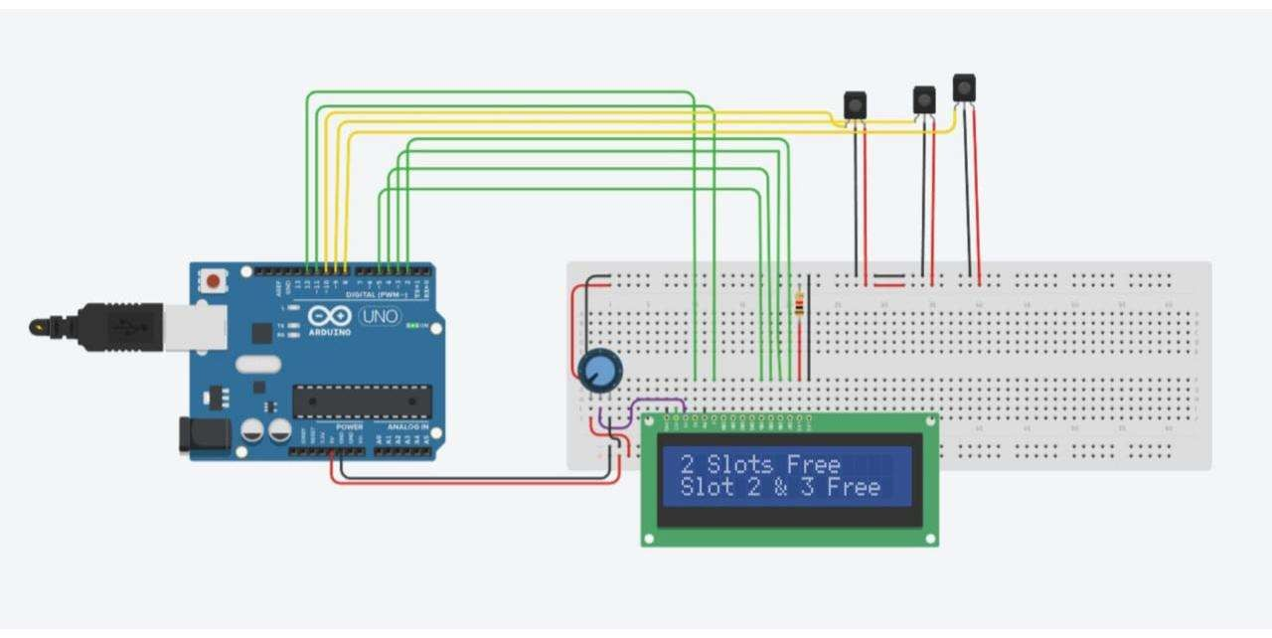
After Simulation:

