Slide 1
Robotics : Work Envelops
The volume of the space surrounding the robot manipulator is called the work envelop. Accordingly, the work envelop for the rectangular coordinate robot, the cylindrical coordinate robot, the spherical coordinate robot and the jointed (revolute) coordinate robot are different due the different movement of the arm.

Slide 2
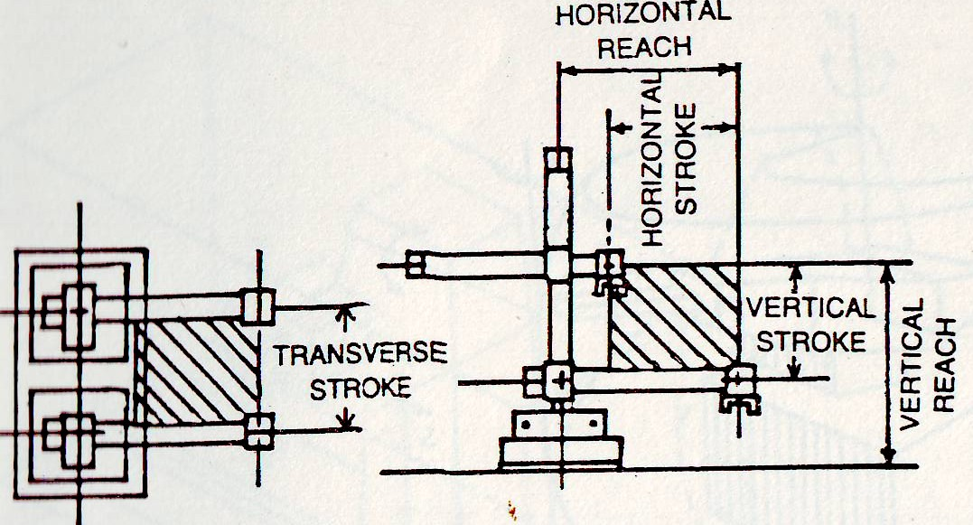
Robotics : Work Envelops Cartesian Coordinate Robot

Slide 3
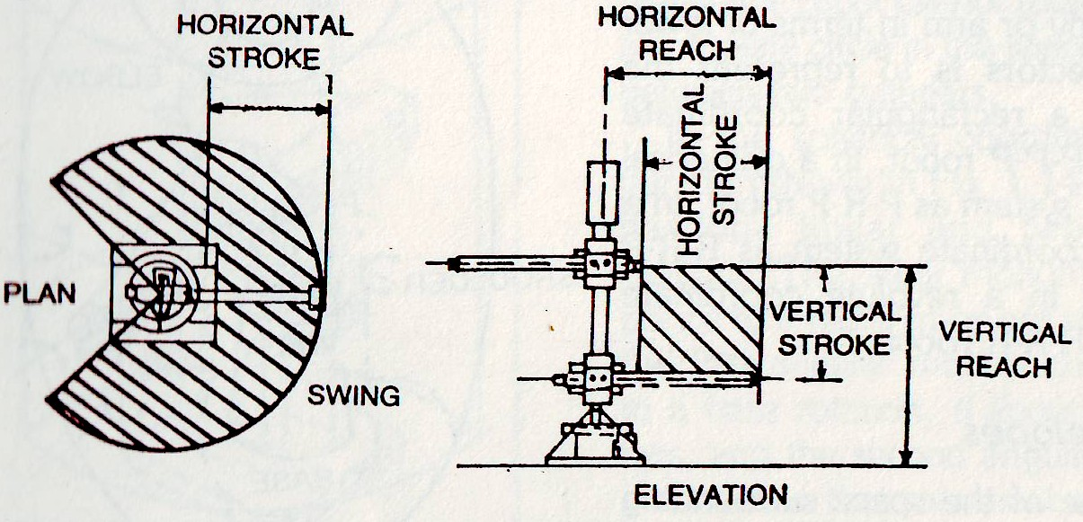
Robotics : Work Envelops Cylindrical Coordinate Robot

Slide 4
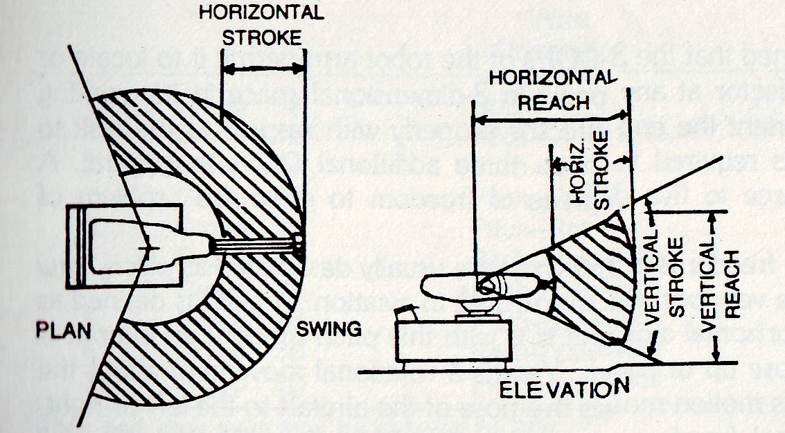
Robotics : Work Envelops Spherical Coordinate Robot

Slide 5
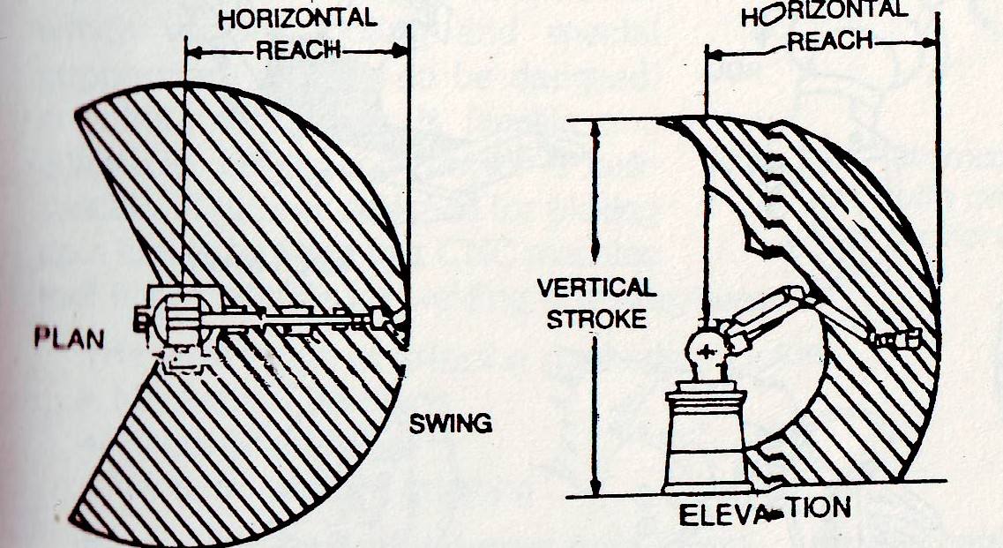
Robotics : Work Envelops Revolute Coordinate Robot

Slide 6
Robotics : Robot Wrists
To orient the end-effectors properly with respect to the task to be performed, it is required to have three additional DOFs in general.
A wrist may have three to five degrees of freedom to solve the problem of orientation.
Three rotational freedoms of the wrist are usually designated as pitch, yaw and roll as they are very popular terms uses in aviation.

Slide 7
Robotics : Robot Wrists
A pitch is defined as rotation about a horizontal axis and it is with this pitch motion, an aircraft is able to move its nose up or down.
Yaw is a rotational movement about the vertical axis and this motion moves the nose of the aircraft to the left or right.
A roll is a rotational freedom about the aircraft's own axis. With the roll motion, a craft can turn about its own axis. This concept has been extended to the design of the robot end-effectors attached to the wrist.

Slide 8
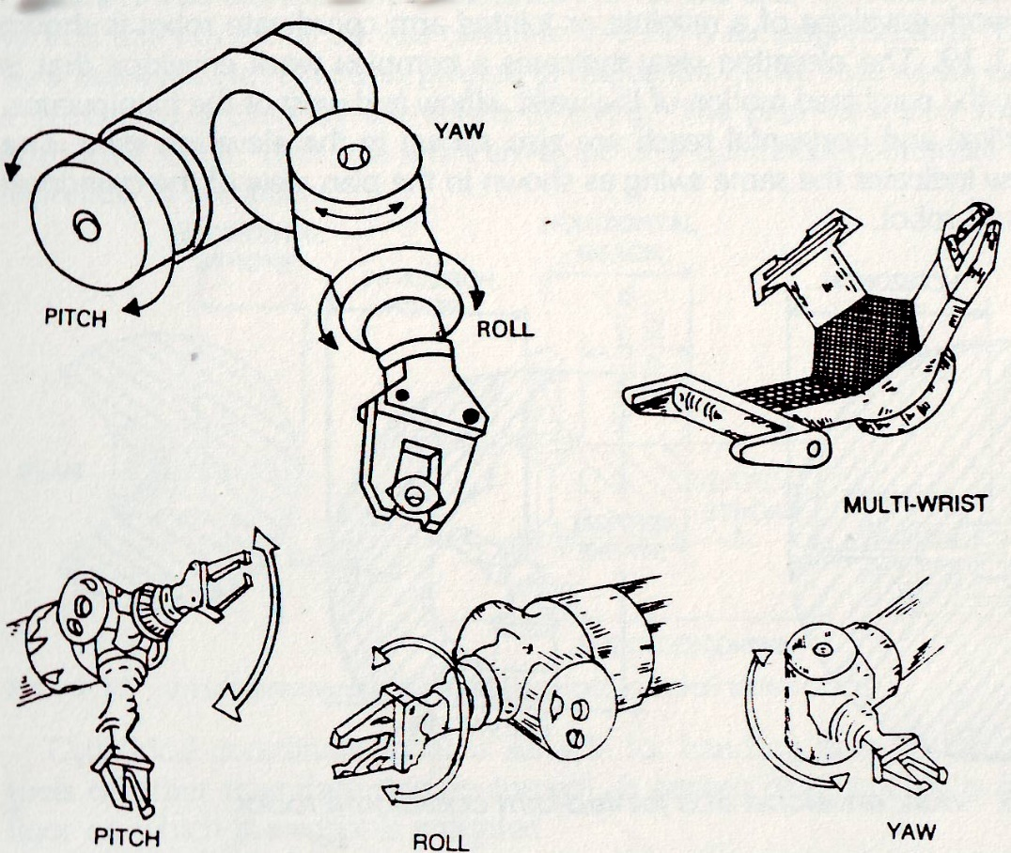
Robotics : Robot Wrists

Slide 9
Robot End-Effectors
Robot end-effectors are the gripper or end-of-arm tooling mounted on the wrist of the robot manipulator arm.
The wide range of gripping methods include
Mechanical clamping
Magnetic gripping
Vacuum (suction) gripping
Mechanical type of grippers may simply use mechanical clamping with vice-type mechanism; it may use hooking or lifting mechanisms and mechanisms for scooping or ladling powders, molten metal or plastics. Mechanical type of grippers find wide applications in forging and metal working industry.
Magnetic grippers may be employed for transfer of steel sheets or chips.
Vacuum cups may be used for transfer of sheets of glass, plastic or thin sheets of papers.

Slide 10
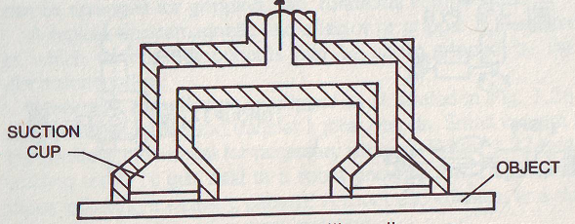
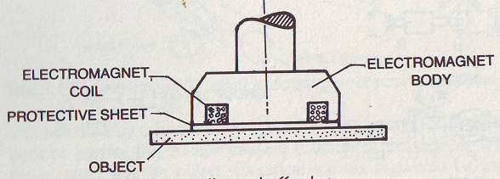
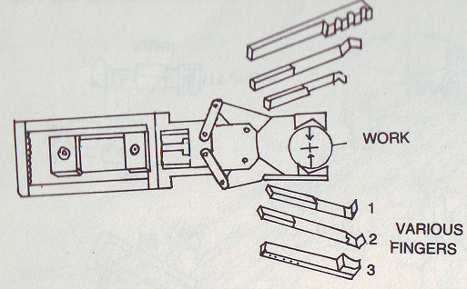
Robot End-Effectors

Slide 11
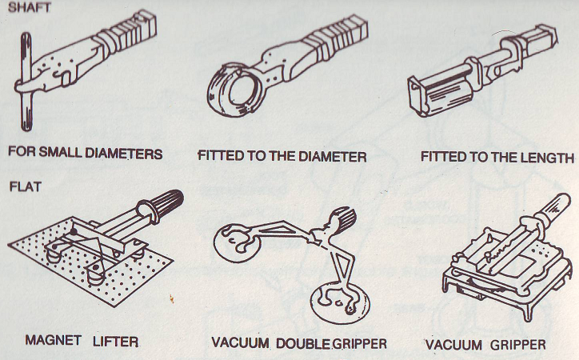
Robot End-Effectors

Slide 12
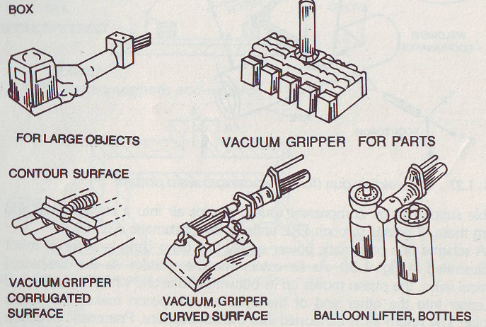
Robot End-Effectors

