Slide 1

Texture mapping
Presented by Md. Monir Ahammod 16CSE061 Department of Computer Science and Engineering BSMRSTU |  | Supervised by Tumpa Rani Sarker Lecturer, Department of Computer Science and Engineering BSMRSTU
Computer Science and Engineering

Slide 2
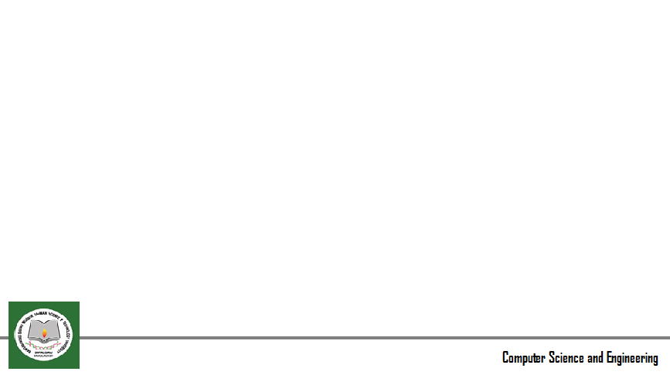
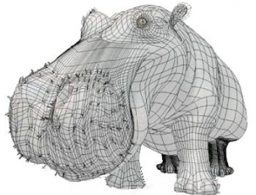
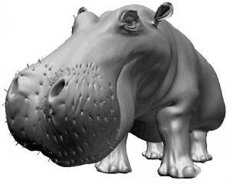
Introduction(Cont..)
Without Texture mapped
With Texture mapped

Slide 3
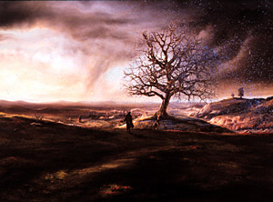
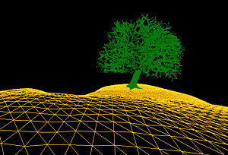
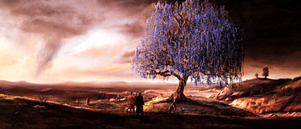
Introduction(Cont..)
Texture mapping

Slide 4
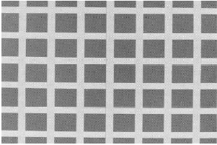
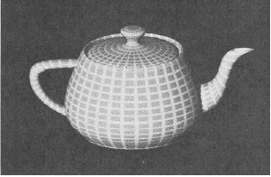
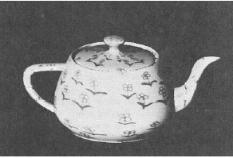

Introduction(Cont..)
Texture Mapped on to Tea Pot

Slide 5
Texture mapping methods
2D texture mapping: paint 2D pattern onto the surface
Environmental (reflection) mapping
Bump mapping: Disturb surface normal to fool shading algorithms
Procedural texture mapping, 3D texture

Slide 6
Texture mapping methods
Based on parametric texture coordinates
glTexCoord*() specified at each vertex

Slide 7
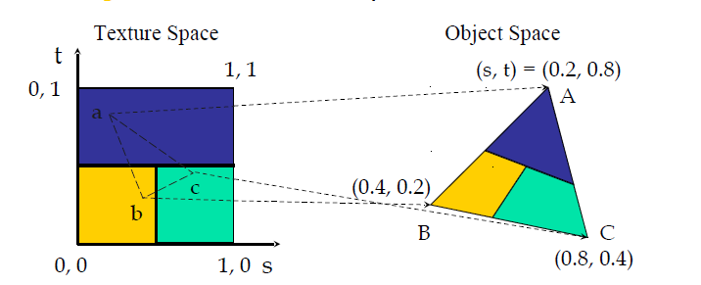
Mapping a Texture
Based on parametric texture coordinates
glTexCoord*() specified at each vertex

Slide 8
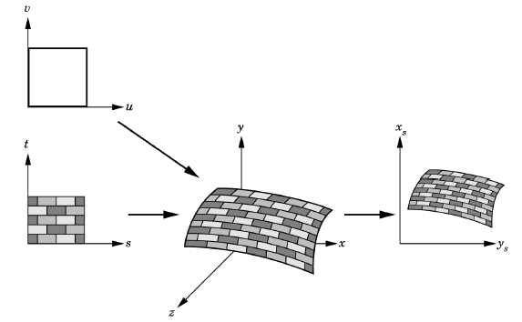
Mapping texture onto parametric surface using liner map
Point on the parametric surface
p : x = x(u,v), y = y(u, v), z = z(u,v)
The map from texture to the parametric coord using invertible linear map between the texture space (s,t) and the domain (u,v)
p : x = x(u,v), y = y(u, v), z = z(u,v)
u=as+bt+c
V=ds+et+f

Slide 9
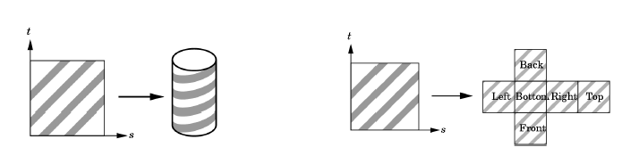
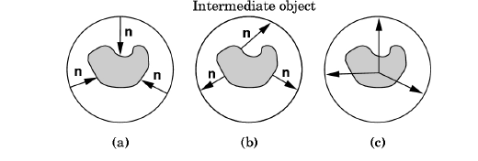
Two-step mapping example (Intermediate Surface)
parametric form cylinder:
x = rcos(2 PI u)
y = r sin(2 PI u)
z = v h
0<=u, v<=1
first step: u = s, v = t
• sphere
• cube
Second-step: map intermediate surface to
the surface being rendered.
Various strategies: a, b, c

Slide 10
Thanks All

