Slide 1
Deep cross-modal feature learning applied to predict
acutely decompensated heart failure using in-home
collected electrocardiography and transthoracic
bioimpedance
Authors: Xiang Pan, Chuangqi Wang, Yudong Yu, et al.
Affiliations: Worcester Polytechnic Institute, University of Connecticut, Boston Children’s Hospital, University of
Massachusetts Medical School
Published in: Artificial Intelligence In Medicine (ELSEVIER) (2023)
Chonnam National University
Presenter: Atique Md Monir Ahammod Bin (248810)

Slide 2

Index
Introduction
Motivation
Methodology
Architecture
Result Analysis
Conclusion
Notes:
Explanation :

Slide 3
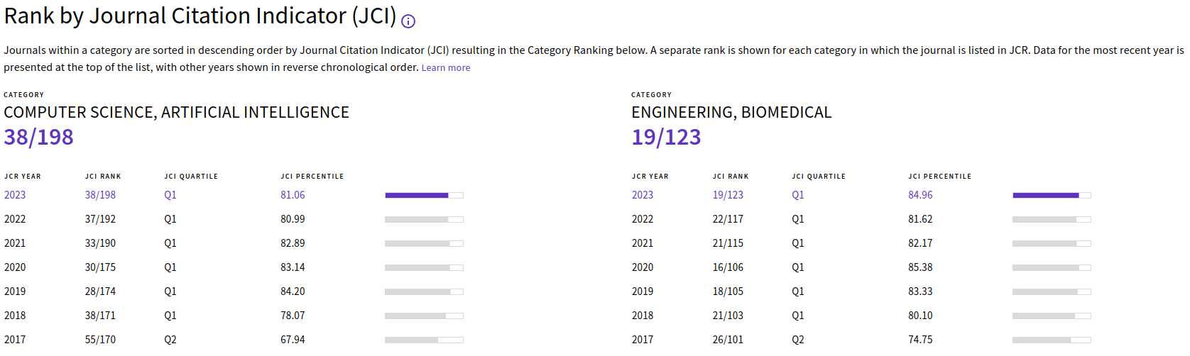

Journal Information
Artificial Intelligence In Medicine 140 (2023) 102548
Published in: Artificial Intelligence In Medicine
Volume: Volume 140
Date of Publication: 11 April 2023
DOI: https://doi.org/10.1016/j.artmed.2023.102548
Publisher: ELSEVIER
Q1 Journal
CiteScore: 15.0
Impact Factor: 6.1
Notes:
Explanation :

Slide 4

Journal Home Page
Notes:
Explanation :

Slide 5
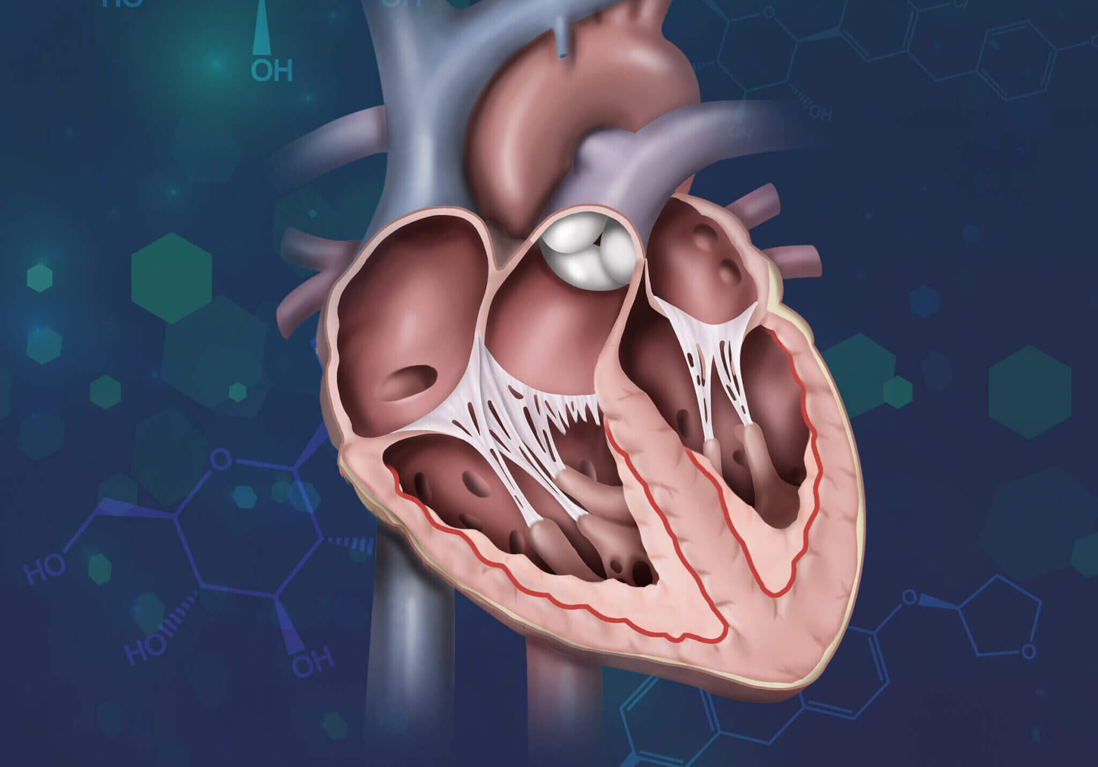
Introduction
• Acute decompensated heart failure (ADHF) worsens heart failure (HF) symptoms like dyspnea and edema.
• ADHF reduces heart's ability to pump blood, leading to serious symptoms and organ failure.
• Nearly 4.3 million U.S. hospitalizations in 2014 were HF-related.
• A recent study showed that early recurrent ADHF after discharge is common (51% with moderate and 27% with severe
congestion in the first month), with a mortality rate of about 20% for those with recurrent ADHF.
Acute decompensated heart failure
Notes:
Explanation :

Slide 6
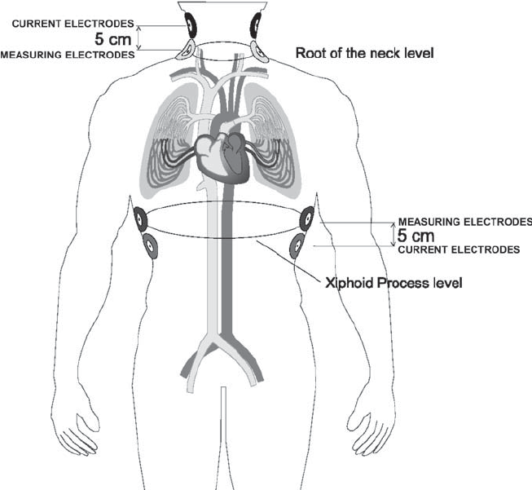
Introduction: Transthoracic Bioimpedance (TBI)
• Accurately identify HF patients at high risk of recurrent ADHF.
• ADHF often presents with severe dyspnea from pulmonary edema; where, detecting lung fluid is crucial.
• Traditional method: total body weight as a proxy for volume status.
• Transthoracic Bioimpedance (TBI) directly measures lung fluid.
• TBI is a more accurate measure of fluid accumulation than weight monitoring.
Transthoracic bioimpedance measurement
Notes:
Explanation :

Slide 7
Introduction
• Previous DNN applications in ECG focus mostly on rhythm classification, such as atrial fibrillation, from ambulatory
patients in controlled settings.
• Limited research exists on predicting worsening ADHF using single-channel ECG signals from wearable devices.
• This study aims to Accurately predict ADHF post-discharge using bioimpedance and single-channel ECG from
wearable devices.
• The paper introduces ECGX-Net (ECG X-modal Network), a new pipeline for cross-modal feature learning using ECG
and bioimpedance.
• Uses MLP regressor to predict transthoracic bioimpedance, enabling ADHF prediction from raw ECG recordings.
Notes:
Explanation :

Slide 8
Problem Statement
• Predicting acutely decompensated heart failure (ADHF) is challenging.
• Existing methods rely on controlled clinical settings.
• Limited studies on wearable ECG data for ADHF prediction.
• Early recurrent ADHF post-hospitalization is common and dangerous.
• Need for effective prediction using home-collected ECG data.
Notes:
Explanation :

Slide 9
Contributions
• The paper predicts acutely decompensated heart failure (ADHF) using ECG data.
• It utilizes a deep cross-modal feature learning pipeline, ECGX-Net.
• The study combines ECG and bioimpedance data to enhance predictions, resulting in refined ECG features.
• It demonstrates high precision and recall in ADHF classification.
• The approach addresses unique medical scenario requirements and resource limitations.

Slide 10
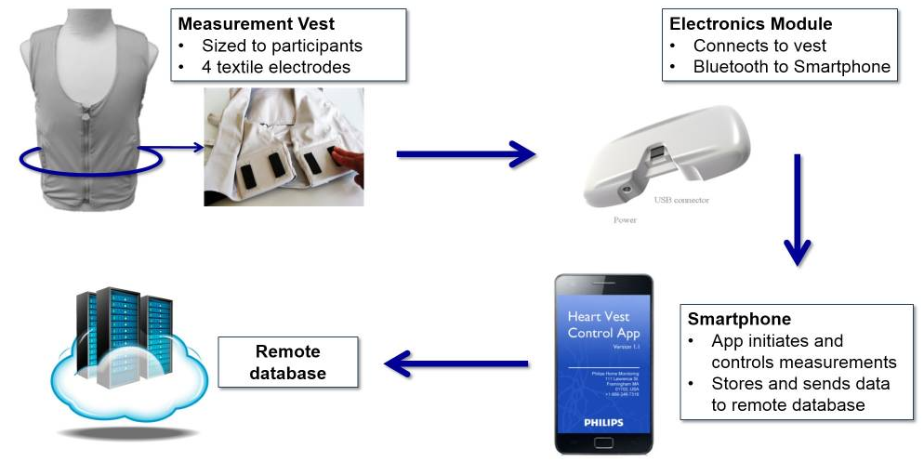
Data preparation
1,318 ECG recordings from 37 participants in the SENTINEL-HF study (by Dovancescu et al. )
The SENTINEL-HF study enrolled patients (≥21 years) who were hospitalized with a primary diagnosis of
heart failure or with ADHF symptoms.
Each ECG recording lasted about 5 minutes, containing 250-350 heartbeats.
A total of 7414 heartbeat ECG segments were extracted, with 2999 discarded due to artifacts.
TBI measurement in SENTINEL-HF study

Slide 11

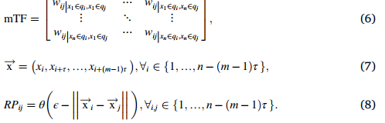
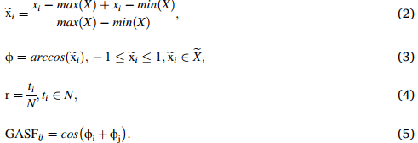
Data transformation from time series
• The five-heartbeat ECG segments, normalized as time series, were transformed into 2D grayscale images using the
Gramian Angular Summation Field (GASF).
• Images were duplicated to create RGB images for CNN input.
• Feature extraction was compared with other image transformation methods like Markov Transition Field (MTF) and
Recurrence Plot (RP).
• The final images were resized to 224 × 224 pixels for CNN input.

Slide 12
Feature extraction and reduction
DenseNet121 and VGG19 pretrained on ImageNet were used to extract features from the resized RGB images
of the ECG time series data. VGG19 network consists of 16 convolutional layers and 1 FC layer.
Principal component analysis (PCA) was used to reduce feature dimensions for various models, optimizing for noise reduction.
PCA reduced VGG19’s 4096 features to 250 and DenseNet121’s 1024 features to 170.
Similar processes were applied to other pretrained models like VGG16, ResNet50, ResNet101, DenseNet169,
and AlexNet, with PCA reducing feature dimensions for optimal noise reduction.

Slide 13
MLP regressor with bioimpedance
Multi-layer Perceptron (MLP) regressor with three dense layers (128, 64, and 1) added transthoracic bioimpedance
to the ECG-DenseNet191-PCA or ECG-VGG19-PCA features.
The outcome of the model was used as the predicted bioimpedance for the test set.
All DenseNet121-PCA or VGG19-PCA features were processed through the model.
New features were generated after processing through the model, preserving ECG and bioimpedance information.
New 64-dimensional features preserved ECG and bioimpedance information for improved accuracy.

Slide 14
Classifier training and Hyperparameter searching
Model training:
Integrated DenseNet121-PCA or VGG19-PCA features with MLP regressor outputs for classification.
Utilized a radial basis function (RBF) kernel with optimized parameters from grid search and five-fold cross-validation.
Training set included ECGs with bioimpedance (229 samples); testing set contained ECGs without bioimpedance (212
samples).
Conducted 50 training iterations with a random 1:1 HF to N ratio, averaging results for model performance assessment.
B. Hyperparameter searching:
Various MLP structures and optimizers were tested to optimize classification performance.
Tested ten configurations for the MLP regressor with various dense layer structures, such as 128 → 64 → 1 and
128 → 32 → 1.
Grid search was conducted for SVM classifier parameters across different kernel types. 128 → 64 → 1 structure,
Adam optimizer with 0.001 learning rate.

Slide 15
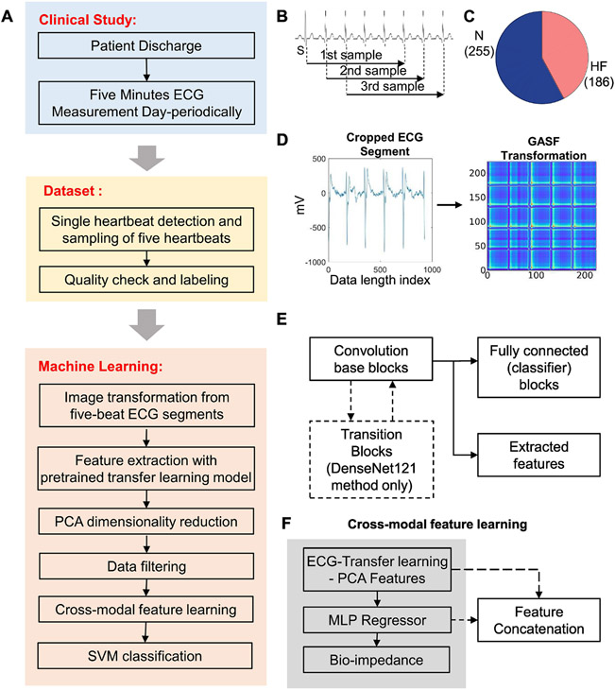
ML Pipeline (ECGX-Net) and Architecture Overview
Class HF: Data from participants with recurrent ADHF events or cardiac ischemic-related heart
failure (rehospitalized/worsening cases).
Class N: With no rehospitalization or ADHF
events, representing the normal group.
Figure 1.The schematics and flowchart of worsening heart failure detection with transfer learning: (A) the flowchart of the pipeline; (B) schematic of raw ECG time series cropping; (C) distribution of data among Class HF and N after data filtering; (D) transformation of ECG time series into 2D images by GASF

Slide 16
ML Pipeline (ECGX-Net) and Architecture Overview (Cont.)
DenseNet121-PCA or VGG19-PCA features
ECGX-Net
features
Figure 1. (E) the schematic structure of feature extraction using transfer learning models.
(F) Cross-modal feature learning between ECG and bio-impedance.

Slide 17
An overview of the data and the ML pipeline
• ECG and other measurements were regularly recorded by post-discharge participants using wearable devices.
• In SENTINEL-HF study, the bioimpedance vest measured intrathoracic fluid accumulation and also recorded ECG signals in the form of a single-
channel time series. Participants conducted daily procedures, generating 5-min ECG time series used as this study's raw dataset.
• The raw dataset consisted of 1318 unprocessed ECG time series from 37 participants.
• Then, used peak detection algorithm for S wave location identification.
• At each S wave location in the ECG signal, subsegments with five consecutive heartbeats were extracted (Fig. 1B).
• Follow-up subsegments began one heartbeat after the previous subsegment’s start. ECG data was visually inspected during training set
preparation, and removed data containing artifacts (including large noise and missing/extra parts).
• ECG data was randomly selected from participants with later HF or worsening HF indicators, and also from stable participants in the Dovancescu
et al. study. Labels were assigned based on health status at the end of the SENTINEL-HF study, categorizing ECG subsegments into two
classes (Fig. 1C).
• Verified 1,462 raw ECG subsegments from 18 volunteers; after filtering, 186 ADHF and 255 normal subsegments remained (Fig. 1C).
• Transformed ECG subsegments into 2-D gray-scaled images by GASF algorithm (Fig. 1D). Time series lengths were standardized to 224 × 224
pixels in GASF transformation for consistency across samples.
• For feature extraction, images were duplicated across RGB channels and input into ImageNet-pretrained DenseNet121 or VGG19 models
(Fig 1E).
• This transfer learning approach has both high simplicity and proven high accuracy on the classification and segmentation of biomedical images.
• Then, the dimension of the extracted pretrained model features was reduced by PCA.
• Conducted data filtering to remove artifacts and categorize ECG subsegments.
• Next, they refined the ECG features by performing cross-modal feature learning by predicting the bioimpedance using the pretrained model
features of ECG (Fig. 1F).
• The features extracted from the MLP-based regressor were then concatenated with the pretrained CNN-PCA features (DenseNet121-PCA or
VGG19-PCA features), followed by SVM classification using the ECG features for cross-modal learning.

Slide 18
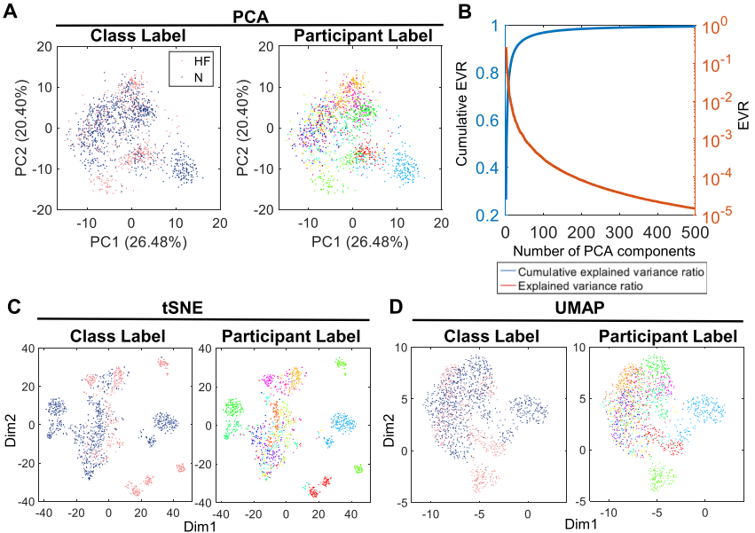
VGG19 features of image-based ECG signals
• Features were extracted by VGG19 after the first fully connected layer and reduced using PCA.
• t-SNE and UMAP visualizations showed distinct clusters corresponding to heart failure classes.
Fig. 2. (A) first two components of PCA on VGG19 features; (B) explained variance ratio (EVR) and cumulative EVR plots with the number of
PCA components; (C–D) t-SNE (C) and UMAP (D) plots of VGG19-PCA features. Right of (C), (D): Each color represents individual participants.

Slide 19
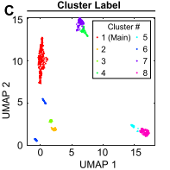
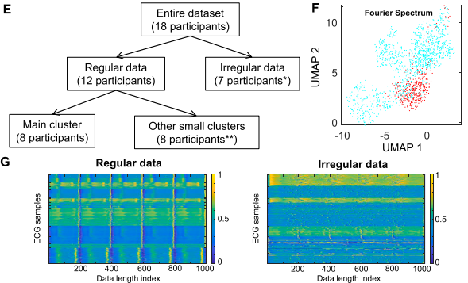
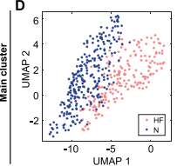
Data filtering
Filtered the dataset into regular and irregular heartbeat groups.
Regular heartbeat data showed a constant heart rate, while irregular heartbeat data exhibited dramatic changes in heart rate.
To eliminate atrial fibrillation effects, data was labeled as irregular if over half was deemed irregular from a participant on a
given day. Data filtering was necessary to distinguish ADHF-related features from patient-specific biases.
K-means clustering identified one main cluster with 441 samples for classifier building, showing a clear boundary between
heart failure (HF) and normal (N) groups in UMAP visualization.
Fig. 2. (E) tree diagram for data filtering (*: 1 participant contributed data to both irregular and regular data groups; ** 4 participants contributed
data in the main cluster and the small clusters); (F) UMAP plot of the single-sided spectrum from Fast Fourier Transform (blue: regular data;
red: irregular data); (G) heatmaps of interpolated ECG of regular and irregular data.

Slide 20
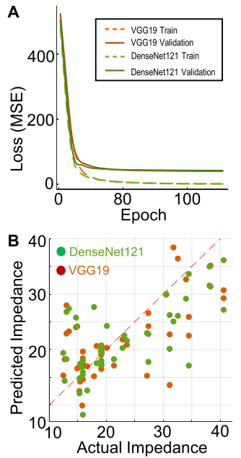
Cross-modal feature learning of ECG with transthoracic bioimpedance
Training and validation groups were created using ECG features with recorded bioimpedance.
Trained MLP regressor using DenseNet121-PCA or VGG19-PCA features and bioimpedance data, achieving a strong correlation
between actual and predicted values.
ECG features effectively recognized bioimpedance values related to heart failure.
The study did not use irregular ECG data for cross-modal training due to participant limitations of bioimpedance recordings.
Fig. 4. (A) Training loss curve of bioimpedance MLP regressor (green: using DenseNet121 features; orange: using VGG19 features; dotted line:
training loss; solid line: validation loss); (B) Actual and predicted bioimpedance values of R0 transthoracic bioimpedance on the validation set.

Slide 21
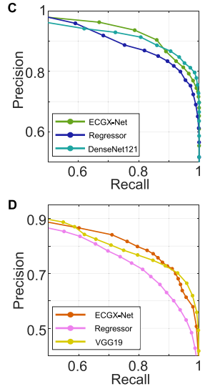
Prediction of ADHF using a support vector machine
We combined 64-dimensional MLP cross-modal features with DenseNet121-PCA or VGG19-PCA features (ECGX-Net
features), training an SVM classifier with bioimpedance data as the training set and non-bioimpedance data as the test set.
Precision-recall curves indicated the effectiveness of ECGX-Net in classification, with higher AUC-PR in DenseNet121 (0.9249)
and VGG19 (0.8371) compared to individual model features.
• In heart failure detection, high-recall classifiers are favored to minimize false negatives, which can worsen the condition and
increase morbidity or mortality. While cross-modal features may not be essential for basic screening, ECGX-Net’s high-precision
performance is beneficial for downstream diagnosis or low-risk patients, reducing unnecessary tests for healthy individuals.
Fig. 4. (C–D) Precision-recall curves of (C) DenseNet121 (green: DenseNet121-PCA + bioimpedance regression features; blue: bioimpedance regression features; cyan: DenseNet121-PCA features) and (D) VGG19 (orange: VGG19-PCA + bioimpedance regression features; red:
bioimpedance regression features; yellow: VGG19-PCA features)

Slide 22
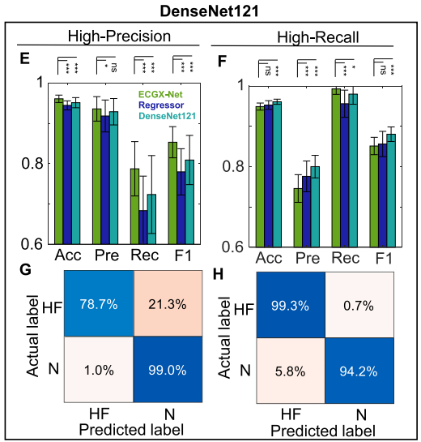
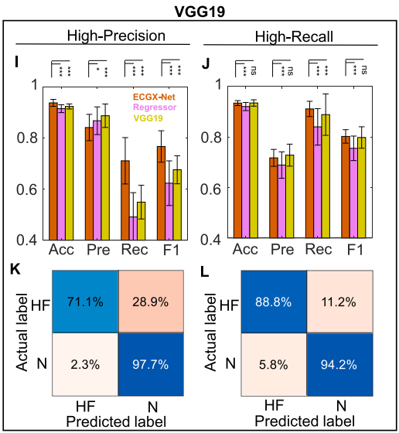
Prediction of ADHF using a support vector machine
ECGX-Net with DenseNet121 achieved 99.29% recall, ideal for high-recall classification, while DenseNet121 alone reached 98%
recall. For high-precision tasks, ECGX-Net is preferable; DenseNet121 without cross-modal features suits recall-focused tasks.
Fig. 4. (E) and confusion matrix (G) in high-precision classification (85 % HF estimate probability threshold (pt)). Performance (F) and confusion matrix
(H) in high-recall classification (50 % HF estimate pt). (I–L) VGG19 SVM classification comparison. Performance (I) and confusion matrix (K) in
high-precision classification (85 % HF estimate pt). Performance (J) and confusion matrix (L) in high-recall classification (35 % HF estimate pt)

Slide 23
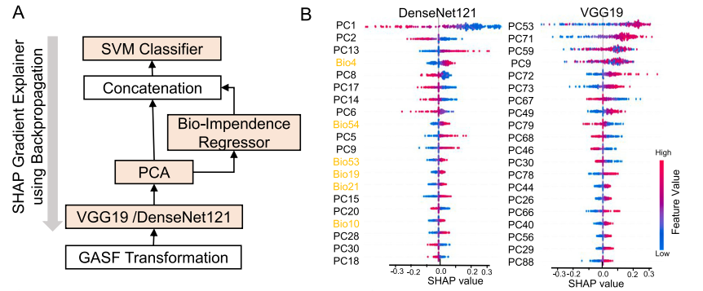
Interpreting the model performance with SHAP values
• SHAP (Shapley Additive exPlanations) values reveal feature contributions, linking ECG image patterns and
bioimpedance features to heart failure prediction.
• Model Components: Deep feature extraction (DenseNet121 or VGG19) ➔ PCA ➔ MLP for bioimpedance
prediction ➔ SVM classification.
• Top Features: DenseNet121: 14 PC features from DenseNet121, 6 bioimpedance features.
VGG19: All top features from VGG19-PC, no bioimpedance influence.
• Bioimpedance features are crucial with DenseNet121; minimal impact with VGG19.
Fig. 5. Model interpretation using SHAP values. (A) Backpropagation of SHAP values through ECGX-Net. (B) SHAP values of top 20 features
for the SVM classifier. PC: principal component of the pretrained model features. Bio (orange): bioimpedance regressor features.

Slide 24
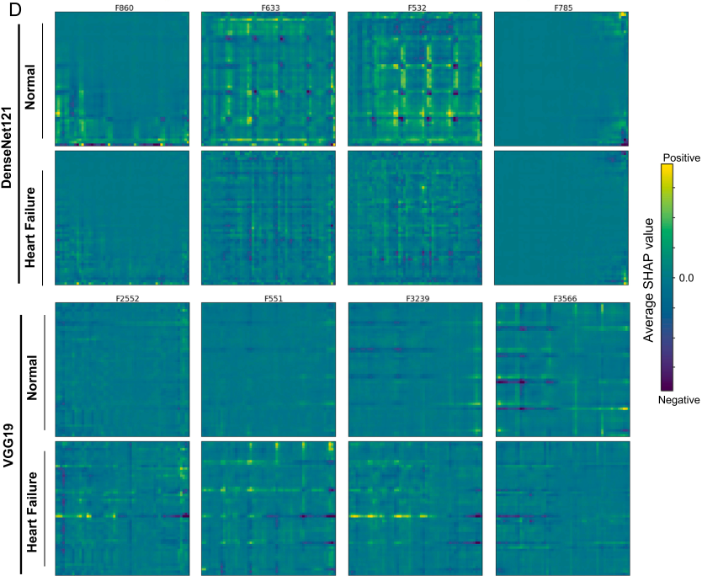
Interpreting the model performance with SHAP values (Cont.)
Fig. 5. (D) Four deep features with the largest SHAP contributions on the GASF transformed ECG images in N and HF classes (Top: DenseNet121, Bottom: VGG19).

Slide 25
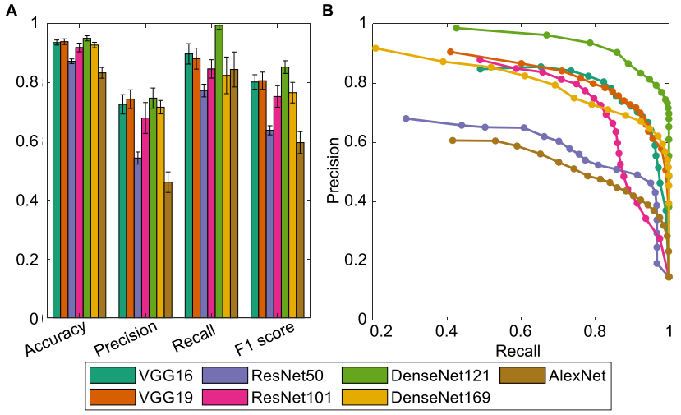
Roles of the pretrained model and image transformation in ECGX-Net
• To assess DenseNet121/VGG19's role, authors tested alternative pretrained models and ECGX-Net. DenseNet121
(Precision: 0.7459, Recall: 0.9929, F1- score: 0.85) outperformed other pretrained models in classification performance.
• DenseNet121, VGG16, and VGG19 offer superior features, significantly boosting downstream analysis performance. GASF
transformation provided better interpretability and performance compared to other methods like MTF or RP.
Fig. 6.(A) classification performances with different pretrained models; (B) precision-recall curves of different pretrained models. (VGG16: 0.815; VGG19: 0.837; ResNet50: 0.610; ResNet101: 0.790; DenseNet121: 0.925; DenseNet169: 0.803; AlexNet: 0.553 for AUC

Slide 26
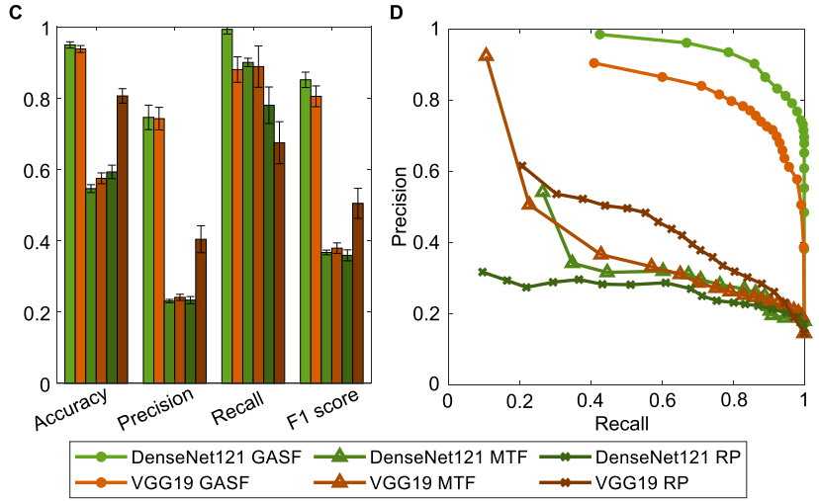
Roles of the pretrained model and image transformation in ECGX-Net (Cont.)
• Authors evaluated GASF image transformation by substituting it with MTF or RP.
• GASF offered clearer ECG time series encoding with temporal relationships than MTF and RP.
Fig. 6. (C) classification performances with different image transformation methods; (D) precision-recall curves of different image transformation methods (MTF + DenseNet121: 0.417; MTF + VGG19: 0.400; RP + DenseNet121: 0.269; RP + VGG19: 0.467 for AUC)

Slide 27
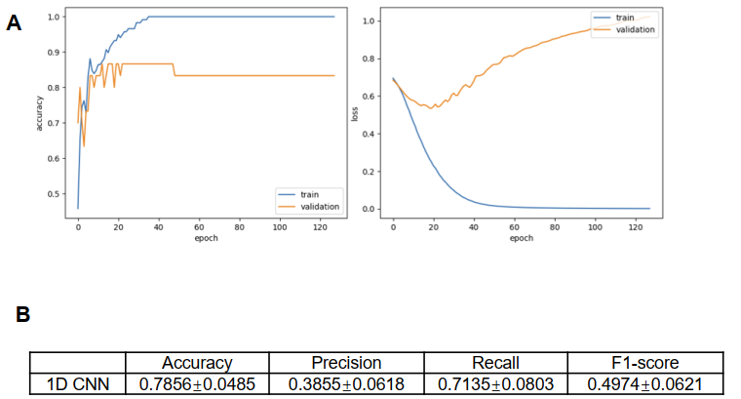
Roles of the pretrained model and image transformation in ECGX-Net (Cont.)
• A 1D CNN model with a simple one-layer design showed significant overfitting due to limited data, resulting in lower
performance than authors pipeline. This highlights the importance of transfer learning with ImageNet-trained models
in our approach.
Supplementary Figure 8. Performance of conventional 1D CNN and LSTM for prediction of heart failure.
(A) Training curves of accuracy and loss of 1D CNN. (B) Performance metrics

Slide 28
Discussions
• The method achieved high accuracy in predicting ADHF using transformed ECG images.
• Future studies should increase data size and include irregular ECG patterns for robustness.
• The approach allows remote monitoring of patients post-discharge, enhancing timely interventions.
• Balancing precision and recall is crucial for different patient risk groups.
• The study demonstrates the potential of machine learning in medical applications, paving the way for future research.

Slide 29
Limitations
The study did not include irregular ECG data.
Limited data size affected classification robustness.
Small sample size may introduce bias.
Lack of bioimpedance measurements for some data.
High-recall classifiers may lead to false positives.
High-precision classifiers may miss critical heart failure cases.

Slide 30
Conclusions and Future Works
• ECGX-Net predicted ADHF with 94% precision.
• High-recall classifier had 98% recall using DenseNet121.
• ECGX-Net achieved an F1-score of 0.85 and DenseNet121 achieved an F1-score of 0.88.
• ECGX-Net effective for high-precision classification and DenseNet121 effective for high-recall classification.
Exploration of larger datasets for ECG and bioimpedance analysis.
Development of more effective pretrained models for time series data.
Investigation of cross-modal learning in diverse medical conditions.
Enhancement of real-time monitoring systems for heart failure prediction.
Study of patient-specific variations in ECG patterns and responses.
Application of deep learning in other cardiovascular diseases.

Slide 31
Dataset

Slide 32
Dataset: SENTINEL-HF Study
• SENTINEL-HF Study
• Paper Link: Dovancescu S, et al. Detecting heart failure decompensation by measuring transthoracic
bioimpedance in the outpatient setting: rationale and design of the SENTINEL-HF study. JMIR Res
Protoc 2015;4:e121. https://doi.org/10.2196/ resprot.4899.
• https://www.researchprotocols.org/2015/4/e121/

Slide 33
Code

Slide 34
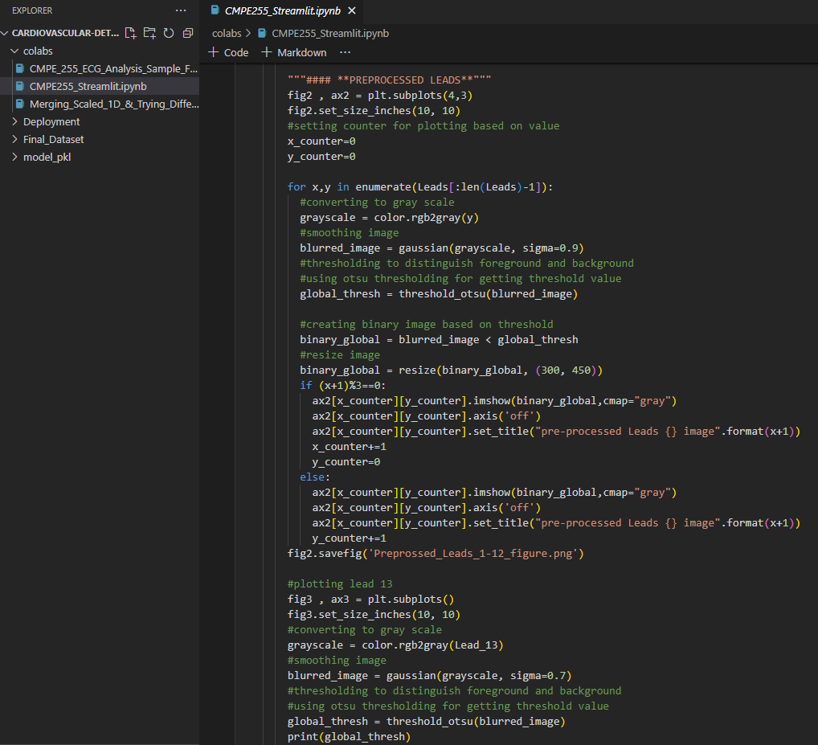
Data preprocessing
https://github.com/rameshavinash94/Cardiovascular-Detection-using-ECG-images/blob/main/colabs/CMPE_255_ECG_Analysis_Sample_FInal%20(1).ipynb

Slide 35
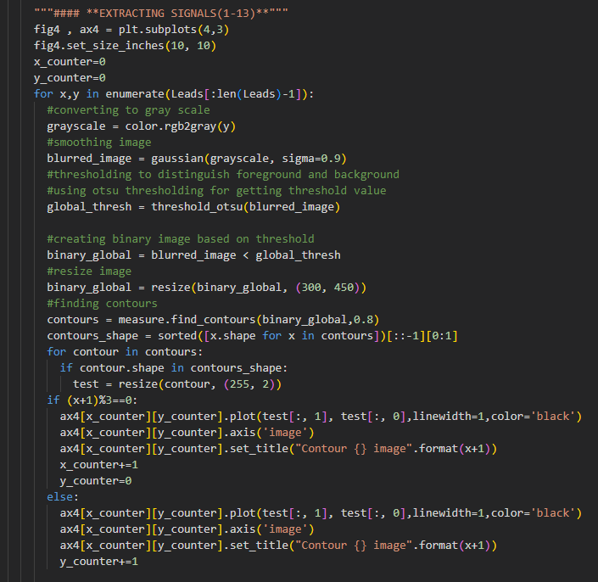
Data preprocessing (Cont.)

Slide 36
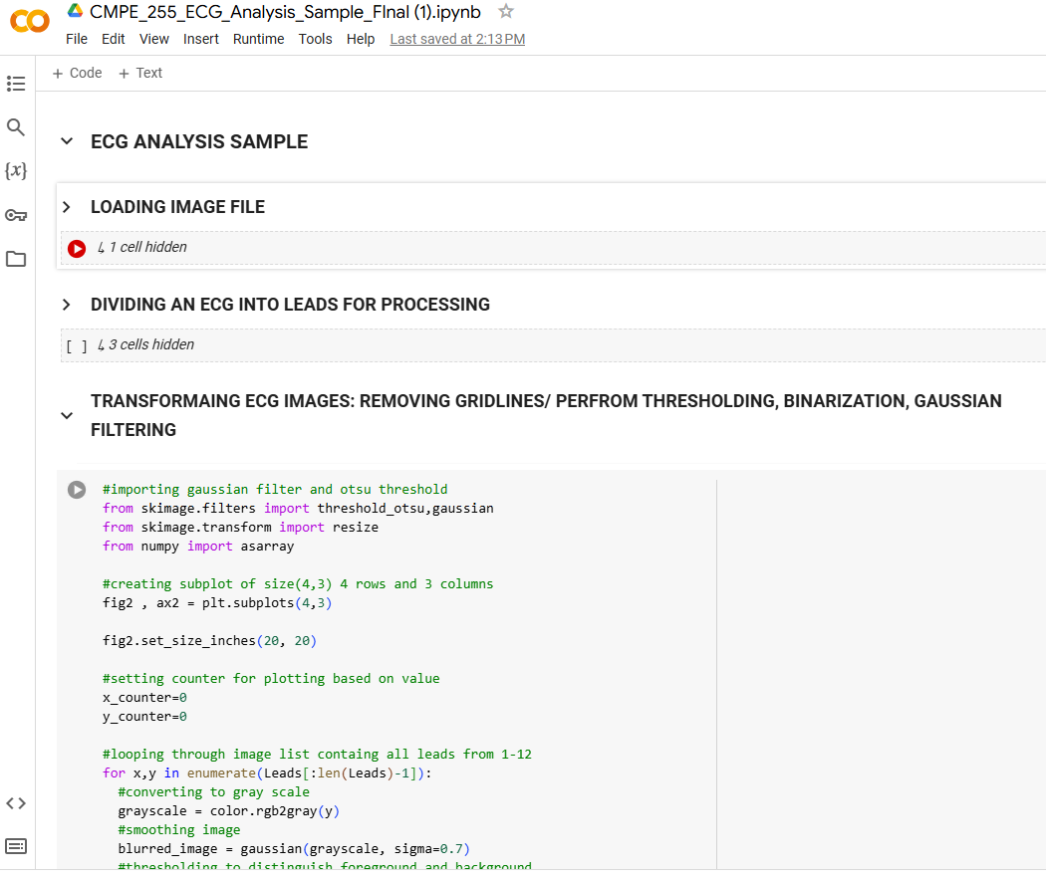
Model train
https://colab.research.google.com/drive/17stwjHR30fQjtDE7oCnjLY78AMOBgPjY#scrollTo=x_JytPc6irC2

Slide 37
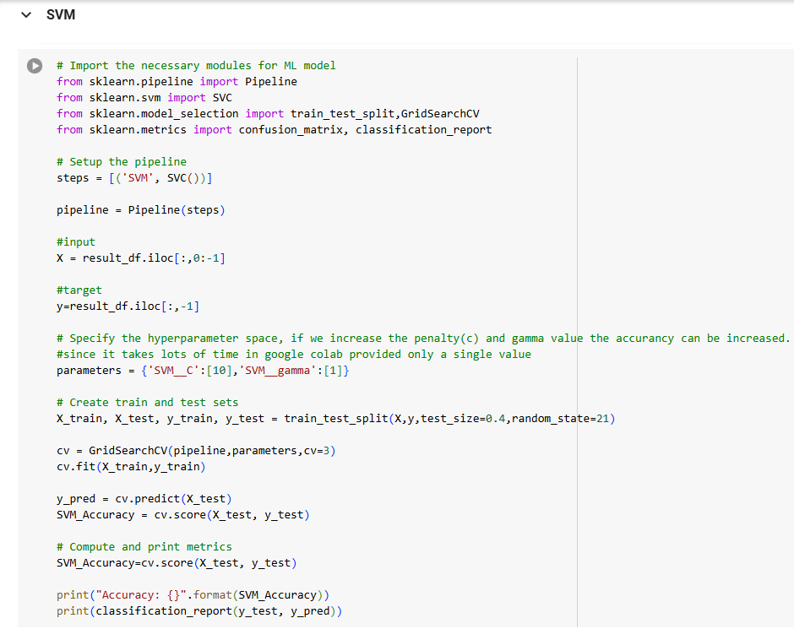
Model train (cont.)
https://colab.research.google.com/drive/1XXYUS9YuNvRUx-2VHZw1RzneUty8gEhd?usp=sharing

Slide 38
Any Question?

Slide 39
Thank You☺

