Slide 1
Heart Diseases Medical Terminology Search Engine
Monir, Thong

Slide 2
Outline
Introduction
Architecture
Crawling with Apache Nutch
Features profiling
Extract to structured data
Matchmaking and ranking
Implementation and Result

Slide 3
Introduction
Why users need Medical Terminology Search Engine?
Detailing medical term with related terms and description all together.
Providing accurate, reliable information from trusted sources.
Connecting related information for better understanding.

Slide 4
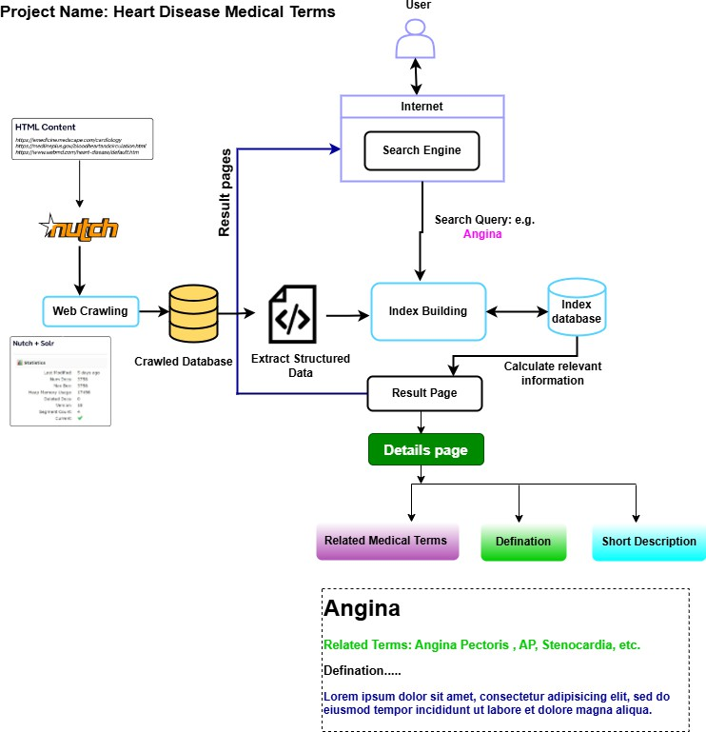
Architecture

Slide 5
Web Crawling with Apache Nutch

Slide 6
Crawling Process

Slide 7
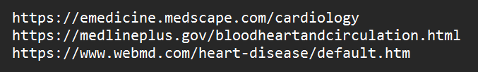
Data Sources
seed.txt

Slide 8
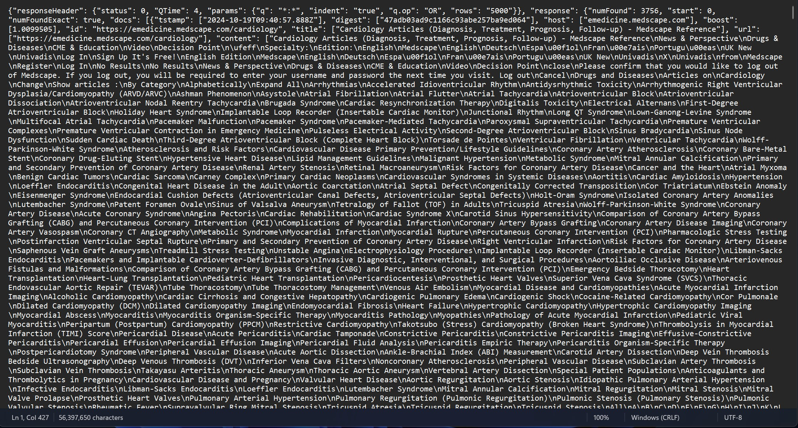
Crawled Database

Slide 9
Features profiling

Slide 10
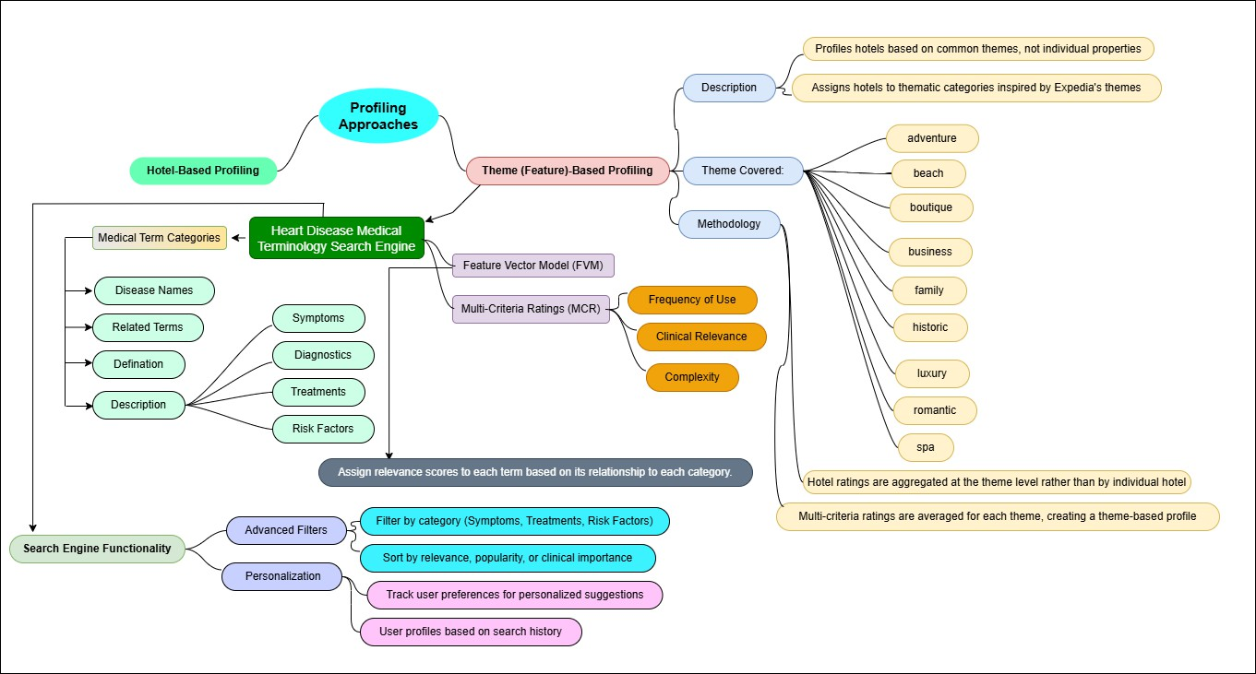
Feature Profiling Mind Map
https://doi.org/10.1016/j.elerap.2019.100832

Slide 11
Features for Medical Terminology Search Engine
Related Medical Terms
Definition
Symptoms
Diagnosis
Treatment
Risk Factors

Slide 12
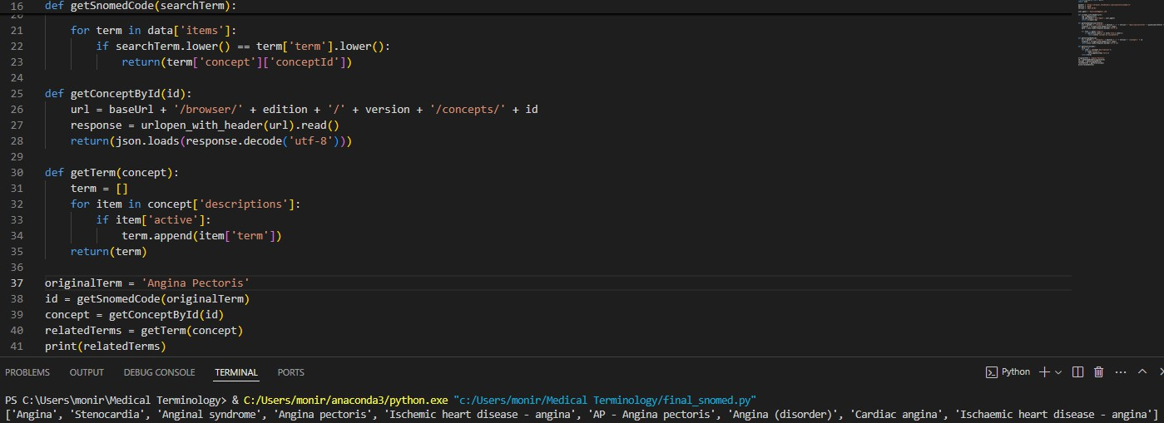
Generate Related Medical Terms by Snomed API (e.g. Angina)

Slide 13
Extract to structured data

Slide 14
Natural Language Processing (NLP) Techniques
Core NLP
Advanced NLP Techniques

Slide 15
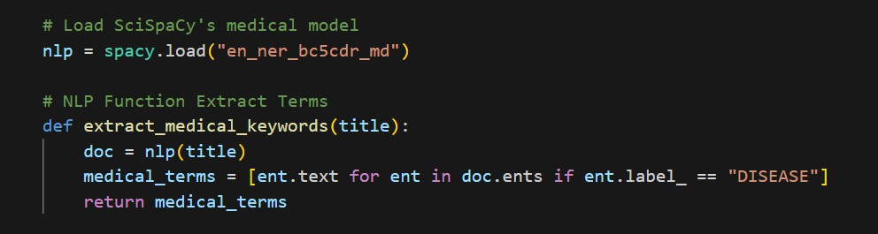
Extract “term” from “title” in crawled data
Use Named Entity Recognition (NER) NLP Technique in SpaCy's biomedical model (“en_ner_bc5cdr_md”) to extract topic keywords (medical terms) from the titles.
The keywords with label “DISEASE” will be extracted as a medical terminology.

Slide 16
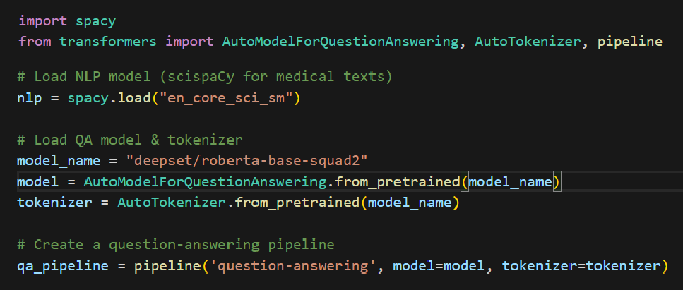
Extract “definition” feature
Sentence Segmentation:
Use SpaCy's biomedical model (“en_core_sci_sm”) to split the medical
content into sentences.
Question-Answering (QA) Model:
Use the QA model (“deepset/roberta-base-squad2”) to answer the question: What is <term>? to detect sentences that define the terms.

Slide 17
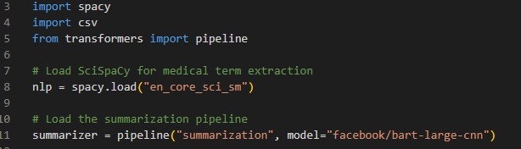
Extracting Medical Information (Description)
Objective: The goal is to extract key medical information (Symptoms, Diagnosis, Treatment, and Risk Factors) from a large corpus of medical text and summarize it.
Key Components:
SpaCy: Used for natural language processing (NLP) and entity extraction from the medical
text.
Hugging Face Transformers: Utilized for text summarization using the facebook/bart-large-cnn model.
Chunking and Tokenization: Text is tokenized into manageable chunks to fit within the model’s token limit (1024 tokens), ensuring it can be processed without errors.

Slide 18
Description Extraction and Summarization
Preprocessing:
  The JSON file is read and sanitized to remove invalid characters (like newlines and control characters).
  The data is parsed into a Python dictionary.
2. Text Chunking:
  Large text blocks are split into smaller chunks based on token length using the tokenizer from Hugging Face.
  Each chunk is ensured to stay within the model's token limit of 1024 tokens to avoid errors.
3. Keyword-based Extraction:
  Keywords like "symptom", "treatment", "diagnosis", and "risk" are used to filter and extract relevant sentences from the content.
4. Summarization:
  Each relevant section is summarized using the facebook/bart-large-cnn model.
  The summarizer ensures that no chunk exceeds the token limit while generating meaningful, concise summaries.

Slide 19
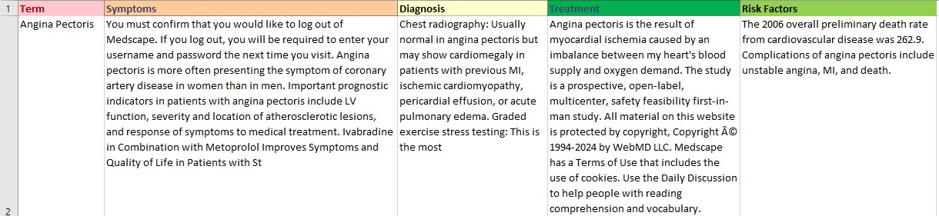
Output Example: Extracted Information
The code successfully extracts and categorizes medical information under four headings: Symptoms, Diagnosis, Treatment, and Risk Factors.
For example, the term Angina Pectoris is summarized with related symptoms, diagnostic methods, treatments, and common risk factors.
Contents of "terms_and_descriptions.csv"

Slide 20
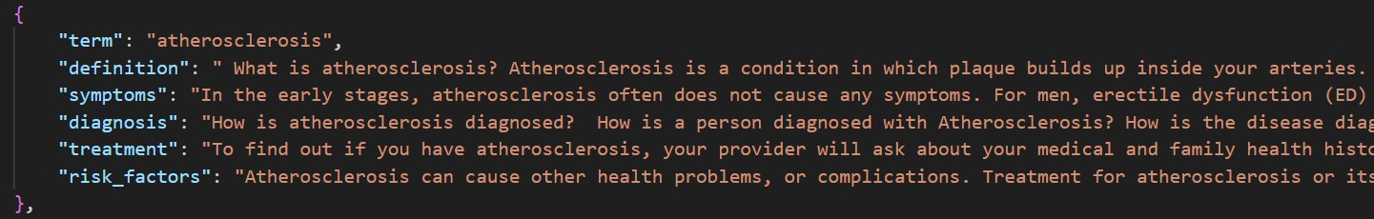
Extracted Database

Slide 21
Matchmaking and Ranking

Slide 22

Ranking by Cosine Similarity
TF-IDF (Term Frequency-Inverse Document Frequency):
  Measures the importance of words in a document relative to a collection of documents.
  Term Frequency (TF): How often a word appears in a document.
  Inverse Document Frequency (IDF): Penalizes common words by assigning lower importance to words that appear in many documents.
  TfidfVectorizer function converts the term and definitions into numerical TF-IDF vectors.
Cosine Similarity:
  Measures the cosine of the angle between two vectors in a multi-dimensional space. It
quantifies the similarity between two pieces of text.
  The cosine similarity between the term and each definitions is computed by comparing their TF-IDF vectors using cosine_similarity function.

Slide 23
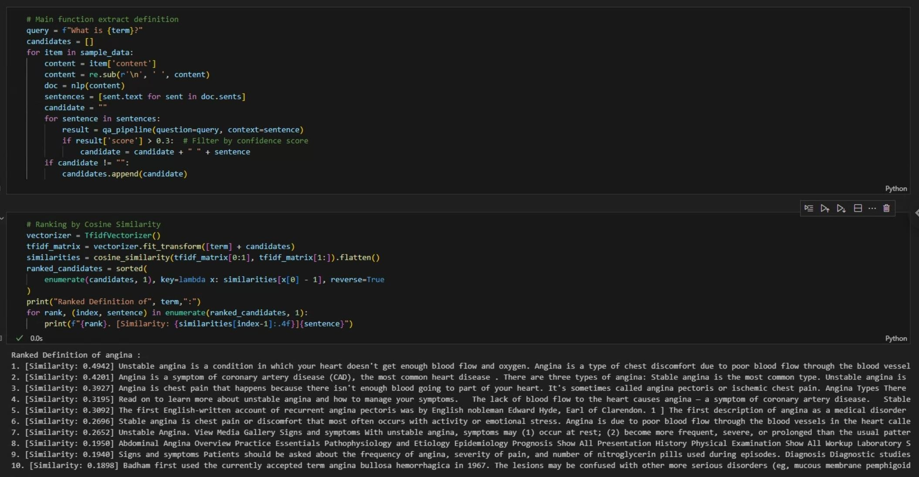
Ranking Example: Angina

Slide 24
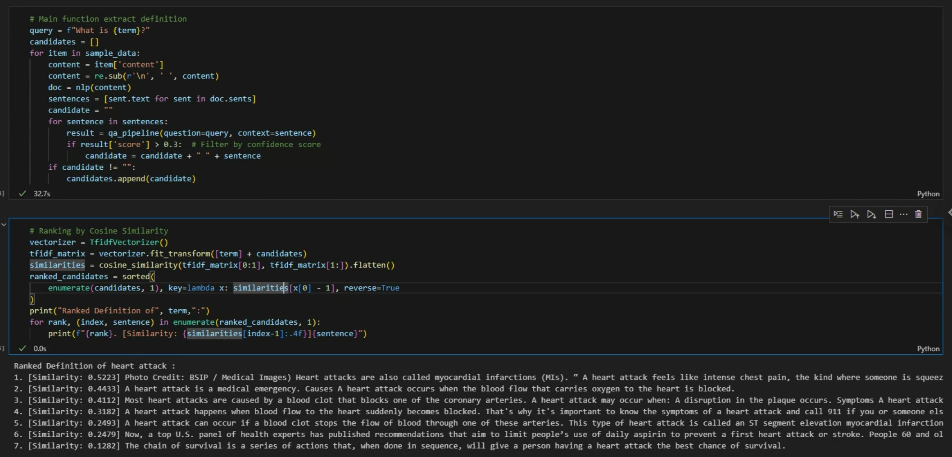
Ranking Example: Heart Attack

Slide 25
Implementation and Result

Slide 26
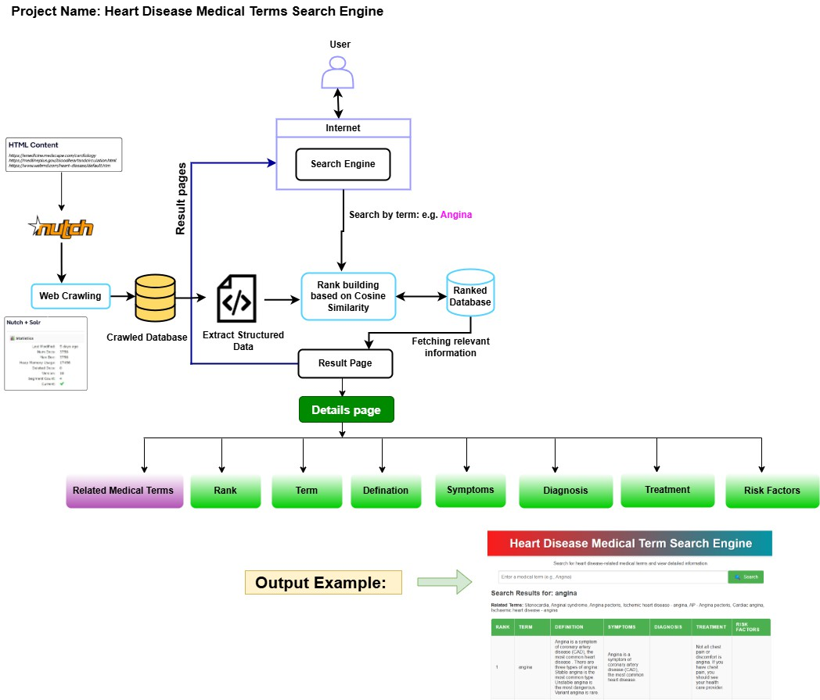
Updated Architecture

Slide 27
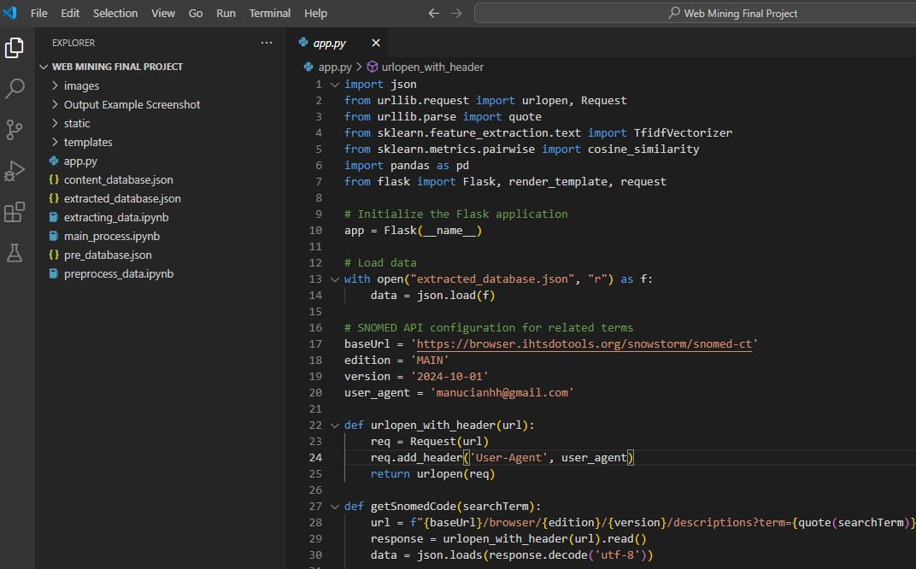
Final Project Code

Slide 28
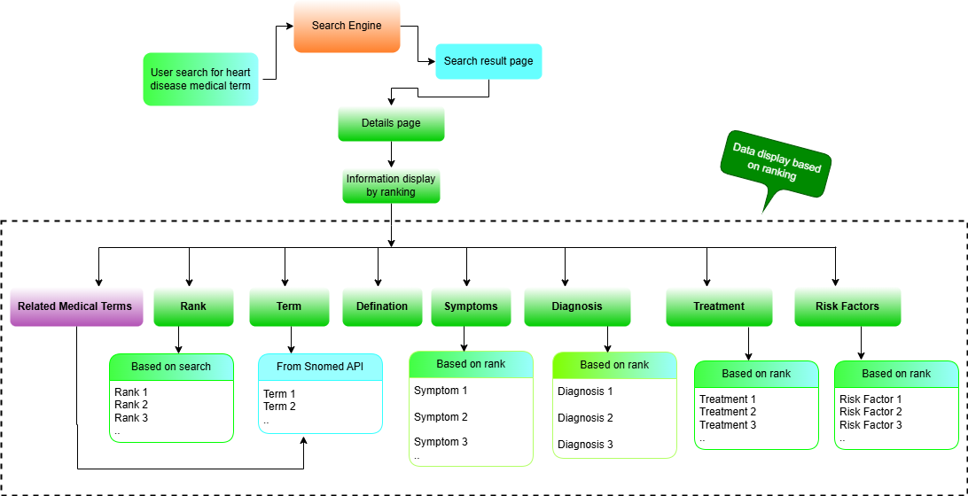
User Case Scenario

Slide 29
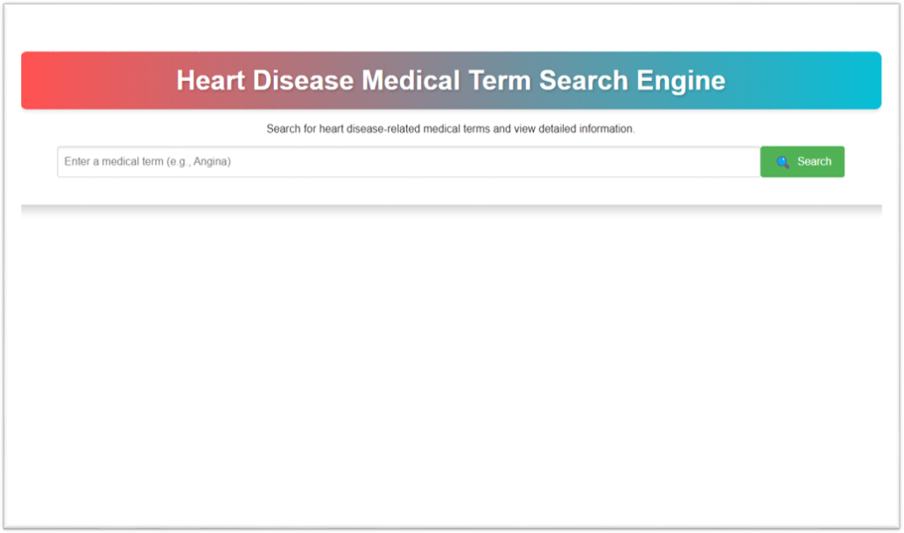
User Interface

Slide 30
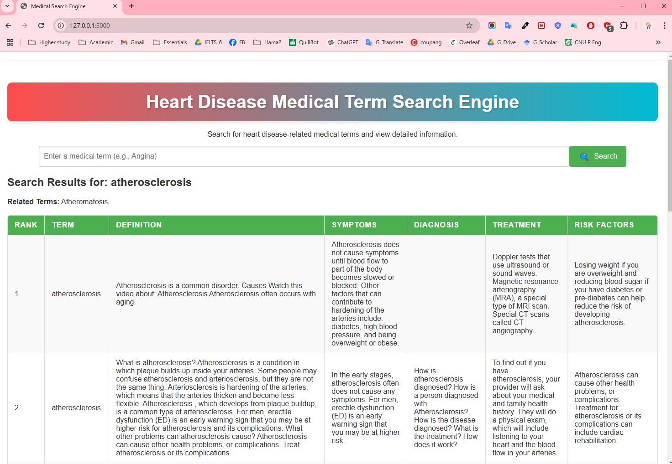
Output Example: Atherosclerosis

Slide 31
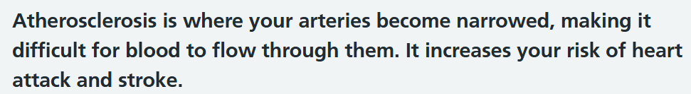
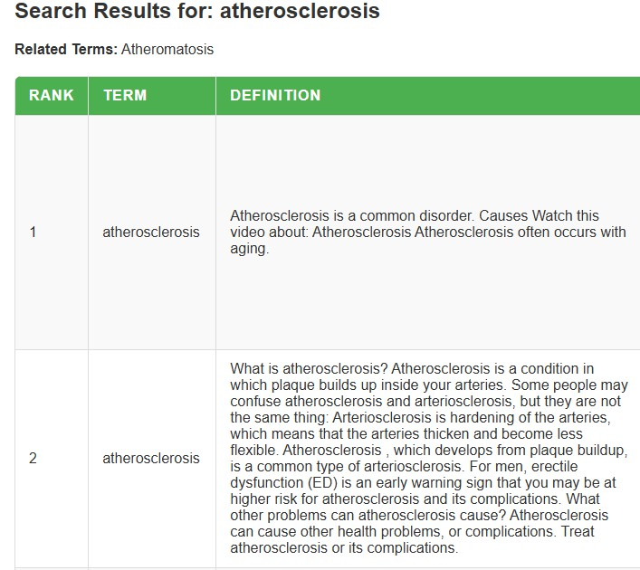
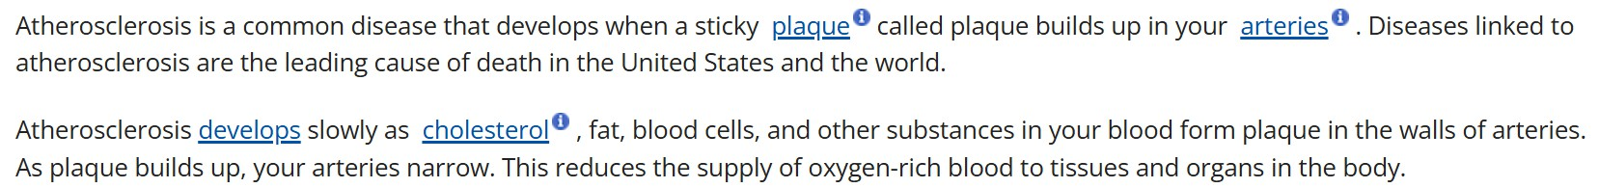
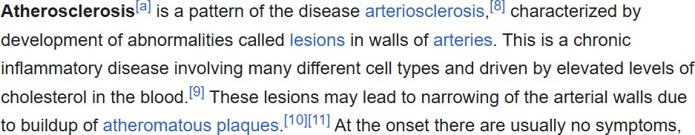
Result comparison with other webpages
https://www.nhs.uk/conditions/atherosclerosis/
https://www.nhlbi.nih.gov/health/atherosclerosis
https://en.wikipedia.org/wiki/Atherosclerosis

Slide 32
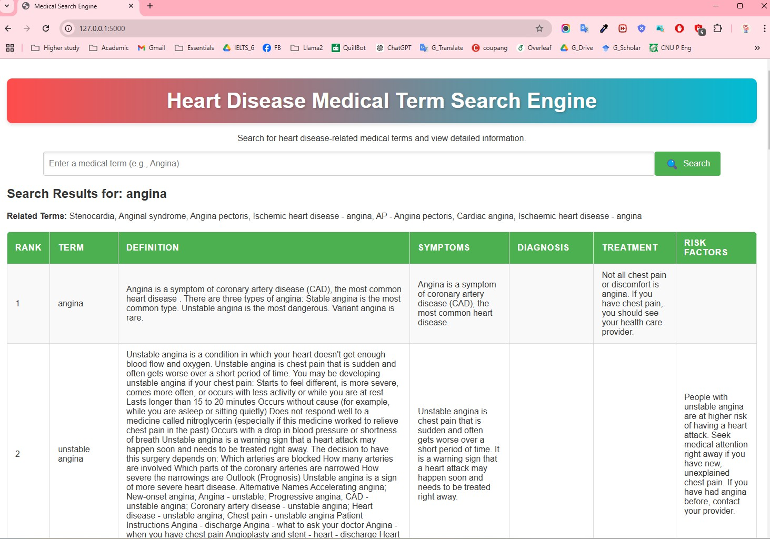
Output Example: Angina

Slide 33
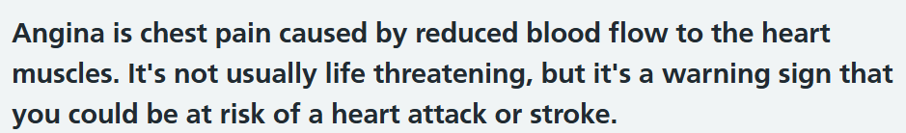
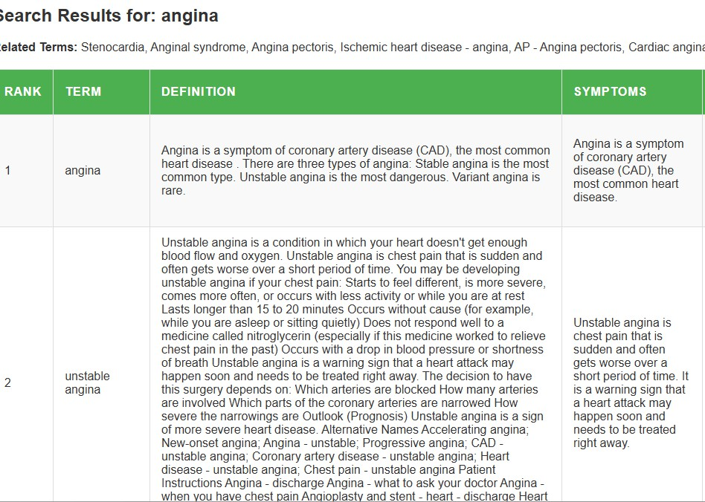
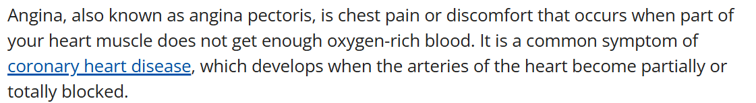
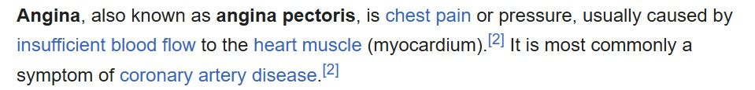
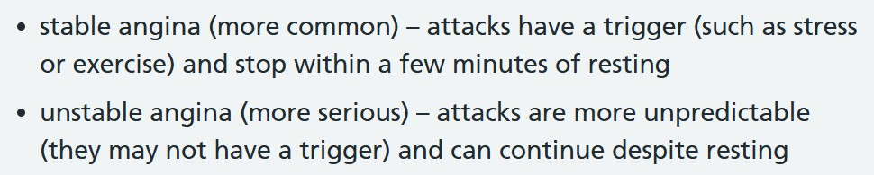
Result comparison with other webpages
https://www.nhs.uk/conditions/angina/
https://www.nhlbi.nih.gov/health/angina
https://en.wikipedia.org/wiki/Angina

Slide 34
Live Demo

Slide 35
Thank You

