Slide 1

Theory of Computation
Md. Mahadi Hasan Shaon
Lecturer, UGV

Slide 2
Deterministic and Nondeterministic Computation

Slide 3
Types of Automata
Finite Automata
Deterministic Finite Automata
Non Deterministic
Finite Automata

Slide 4
Difference between DFA & NFA
Deterministic Finite Automata | Non Deterministic Finite Automata
For Every symbol of the alphabet, there is only one state transition in DFA. | We do not need to specify how does the NFA react according to some symbol.
DFA cannot use Empty String transition. | NFA can use Empty String transition.
DFA can be understood as one machine. | NFA can be understood as multiple little machines computing at the same time.
DFA will reject the string if it end at other than accepting state. | If all of the branches of NFA dies or rejects the string, we can say that NFA reject the string.
Backtracking is allowed in DFA. | Backtracking is not always allowed in NFA.
DFA is more difficult to construct. | NFA is easier to construct.

Slide 5
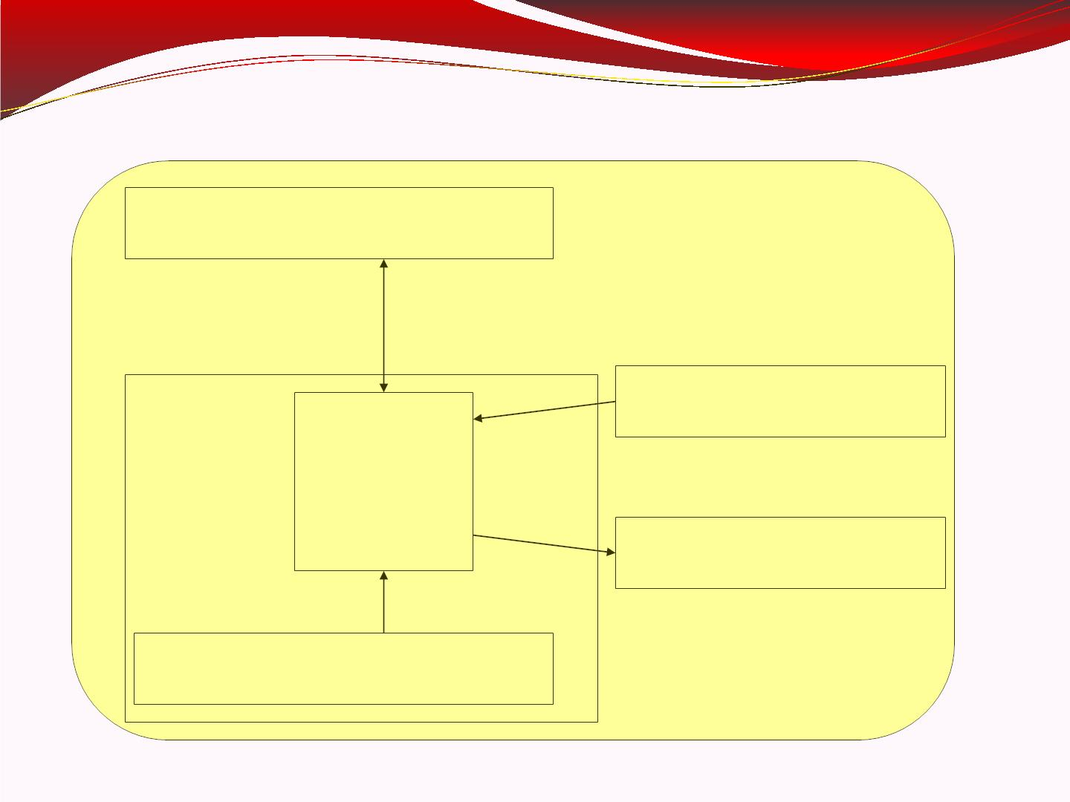
Automaton
temporary memory
Automaton
CPU
input memory
output memory
Program memory

Slide 6
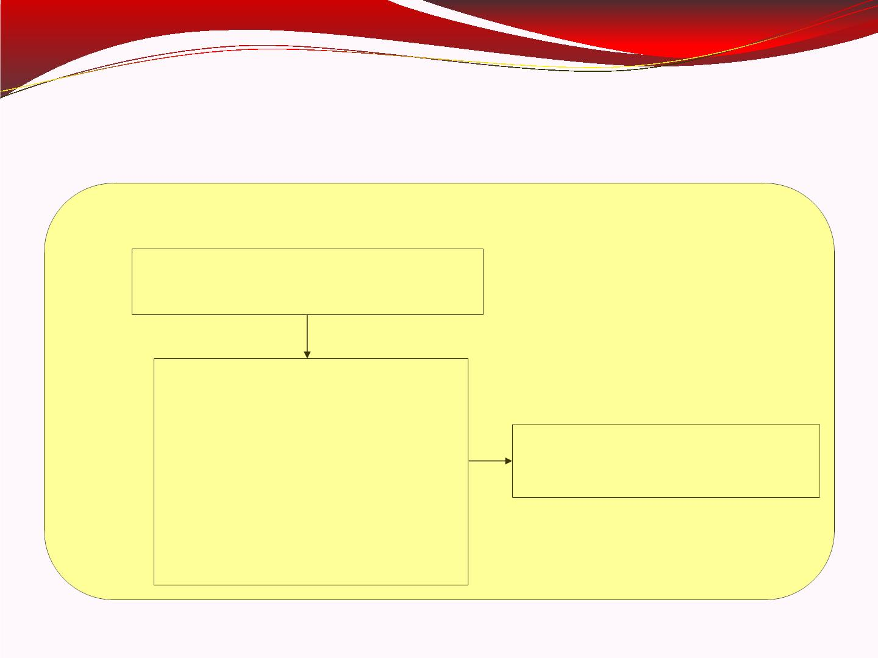
Finite Automaton
Input
String
Output
String
Finite
Automaton

Slide 7
DFA
DFA: Deterministic Finite Automaton.
Every step of a computation follows in a unique way from the preceding step.
When the machine is in a given state and reads the next input symbol, we know the next state will be – it is determined.
We call this deterministic computation.

Slide 8
Formal Definition of a DFA
A DFA is a five-tuple:
M = (Q, Σ, δ, q₀, F)
Q A finite set of states
Σ A finite input alphabet
q₀ The initial/starting state, q₀ is in Q
F A set of final/accepting states, which is a subset of Q
δ A transition function, which is a total function from Q x Σ to Q
δ: (Q x Σ) –> Q δ is defined for any q in Q and s in Σ, and
δ(q,s) = q’ is equal to some state q’ in Q, could be q’=q
Intuitively, δ(q,s) is the state entered by M after reading symbol s while in state q.

Slide 9
The finite control can be described by a transition diagram or table:
1 0 0 1 1
q₀ q₀ q₁ q₀ q₀ q_{0 accpeted}
One state is final/accepting, all others are rejecting.
The above DFA accepts those strings that contain an even number of 0’s, including the null string, over Sigma = {0,1}
L = {all strings with zero or more 0’s}
Note, the DFA must reject all other strings
1
0
q₀
q₁
1
0

Slide 10
Q = {q₀, q₁}
Σ = {0, 1}
Start state is q₀
F = {q₀}
δ:
0 1
q₀ q₁ q₀
q₁ q₀ q₁
1
0
q₀
q₁
1
0

Slide 11
Nondeterministic Finite State
Automata (NFA)
An NFA is a five-tuple:
M = (Q, Σ, δ, q₀, F)
Q A finite set of states
Σ A finite input alphabet
q₀ The initial/starting state, q₀ is in Q
F A set of final/accepting states, which is a subset of Q
δ A transition function, which is a total function from Q x Σ to 2^{Q}
δ: (Q x Σ) –> 2^{Q} :2^{Q} is the power set of Q, the set of all subsets of Q δ(q,s) :The set of all states p such that there is a transition
labeled s from q to p
δ(q,s) is a function from Q x S to 2^{Q} (but not only to Q)

Slide 12
Properties of NFA
0,1
0,1
a₁
1
a₂
0, ε
a₃
1
a₄
We already know DFA, so it would be sufficient to look into the differences of properties between the two.
In NFA a state may have –
  Zero or more exiting arrows for each alphabet symbol.
  Zero or more exiting arrows with the label ε.
So we can see that, not all steps of a computation follows in a unique way from the preceding step. There can be multiple choices to move from one state to another with a symbol. That’s the reason it’s computation is called nondeterministic.

Slide 13
Running an NFA
If we encounter a state with multiple ways to proceed –
  The machine splits into multiple copies of itself and follows all the possibilities in parallel.
  Each copy of the machine takes one of the possible ways to proceed and continues as before.
  If there are subsequent choices, the machine splits again.
If a state with an ε symbol on an exiting arrow is encountered without reading any input, the machine splits into multiple copies,
  one following each of the exiting ε-labeled arrows and
  one staying in the current state.
If the next input symbol doesn’t appear on any of the arrows exiting the state occupied by a copy of the machine, that copy of the machine dies, along with the branch of the computation associated with it.
If any one of these copies of the machine is in an accept state at the end of the input, the NFA accepts the input strings.
So, nondeterminism may be viewed as a kind of parallel computation wherein several processes can be running concurrently.
If at least one of these processes accepts then the entire computation accepts.

Slide 14
Example
0,1
0,1
010110
a₁
1
a₂
0, ε
a₃
1
a₄
Symbol read
0 -------------------------------------------------------------------------
1 ----------------------------------------------------------------
0 --------------------------------------------------------
1 ----------------------------------------------------
1 ------------------------------------------
0 -------------------------------------
a₁
a₁
a₁
a₂
a₃
a₁
a₃
a₁
a₂
a₃
a₄
a₁
a₂
a₃
a₄
a₄
a₁
a₃
a₄
a₄
a₄
a₄

Slide 15
Example
0,1
0,1
a₁
1
a₂
0, ε
a₃
1
a₄
Let, the above NFA N₁ = (Q₁, Σ, δ₁, a₁, F₁).
  Q₁ = {a₁, a₂, a₃, a₄}.
  Σ = {0, 1}.
  δ₁ is given as –
  | 0 1 ε
  a₁ | {a₁} {a₁, a₂} φ
  a₂ | {a₃} φ {a₃}
  a₃ | φ {a₄} φ
  a₄ | {a₄} {a₄} φ
  a₁ is the start state.
  F₁ = {a₄}.

Slide 16
Example
b₁
0
1
ε
0
b₂
b₃
0,1
Let, the above NFA N₂ = (Q₂, Σ, δ₂, b₁, F₂).
  Q₂ = {b₁, b₂, b₃}.
  Σ = {0, 1}.
  δ₂ is given as –
  | 0 1 ε
  b₁ | φ {b₂} {b₃}
  b₂ | {b₂, b₃} {b₃} φ
  b₃ | {b₁} φ φ
  b₁ is the start state.
  F₂ = {b₁}.

