Slide 1
Innovation at Machine Speed
AI in Development & Product Design
Design, Develop and Innovate with AI
Presented by
Monirul Haque and Sheikh Araf Noshin

Slide 2

— Sam Altman, 2024
CEO, OPENAI
“AI is not just a technology trend—it’s a rewriting of how we think about knowledge, work and invention itself.”

Slide 3
The Beginning of AI uprising
Data Explosion: Trillions of data points are being generated every second from social media, sensors, transactions, and interactions.
Hardware Advancement: GPUs, TPUs, and now custom AI chips enabling models with billions of parameters.
Scientific Breakthrough in Architectures: The paper “Attention is All You Need” released by Google, started this revolution. The transformer models unlocked LLMs capable of human-like reasoning and communication.

Slide 4
The Beginning of AI uprising
Jun 2017
Nov 2022
Jan 2023
Present
“Attention is All You Need” Paper released
OpenAI released Chatgpt as conversational AI
Chatgpt crossed 100 million users (still the fastest growing app ever)
We have tons of LLM and AI agents for Software, design, healthcare, logistics…

Slide 5
Large Language Model
vs
AI Workflow
vs
AI Agent
vs
Agentic/Multi-Agent AI

Slide 6
Large Language Model
What it is: A type of AI model (generally derived from transformer arch) trained on huge amounts of text data that can understand and generate human-like language.
Core ability: Predicts the “next word” in a sequence, but can be used for reasoning, summarizing, translating, coding, etc.
Example tools to use it: Chatgpt (GPT 4), Claude, Llama, Gemini

Slide 7
AI Workflow
What it is: A structured sequence of AI models + traditional steps to solve a task. The LLM is one tool inside the workflow, but not the whole thing.
We can combine multiple LLM models with different neural network architectures, statistical models and normal logic/python scripts.
Core ability: Combines multiple tools (databases, APIs, LLMs, rules) into a pipeline.
Example tools to use it: n8n, Zapier, ComfyUI, Microsoft power automate

Slide 8
AI workflow example: Commercial Invoice processing
Invoice paper
CNN based OCR model to recognize texts from the paper
(e.g. paddleOCR)
Store all the information in a database management system
LLM cleaning up the texts and extract useful information
(e.g. Llama)
Classify the document using a statistical classifier model (e.g. Decision Tree)
Script to check vendor/buyer info and send them notification through sms

Slide 9
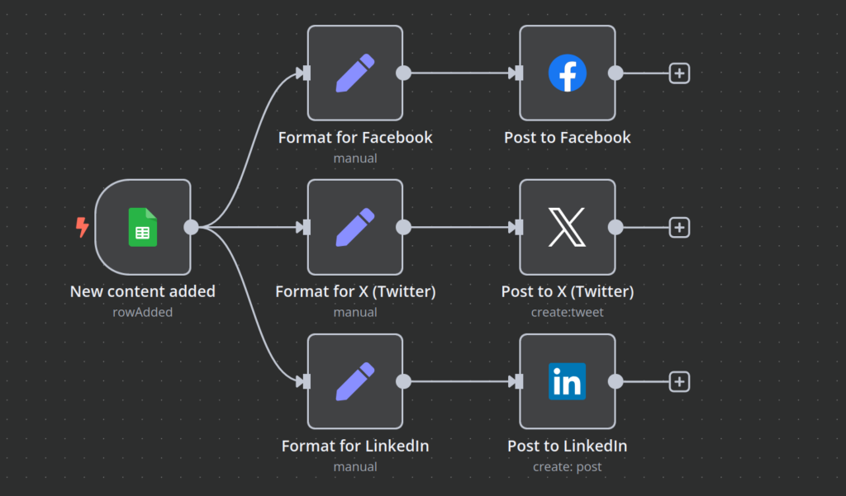
AI workflow example: Content posting (n8n example)

Slide 10
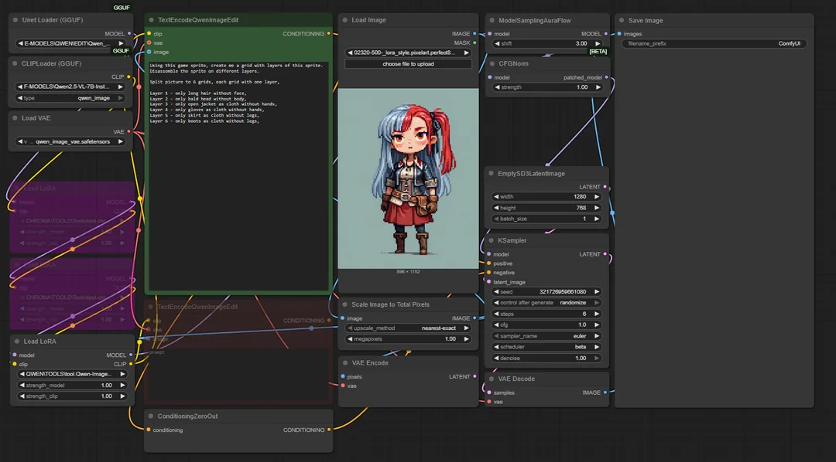
AI workflow example: Pixel animation (ComfyUI example)

Slide 11
AI Agent
What it is: An AI helper system (generally powered by an LLM) that can take actions, not just answer. It plans, calls external tools/APIs, and adapts.
Core ability: Can decide steps, execute, evaluate itself and repeat to improve results
Example tools to use it: Cursor IDE, Gemini CLI, ChatGPT plus (agent mode)

Slide 12
AI agent example: Coding & testing (Micro Agent)

Slide 13
Agentic AI Or Multi-Agent AI
What it is: Multiple AI agents working in a team. It’s like a team of specialists working together to solve a problem.
Example tools to use it: n8n, ComfyUI-CrewAI
In the previous example of AI Agent we saw an AI agent capable of writing code, executing the code from terminal, testing the outputs, then modifying the code again to fix the bugs. It’s just an AI agent specialized in programming. Imagine AI agents for Designing, Programming, QA testing and Documentation working together to create a whole software; that’s agentic ai or multi-agent ai.

Slide 14
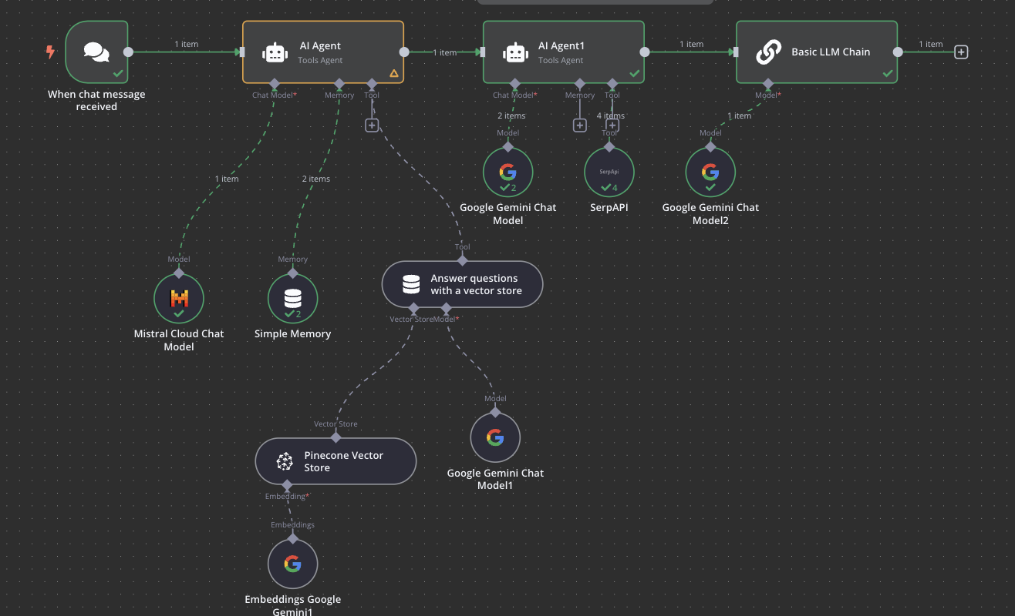
AI agent example: An n8n example of how perplexity search works underneath

Slide 15
Trending AI tools
AI assistants: ChatGPT, Grok, Claude, Gemini, Microsoft Copilot, Meta AI, Pi (Inflection), Mistral Le Chat, Amazon Q, Perplexity AI, Character.AI
Video generation: Synthesia, Google Veo, OpusClip, Runway Gen-3, Pika, Luma Dream Machine, HeyGen, Descript AI Video, Stable Video Diffusion, Vizard
Image generation: GPT-4o, Midjourney, DALL·E 3, Stable Diffusion XL, Adobe Firefly, Ideogram, Leonardo.ai, Playground v2, Flux (Black Forest Labs), Recraft
Meeting assistants: Fathom, Nyota, OtterPilot (Otter.ai), Fireflies.ai, Supernormal, Sembly, Avoma, Read.ai, tl;dv, Airgram
Automation: n8n, Manus, Zapier, Make (Integromat), IFTTT, Pipedream, Bardeen, UiPath, Automation Anywhere, Microsoft Power Automate, Tines
Research: Deep Research, NotebookLM, Consensus, scite Assistant, ResearchRabbit, Connected Papers, Litmaps, Semantic Scholar

Slide 16
Trending AI tools
Writing: Rytr, Sudowrite, Jasper, Writesonic, Grammarly, Wordtune, Copy.ai, QuillBot, Anyword, Lex
Search engines: Google AI Mode, Perplexity, ChatGPT Search, Bing Copilot, You.com, Phind, Brave Search, Kagi
Graphic design: Canva Magic Studio, Looka, Adobe Express, Microsoft Designer, Kittl, VistaCreate, Fotor, Snappa, Tailor Brands, Brandmark
App builders & coding tools: Lovable, Cursor, GitHub Copilot, Codeium, Tabnine, Replit Agents, Bolt.new (StackBlitz), Vercel v0, Debuild, Windmill
Knowledge management: Notion Q&A, Guru, Coda AI, Confluence AI, ClickUp Brain, Slab AI, Mem, Glean, Slite AI, Tettra
Email: Hubspot Email Writer, Fyxer, Shortwave, Superhuman AI, Flowrite, Lavender, Ellie, Front AI, Gmail “Help me write” (Gemini)
Scheduling: Reclaim, Clockwise, Motion, Vimcal, Calendly, Mayday, Trevor AI, CalendarHero

Slide 17
Trending AI tools
Presentations: Gamma, Copilot for PowerPoint, Tome, Beautiful.ai, Pitch, SlidesAI.io, Plus AI (for Google Slides), Prezi AI, Canva Magic Design
Resume builders: Teal, Kickresume, Rezi, Resume.io, Enhancv, Standard Resume, FlowCV, Wonsulting ResumAI, Zety, Novorésumé
Voice generation: ElevenLabs, Murf, Play.ht, Resemble AI, NaturalReader, Amazon Polly, Azure Neural TTS, Google Cloud TTS, Coqui TTS
Music generation: Suno, Udio, Stable Audio, AIVA, Soundraw, Beatoven.ai, Mubert, Boomy, Meta MusicGen
Marketing: AdCreative, AirOps, Jasper (Campaigns), Copy.ai (Ads), Anyword, Predis.ai, Ocoya, Surfer AI, HubSpot Content Assistant, HoppyCopy
Game Sprite/Animation Generation: Meshy, Retrodiffusion, Scenario.gg, PixelVibe, Kaedim 3D, Inworld Sprite Creator, GANimator, PIFuHD, Anything V5 (anime/manga sprite-focused models),

Slide 18
AI company types
Foundational Companies: (e.g. OpenAI, Anthropic, Mistral, Google)
They research and develop their own models
Only large companies with huge funding can do that
Wrapper Companies: (e.g.Jasper, CopyAI, Descript etc)
Leverage the already existing apis from foundational companies and use them to build user-facing products
It’s easy and quick to startup a wrapper company but easily replicated by competitors.
Hybrid Companies: (e.g. Perplexity, Microsoft)
They start by using others apis but eventually research and develop their own models and keep both their own models and external models on their UI.

Slide 19
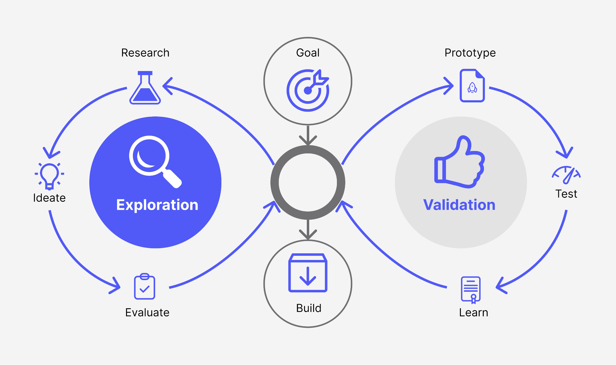
Product Design
It’s all about user convenience
Observe your environment and ask yourself “What painful problem do people have, that AI could solve 10× better/cheaper/faster?”

Slide 20
What Modern AI products have underneath
RAG (Retrieval-Augmented Generation):
LLMs often “hallucinate” because they rely on their training data only.
Instead of asking the LLM to “remember everything,” you give it access to a retrieval system (like a database or search engine).
Adding RAG to product means the AI product will have up-to-date knowledge.
MCP (Model Context Protocol):
A universal translator between an AI model and external tools (APIs, databases, agents).
If your agent needs to use a calendar, a database or an api; MCP ensures the model can understand the capabilities of each and use them consistently.
MCP makes agents more modular and extensible.

Slide 21
What Modern AI products have underneath
LLM Quantization:
Compress the model weights
Make LLM’s run on low resource devices.
There are some algorithms to reduce the number of bits each model weight stores in memory. That’s how we get fp-16 or fp-8 quantized models, where each model weight takes up 8 bit space in GPU memory.
We even have a 1-bit LLM now (Microsoft’s Bitnet 1.58b) which even runs on 2GB vram.
Guardrails
Raw LLMS are unpredictable, so a secondary model needs to be added before LLM to filter prompts before they hit the LLM and outputs after they’re generated.
Guardrails can be used as prompt enhancer for LLM’s too.

Slide 22
What Modern AI products have underneath
LoRA (Low Rank Adaption):
A way to fine-tune giant LLMs efficiently.
Instead of retraining the whole model, you only add/update small number of layers or some “adapter” layers.
Makes it possible to customize LLMs for new tasks cheaply (e.g., tuning a general model into a medical chatbot, tuning a general image model into a 2D pixel art game sprite generator).
LoRA modules are also modular and shareable — you can load LoRAs trained by others onto a base model and use them in tools like ComfyUI very quickly.

Slide 23
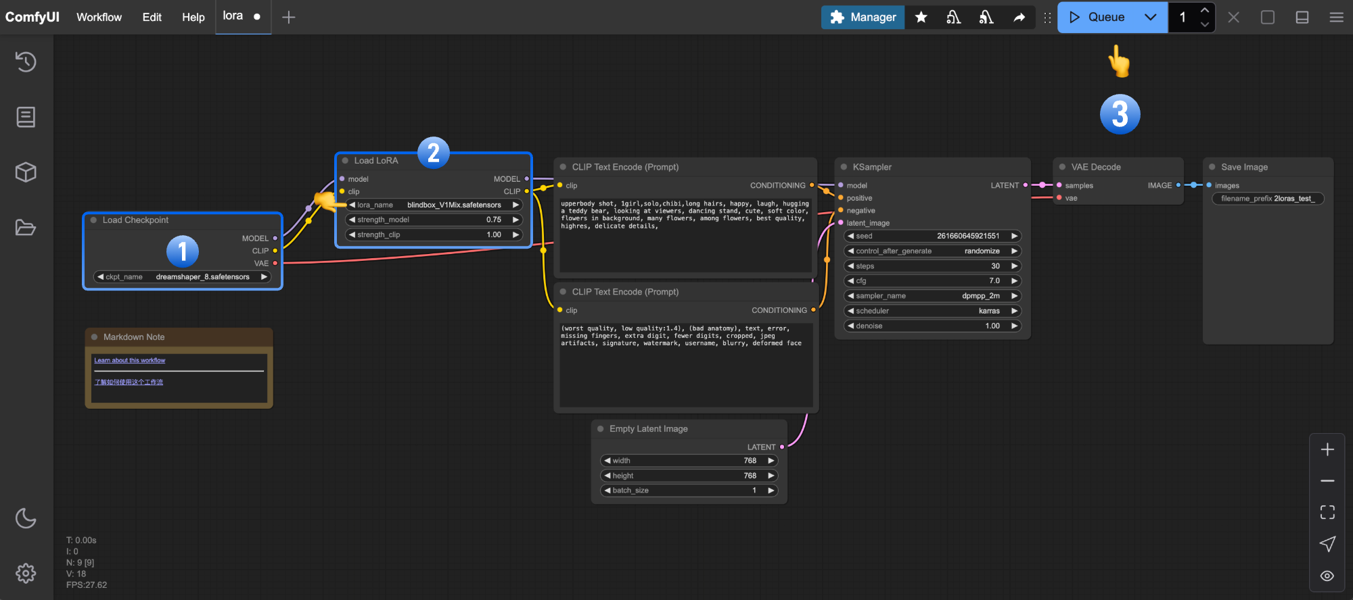
ComfyUI LORA example

Slide 24
What AI Engineers/Data Scientists do?
Understand the problem and determine whether solving this problem requires an LLM or Transformer/NeuralNet architecture or Statistical classifier or just normal programming logic.
Data collection, cleaning, preprocessing and annotation (if needed)
Create/fine-tune model or add an existing pretrained model to an AI workflow.
Create API out of that model (generally flask or Django)
Deploy the model or API (Startups require the AI engineer to do MLOps tasks)
Improve preprocessing/ finetune the model with new data/change the model after getting feedback.

Slide 25
How to find remote jobs
Build the right skills and showcase your projects on your CV and portfolio site
Learn the basics of Scikit-learn, Pytorch, pandas, numpy etc.
Also learn git, docker, ComfyUI, Selenium/Playwright, Linux terminal commands, rest api using flask
Where to find:
wellfound.com (previously known as AngelList)
Weworkremotely
Flexjobs
LinkedIn posts
remoteok.com
Toptal
Indeed
Airwrk

Slide 26
How to get product ideas for your startup?
Visit github trending repositories page regularly: https://github.com/trending
Keep track of the trending tech stacks or latest AI models that are being released regularly:
https://www.youtube.com/@theAIsearch
https://www.youtube.com/@Fireship
https://www.youtube.com/@TwoMinutePapers

Slide 27
Limitations: AI is not perfect yet
Replit AI disaster: AI agent ignored explicit instructions to freeze all changes and deleted a live production database on July 2025.
Klarna, a fintech company that fired around 700 employees to replace them with AI-driven customer support. The company stock has plummeted to 6.7 billion from 45.6 billion dollars
Wimbledon’s AI-powered line judge was accidentally turned off during a match, forcing players to replay points, illustrating operational risks with AI systems in live events.
Apple released Iphone 15 overhyping Apple AI but failed miserably. The beta version underperformed and was far behind from the current competition.
Apple’s paper “The illusion of thinking” https://ml-site.cdn-apple.com/papers/the-illusion-of-thinking.pdf "The Illusion of Thinking"

Slide 28
Future Research
Continual Learning
Hierarchical Reasoning Model
Model Distillation
Quantum Machine learning
Parameter/Energy-Efficient AI Architectures
Sustainable AI
Explainable LLM
Reinforcement Learning Agent
Efficient Model Pruning
Swarm Intelligence and Collective AI

Slide 29
THANK YOU
Do you have any questions?

