Slide 1
Data Analytics Project
Title: Healthcare Analytics: Predicting Stroke Risk using Machine Learning
A comprehensive data pipeline from raw data to interactive prediction.
Md. Islam
TMU ID: 500863499
Supervisor: Dr. Ceni Babaoglu

Slide 2
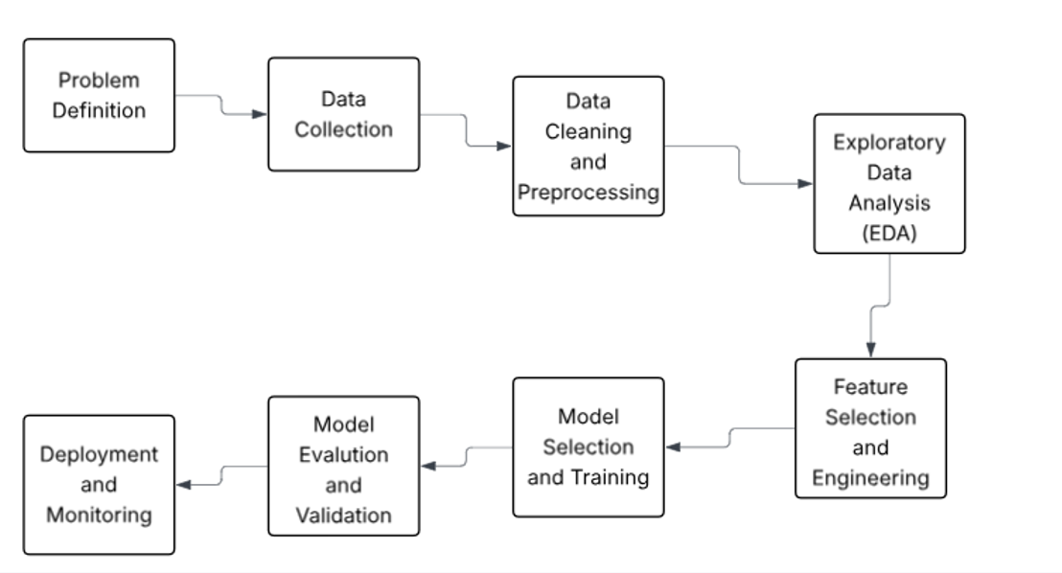
Agenda
Problem Statement & Objective
Dataset Overview (Health-Stroke)
Data Cleaning & Outlier Handling (Data Preprocessing)
Exploratory Data Analysis (EDA)
Feature Preparing & Handling Imbalance (SMOTE)
Model Selection Strategy (10-Fold Cross-Validation)
Final Model Evaluation (Confusion Matrix)
Key Risk Factors (Feature Importance)
Practical Application: Interactive Tool
Conclusion

Slide 3
Problem Statement & Objective
Challenge: Stroke is a leading cause of death and disability globally.
Key Insight: Early identification of high-risk individuals enables preventative care.
Our Goal: Build a smart, data-driven tool to estimate a person's stroke risk.
Vision: Move from reactive treatment to proactive, preventative healthcare.

Slide 4
Project Deliverables
The Model:
"Which machine learning algorithm (With several models to choose from) works best for this specific prediction task?",
The Drivers:
Beyond just making a prediction, What does it tell us about the drivers of stroke risk?

Slide 5
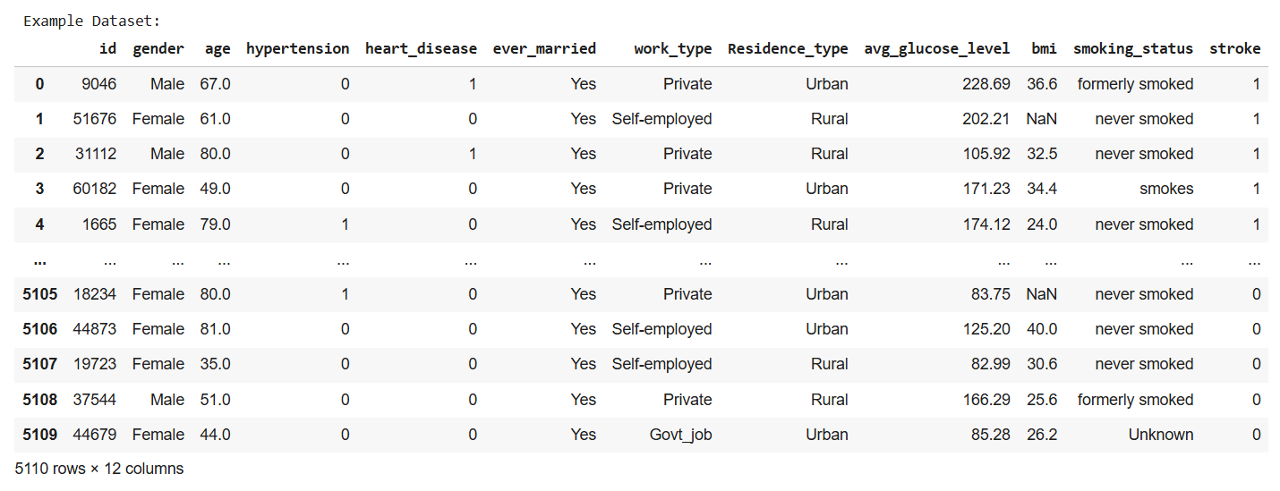
Heart_Stroke - Dataset

Slide 6
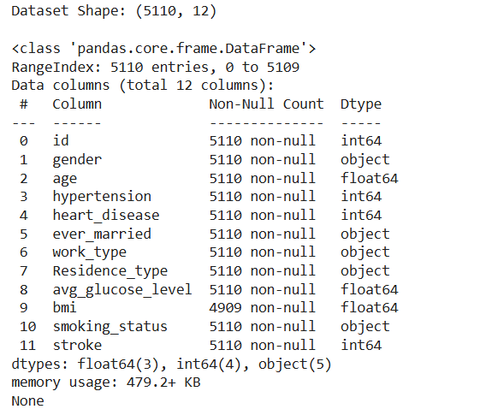
Dataset Overview
Source & Structure:
Data Source: Healthcare Stroke Dataset (CSV).
Initial Shape: Approximately 5,100 records, 12 columns.
Target Variable: stroke (Binary: 0 = No, 1 = Yes).
Key Features:
Demographic: Gender, Age, Residence Type, Marital Status.
Medical: Hypertension, Heart Disease, Average Glucose Level, BMI.
Lifestyle: Work Type, Smoking Status.

Slide 7
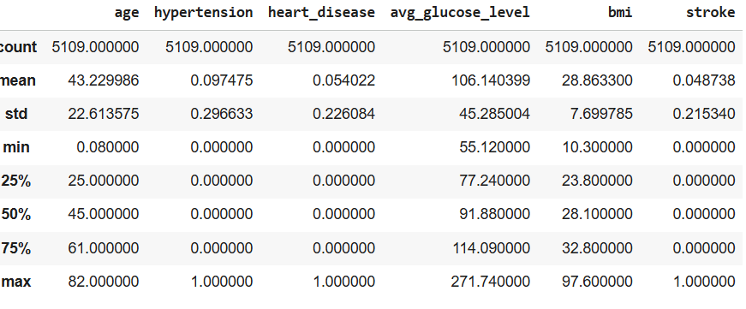
Data Cleaning & Preprocessing Strategy
Handling Missing Values:
  Detected missing values in bmi.
  Imputed using the median value to be robust against outliers.
Dropping Irrelevant Data:
  Removed the id column (provides no predictive power).
Handling Inconsistencies:
  Removed rows with 'Other' gender (too few samples).
  Merged 'Unknown' smoking status into 'never smoked' for consistency.

Slide 8
Handling Outliers (Numerical Data)
Features affected: age, avg_glucose_level, bmi.:
Distribution pattern:
  Age: The distribution is relatively uniform.
  Avg_glucose_level: This feature is highly right-skewed
  BMI: The BMI distribution is close to normal but slightly right-skewed, which aligns with the global trend towards overweight/obesity.
Method:
Interquartile Range (IQR) Clipping.
Values outside 1.5x the IQR were capped at the lower and upper bounds.

Slide 9
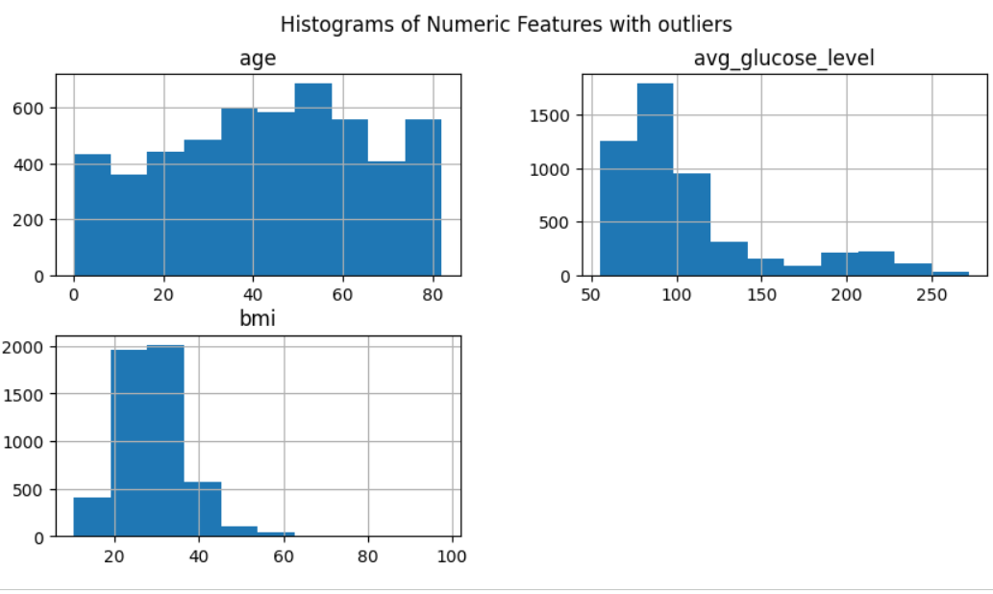
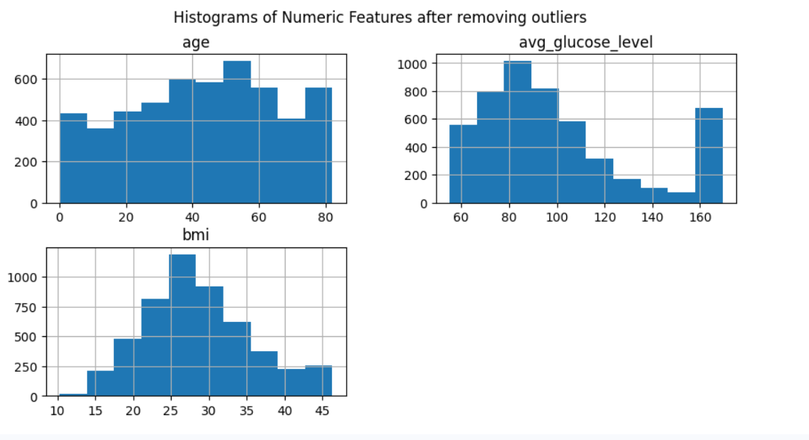
Exploratory Data Analysis (Numerical Data)

Slide 10
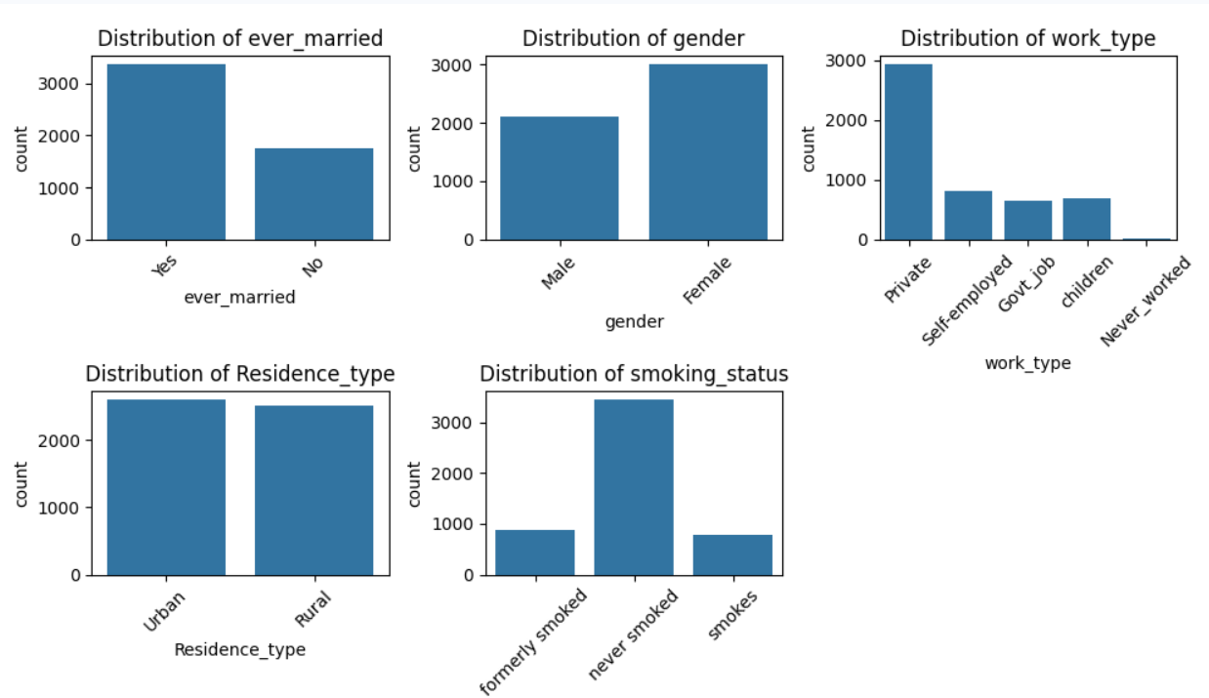
Exploratory Data Analysis (Categorical Data)
Key Observations:
Gender & Marriage: Balanced gender distribution; higher proportion of married individuals.
Work Type: Majority employed in the private sector.
Residence: Roughly equal split between Urban and Rural.
Smoking Status: Large proportion of 'never smoked' (after merging unknowns).

Slide 11
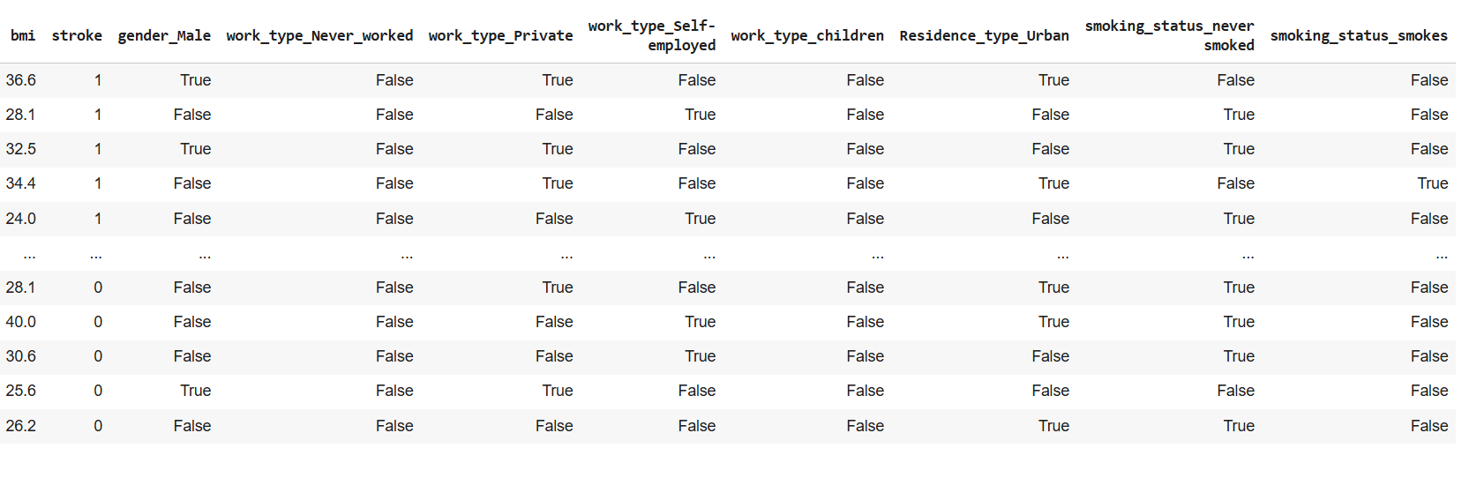
Feature Preparing
Binary Encoding (0/1):
Converted yes/no features: ever_married, hypertension, heart_disease.
One-Hot Encoding:
Applied to multi-category nominal features to avoid introducing false ordinal relationships.
Features: gender, work_type, Residence_type, smoking_status.
Note: Used drop_first=True to prevent multicollinearity (the dummy variable trap).

Slide 12
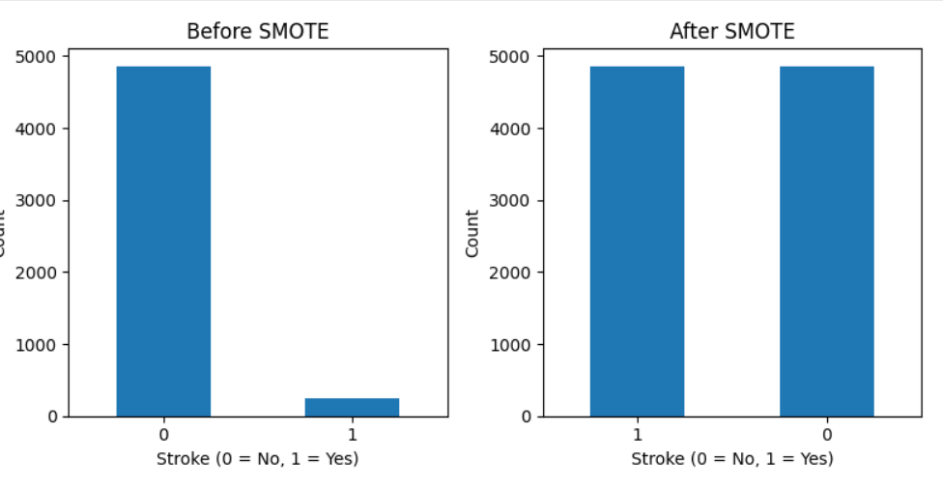
The Critical Challenge: Class Imbalance
The Problem:
Strokes are rare events.
Initial Distribution: Approx. 95% "No Stroke" vs. 5% "Stroke".
A model could achieve 95% accuracy by simply predicting "No" every time—this is useless.
The Solution: SMOTE (Synthetic Minority Over-sampling Technique)
Applied SMOTE to create synthetic examples of the minority class ("Stroke").
Result: A perfectly balanced training dataset (50/50 split), allowing models to learn stroke characteristics effectively.

Slide 13
Model Selection Strategy
Models Tested:
- Logistic Regression - Decision Tree Classifier - Random Forest Classifier
Performance Matrics:
- Accuracy - Precision - Recall - F1 Score
Evaluation Method: (Rigorous testing to find the best algorithm)
  10-Fold Cross-Validation on the balanced (SMOTE) dataset.
  Primary Metric: F1 Score ( Harmonic mean of Precision and Recall—the best metric for balanced evaluation).

Slide 14
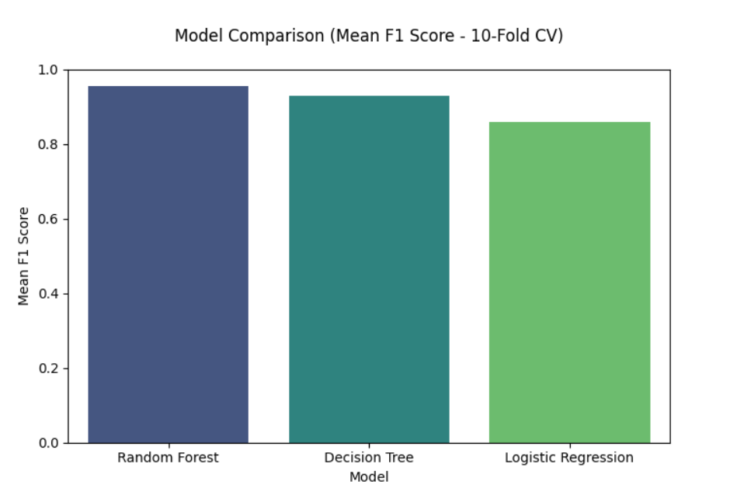
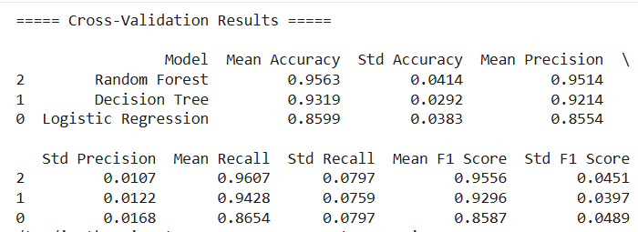
Models Performances

Slide 15
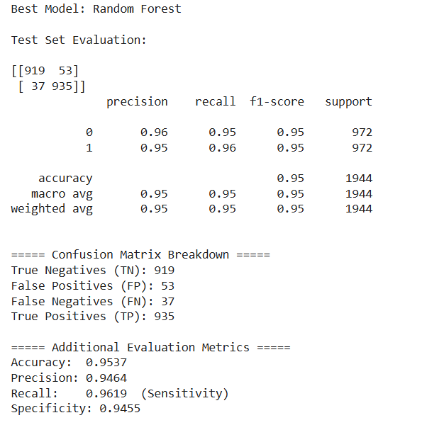
Best Model Performance
Train dataset:
Data Split: 80% Training / 20% Testing (Stratified).
Performance of the "Best Model" (Random Forest) on test data.

Slide 16
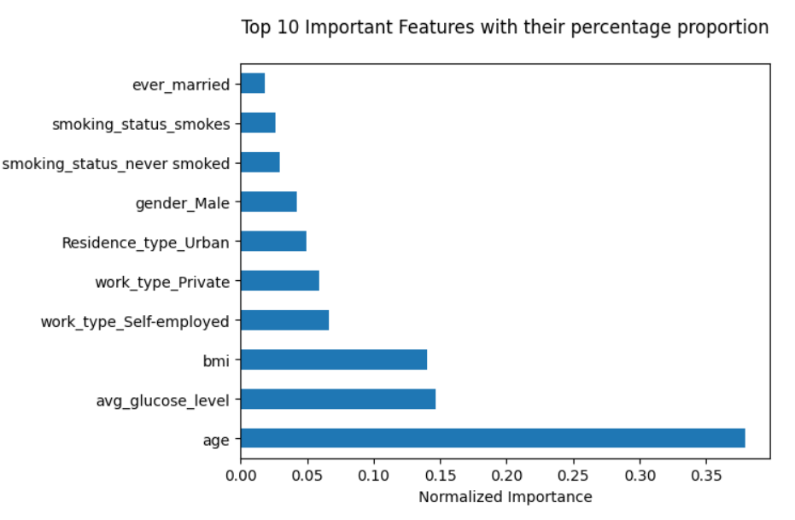
Key Stroke Risk Factors
Feature Importance :
The model (Random Forest) identified the following as the most significant predictors of stroke risk:
Interpretation: Typically, Age, Glucose Level, and BMI are top drivers, alongside specific work types or health conditions.

Slide 17
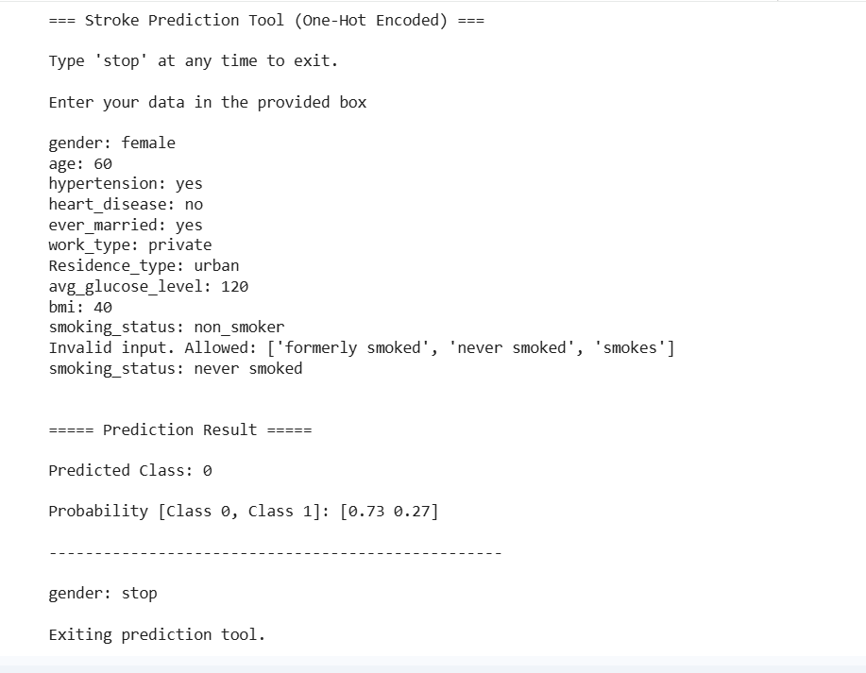
Practical Application: Interactive Tool
We developed a Python-based interactive function that mimics real-world deployment.
How it works:
User Input: A clinician or user enters patient details (Age, BMI, Smoking Status, etc.).
Preprocessing Pipeline: The tool applies the exact same encoding (one-hot) and alignment used during training.
Prediction: The trained Random Forest model outputs a classification (Stroke/No Stroke) and a probability score.

Slide 18
Conclusion & Future Work
Summary:
Successfully built an end-to-end pipeline handling missing data, outliers, and severe class imbalance via SMOTE.
Random Forest outperformed other models based on Cross-Validation F1 scores.
Identified key physiological and demographic risk factors.

Slide 19
Limitations
Limitations:
No project is perfect, and we're aware of ours:
Dataset relatively small and contains synthetic samples after SMOTE
Some features self-reported (e.g., smoking status had 30% “Unknown”)
No temporal or lifestyle depth (exercise, diet, family history)
While Random Forest, it required greater computational resources. This may pose challenges for deployment in resource-limited healthcare settings.
Simplified models (e.g., calibrated Logistic Regression) could be deployed in low-resource healthcare environments where computational capacity is limited, ensuring broader accessibility

Slide 20
Future Work
So, what's next? We'd love to:
Test more powerful models.
Source a larger, more diverse, and clinically rich dataset.
Turn our command-line tool into a user-friendly web app.

Slide 21
Thank you for your time!
I'm happy to answer any questions.
Thank you!

