Slide 1
NodeJs
Introduction
By Monirul Molla

Slide 2
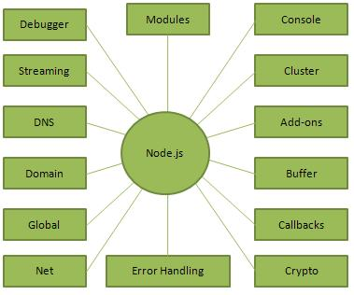
What is NodeJs?
Created 2009 by Ryan Dahl
Evented I/O for JavaScript
Server Side JavaScript
Runs on Google's V8 JavaScript Engine

Slide 3
Where to Use Node.js?
I/O bound Applications
Data Streaming Applications
Data Intensive Real-time Applications (DIRT)
JSON APIs based Applications
Single Page Applications

Slide 4
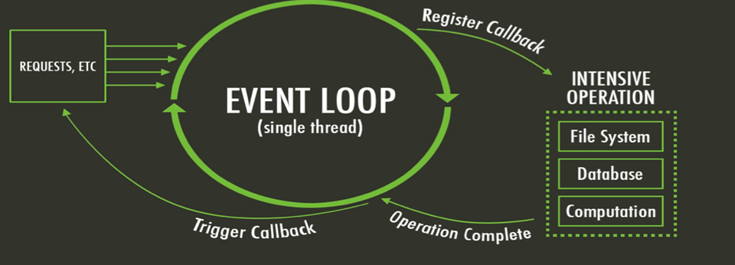
What is unique about Node.js?
JavaScript on server-side thus making communication between client and server will happen in same language
Servers normally thread based but Node.JS is “Event” based. Node.JS serves each request in a Evented loop that can handle simultaneous requests.

Slide 5
What can you do with Node ?
It lets you Layered on top of the TCP library is a HTTP and HTTPS client/server.
The JS executed by the V8 javascript engine (the thing that makes Google Chrome so fast)
Node provides a JavaScript API to access the network and file system.

Slide 6
What can’t do with Node?
Node is a platform for writing JavaScript applications outside web browsers. This is not the JavaScript we are familiar with in web browsers. There is no DOM built into Node, nor any other browser capability.
Node can’t run on GUI, but run on terminal

Slide 7
Threads VS Event-driven
Threads | Asynchronous Event-driven
Lock application / request with listener-workers threads | only one thread, which repeatedly fetches an event
Using incoming-request model | Using queue and then processes it
multithreaded server might block the request which might involve multiple events | manually saves state and then goes on to process the next event
Using context switching | no contention and no context switches
Using multithreading environments where listener and workers threads are used frequently to take an incoming-request lock | Using asynchronous I/O facilities (callbacks, not poll/select or O_NONBLOCK) environments

Slide 8
Why node.js use event-based?
1) Normal process the webserver while processing the request will have to wait for the IO operations and thus blocking the next request to be processed.
2) Node.JS process each request as events, doesn’t wait (non-blocking) for the IO operation to complete → it can handle other request at the same time.
When the IO operation of first request is completed it will call-back the server to complete the request.

Slide 9
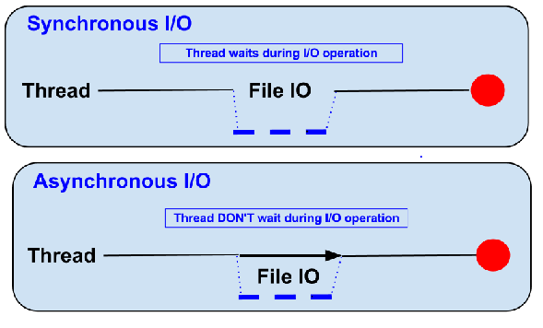
Blocking vs Non-Blocking
Example :: Read data from file and show data
Block:::
● Read data from file
● Show data
● Do other tasks
var data = fs.readFileSync( “test.txt” );
console.log( data );
console.log( “Do other tasks” );
Non Blocking::
● Read data from file
When read data completed, show data
● Do other tasks
fs.readFile( “test.txt”, function( err, data ) {
console.log(data);});

Slide 10
Node.js VS Apache
It's faster
It can handle tons of concurrent requests
Platform | Number of request per second
PHP ( via Apache) | 3187,27
Static ( via Apache ) | 2966,51
Node.js | 5569,30

Slide 11
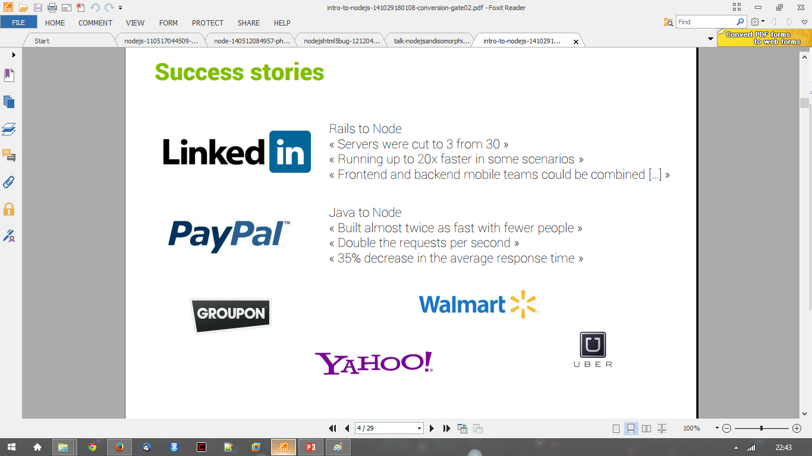
Success Stories….

Slide 12
Node Js for…
● Web application
● Websocket server
● Ad server
● Proxy server
● Streaming server
● Fast file upload client
● Any Real-time data apps
● Anything with high I/O

Slide 13
File package.json
{
"name": "node-js-getting-started",
"version": "0.2.5",
"description": "A sample Node.js app using Express 4",
"engines": {
"node": "5.9.1"
},
"main": "index.js",
"scripts": {
"start": "node index.js"
},
"dependencies": {
"body-parser": "^1.16.1",
"cookie-parser": "^1.4.3",
"cool-ascii-faces": "1.3.4",
"ejs": "2.4.1",
"express": "^4.13.3",
"express-session": "^1.15.1",
"mongodb": "^2.2.24",
"multer": "^1.3.0",
"pg": "4.x",
"pug": "^2.0.0-beta11"
},
"repository": {
"type": "git",
"url": "https://github.com/heroku/node-js-getting-started"
},
"keywords": [
"node",
"heroku",
"express"
],
"license": "MIT"
}
Project information
• Name
• Version
• Dependencies
• Licence
• Main file etc

Slide 14
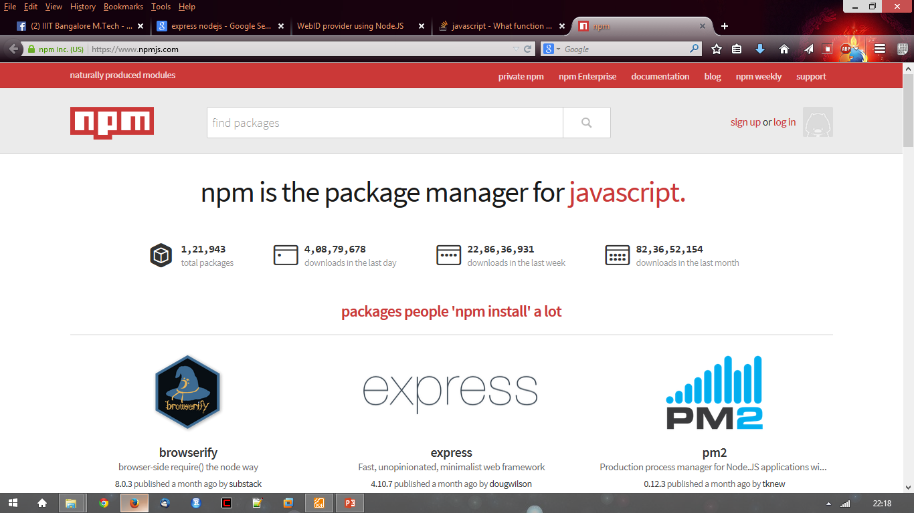
NodeJs module
● https://npmjs.org/
● # of modules = 1,21,943
To install a module…..inside your project directory
npm install <module name>
To use the module in the java script file:
var http = require(‘http’);
var fs = require(‘fs’);
var express = require(‘express’);

Slide 15
Basic Steps to Create a NodeJs Project
Step 1: Create a directory
>mkdir MyEventApp
>cd MyEventApp
Step 2: Call npm init and follow the instructions to create package.json
(prompts you for a number of things, such as the name and version of your application)
> $ npm init
package.json
{ "name": “MyEventApp", "version": "1.0.0", "description": "To process http server request", "main": "index.js", "scripts": { "test": "echo \"Error: no test specified\" && exit 1" }, "author": "monirul", "license": "ISC", "dependencies": { "connect":"*", "body-parser": "*" } }

Slide 16
Basic Steps to NodeJs Project continue
Step 3: Create file index.js with the following code
index.js
console.log("handing web server events"); //This http module is used to handle http request and response. var http = require('http');
// To create an http serever var server = http.createServer(); //To handle a client request server.on('request',function(req,res){ console.log("Request Recieved::",req.headers); res.end("Thanks I got your request"); }) server.on('upgrade',function(req,socket,head){ console.log("upgrade the connection to web socket connection"); }) //To set listener host and port server.listen(3456,'localhost',function(){ console.log("Http server listening to port 3456"); });

Slide 17
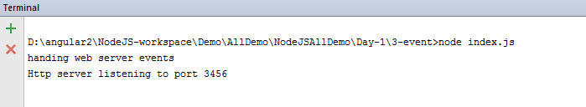
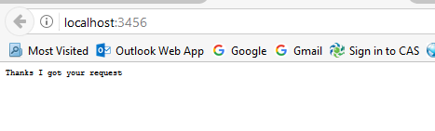
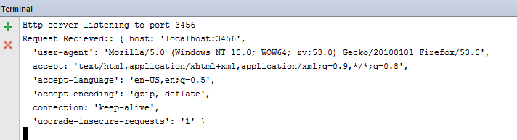
Basic Steps to NodeJs Project continue
Step 4: Run the server application using the following command
node index.js
Step 5: Load http://localhost:3456/ in a browser.

