Slide 1
ChatbotRestAPI
Introduction
By Monirul Molla

Slide 2
What is ChatbotRestAPI?
It's a rest API developed for Chatbot application to get the deployment status of assets. Generally when the user will request to get the details about the status through the chatbot of the asset which he requested for deployment. Internally chatbot use this Rest API to fetch the details of the asset
Technologies Used:
Spring Boot

Slide 3
ChatbotRestAPI-Functions
The rest API have two functions:
Getting the details of deployment information of all the environments of the asset.
Getting the status of a particular environment of the asset.

Slide 4
Machine Learning
Introduction
By Monirul Molla

Slide 5
What is Machine Learning?
A branch of artificial intelligence, concerned with the design and development of algorithms that allow computers to evolve behaviors based on empirical data.
As intelligence requires knowledge, it is necessary for the computers to acquire knowledge.

Slide 6
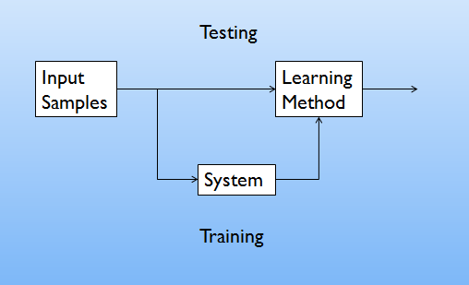
Learning System Model

Slide 7
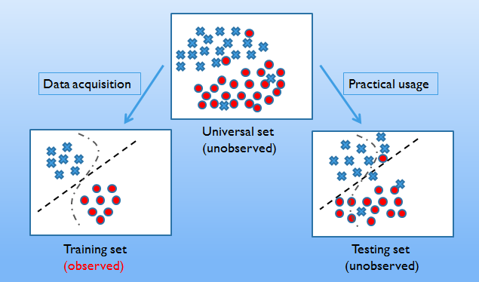
Training and Testing

Slide 8
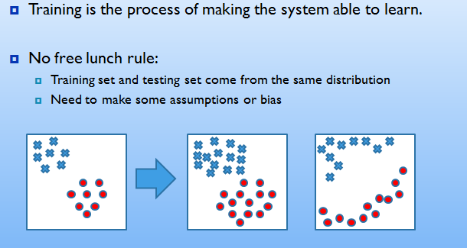
Training and Testing

Slide 9
Performance
There are several factors affecting the performance:
Types of training provided
The form and extent of any initial background knowledge
The type of feedback provided
The learning algorithms used
Two important factors:
Modeling
Optimization

Slide 10
Algrothims
The success of machine learning system also depends on the algorithms.
The algorithms control the search to find and build the knowledge structures.
The learning algorithms should extract useful information from training examples.

Slide 11


Algrothims
Supervised learning ( )
Prediction
Classification (discrete labels), Regression (real values)
Unsupervised learning ( )
Clustering
Probability distribution estimation
Finding association (in features)
Dimension reduction
Semi-supervised learning
Reinforcement learning
Decision making (robot, chess machine)

Slide 12
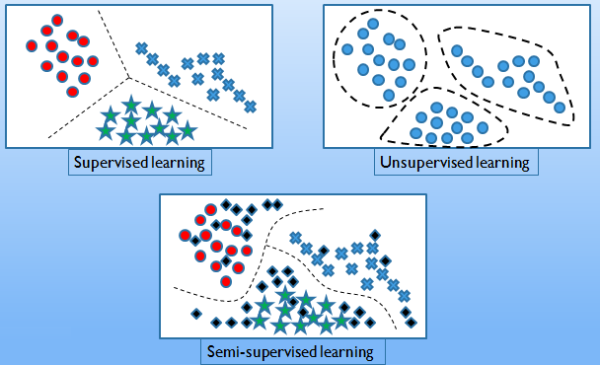
Algrothims

Slide 13
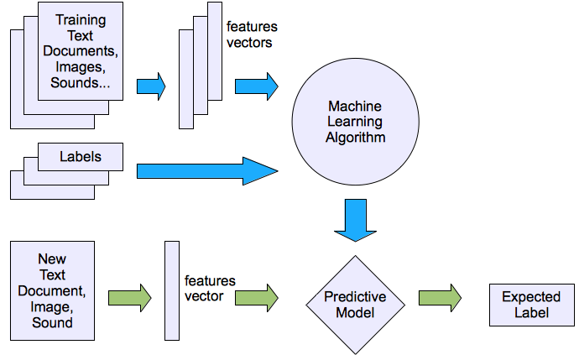
Machine Learning Structure
Supervised learning

Slide 14
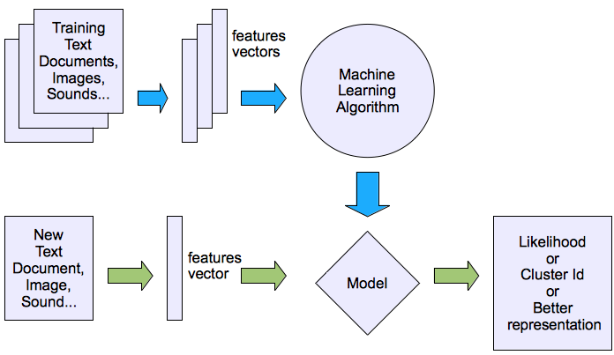
Machine Learning Structure
Unsupervised learning

Slide 15
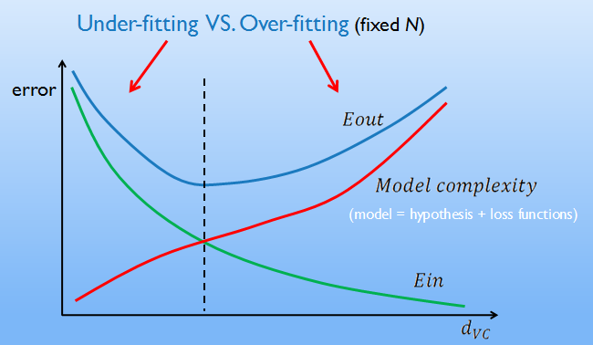
Under-fitting Vs Over-fitting

Slide 16
Learning Techniques
Supervised learning categories and techniques
Linear classifier (numerical functions)
Parametric (Probabilistic functions)
Naïve Bayes, Gaussian discriminant analysis (GDA), Hidden Markov models (HMM), Probabilistic graphical models
Non-parametric (Instance-based functions)
K-nearest neighbors, Kernel regression, Kernel density estimation, Local regression
Non-metric (Symbolic functions)
Classification and regression tree (CART), decision tree
Aggregation
Bagging (bootstrap + aggregation), Adaboost, Random forest

Slide 17
Learning Techniques
Unsupervised learning categories and techniques
Clustering
K-means clustering
Spectral clustering
Density Estimation
Gaussian mixture model (GMM)
Graphical models
Dimensionality reduction
Principal component analysis (PCA)
Factor analysis

Slide 18
Thank You

