Slide 1
NIFTY 50 STOCK MARKET
Trading Analytics Dashboard
Project focus
Stock performance • risk • valuation • trading activity
Prepared by Monika Srinivasan
1

Slide 2
1. Project Overview
Business-oriented analysis of NIFTY 50 stock data
Objective
Dataset Snapshot
• Analyze stock returns, volatility and trading activity.
• Compare companies and sectors using common KPIs.
• Identify high-return, high-volatility and high-volume stocks.
• Present valuation indicators such as P/E, EPS and Price-to-Book.
• Build an interactive 3-page Power BI dashboard.
49
7K
Companies
Trading Days
2T
197T
Total Volume
Market Cap
The dataset combines company-level summary
statistics with daily historical stock observations.
2

Slide 3
2. Data Structure & Key Fields
Two levels of analysis: company summary + daily market activity
Company Summary Table
Daily Historical Table
• Ticker, Company_Name, Sector
• Starting / Ending Price
• Total Return %
• Highest / Lowest Price
• Average Daily Volume
• Current Market Cap and P/E
• Volatility % and Total Dividends
• Date, Ticker, Sector
• Open, High, Low, Close
• Volume and Dividend
• Daily Return and 20D Volatility
• MA_50 and market indicators
• P/E, Forward P/E, PEG, P/B
• EPS, Beta, 52-week High / Low
3

Slide 4
3. Problem Statements
Business Questions to be Answered
• Which months have the highest and lowest trading volume?
• Which sectors show higher average returns?
• Which companies have the highest market capitalization?
• Which stocks have the highest total returns?
• Which stocks have the highest volatility?
• How do stock performance, risk, valuation and trading activity vary across companies and sectors?
• How can the stock market data be presented through an interactive dashboard for easier analysis?
3

Slide 5
4. Data Cleaning & Preprocessing
Steps taken before building KPIs and dashboard visuals
Data Type Validation
Percentage Handling
• Changed columns to suitable data types.
• Checked dates, numeric fields and categorical fields.
• Ensured values were ready for calculations and visuals.
• Converted percentage-point values into usable percentage values.
• Created separate columns where required for correct display and analysis.
• Avoided applying percentage formatting twice.
Calculated Columns
Remove Unusable Columns
• Created columns needed for analysis.
• Used calculated fields for risk classification and other dashboard analysis.
• Prepared data for KPI calculations.
• Removed columns that did not contain usable analytical data.
• Example: MA_200 had blank values, so it was removed.
• Checked missing values and unusual values before visualization.
4

Slide 6
5. Tools & Analysis Methodology
Power BI
DAX
Dashboard design, interactive visuals, slicers and
report pages.
Calculated measures and columns for KPIs,
risk categories and display metrics.
Data Cleaning
Visual Analytics
Checked data types, percentage formatting,
missing and outliers.
Bar, line, treemap, donut and risk/return analysis
for business interpretation.
5

Slide 7
6. Key KPIs & Visuals
What each dashboard section helps answer
Performance
Risk
Total Return %, Average Daily Return and closing-price trends
show stock performance.
Volatility, Beta and Risk Category highlight differences in price
fluctuation and sensitivity.
Trading
Valuation
Trading Volume and Monthly Volume Trend reveal market
activity and heavily traded stocks.
P/E, EPS and Price-to-Book provide company valuation and
earnings context.
Dividends
Sector Analysis
Dividend contribution and dividend yield compare
income-oriented characteristics.
Sector-level visuals make it easier to compare companies
across industries.
11

Slide 8
7. Slicers & Interactivity
Filters used to make the Power BI dashboard interactive
Company Name
Year
Allows the user to select a particular company and focus the visuals on that company.
Allows the user to filter the dashboard and analyze data for a selected year.
Month
Sector
Allows the user to view trading activity and performance for a selected month.
Allows the user to compare companies and performance within a selected sector.
These slicers help users interact with the dashboard and analyze the data from different perspectives.
7

Slide 9
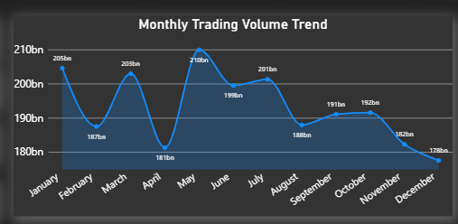
8.Monthly Trading Volume Trend – Line Chart
It shows how the total trading volume changes month by month.
To identify which months had higher or lower trading activity.
8

Slide 10
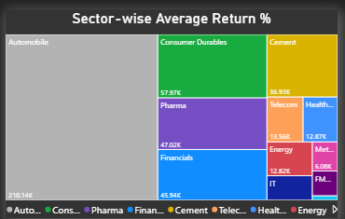
9.Sector-wise Average Return – Tree Map
It compares the average stock return across different sectors.
To understand which sectors performed better or lower based on average return.
8

Slide 11
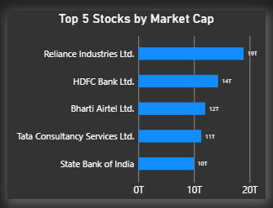
10.Top 5 Stocks by Market Capitalization - BarChart
It displays the five companies with the highest market capitalization.
To identify the companies with the largest market value in the dataset.
8

Slide 12
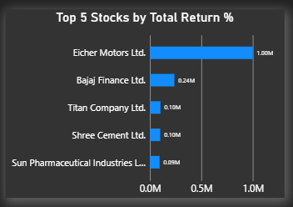
11.Top 5 Stocks by Total Return – Bar Chart
It shows the five companies with the highest total return during the selected period.
To compare the historical return of different companies.
8

Slide 13
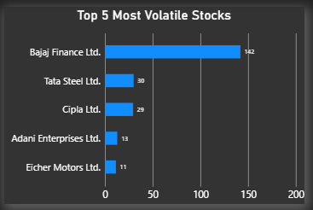
12.Top 5 Most Volatile Stocks – Bar Chart
It shows the five stocks with the highest volatility.
To identify stocks whose prices showed larger fluctuations.
8

Slide 14
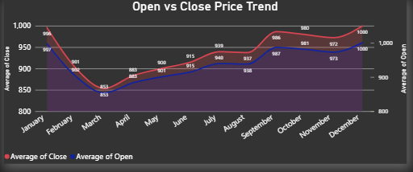
13.Open vs Close Price Trend – Line Chart
It compares the opening and closing prices of a stock over time.
To understand how the stock price moves during the selected period.
8

Slide 15
13.Stock Closing Price Trend – Line Chart
It compares the opening and closing prices of a stock over time.
To understand how the stock price moves during the selected period.
8

Slide 16
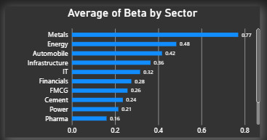
14.Average Beta by Sector – Bar Chart
It compares the average Beta of different sectors.
To understand how the stocks in different sectors move compared with the overall market.
8

Slide 17
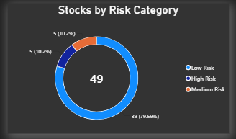
15.Stocks by Risk Category – Donut Chart
It divides stocks into Low Risk, Medium Risk and High Risk categories based on the volatility classification used in my project.
To get a quick view of the risk distribution among the companies.
8

Slide 18
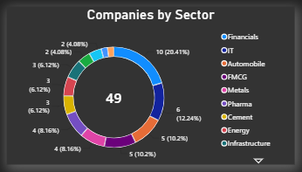
16. Average Daily Return by Sector – Donut Chart
It compares the average daily return of different sectors.
To understand how daily stock performance differs across sectors.
8

Slide 19
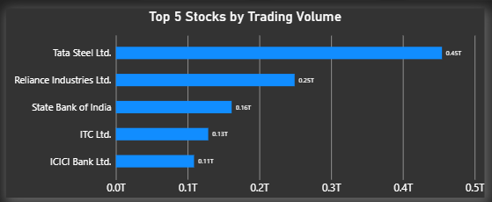
17. Top 5 Stocks By Trading Volume – Bar Chart
It displays the 5 companies with the highest trading volume.
To identify the companies with higher trading activity.
8

Slide 20
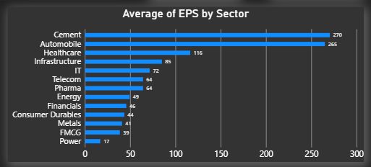
18. Average EPS Average by Sector – Bar Chart
It compares the average Earnings Per Share across sectors.
EPS helps understand the earnings generated per share, so comparing it by sector gives a sector-level view of earnings.
8

Slide 21
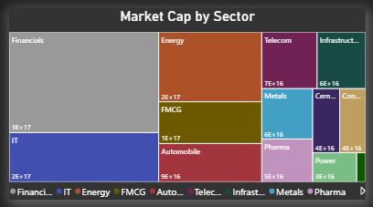
19. Market Capitalization by Sector - Treemap
It shows the total market capitalization contributed by each sector.
To understand which sectors have a larger share of the total market capitalization in my dataset.
8

Slide 22
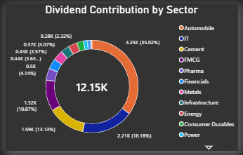
20. Dividend Contribution by Sector – Donut Chart
It shows the dividend contribution from different sectors.
To understand how dividend payments are distributed across sectors.
8

Slide 23
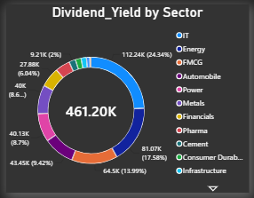
21. Dividend Yield by Sector – Donut Chart
It shows the average dividend yield across different sectors.
To compare how dividend yield varies between sectors.
8

Slide 24
11. Data Preparation & Important Handling
Steps taken to keep the dashboard interpretable
• Percentage-point fields such as Volatility_% and Avg_Daily Return were handled carefully to avoid multiplying values by 100 twice.
• Beta is a ratio, so it is displayed without a % sign.
• MA_200 was removed from the dashboard because the available column had blank values.
• Risk categories were created from volatility: Low Risk < 5%, Medium Risk 5–10%, High Risk > 10%.
• Company-level KPIs are preferred for company comparisons, while daily fields are used for time-series visuals.
• Outlier values such as very high volatility are retained and visible because they are part of the dataset.
12

Slide 25
12. Conclusion
A single interactive report covering performance, risk and valuation
Project Outcome
• Built a 3-page Power BI dashboard for NIFTY 50 stock analytics.
• Combined company-level and daily market information into a structured analysis.
• Used interactive slicers for Company, Year, Month and Sector.
• Created KPI cards and multiple visual types for easier comparison.
• Added risk classification and valuation/dividend analysis for deeper insights.
13

Slide 26
Thank You
Nifty 50 Stock Market Trading Analytics
Presented by Monika Srinivasan
13

