Slide 1
Quick Notes Web App
MONISH B
43110565
STELLAR ST-02

Slide 2
Abstract
Note-taking web app using Node.js and JSON storage.
Users log in to manage private notes.
Supports add, edit, delete, search, and pin.

Slide 3
Existing System
Global storage without authentication.
Data lost on restart.
Privacy issues.

Slide 4
Proposed System
Per-user login and private notes.
Session-based authentication.
Persistent JSON storage.

Slide 5
Advantages
Secure and user-specific.
No external database needed.
Lightweight and simple UI.
Data persists after restart.

Slide 6
Disadvantages
No cloud sync.
Sessions reset on restart.
Not scalable for big apps.

Slide 7
Hardware Requirements
Intel i3 or above.
4 GB RAM minimum.
1 GB free storage.

Slide 8
Software Requirements
Node.js v18 or higher.
NPM package manager.
Modern browser (Chrome, Edge).
VS Code for development.

Slide 9
Modules
Authentication Module.
Notes Management Module.
Persistence (JSON) Module.
Frontend UI Module.
Search & Pin Module.

Slide 10
Module Description
Auth: Register, login, logout.
Notes: Add, edit, delete, pin.
Persistence: Store JSON data.
UI: Display and manage notes.
Search & Pin: Filter and prioritize.

Slide 11
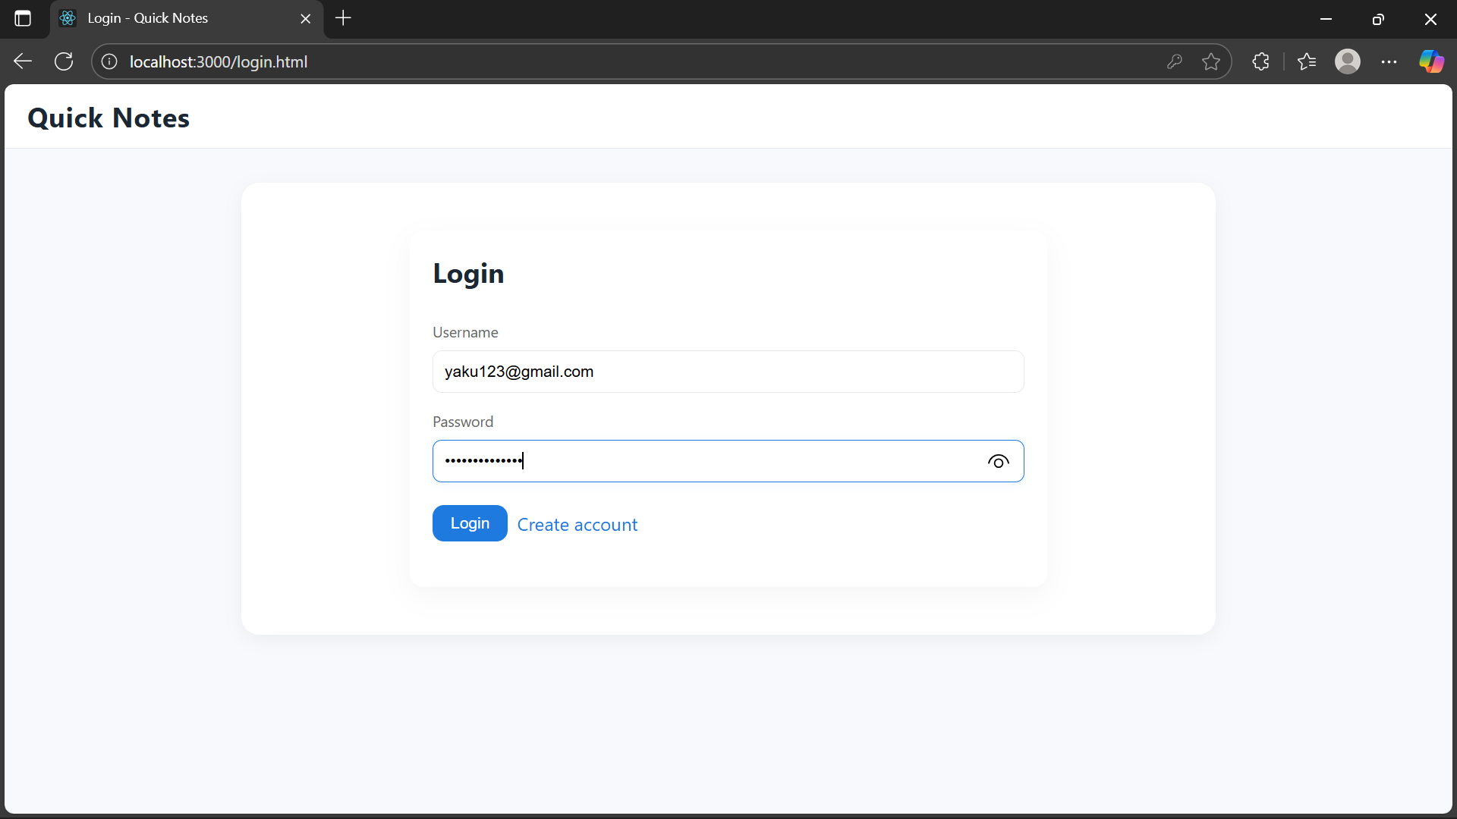
Results
Login page

Slide 12
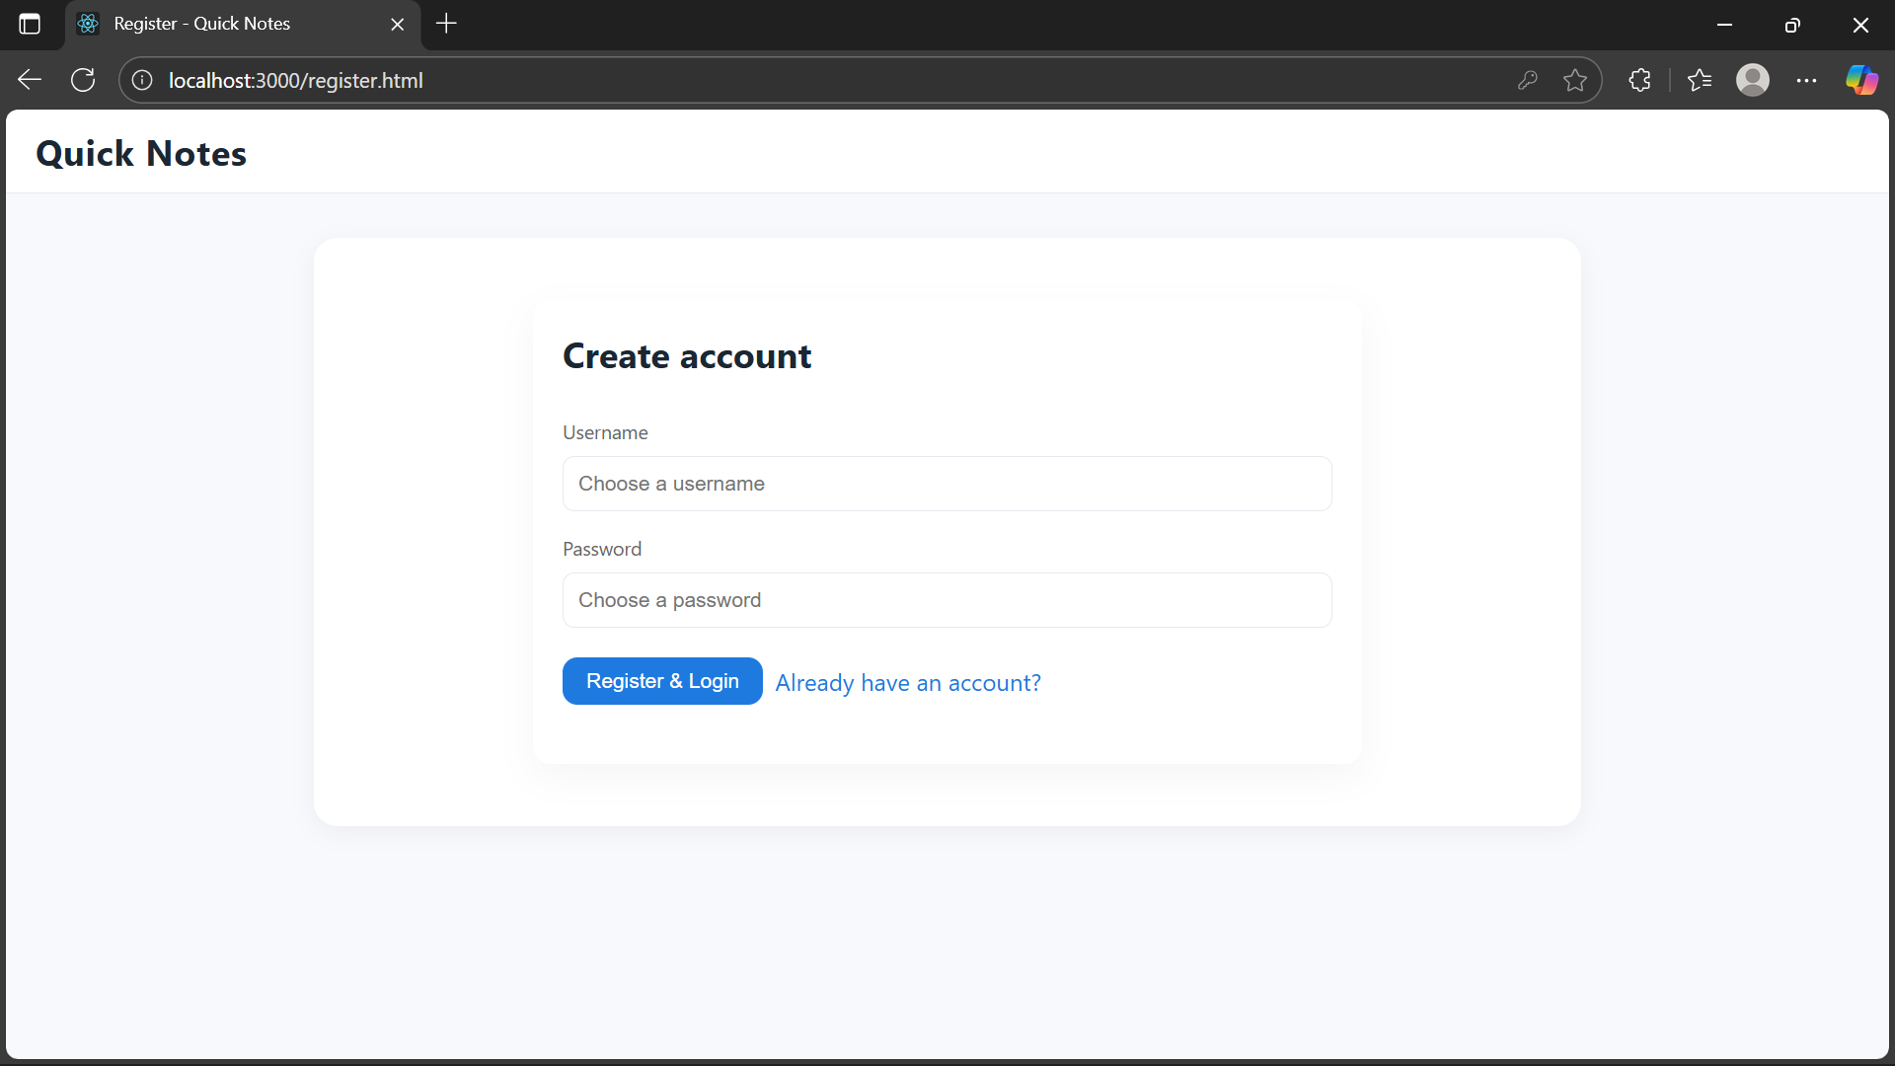
Results
Register page

Slide 13
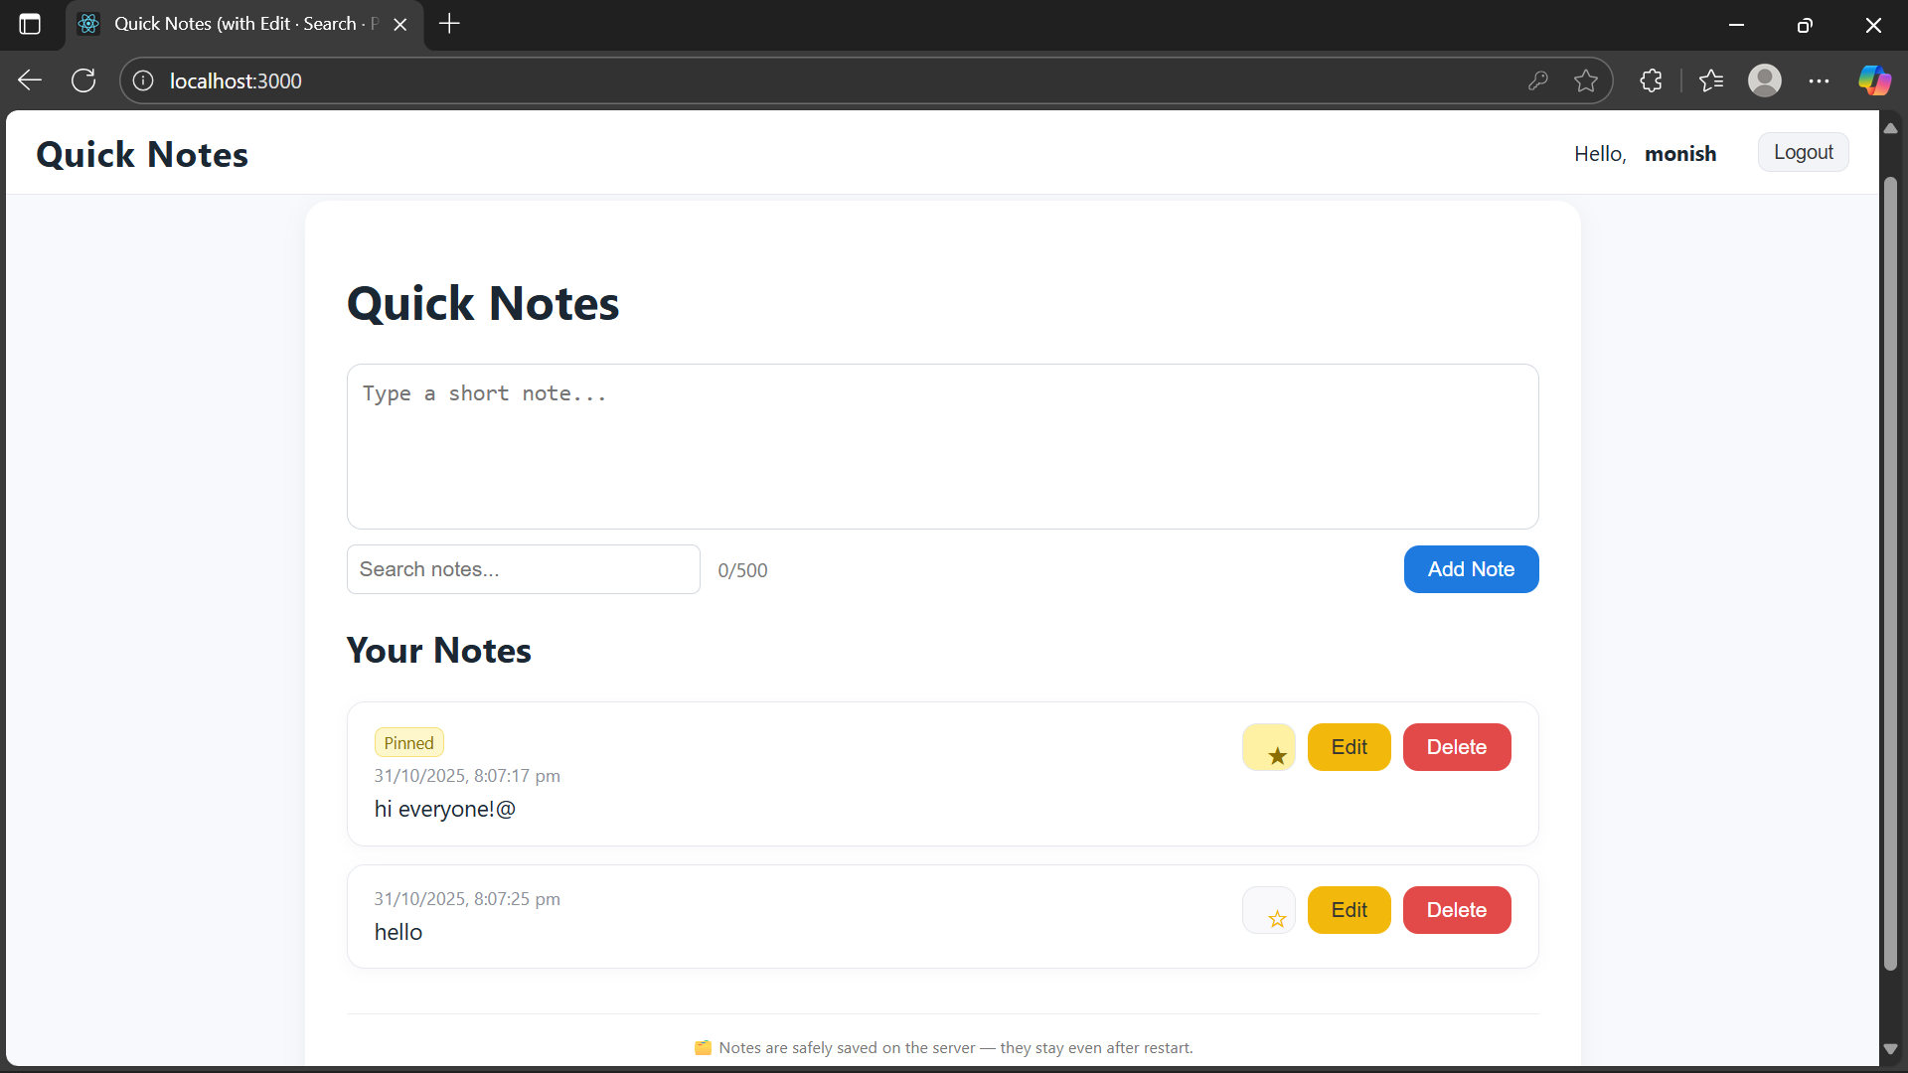
Results
Notes with pin and edit option

Slide 14
Conclusion
Secure and private note app.
Demonstrates full-stack web concepts.
Easy to extend with cloud or database.

