Slide 1
BANKING MANAGEMENT SYSTEM
DONE WITH MAINFRAME

Slide 2
ABSTRACT
This project is about banking system administration, in which the administrator can add and delete both retail and corporate clients, while the user can access and update their information if necessary

Slide 3




Literature Survey
COBOL
JCL
DB2
CICS

Slide 4

DataFLow
Scan/Click this QR code to view the DFD

Slide 5

Modules!

Slide 6
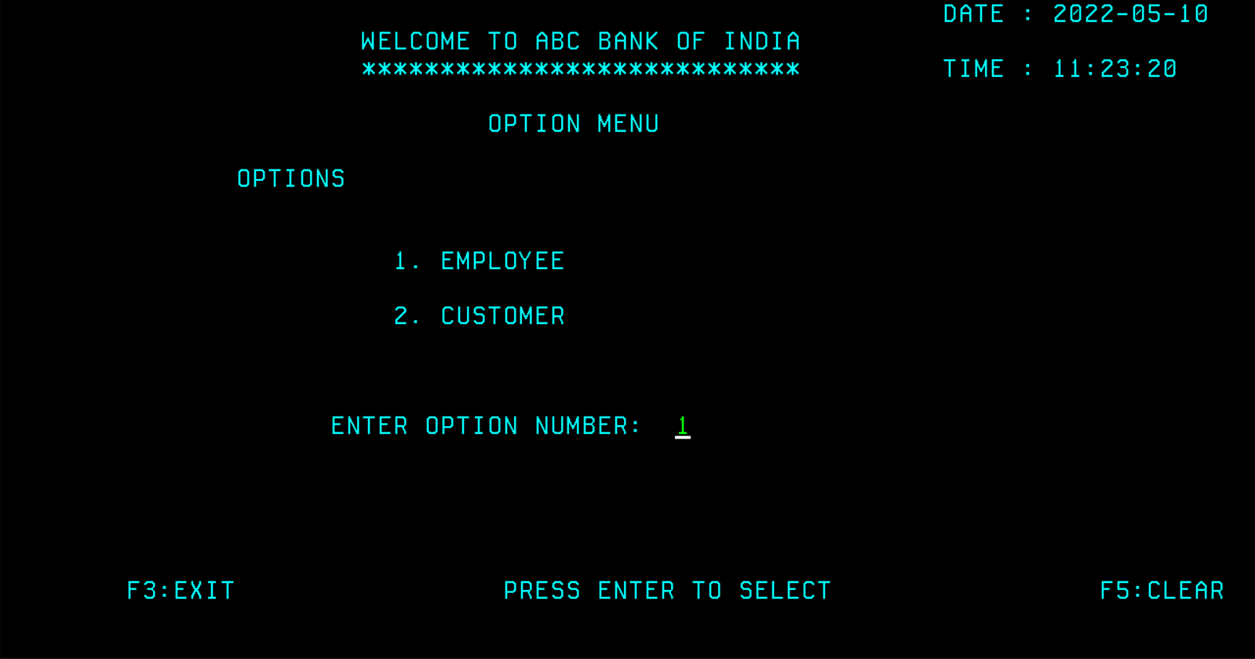
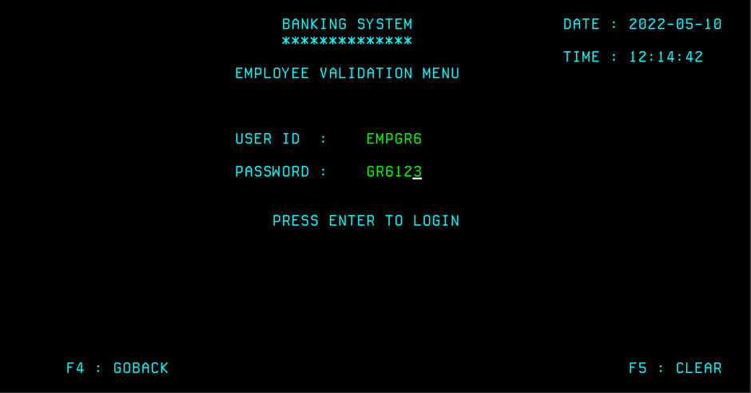
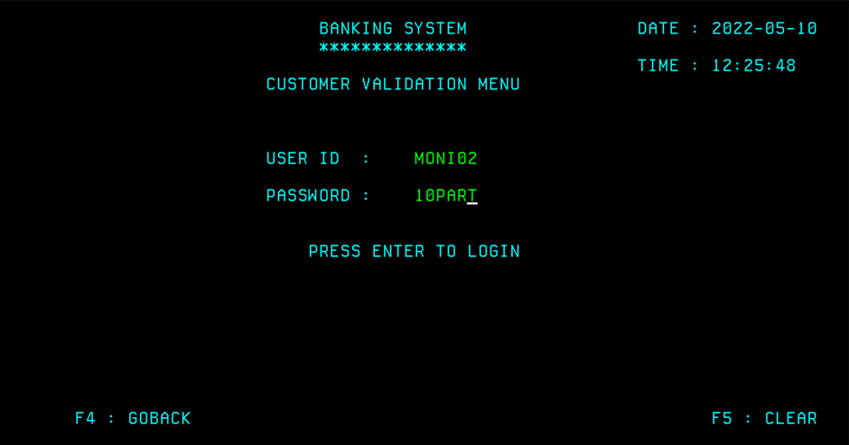
VALIDATION MODULE

Slide 7
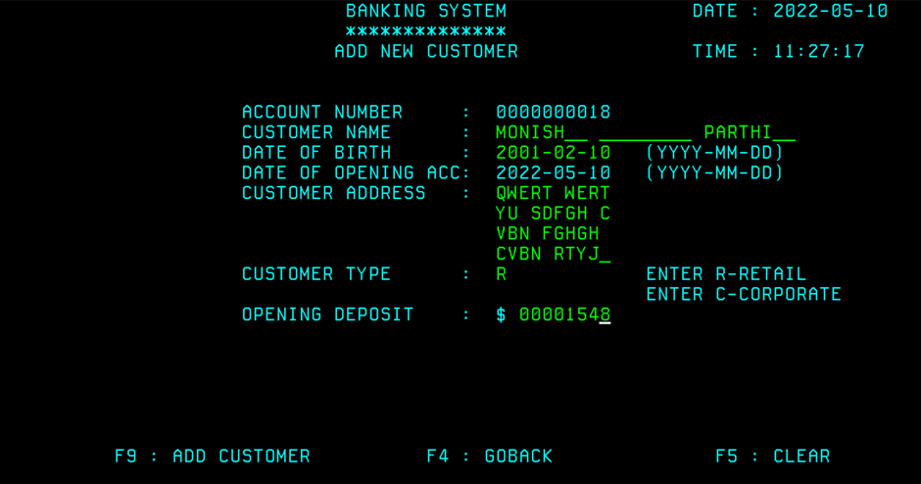
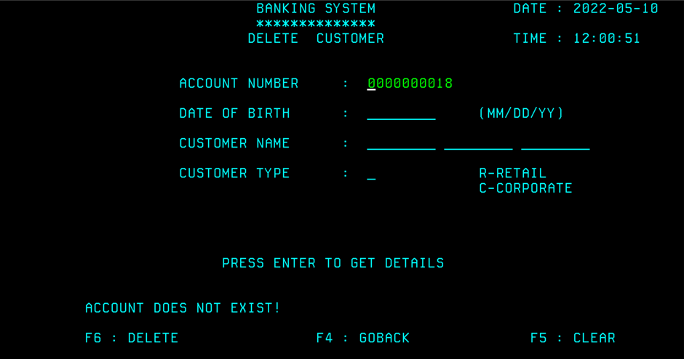
EMPLOYEE MODULE

Slide 8
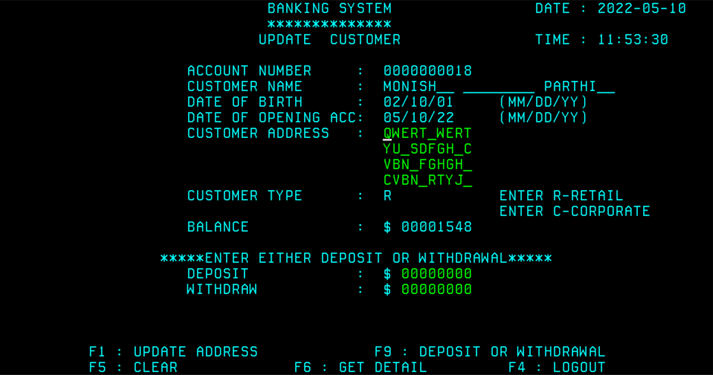
CUSTOMER MODULE

Slide 9
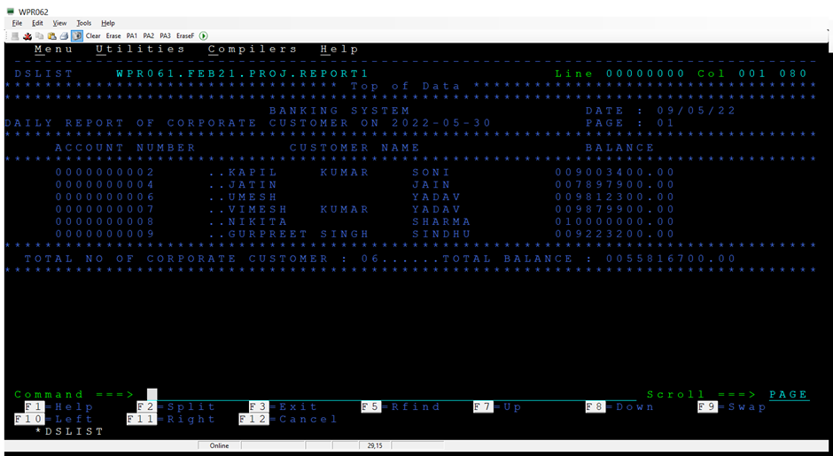
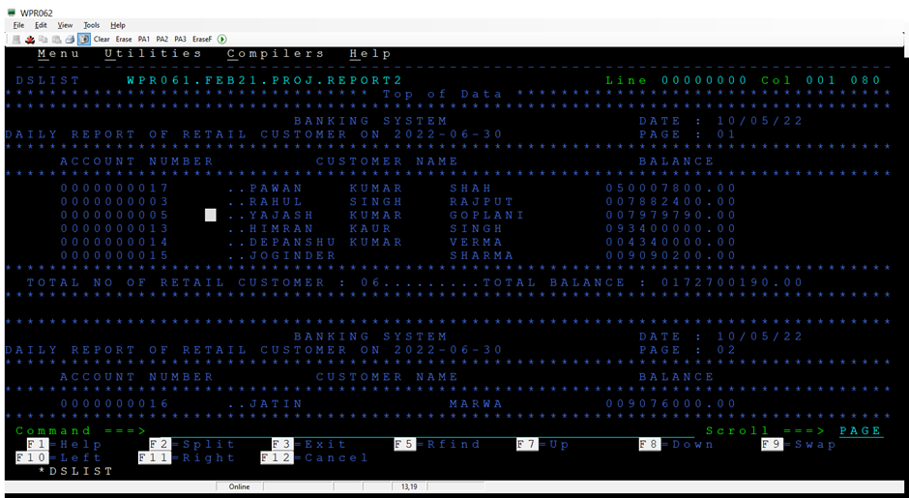
REPORT MODULE

Slide 10
Conclusion
Digital technology is becoming more adaptive than paperwork in today's age of modernity.
As a result, our online Banking System is a move in the right direction to make things easier.
10

Slide 11
Reference
JCL
https://www.ibmmainframer.com/jcl-tutorial/
CICS
https://www.mainframestechhelp.com/tutorials/cics/index.htm
J
C
https://www.tutorialspoint.com/db2/index.htm
DB2
https://www.mainframestechhelp.com/tutorials/cobol/
COBOL
D
C

Slide 12
Done by:
Monish P
Vibhu Kalash Jain
Tushar Kaundal
Sushree Rinsipriya Swain
Naveen Kumar Rai
Sandeep Kumar Yedla
VEGI RAVI

Slide 13
Thanks!

