Slide 1
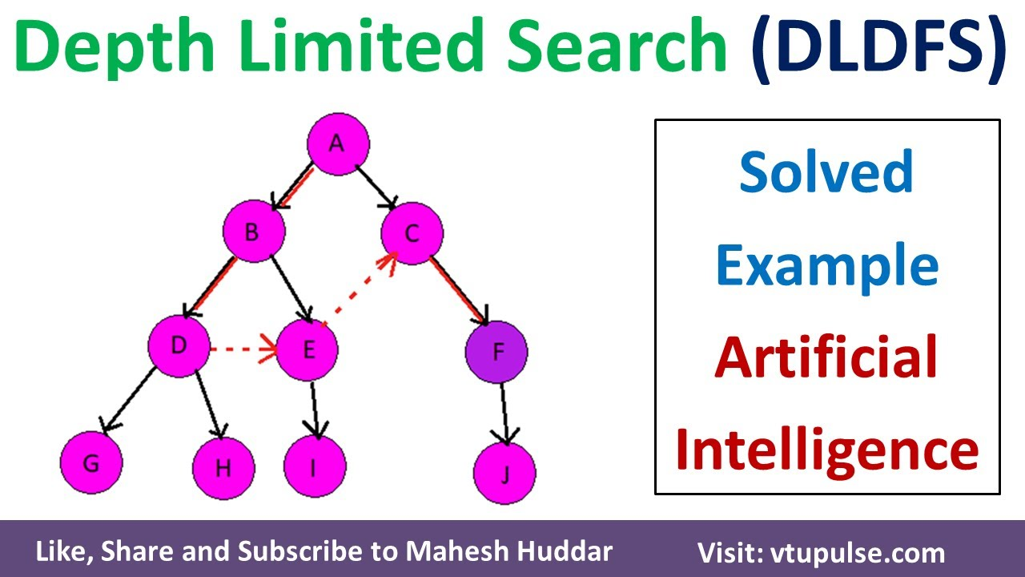
Depth-Limited Search
Notes:
Welcome to the lecture on Depth-Limited Search.

Slide 2
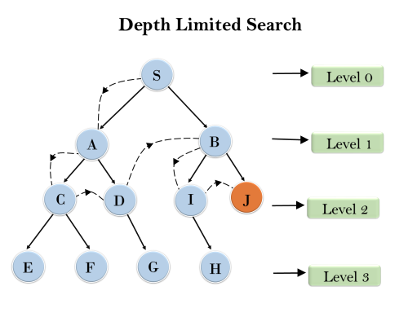
What is Depth-Limited Search?
Modified Depth-First Search
Limits search depth
Avoids infinite loops
Notes:
Depth-Limited Search is a variation of Depth-First Search that prevents infinite loops by setting a maximum search depth.

Slide 3

How it Works
Sets a depth limit 'l'
Explores nodes up to 'l'
Stops at the limit
Notes:
The algorithm explores nodes until it reaches the specified depth limit, preventing infinite exploration in graphs with cycles.

Slide 4

Advantages
Memory efficient
Simple to implement
Suitable for shallow searches
Notes:
Depth-Limited Search is memory-efficient and easy to implement, making it suitable for problems with shallow search spaces.

Slide 5
Disadvantages
Incomplete
Optimal solution?
Depth limit crucial
Notes:
It might not find the optimal solution if the solution lies beyond the depth limit. Choosing the right depth limit is crucial.

Slide 6

Applications
Game playing
Robotics
Pathfinding
Notes:
Depth-Limited Search finds applications in various fields, including game playing, robotics, and pathfinding.

Slide 7
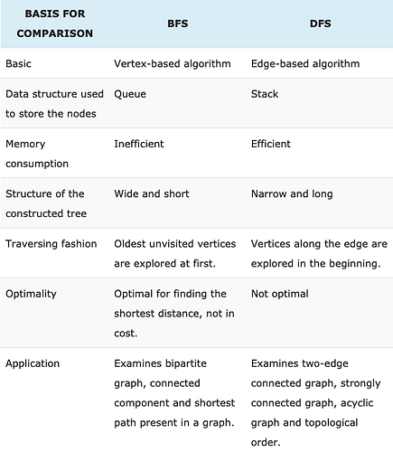
Comparison with DFS
DFS: Unbounded depth
DLS: Bounded depth
DLS avoids infinite loops
Notes:
Key difference: Depth-Limited Search adds a depth bound, preventing the infinite exploration that can occur with standard Depth-First Search.

Slide 8

Conclusion
Useful search technique
Memory efficient
Consider depth limit
Notes:
Depth-Limited Search is a valuable tool, but careful consideration of the depth limit is essential for effective use.

