Slide 1

PREDICTING MALIGNANCY
OF BREAST
CANCER
By:
SUSMITA GOSWAMI
ANIK DUTTA
PRALAY GHOSH
SANKHA MANDAL
SAYAN CHOWDHURY
UDAYADITYA SASMAL

Slide 2
INDEX
OBJECTIVE
DATA DESCRIPTION
EXPLORATORY DATA ANALYSIS
IMPLEMENTED MODELS
SELECTED MODEL
INFERNCE

Slide 3
OBJECTIVE
Create a Learner Model by inductive learning.
The Learner Model predicts malignancy of breast cancer i.e. if a tumours is of malignant type or benign type based on 30 features.
Time Saving
Cost Saving

Slide 4
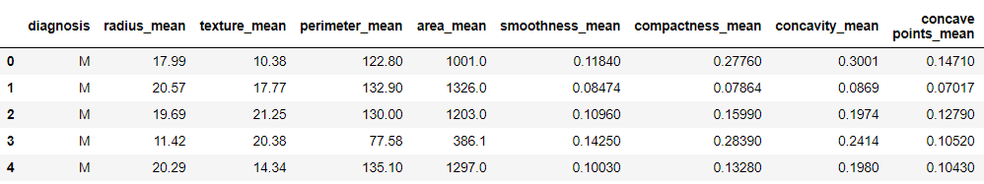
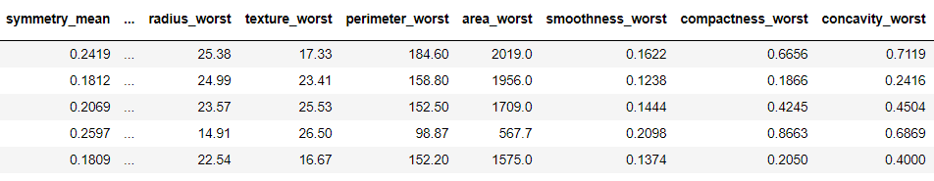
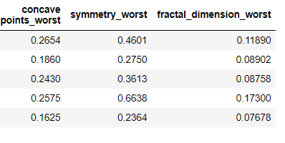
DATA DESCRIPTION
Diagnosis (M = malignant, B = benign)
Ten real-valued features are computed for each cell nucleus:
a) radius
b) texture
c) perimeter
d) area
e) smoothness
f) compactness
g) concavity
h) concave points
i) symmetry
j) fractal dimension

Slide 5
EXPLORATORY DATA ANALYSIS
Data Cleaning
Univariate Analysis
Bivariate Analysis
Missing Value Treatment
Outlier Treatment
Feature Selection
Variable Transformation & Creation

Slide 6
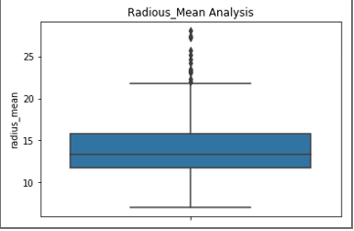
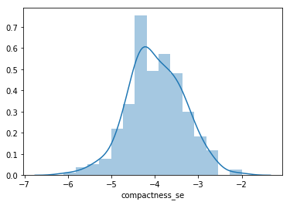
Univariate Analysis
Simplest form of analyzing Data
Analyzing of one feature
Examples- Boxplot, Distplot etc.

Slide 7
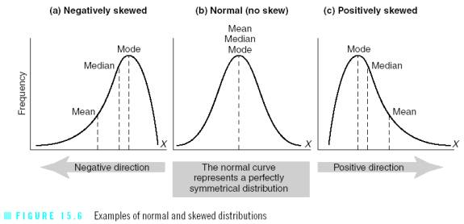
Skewness Analysis
Skewness: Asymmetry in statistical distribution
Determine the Skewness
How to Remove Skewness

Slide 8
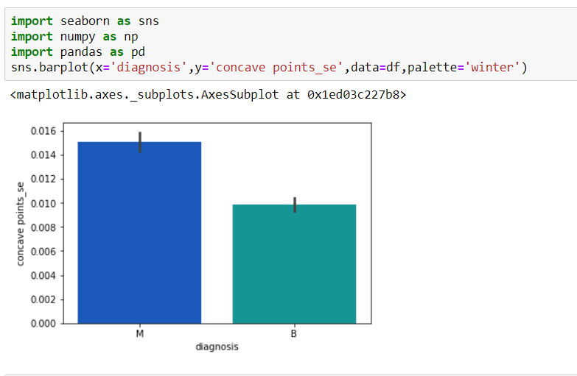
Bivariate Analysis
Complex form of analyzing Data
Analysis of Two features
Testing simplest hypotheses
Examples-Bar Plot

Slide 9
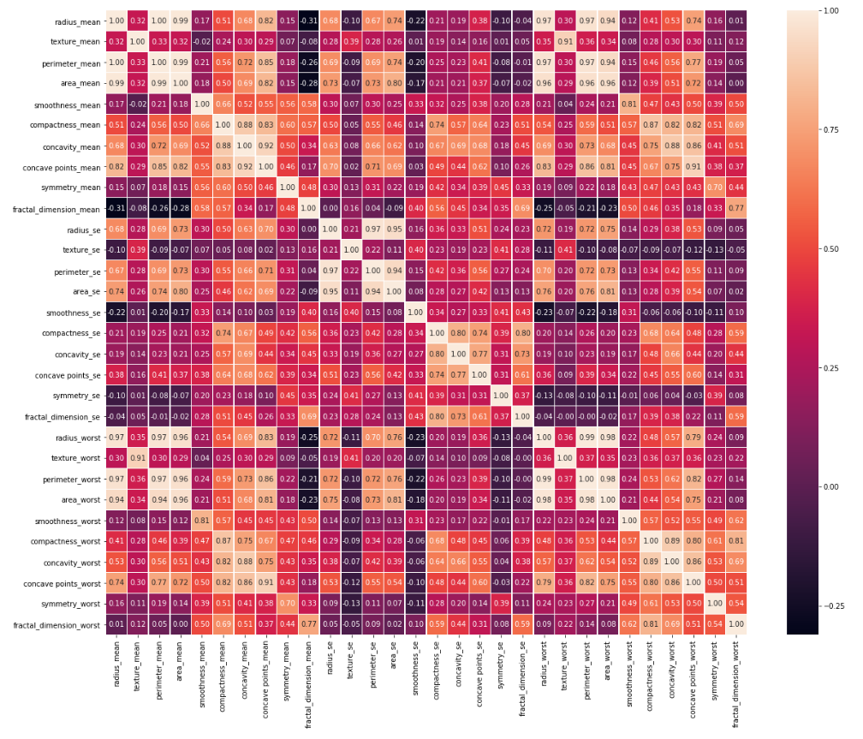
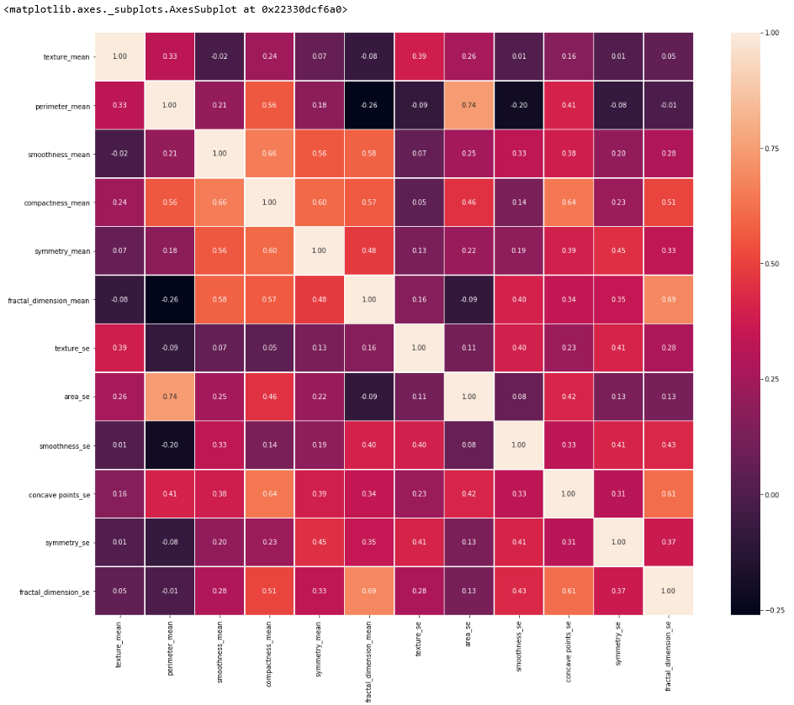
Heatmap
Graphical Representation of Data
Originated in 2D display
Feature Selection
Represent Complex Statistical Data

Slide 10
IMPLEMENTED MODELS
After analyzing all the EDA we have implemented four models
Logistic Regression
Decision Tree
KNN
Naive Baye’s
Ensemble

Slide 11
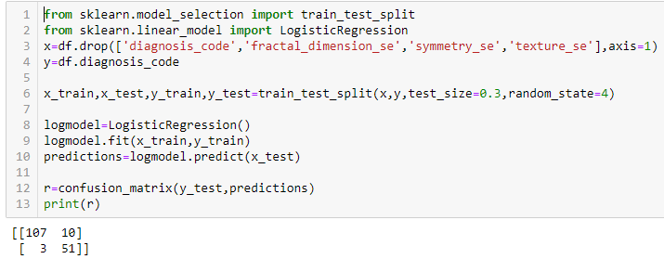
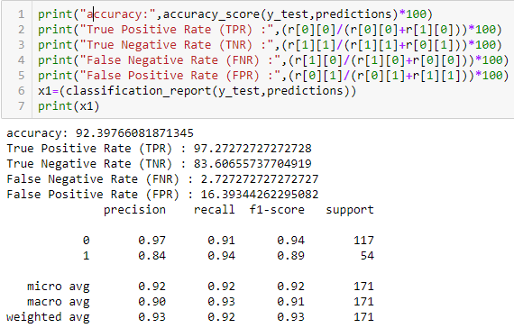
Logistic regression model

Slide 12
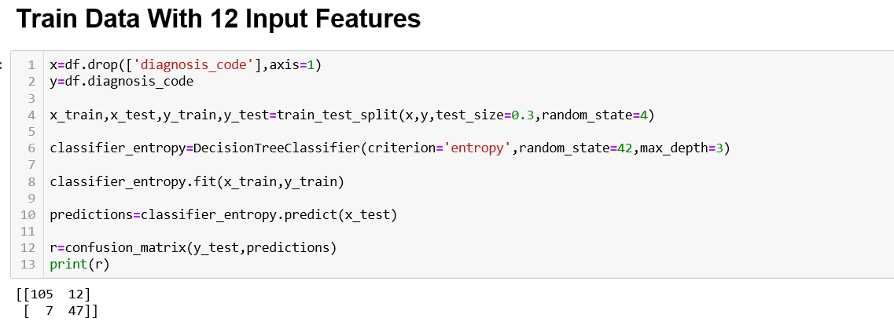
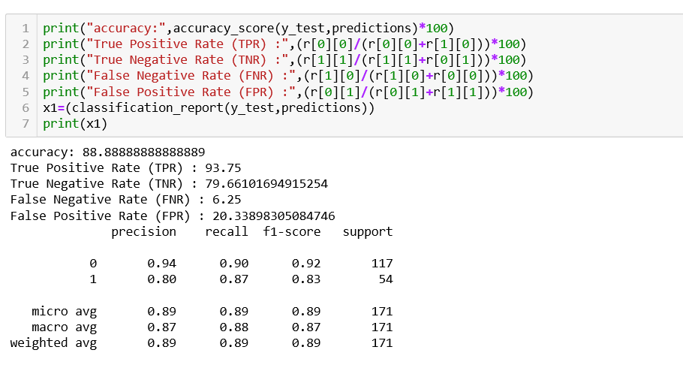
Decision Tree

Slide 13
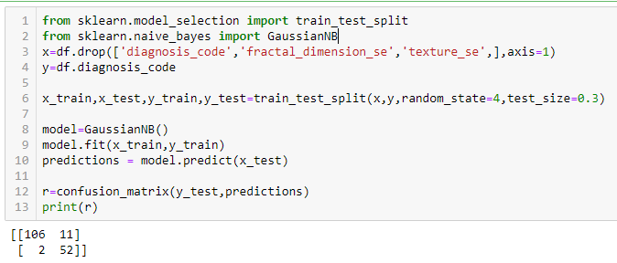
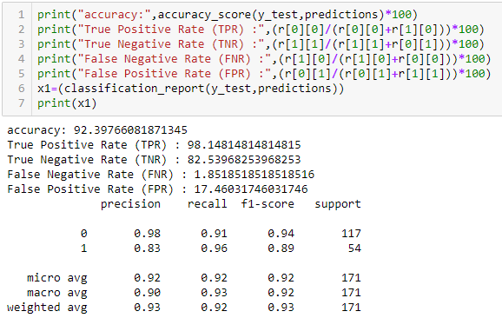
Naive Baye’s

Slide 14
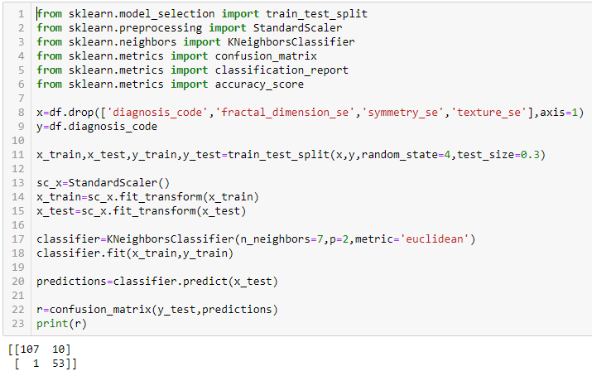
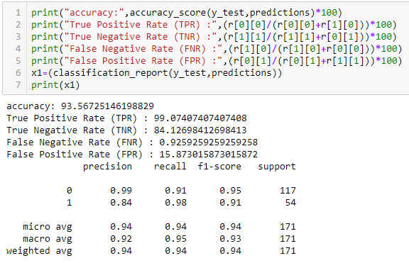
KNN Model

Slide 15
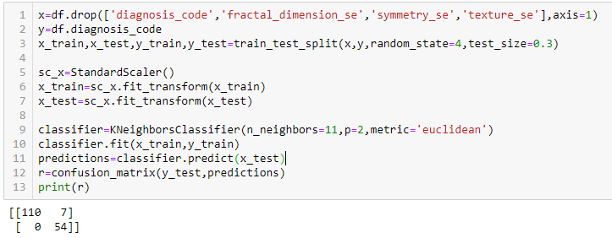
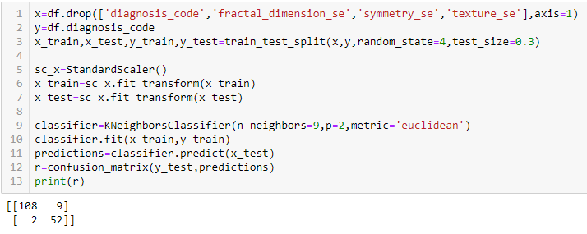
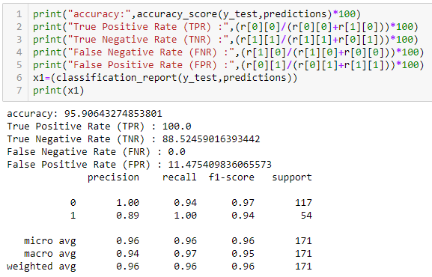
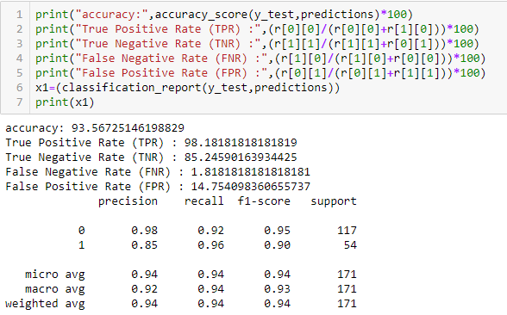
KNN Model

Slide 16
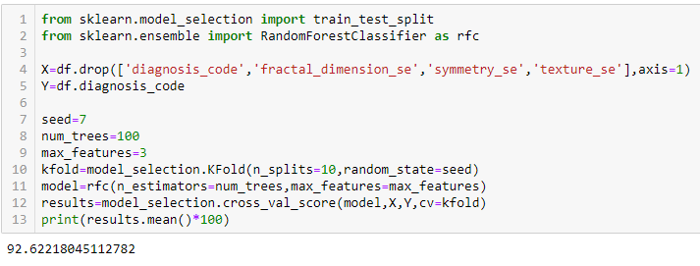
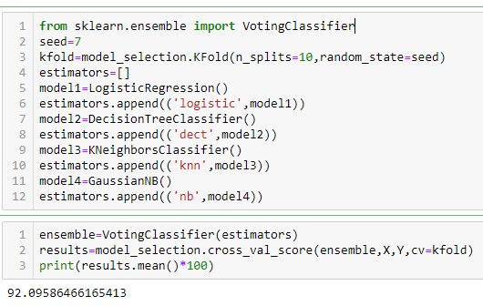
Ensemble Model
Bagging Ensemble
Voting Ensemble

Slide 17
Inference
By evaluating all the five types of models (Logistic Regression, Decision Tree, KNN, Naïve Bayes' and Ensemble) we have found that KNN model model is giving the best accuracy (94.73680) , True Positive rate 100 and False Negative Rate 0 while using Texture Mean, Perimeter Mean, Smoothness Mean, Compactness Mean , Symmetry Mean, Fractal Dimension Mean ,Smoothness SE, Area SE and Concave Point Se. Thus our prediction model (KNN) can detect malignancy faster and at a lower cost.

Slide 18
THANK YOU

