Slide 1
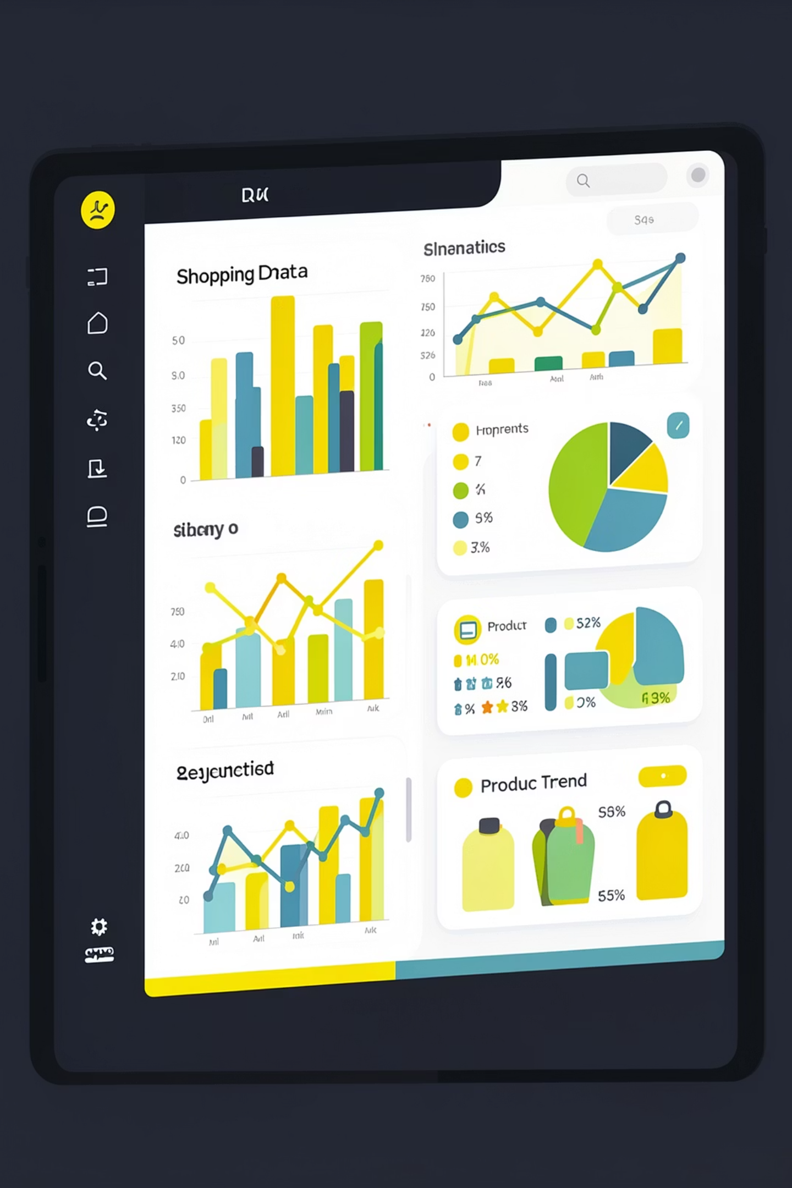
Customer Shopping Behavior Analysis
Uncovering insights from 3,900 transactions across product categories to guide strategic business decisions.

Slide 2
Dataset at a Glance
3,900
18
37
Purchases
Columns
Missing Ratings
Demographics
Purchase Details
Behavior
Age, Gender, Location, Subscription
Item, Category, Amount, Season, Size
Discounts, Frequency, Ratings, Shipping

Slide 3

Data Preparation in Python
01
Load & Explore
Imported with pandas; used df.info() and .describe()
02
Clean & Impute
Filled missing Review Ratings with per-category median
03
Feature Engineering
Created age_group and purchase_frequency_days columns
04
DB Integration
Loaded cleaned data into PostgreSQL for SQL analysis

Slide 4
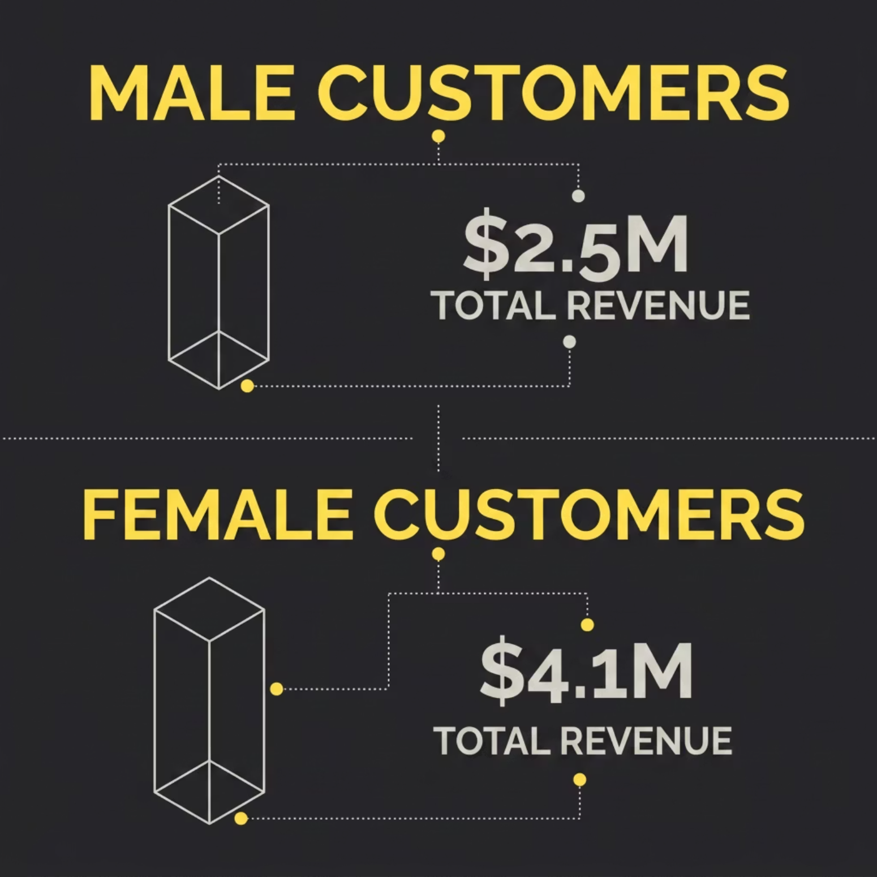

SQL Analysis: Revenue Insights
Revenue by Gender
Compared total revenue from male vs. female customers.
Revenue by Age Group
Calculated total revenue contribution of each age group to identify high-value segments.
Subscribers vs. Non-Subscribers
Subscribers show higher average spend and total revenue.

Slide 5


SQL Analysis: Customer Segments
New
Returning
Loyal
First-time buyers
Moderate purchase history
High-frequency repeat buyers
Customers with more than 5 purchases are significantly more likely to hold an active subscription.

Slide 6
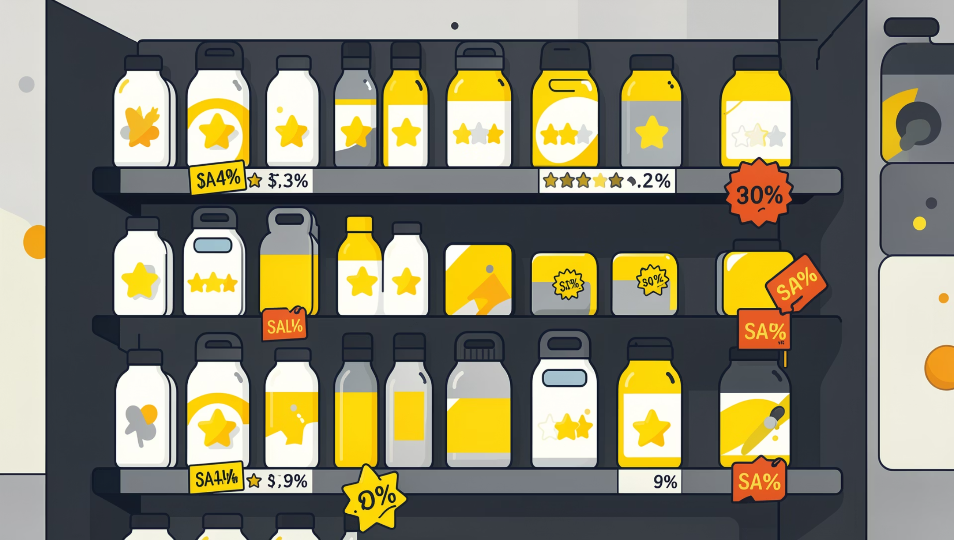
SQL Analysis: Products & Discounts
Top 5 by Rating
Products with highest average review scores identified for campaign spotlighting.
Top 3 per Category
Most-purchased products ranked within each product category.
Discount-Dependent Products
5 products with the highest % of discounted purchases flagged for margin review.

Slide 7
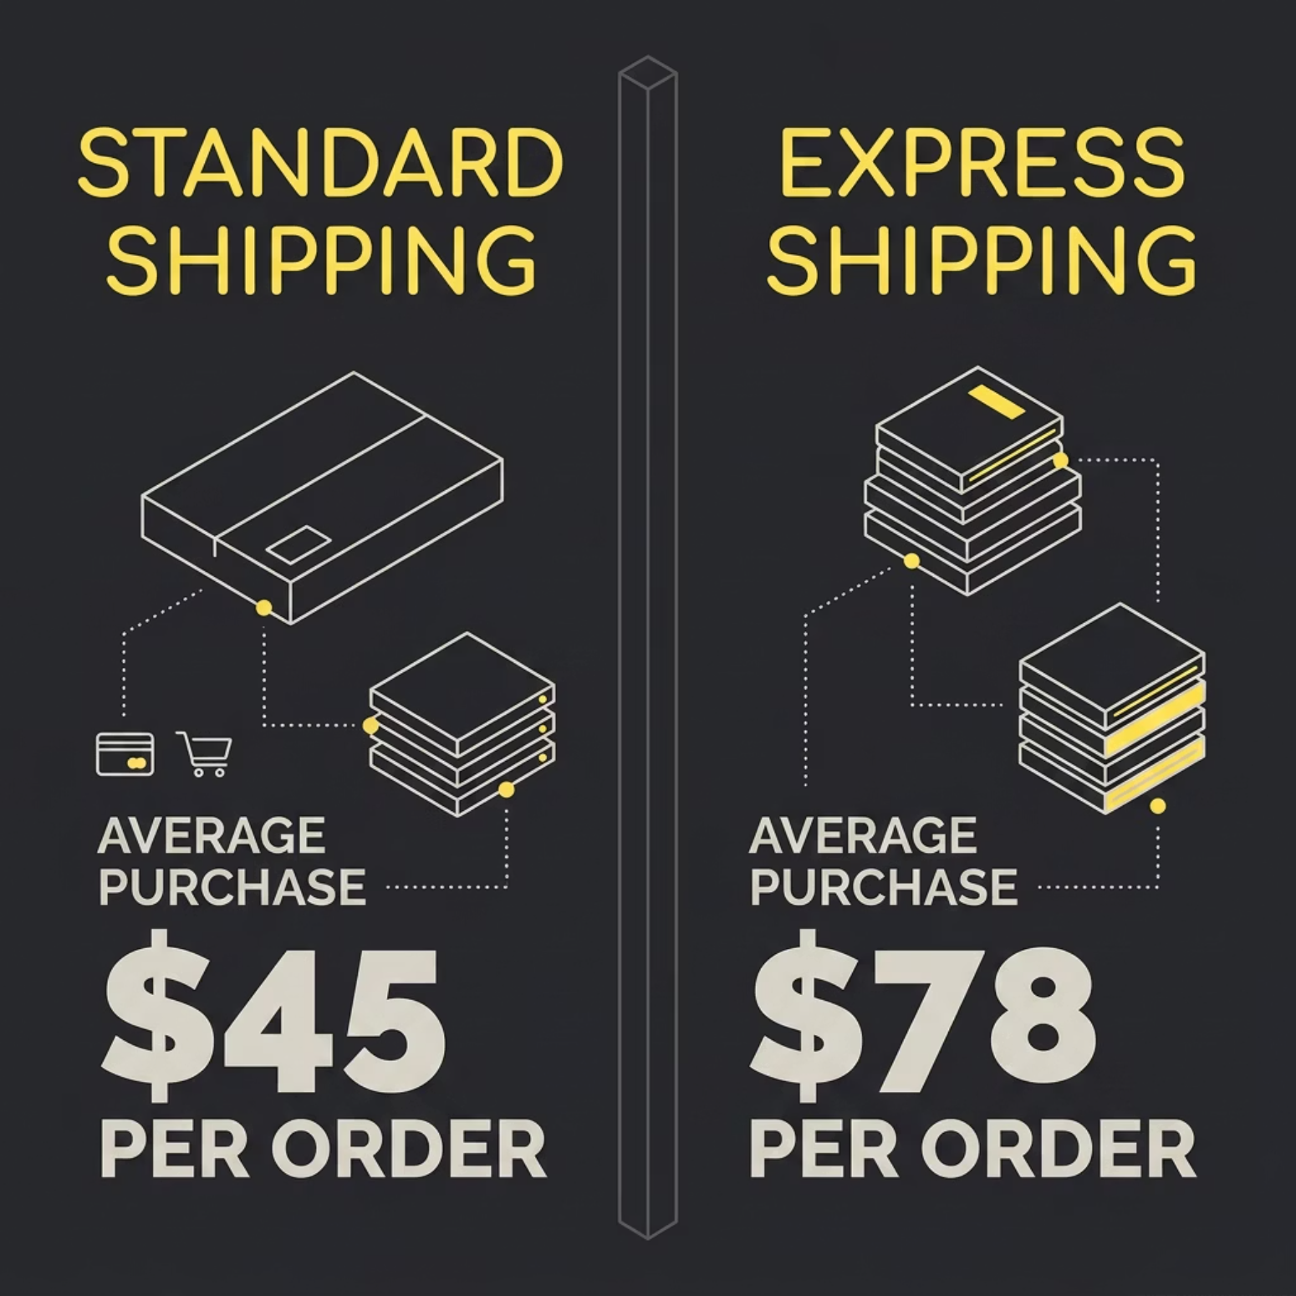
SQL Analysis: Shipping & Spend
Shipping Type Comparison
Average purchase amounts compared between Standard and Express shipping customers.
High-Spending Discount Users
Customers who used discounts but still spent above average — a key loyalty signal.

Slide 8
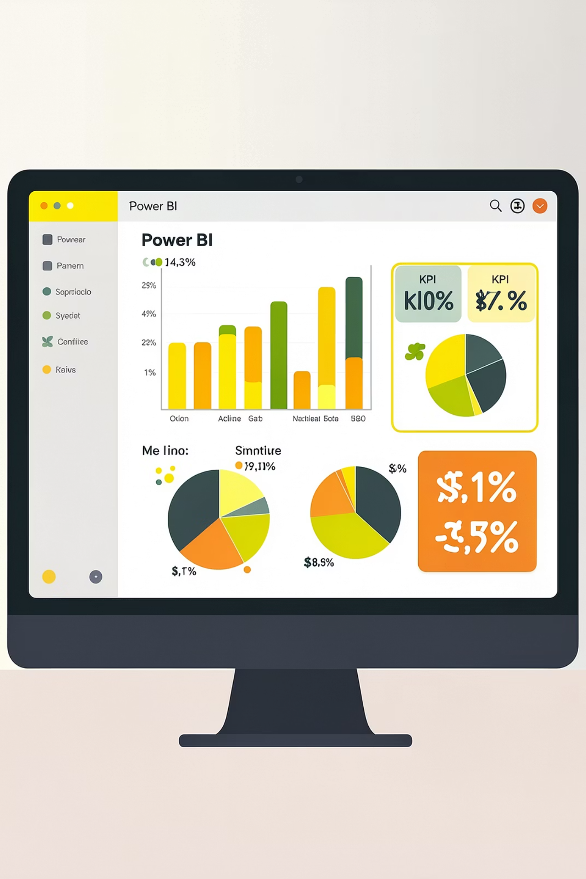
Power BI Dashboard
An interactive dashboard built to present all findings visually — enabling stakeholders to explore segments, revenue, and product trends at a glance.

Slide 9
Business Recommendations
Boost Subscriptions
Loyalty Programs
Review Discount Policy
Promote exclusive benefits to convert non-subscribers
Reward repeat buyers to move them into the "Loyal" segment
Balance sales boosts with margin control
Product Positioning
Targeted Marketing
Highlight top-rated and best-selling products in campaigns
Focus on high-revenue age groups and express-shipping users

Slide 10

Key Takeaways
3,900 Transactions
Python + SQL + Power BI
Actionable Segments
Rich dataset across demographics, behavior & products
End-to-end pipeline from raw data to visual insights
New, Returning & Loyal customers identified for targeting
Data-driven decisions across subscriptions, discounts, products, and marketing can meaningfully grow revenue.

