Slide 1

CSA0820- PYTHON PROGRAMMING FOR SCIENTIFIC COMPUTING
Pharmacy Management System For Inventory And Billing
Guided By :
Dr P Vijayaraghavan
Dr S K Aruna
Presented By:
B Aishwarya(192421432)
S Monisha Reddy(192524152)

Slide 2


INTRODUCTION
• Pharmacies handle a large number of medicines, making manual inventory management difficult and time-consuming.
• Traditional billing methods often result in calculation errors and increased waiting times for customers.
• It enables pharmacists to maintain medicine records, monitor stock levels, and process sales efficiently.
• The system improves operational accuracy while reducing the workload associated with manual record keeping.
• The application can be further enhanced with barcode scanning and database support for real-world deployment.

Slide 3
Problem Statement
• Many pharmacies continue to depend on paper records and manual billing procedures for daily operations.
• Updating stock quantities manually increases the chances of inconsistencies and human errors.
• Expiry dates are often monitored through physical verification, making expired medicines difficult to identify promptly.
• The absence of an integrated system leads to delays in billing and inefficient inventory management.
• Generating reports manually requires significant effort and limits effective decision-making.
• Therefore, an automated pharmacy management solution is required to improve efficiency, accuracy, and reliability.

Slide 4
Objectives
• The system enables efficient maintenance of medicine details such as quantity, price, and expiry date.
• It automatically updates stock levels whenever medicines are sold or restocked.
• The application generates accurate customer bills and reduces billing errors.
• It assists pharmacists in identifying low-stock and expired medicines at the appropriate time.
• The system also provides reports that support inventory planning and business analysis.

Slide 5
Literature Survey
S.No | Year | Author(s) | Survey (Title – Source) | Advantage(s) | Disadvantage(s) | Problem Identified (Linked to Project)
1 | 2024 | Patel et al. | Pharmacy Inventory Management Systems | Improves medicine stock tracking and accessibility. | Focuses mainly on inventory control | Need for an integrated system
2 | 2025 | Kumar & Singh | Automation in Retail Pharmacy Operations | Automates routine pharmacy activities | Implementation complexity | User friendly management
3 | 2025 | Sharma et al. | Computerized Billing Systems in Pharmacies | Provides fast and accurate bill | Billing systems often function independently | Need for real-time inventory updates

Slide 6
Proposed System
EXISTING SYSTEM | MODULE IMPROVISATION
Medicine records are maintained manually using registers or spreadsheets, making updates time-consuming and error-prone. | Uses a computerized inventory management system to store, update, and retrieve medicine records efficiently.
Billing calculations are performed manually, increasing the chances of arithmetic errors and delays during transactions. | Generates customer bills automatically with accurate calculations and faster processing.
Stock quantities are updated manually after sales, often resulting in inaccurate inventory information. | Automatically updates inventory levels in real time whenever medicines are sold or restocked.
Expiry dates are monitored through physical verification, making it difficult to identify expired medicines promptly. | Tracks medicine expiry dates systematically and provides alerts for expired or near-expiry products.
Pharmacists identify low-stock medicines only after routine checks, leading to delayed replenishment. | Continuously monitors stock availability and notifies users when medicines reach minimum stock levels.

Slide 7
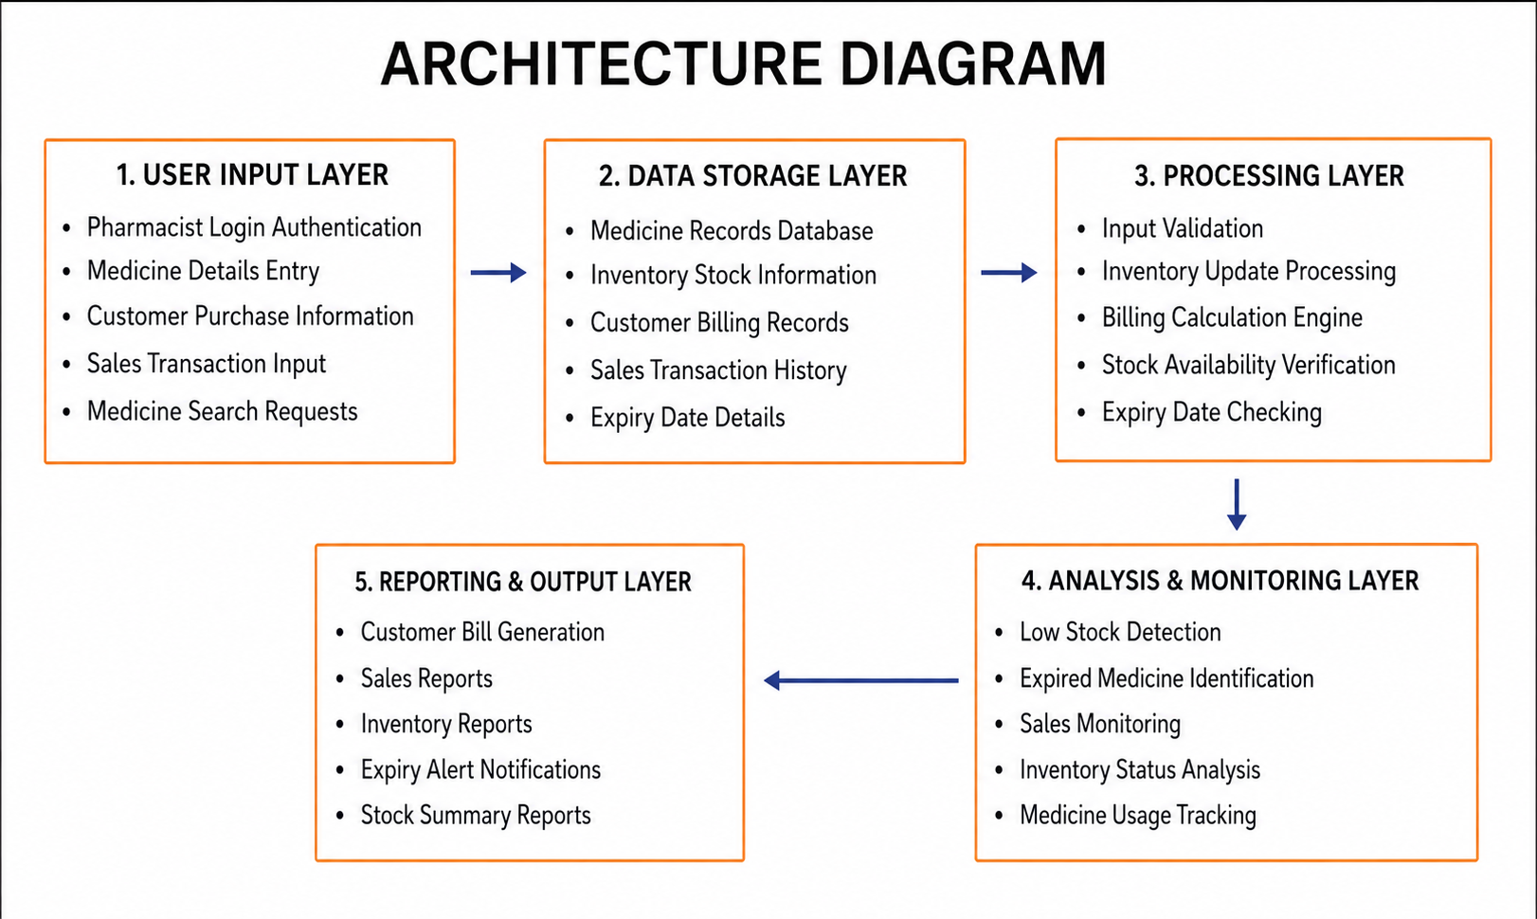
Architecture Diagram

Slide 8
MODULE -1
Medicine Inventory Management
This module is responsible for maintaining a centralized record of all medicines available in the pharmacy.
It stores important information such as medicine names, quantities, prices, manufacturers, batch numbers, and expiry dates.
Pharmacists can add newly arrived medicines and update the details of existing products whenever necessary.
The module also allows the removal of discontinued or unavailable medicines from the inventory. It enables quick searching and retrieval of medicine information during daily operations.
By automating inventory maintenance, the module improves record accuracy and reduces the chances of manual errors.

Slide 9
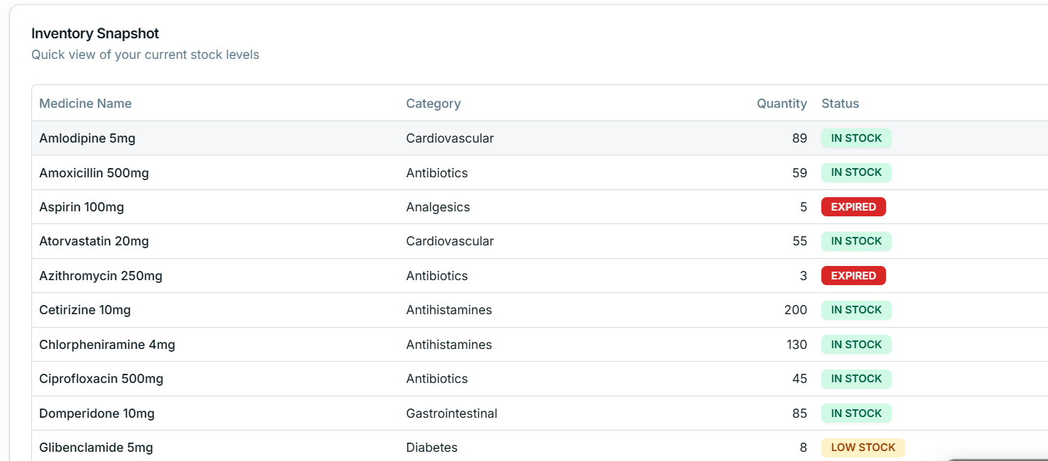
Implementation

Slide 10
MODULE -2
Billing and Sales Management
This module automates the process of generating bills for customers purchasing medicines from the pharmacy.
It calculates the total payable amount based on the selected medicines and their quantities.
Customer transactions are recorded systematically to maintain an organized sales history.
The module ensures that billing calculations are accurate and eliminates errors associated with manual computation. It speeds up the checkout process and reduces customer waiting time during peak hours.
By simplifying sales operations, the module enhances service quality and operational efficiency.

Slide 11
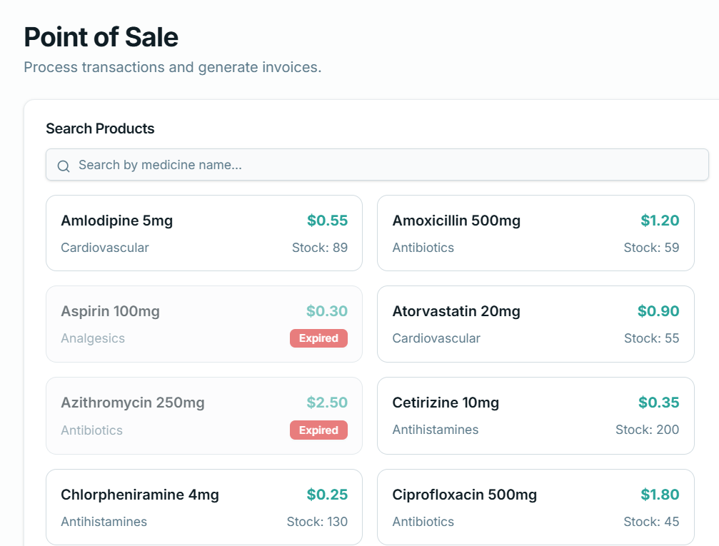
Implementation

Slide 12
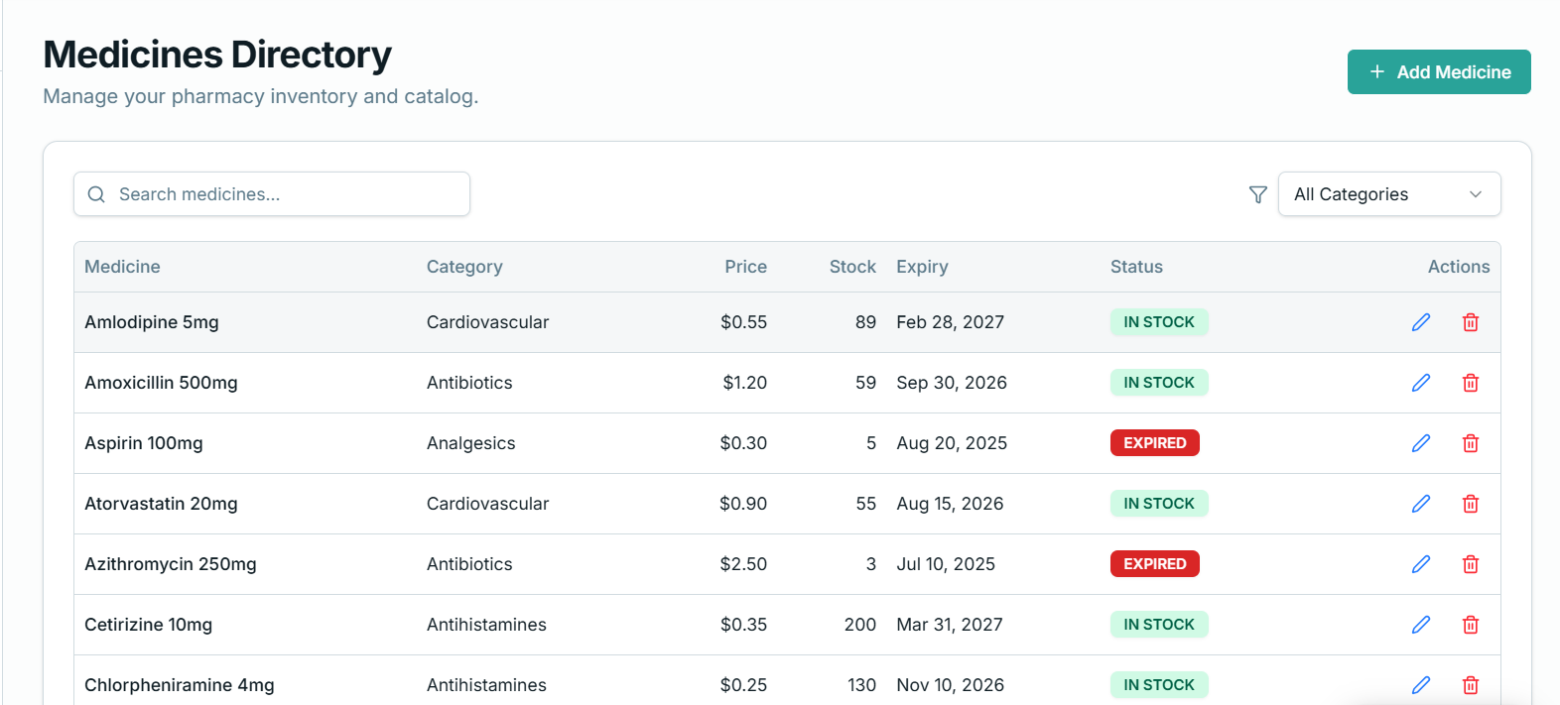
Implementation

Slide 13
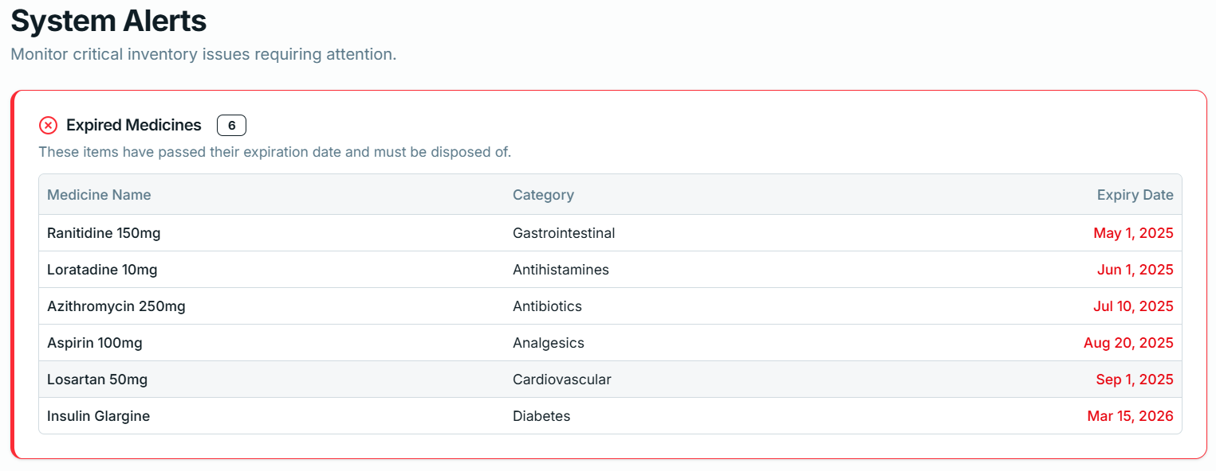
Implementation

Slide 14
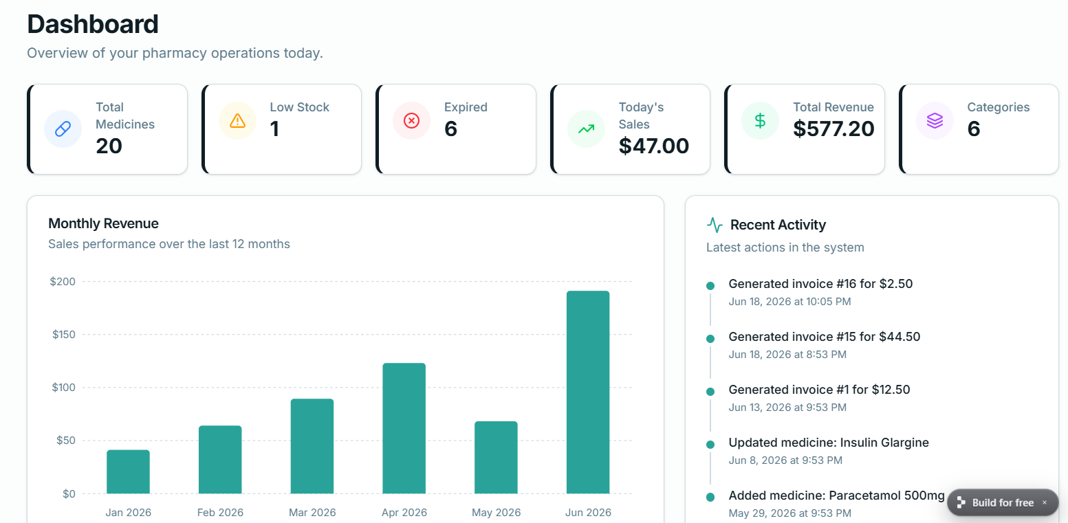
Implementation

Slide 15
Future Scope And Conclusion
The Pharmacy Management System automates inventory tracking and billing, reducing manual effort and improving operational efficiency.
It enhances the accuracy of stock maintenance, minimizes billing errors, and supports better medicine management through expiry and stock monitoring.
Faster transaction processing and organized record keeping contribute to improved customer service and patient safety.
Future enhancements such as barcode scanning, database integration, and supplier management can expand the functionality of the system.
Mobile accessibility, notification services, and multi-branch support can make the application suitable for real-world pharmacy environments.

Slide 16
References
Patel, R., et al. Pharmacy Inventory Management Systems: A Review. International Journal of Pharmacy Practice, 2022.
Kumar, S., and Singh, A. Automation in Retail Pharmacy Operations. Healthcare Technology Journal, 2022.
Sharma, P., et al. Computerized Billing Systems in Pharmacies. Journal of Medical Informatics, 2023.
Ahmed, M., et al. Medicine Expiry Monitoring Techniques. International Journal of Pharmaceutical Sciences, 2023.
Joseph, T., et al. Healthcare Inventory Optimization Strategies. Healthcare Management Review, 2024.
Goundrey-Smith, S. Pharmacy Management Systems. In: Information Technology in Pharmacy. Springer, 2023.
Boggie, D. Pharmacy Information Systems. In: Pharmacy Informatics. CRC Press, 2024.
Siska, M. H., and Meyer, G. E. Pharmacy Informatics: Aligning for Success. American Journal of Health-System Pharmacy, 2020.
Fox, B. I., and Hollingsworth, J. C. Pharmacy Informatics I: Systems and Technology for Patient Care. In: Drug Information: A Guide for Pharmacists (7th Edition). McGraw Hill Medical, 2022.

Slide 17
Thank You !!

