Slide 1

E-Commerce Website for Visually Impaired Batch-88 “Team-02”
Presented By:
Manish Gupta
Sujan G Bhargav
Monisha Narayan
Manjunatha Durgesh
Ratan Kumar Panchal

Slide 2
Contents
Problem Statement
Flow Chart
Technologies & Languages Used
Results

Slide 3
Problem Statement
An ecommerce website is developed to assist blind people that automatically recognize by speech. This system processes the voice output, and asks for the input by pressing the button of their desire choices. Which will help them to buy their desired products online All kind of instructions will be provided to them in the form of audio, they need to hear and follow the instructions.

Slide 4
Flow Chart
Start
Add Product
Login
Edit Product
Delete Product
verify
List Customer
Admin
Not Valid
Admin Index
Sign Up
View Payment
Product
Valid User
Feedback
View Product
Message
Order List
Add to cart
Buy Now
Profile
Contact
Feedback
Cart Item
Payment
Edit
View
Order status
Remove
Buy Now
Feedback

Slide 5
Technologies & Languages Used
Flask
MySQL Database
PyCharm
python
Speech Recognition
Java Script
HTML
CSS

Slide 6
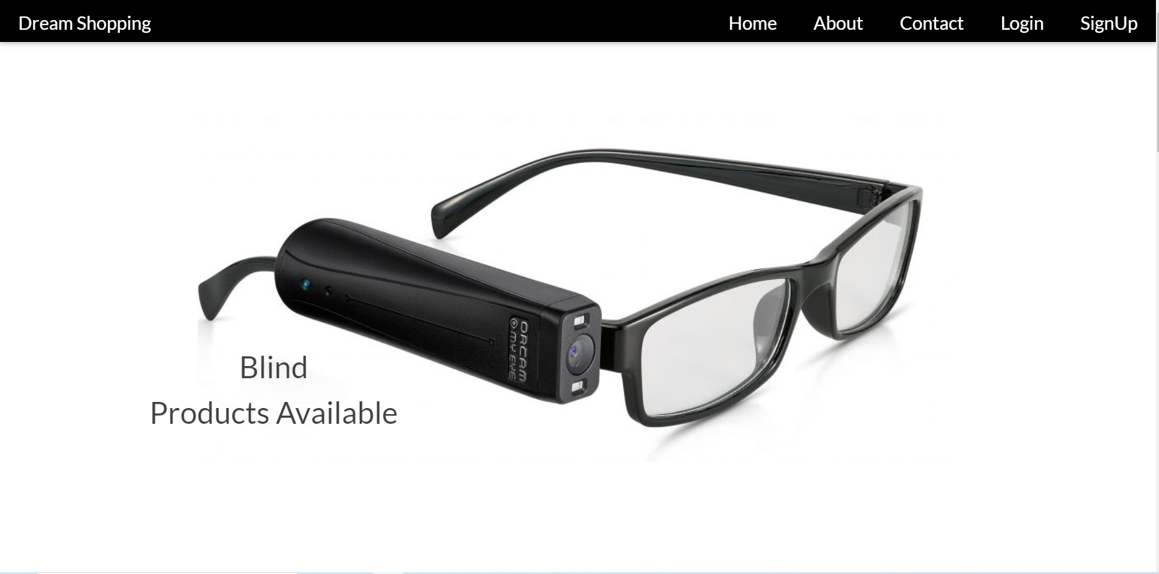
Results
Index Page

Slide 7
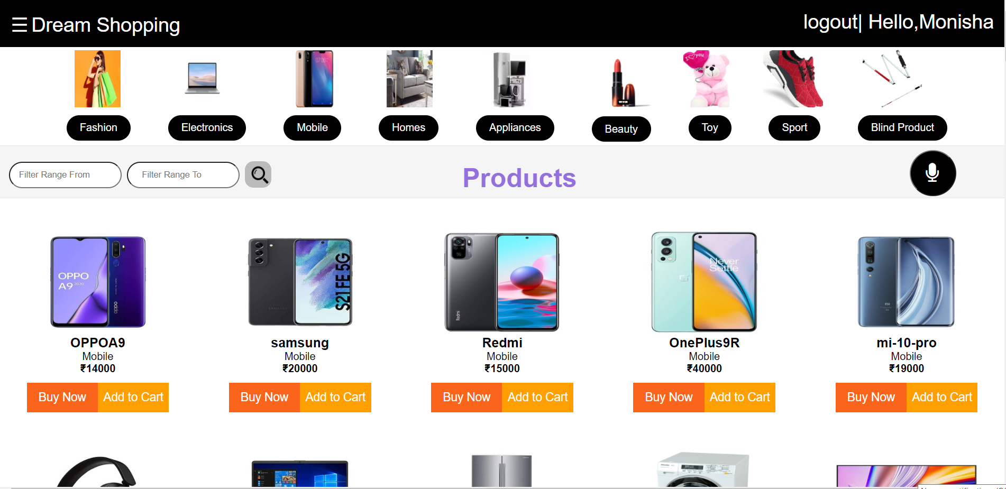
User Page

Slide 8
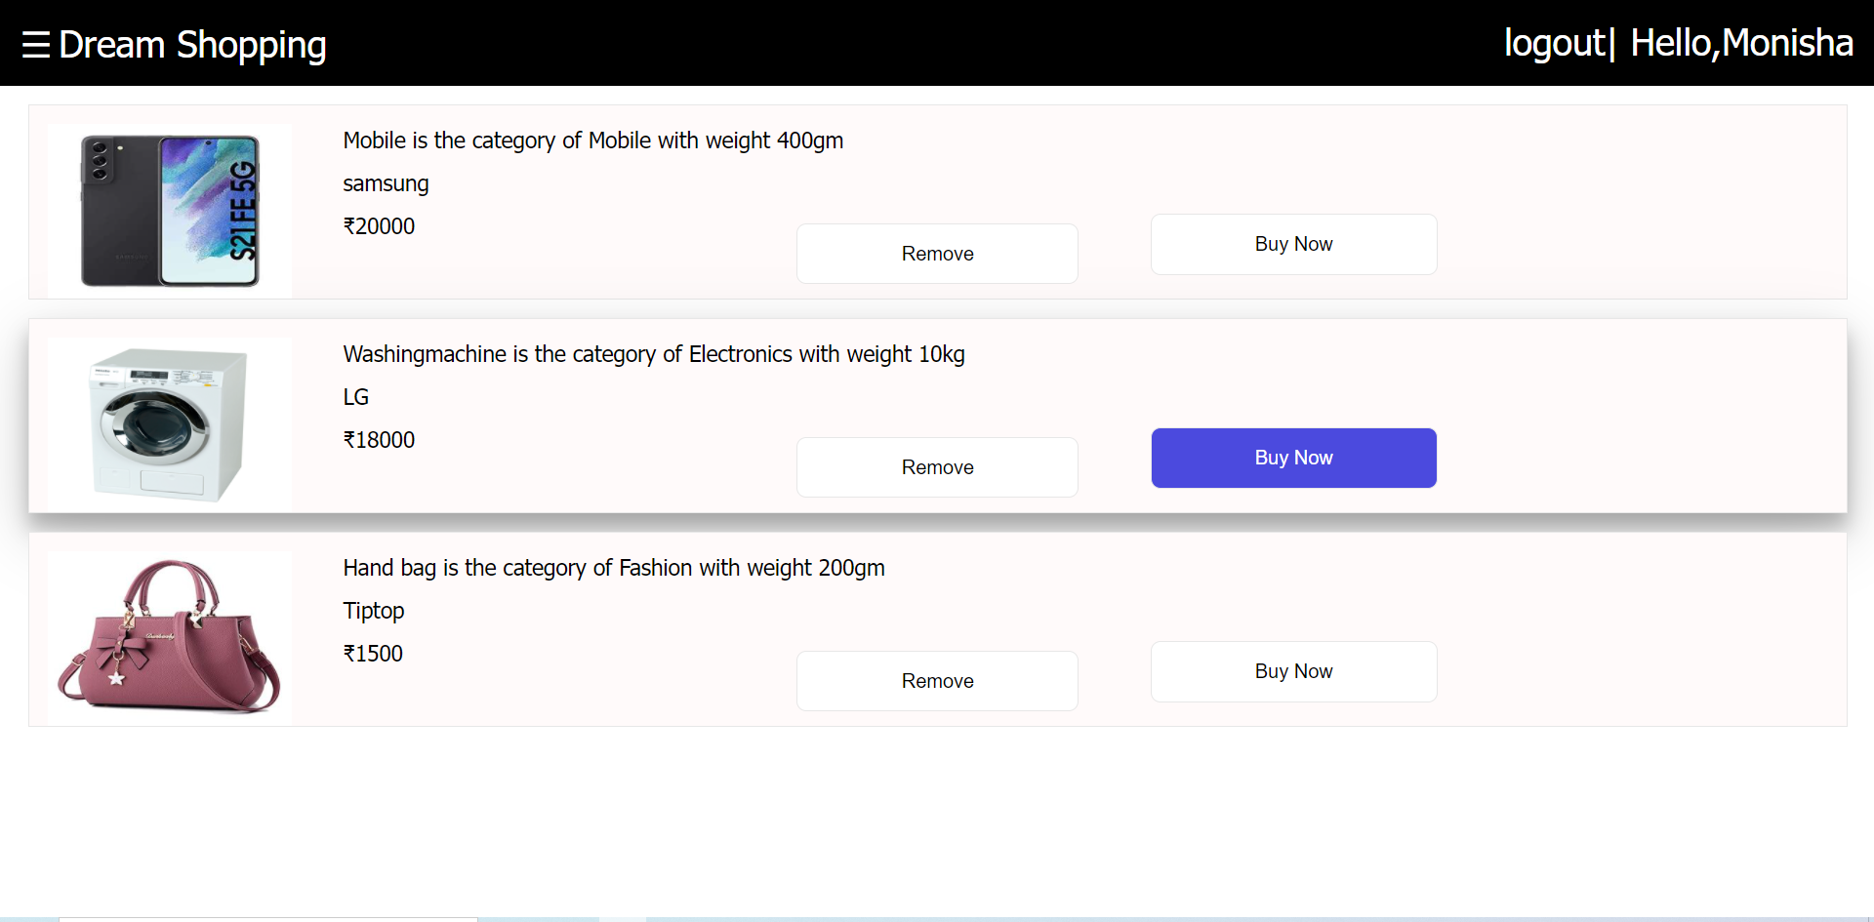
Cart items

Slide 9
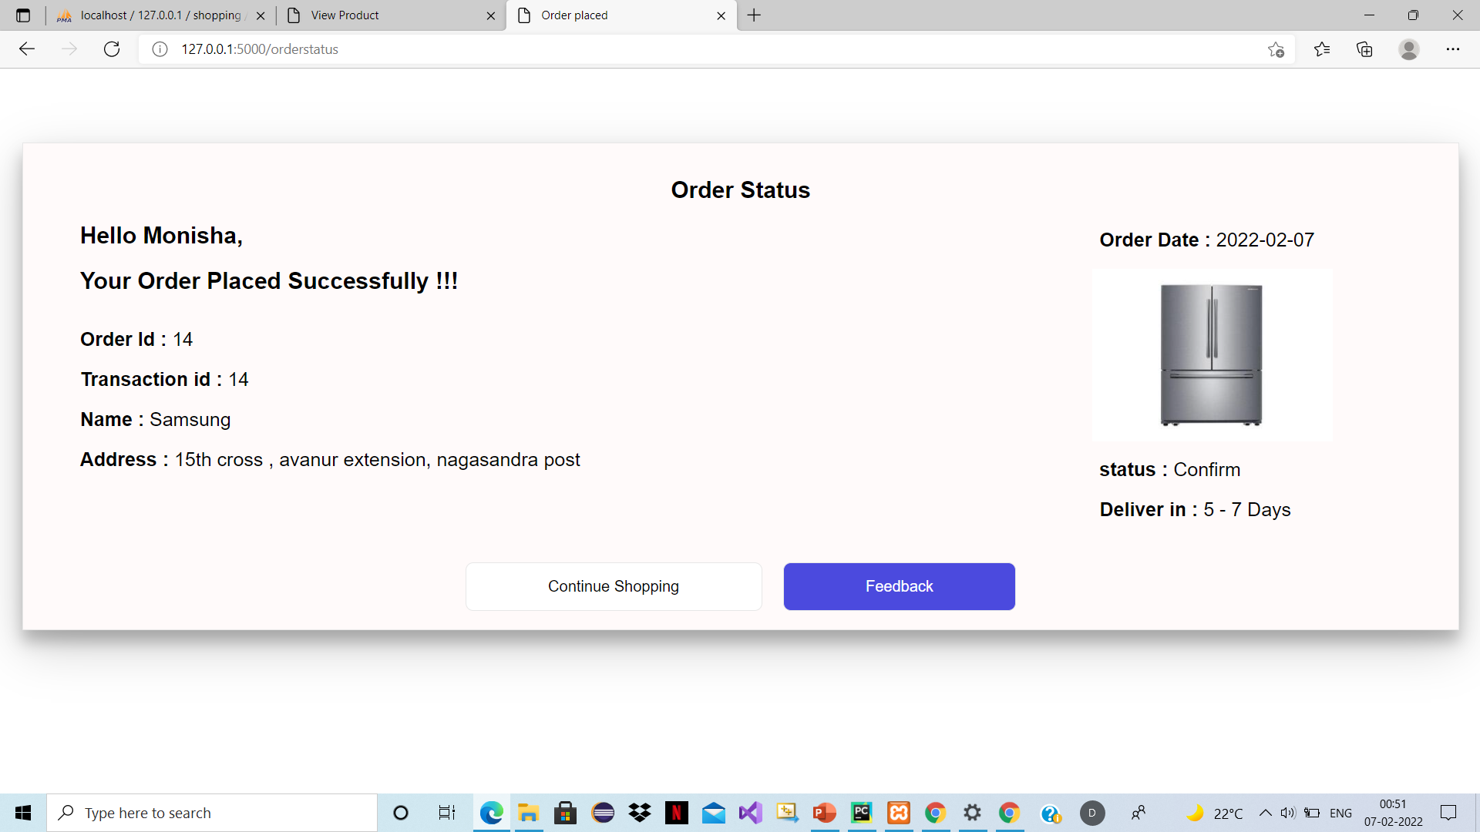
Order status

Slide 10
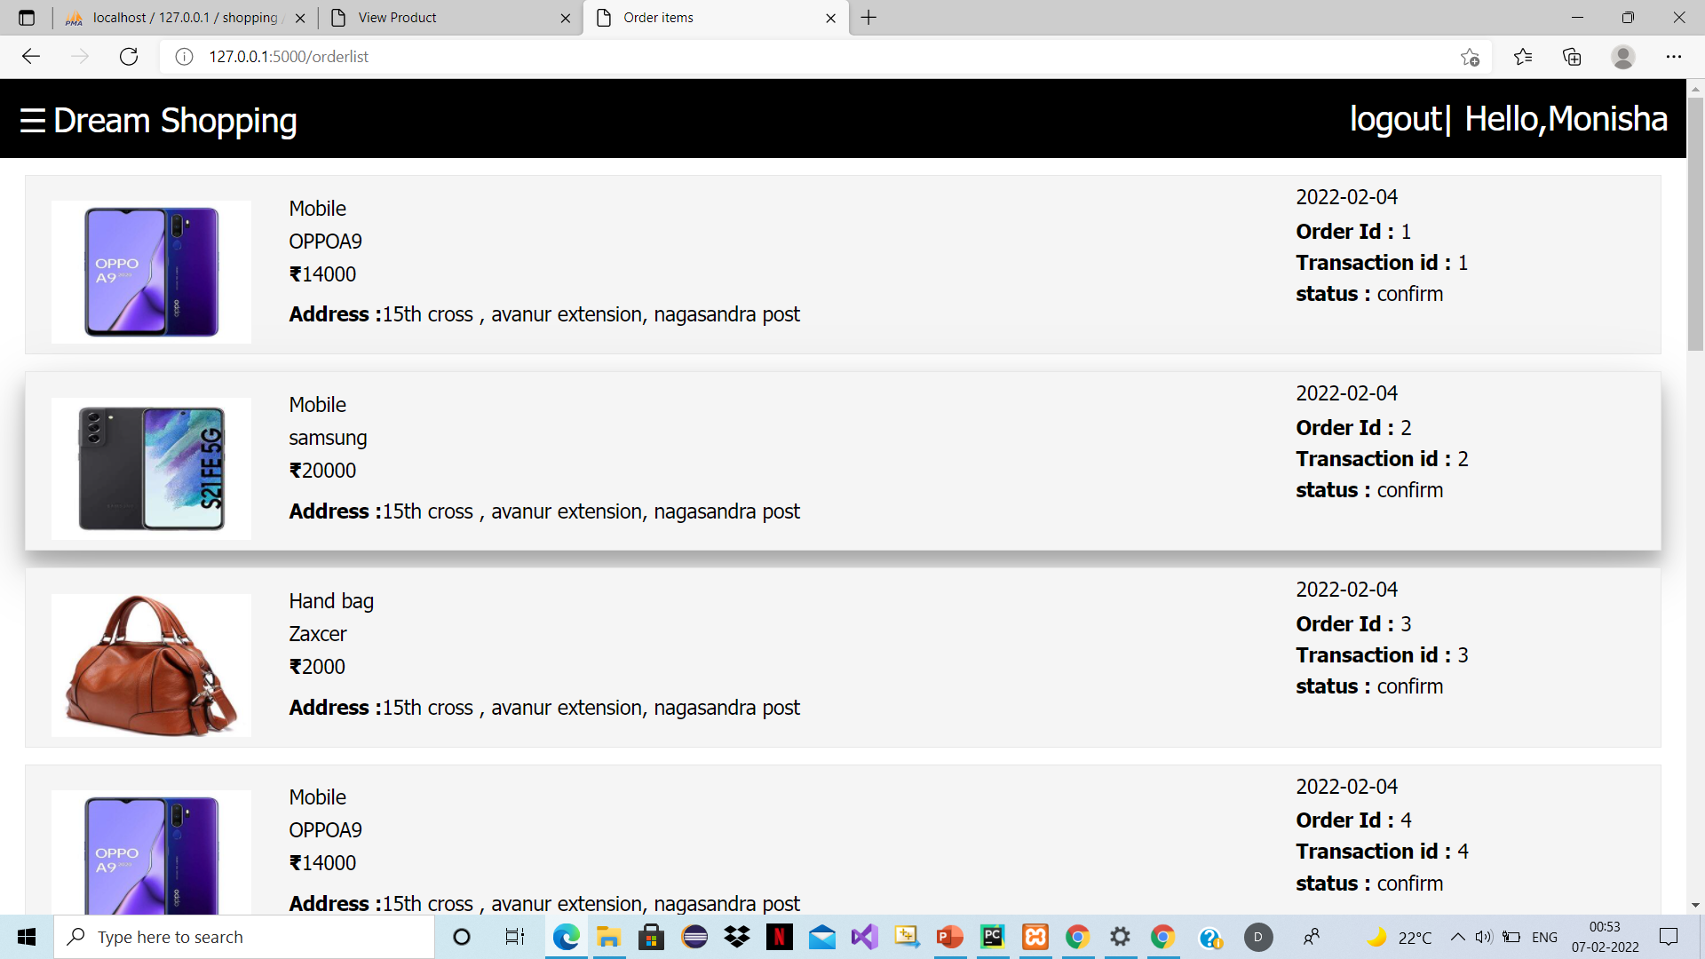
Ordered List

Slide 11
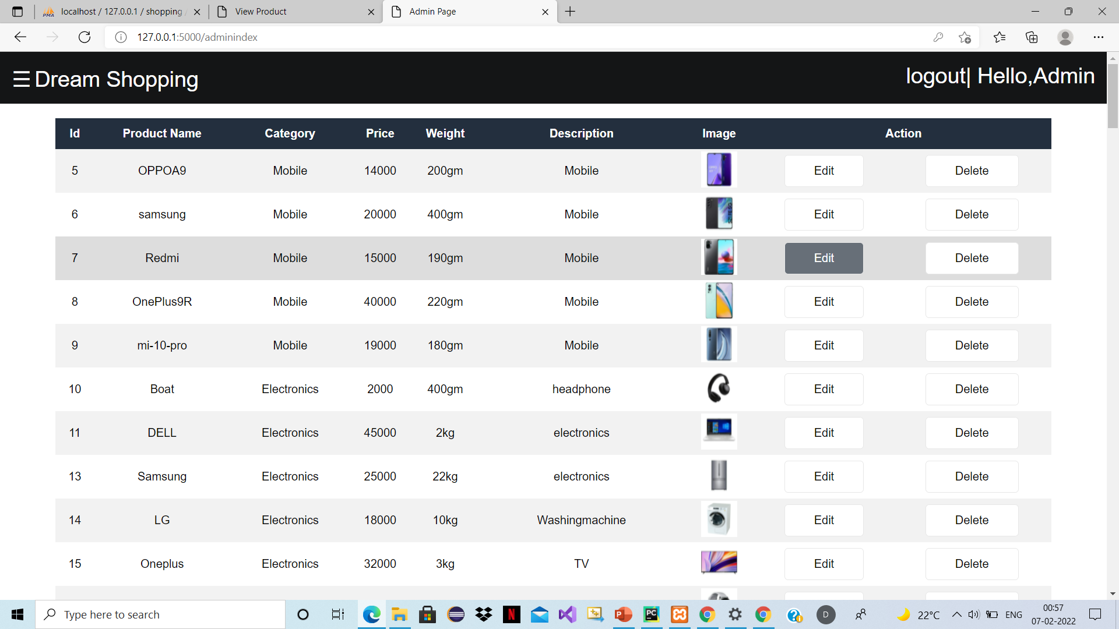
Admin Page

Slide 12
Thank You

