Slide 1
Data Structures and Algorithms -3 (25CS2103E) Recipe Finder
Team Members
Monisha Raghini Chelle: 2520030537
Shaik Sabiya Tabassum: 2520030502
K. Siri Chandana : 2520030453
Under the Esteemed Guidance of
Dr. V.Sireesha Professor
Department of CSE

Slide 2
Contents
Abstract
Introduction
Literature survey
Problem Statement and Objectives
Hardware and Software requirements
Results
Conclusion
Future Scope

Slide 3
Abstract
• Recipe Finder is a Java console application for searching a text-based recipe corpus.
• Recipe data is stored in data/recipes.txt.
• Pattern Matching uses the case-insensitive Naive Pattern Matching algorithm.
• Fuzzy Search uses Levenshtein Edit Distance to handle small spelling mistakes.
• Similarity is calculated as a percentage and the best matching recipe is selected.
• A fuzzy match is accepted when the best score is at least 70%.
• The complete recipe is displayed when a suitable match is found.

Slide 4
Introduction
• The user opens Recipe Finder and selects Pattern Matching or Fuzzy Search.
• The user then enters a recipe name.
• The program reads data/recipes.txt line by line.
• Recipe headers are identified using the “Recipe:” prefix.
• The recipe name is extracted from each recipe record.
• Pattern Matching searches using the Naive algorithm.
• Fuzzy Search compares recipe names using Levenshtein Distance and similarity.
• The matching or closest complete recipe is displayed.

Slide 5
Literature Survey
The implementation uses the following algorithm concepts:
1. Naive Pattern Matching
• Compares the search pattern with a recipe name character by character.
• Used for direct recipe-name searching.
2. Levenshtein Edit Distance
• Measures the number of insertions, deletions and substitutions needed to change one string into another.
• Used for fuzzy searching.
3. Similarity Calculation
• Converts edit distance into a percentage.
• Higher percentage means the two recipe names are more similar.
• The highest score is selected for fuzzy search.

Slide 6
Problem Statement and Objectives
Problem Statement
• Users may enter a recipe name with different letter cases or small spelling mistakes.
• A single exact-search method is not sufficient for flexible recipe searching.
Objectives
• Create and maintain the Git/GitHub project repository.
• Store the recipe corpus and project files in an organized structure.
• Implement Naive Pattern Matching for recipe-name search.
• Implement Levenshtein Edit Distance for fuzzy comparison.
• Calculate similarity percentage and select the closest recipe.
• Display the complete recipe or “Recipe not found”.
• Demonstrate the required Review-2 partial implementation.

Slide 7
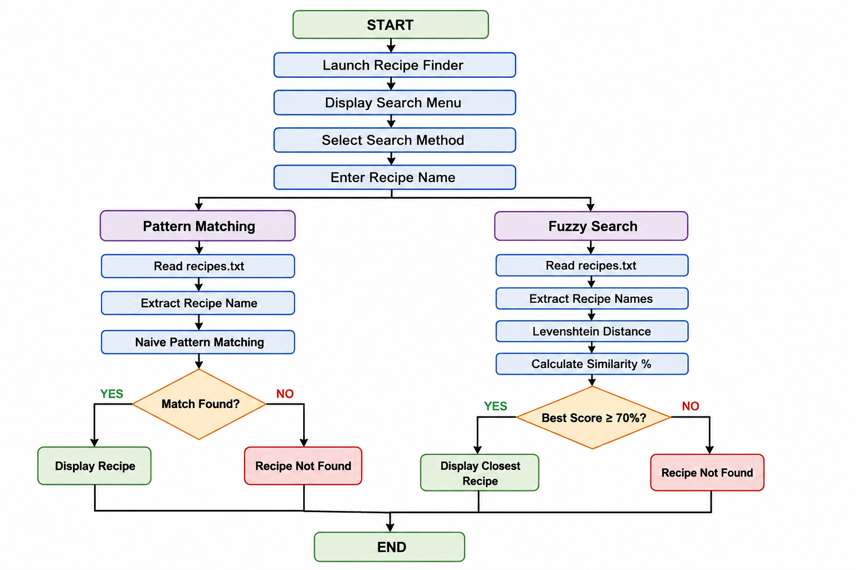
Flow Chart

Slide 8
Results
Implementation Results
Pattern Matching
• Cake → Complete recipe displayed.
• Pasta → Complete recipe displayed.
• Burger → Recipe not found.
Fuzzy Search
• cak → Closest Recipe: Cake; Similarity: 75.00%.
• Pizza → Closest Recipe: Pizza; Similarity: 100.00%.
Input Validation
• Empty input → “Please enter a recipe name.”
Repository Evidence
• src/RecipeFinder.java
• data/recipes.txt
• README.md
• results/ output screenshots
• docs/ and reports/ project files

Slide 9
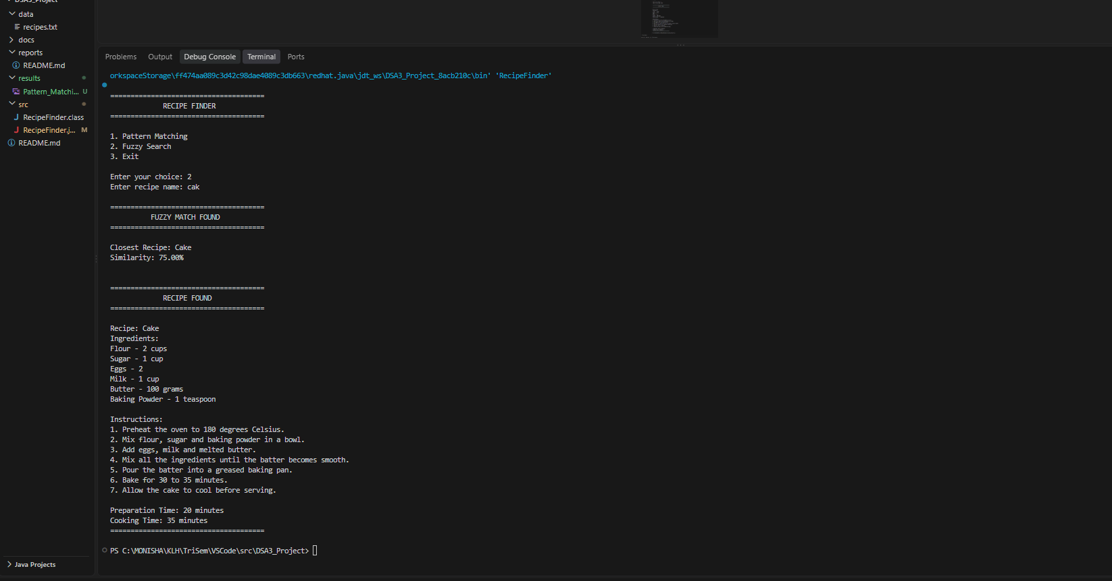
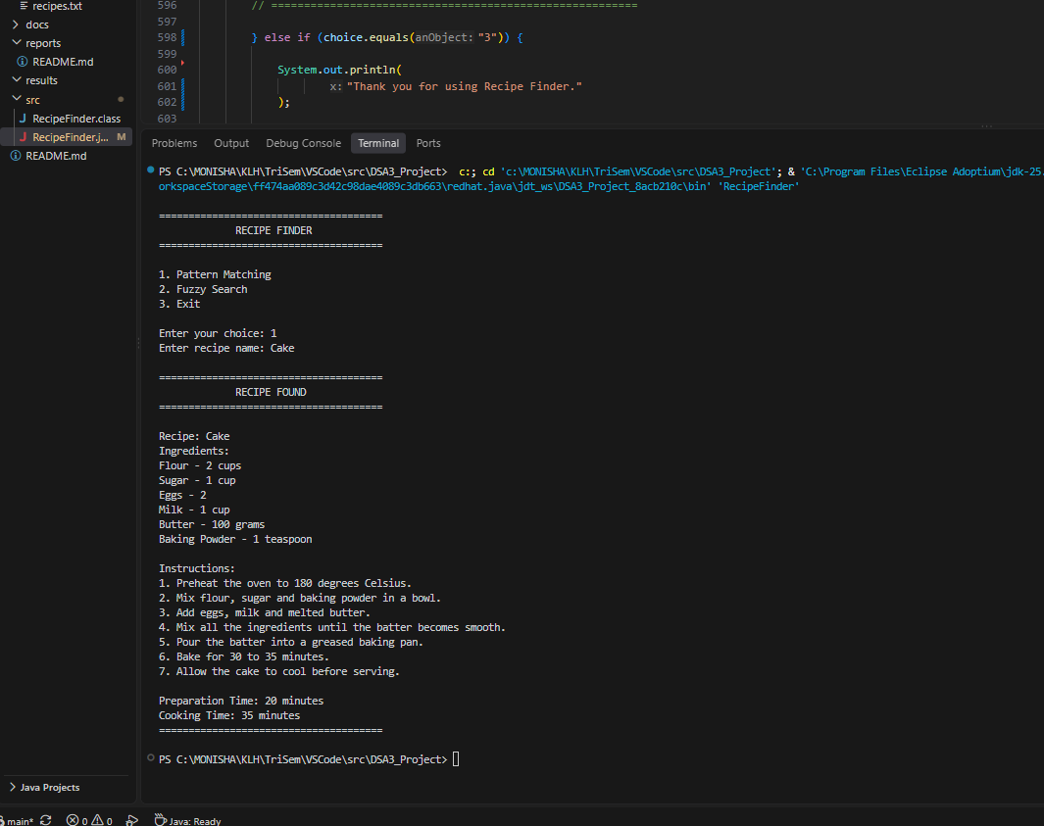
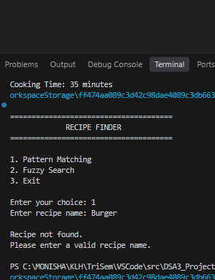

Slide 10
Hardware and Software requirements
Hardware Requirements
• Standard computer or laptop
• Minimum 4 GB RAM
• Keyboard and display
• Basic storage for project files
• No special hardware required
Software Requirements
• Java Development Kit (JDK)
• Visual Studio Code / IntelliJ IDEA / Eclipse
• Git and GitHub
• Windows / Linux / macOS
Project Repository Structure
• src/ – Java source code
• data/ – recipe corpus
• results/ – output screenshots
• docs/ – documentation
• reports/ – project/review reports
• README.md – project information and setup instructions

Slide 11
Conclusion
• Review-2 partial implementation covers Pattern Matching, Fuzzy Search and Similarity Calculation.
• Naive Pattern Matching performs case-insensitive recipe-name searching.
• Levenshtein Edit Distance supports typo-tolerant searching.
• Similarity percentage helps identify the closest recipe.
• A 70% threshold is used for accepting fuzzy matches.
• The program reads the recipe corpus and displays complete recipe details.
• Source code, corpus, README and result evidence are maintained in the repository.

Slide 12
Future Scope
• Add advanced pattern-matching algorithms such as KMP or Rabin–Karp.
• Improve fuzzy ranking and compare more candidate recipes.
• Expand the recipe corpus for larger-scale testing.
• Add filters for ingredients, preparation time and cooking time.
• Add a graphical or web-based user interface.
• Add automated test cases and performance analysis.

Slide 13
Thank you

