Slide 1
Data Structures and Algorithms -3 (25CS2103E)
Recipe Finder
Team Members
Monisha Raghini Chelle : 2520030537
Shaik Sabiya Tabassum : 2520030502
K. Siri Chandana : 2520030453
Under the Esteemed Guidance of
Dr. V. Sireesha
Professor, Department of CSE

Slide 2
Contents
1. Abstract
2. Introduction
3. Literature Survey
4. Problem Statement and Objectives
5. Algorithms and Data Structures
6. Flow Chart
7. Results –Search and Autocomplete
8.Results –Fuzzy Search and Pattern Matching
9.Results – CO4,CO5 and CO6
10. Hardware and Software Requirements
11. CO Mapping and Complexity
12. Conclusion
13. Future Scope
14.Thank You

Slide 3
Abstract
• Java-based application for searching and retrieving recipes from a text corpus.
• Dataset contains 2,000 distinct recipe records stored in data/recipes.txt.
• Normal search interface with automatic prefix suggestions using a Trie.
• Pattern matching uses Naive, KMP, Rabin-Karp and Aho-Corasick implementations internally.
• Fuzzy search uses Levenshtein Edit Distance and similarity calculation.
• Additional DSA features: bipartite ingredient matching, greedy set cover, random recommendation and parallel similarity processing.

Slide 4
Introduction
Application
Supported Queries
• Loads and parses the recipe corpus.
• Builds the Trie for autocomplete.
• Accepts a complete or partial recipe query.
• Displays suggestions and lets the user select one.
• Performs exact search first, then fuzzy search when required.
• Recipe name: Biryani
• Prefix: c
• Fuzzy input: cak
• Ingredient query: ingredient: chicken,onion,tomato
• Coverage query: cover: chicken,onion,tomato
• Recommendation: random

Slide 5
Literature Survey
String Matching
Similarity & Retrieval
• Naive Pattern Matching – direct character comparison.
• KMP – uses the LPS array to avoid unnecessary comparisons.
• Rabin-Karp – uses hashing and a rolling hash.
• Aho-Corasick – Trie + failure links for pattern matching.
• Trie – prefix search and autocomplete.
• Levenshtein Distance – edit-based string similarity.
• Bipartite Matching – ingredient-to-recipe matching.
• Greedy Set Cover – ingredient coverage.
• Randomization & parallel processing – recipe recommendation and similarity computation.

Slide 6
Problem Statement and Objectives
Problem Statement
• Exact search alone is limited for partial names, case variations and small spelling differences.
• Users may also want recipes based on ingredients they already have.
• A practical solution should combine efficient search with user-friendly suggestions.
Objectives
• Implement Naive, KMP, Rabin-Karp and Aho-Corasick pattern matching.
• Provide Trie-based autocomplete and Levenshtein fuzzy search.
• Calculate recipe-name similarity and identify the closest match.
• Implement ingredient matching using bipartite matching.
• Apply Greedy Set Cover for ingredient coverage.
• Provide randomized recommendation and parallel similarity processing.
• Search a dataset of 2,000 distinct recipe records and analyze complexity.

Slide 7
Flow Chart
Start
Load 2,000
recipe records
Build Trie and
search structures
User enters
query
Autocomplete /
query handling
Exact / pattern
search
Fuzzy search +
similarity
Ingredient matching /
Greedy coverage
Random recommendation
Display result

Slide 8
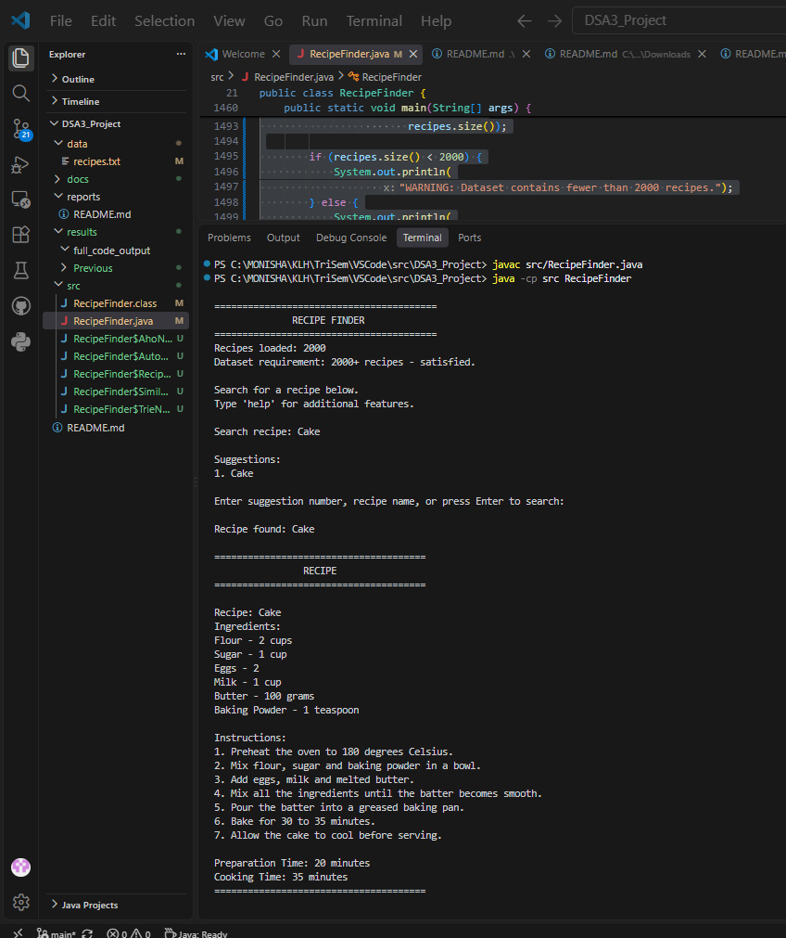
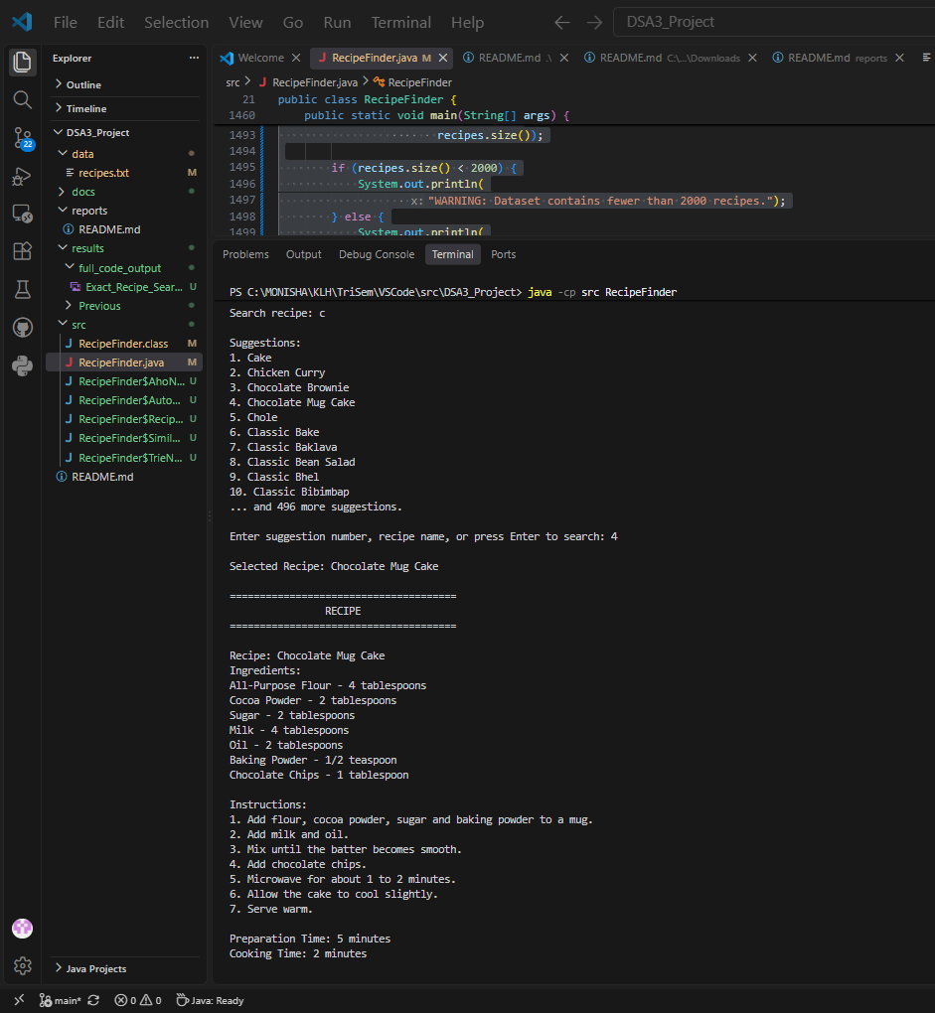
Results – Search and Autocomplete
Exact recipe search
Trie-based autocomplete
Observed behavior: exact recipe names are displayed with complete details; prefix input produces selectable recipe suggestions.

Slide 9
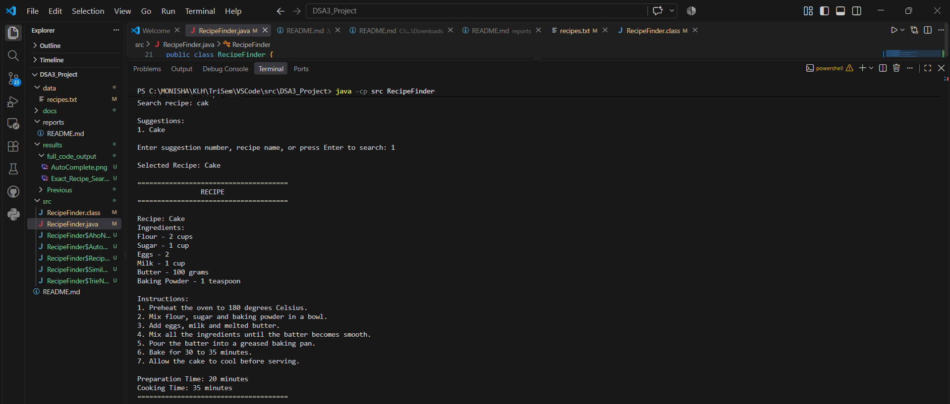
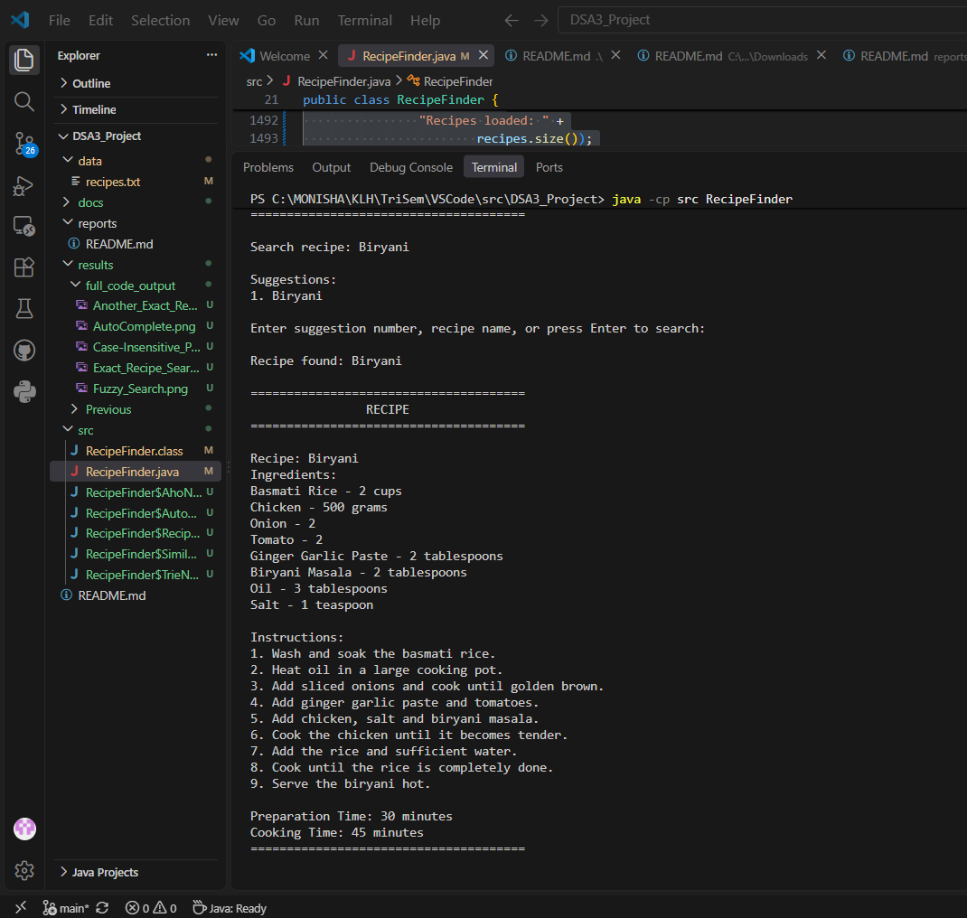
Results – Fuzzy Search and Pattern Matching
Fuzzy search output
Aho-Corasick test
Tested behavior
• Fuzzy search uses the closest similarity score.
• Similarity is accepted when the best score is at least 70%.
• Case-insensitive matching is supported.
• Aho-Corasick is integrated into the pattern-matching verification routine.

Slide 10
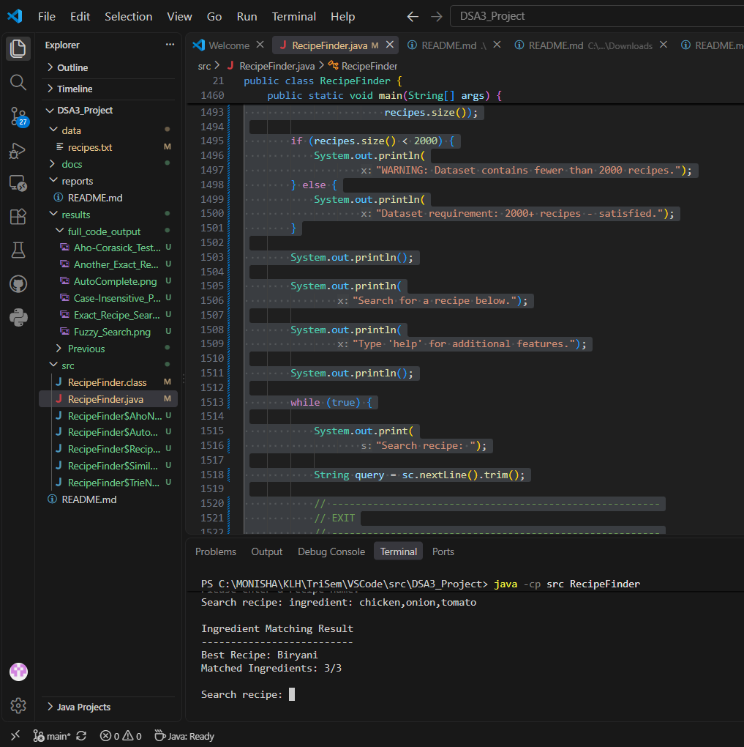
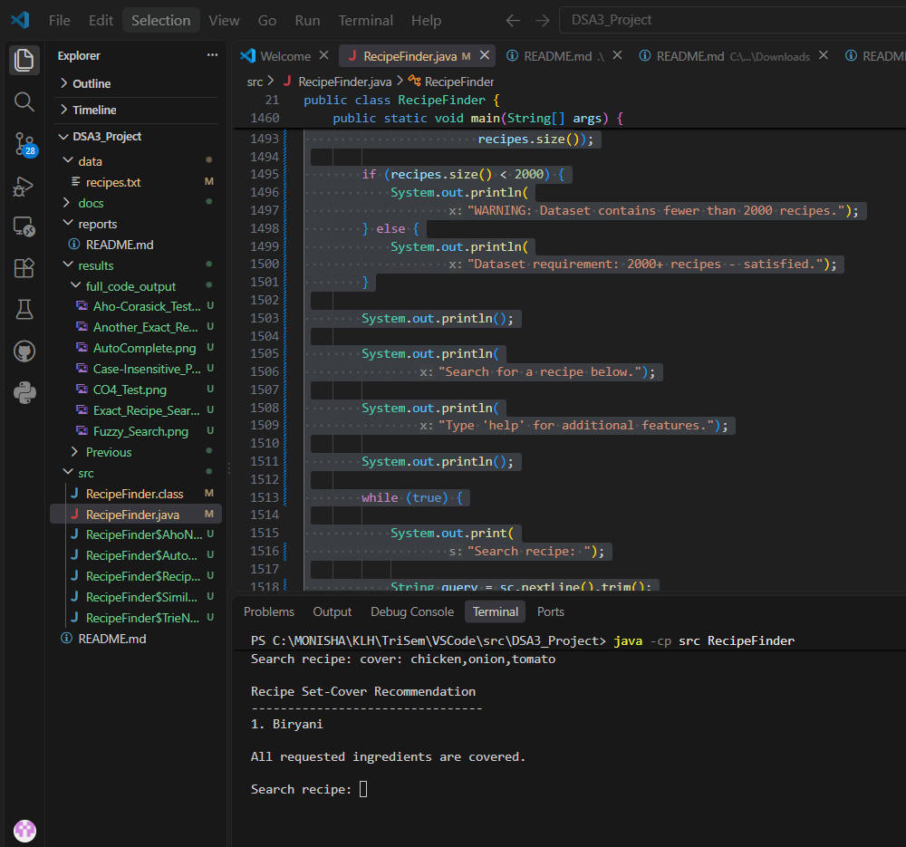
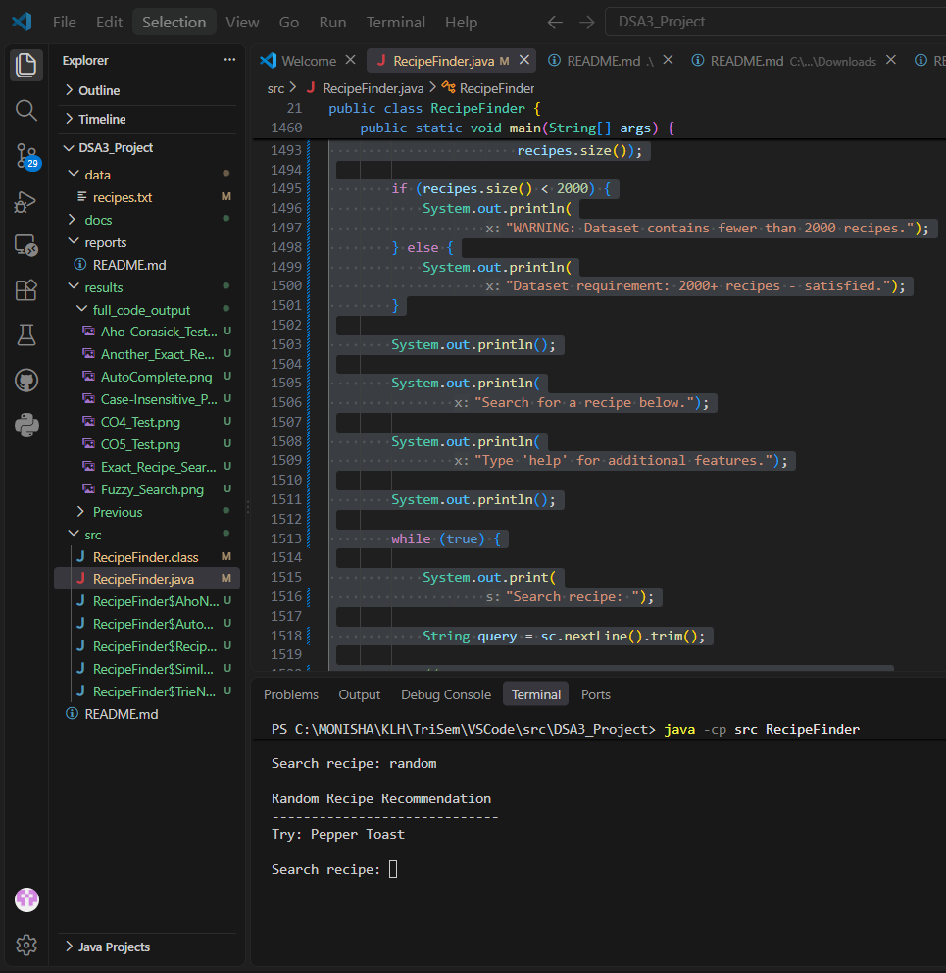
Results – CO4, CO5 and CO6
CO4: Ingredient matching
CO5: Greedy set cover
CO6: Random recommendation
CO4 test: Biryani matched 3/3 requested ingredients. • CO5 test: requested ingredients were fully covered. • CO6 test: random recommendation returned a recipe.

Slide 11
Hardware and Software Requirements
Hardware
Software
• Standard computer or laptop
• Minimum 4 GB RAM
• Keyboard and display
• Basic storage for project files
• No special hardware required
• Java Development Kit (JDK)
• VS Code / IntelliJ IDEA / Eclipse
• Git and GitHub
• Windows / Linux / macOS
• Project dataset: data/recipes.txt
Repository Structure
• src/ – Java source code
• data/ – recipe corpus
• docs/ – presentations and project documents
• results/ – testing screenshots
• reports/ – project report
• README.md – project documentation

Slide 12
CO Mapping and Complexity
CO Mapping
Complexity
Naive: O(n × m) worst case
KMP: O(n + m)
Rabin-Karp: O(n + m) average; O(n × m) worst case
Aho-Corasick: O(P + N + Z)
Trie prefix search: O(p + k) approximately
Levenshtein: O(n × m)
Greedy coverage: depends on the number of recipes and requested ingredients
Random selection: O(1) after dataset loading
CO1 – Problem analysis, algorithm selection and complexity.
CO2 – Naive, KMP, Rabin-Karp and Aho-Corasick.
CO3 – DP, Levenshtein Distance and fuzzy similarity.
CO4 – Bipartite ingredient matching.
CO5 – Greedy Set Cover Approximation.
CO6 – Randomized recommendation and parallel similarity.

Slide 13
Conclusion
• The Recipe Finder combines multiple DSA techniques in a single recipe-search application.
• Pattern matching is implemented using Naive, KMP, Rabin-Karp and Aho-Corasick.
• Trie-based autocomplete provides prefix suggestions through a normal search interface.
• Levenshtein Edit Distance and similarity calculation support fuzzy search.
• Bipartite matching supports ingredient-based retrieval.
• Greedy Set Cover supports ingredient coverage.
• Randomized recommendation and parallel similarity provide additional processing features.
• The implementation is tested using a 2,000-record recipe corpus.

Slide 14
Future Scope
• Improve search-result ranking and relevance scoring.
• Add advanced personalized recipe recommendations.
• Include nutritional information and user dietary preferences.
• Support larger and more diverse real-world recipe datasets.
• Add graph-based relationships between recipes and ingredients.
• Develop a graphical /web-based user interface.
• Add automated performance benchmarking and larger test suites.

Slide 15
Thank You

