Slide 1
Data Structures and Algorithms -3
(25CS2103E)
Recipe Finder
Team Members
Monisha Raghini Chelle – 2520030537
Shaik Sabiya Tabassum – 2520030502
K. Siri Chandana – 2520030453
Under the Esteemed Guidance of
Dr. V. Sireesha
Professor, Department of CSE

Slide 2
Contents
Abstract
Introduction
Literature survey
Problem Statement and Objectives
Hardware and Software requirements
Results
Conclusion
Future Scope

Slide 3
Abstract
• Recipe Finder is a Java-based DSA application for searching and retrieving recipes from a text corpus.
• The current dataset contains 100,000 distinct recipe records stored in data/recipes.txt.
• Java Swing provides a normal search interface with live prefix suggestions using a Trie.
• Internal search uses Naive Pattern Matching, KMP, Rabin-Karp and Aho-Corasick.
• Levenshtein Edit Distance supports fuzzy matching and similarity calculation.
• Ingredient retrieval uses bipartite matching; ingredient coverage uses Greedy Set Cover.
• Randomized recommendation and parallel similarity processing are also implemented.

Slide 4
Introduction
Introduction
• Recipe Finder is a Java-based DSA application for searching a large recipe corpus.
• The system uses a text-based recipe dataset stored in data/recipes.txt.
• The current dataset contains 100,000 recipe records for large-scale testing.
• A Java Swing interface provides a simple desktop environment for recipe search and recommendation.
• Multiple DSA techniques are integrated to support exact search, prefix search, fuzzy matching and ingredient-based operations.
Key Features
• Trie-based autocomplete provides prefix suggestions while typing.
• Naive, KMP, Rabin-Karp and Aho-Corasick support pattern matching.
• Levenshtein Edit Distance supports fuzzy search and similarity calculation.
• Bipartite matching supports ingredient-based recipe retrieval.
• Greedy Set Cover supports ingredient coverage.
• Randomized recommendation and parallel similarity processing are included.

Slide 5
Literature Survey
Pattern Matching
• Naive Pattern Matching – direct character comparison. [1]
• KMP – uses the LPS array to avoid unnecessary comparisons. [1]
• Rabin-Karp – hashing with a rolling hash. [2]
• Aho-Corasick – Trie-based multi-pattern matching with failure links. [3]
Search & Optimization
• Trie – prefix search and autocomplete. [4]
• Levenshtein Distance – edit-based similarity. [5]
• Bipartite Matching – ingredient-to-recipe matching. [6]
• Greedy Set Cover – ingredient coverage.
• Randomized recommendation – random recipe selection.
Numbered references for the surveyed techniques are listed on the final References slide.

Slide 6
Problem Statement and Objectives
Problem Statement
• Exact search alone is limited for partial names, case variations and spelling differences.
• Users may also need recipes based on available ingredients.
• The system must remain usable with a large 100,000-record corpus.
• A practical solution should combine efficient DSA techniques with a simple user interface.
Objectives
• Implement Naive, KMP, Rabin-Karp and Aho-Corasick.
• Provide Trie autocomplete and Levenshtein fuzzy search.
• Support ingredient matching using bipartite matching.
• Apply Greedy Set Cover for ingredient coverage.
• Provide randomized recommendation and parallel similarity.
• Test the application with 100,000 recipe records.

Slide 7
Flow Chart
Start
↓
Load 100,000 recipe records
↓
Build Trie and search structures
↓
User enters query
↓
Autocomplete / query handling
↓
Exact / pattern search
↓
Fuzzy search + similarity
↓
Ingredient matching / Greedy coverage
↓
Random recommendation
↓
Display result

Slide 8
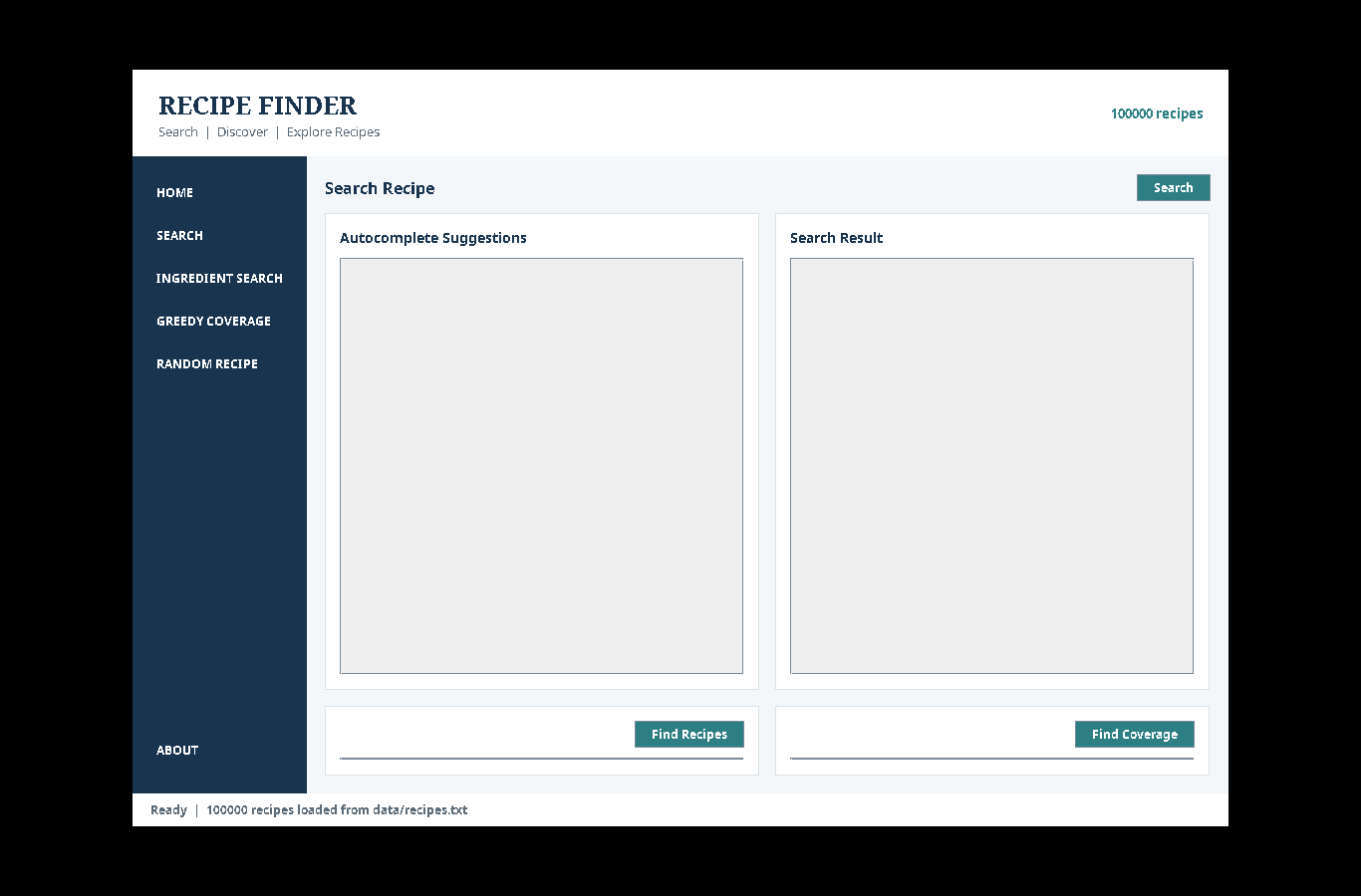
Results
Java Swing GUI
Actual project interface
100,000 recipes loaded
Live Autocomplete
• Prefix suggestions use the existing Trie.
• Suggestions are generated from data/recipes.txt.
Search Workflow
• Exact search first.
• If exact search fails, parallel fuzzy search is used.
• Similarity threshold in GUI: 70%.
Screenshot: current RecipeFinderGUI.java

Slide 9
Hardware and Software requirements
Hardware
• Standard computer/laptop
• Minimum 4 GB RAM
• Keyboard and display
• Basic storage for source code and dataset
• No special hardware required
Software
• Java Development Kit (JDK)
• Java Swing
• VS Code / IntelliJ IDEA / Eclipse
• Git and GitHub
• Windows / Linux / macOS
• Dataset: data/recipes.txt
• Current dataset size: 100,000 records

Slide 10
Conclusion
Conclusion
• Recipe Finder integrates multiple DSA techniques in one recipe-search application.
• Pattern matching is implemented using Naive, KMP, Rabin-Karp and Aho-Corasick.
• Trie-based autocomplete provides prefix suggestions through a normal search interface.
• Levenshtein Edit Distance and similarity calculation support fuzzy search.
• Bipartite matching supports ingredient-based retrieval.
• Greedy Set Cover supports ingredient coverage.
• Randomized recommendation and parallel similarity extend the search functionality.
• The current project operates on a 100,000-record recipe corpus and provides a Java Swing interface.

Slide 11
Future Scope
Future Scope
• Improve search-result ranking and relevance scoring.
• Add advanced personalized recipe recommendations.
• Include nutritional information and user dietary preferences.
• Support larger and more diverse real-world recipe datasets.
• Add graph-based relationships between recipes and ingredients.
• Develop a graphical/web-based interface beyond the current Swing desktop GUI.
• Add automated performance benchmarking and larger test suites.

Slide 12
References
[1] D. E. Knuth, J. H. Morris Jr., V. R. Pratt, “Fast Pattern Matching in Strings,” SIAM Journal on Computing, 6(2), 323–350, 1977. DOI: 10.1137/0206024.
[2] D. E. Knuth, J. H. Morris Jr., V. R. Pratt, “Fast Pattern Matching in Strings,” SIAM Journal on Computing, 1977. (KMP/LPS reference)
[3] R. M. Karp, M. O. Rabin, “Efficient Randomized Pattern-Matching Algorithms,” IBM Journal of Research and Development, 31(2), 249–260, 1987. DOI: 10.1147/rd.312.0249.
[4] A. V. Aho, M. J. Corasick, “Efficient String Matching: An Aid to Bibliographic Search,” Communications of the ACM, 18(6), 333–340, 1975. DOI: 10.1145/360825.360855.
[5] E. Fredkin, “Trie Memory,” Communications of the ACM, 3(9), 490–499, 1960. DOI: 10.1145/367390.367400.
[6] V. I. Levenshtein, “Binary Codes Capable of Correcting Deletions, Insertions, and Reversals,” Soviet Physics Doklady, 10, 707–710, 1966.
[7] J. E. Hopcroft, R. M. Karp, “An n^(5/2) Algorithm for Maximum Matchings in Bipartite Graphs,” SIAM Journal on Computing, 2(4), 225–231, 1973. DOI: 10.1137/0202019.
Thank You

