Slide 1
OPERATING SYSTEMS • PROJECT PRESENTATION
Linux Job Scheduler
and Task Automation System
A terminal-based C application for scheduling approved programs at future times
Monisha Raghini Chelle • 2520030537
Shaik Sabiya Tabassum • 2520030502
K. Siri Chandana • 2520030453
Department of Computer Science and Engineering | K L (Deemed to be) University

Slide 2
Problem Statement & Objectives
Why build a small scheduler instead of starting each program manually?
Problem
Proposed solution
Users may need programs to run at a specified time. Manual execution requires attention, and without logs it can be difficult to confirm what happened.
A menu-driven Linux application accepts an approved program and future time, monitors due jobs while open, executes them, and records results.
Project objectives
• Validate program choice and scheduled date/time.
• Persist job records and assign job IDs.
• Execute due tasks and capture output plus exit status.
• Allow users to view status/logs and cancel pending jobs.
Linux Job Scheduler and Task Automation System
2

Slide 3
Scope & Key Features
One-time scheduling with a restricted allowlist of programs
date
echo
Displays the date/time at execution
Prints a user-provided message
true
false
Success case: exit code 0
Failure case: non-zero exit code
• Menu: schedule, list jobs, view status/logs, cancel pending job, exit.
• Foreground-only: the application must remain running to monitor due jobs.
Linux Job Scheduler and Task Automation System
3

Slide 4
System Design & Architecture
Responsibilities are separated across C modules
User / Menu
Job Manager
Scheduler
Process Manager
Job Storage
main.c
menu.c
job_manager.c
validate + status
scheduler.c
due-time checks
process_manager.c
execute + collect result
job_storage.c
jobs.db + logs
Process execution
Result communication
fork / exec-family / waitpid (as implemented)
Anonymous pipe carries execution-result information
Job records: data/jobs.db • Per-job logs: logs/job_<id>.log
Linux Job Scheduler and Task Automation System
4

Slide 5
System Workflow
From user input to recorded execution result
1
Choose program
2
Enter future time
3
Validate + save job
4
Monitor due time
5
Execute approved program
6
Capture output / exit code
7
Update status + log
Important limitation: after the foreground application exits, it no longer checks pending jobs.
Linux Job Scheduler and Task Automation System
5

Slide 6
Technologies & Implementation Approach
Tools and interfaces used in the supplied project
C11
GCC + GNU Make
Ubuntu / WSL2
Modular application source
Build and link C modules
Linux development and execution environment
POSIX/Linux APIs
POSIX threads
Shell test scripts
Process control, file operations, polling and pipes
Worker-thread lifecycle for due jobs
Integration and verification test suites
Build command: make clean → make | Run target: make run
Linux Job Scheduler and Task Automation System
6

Slide 7
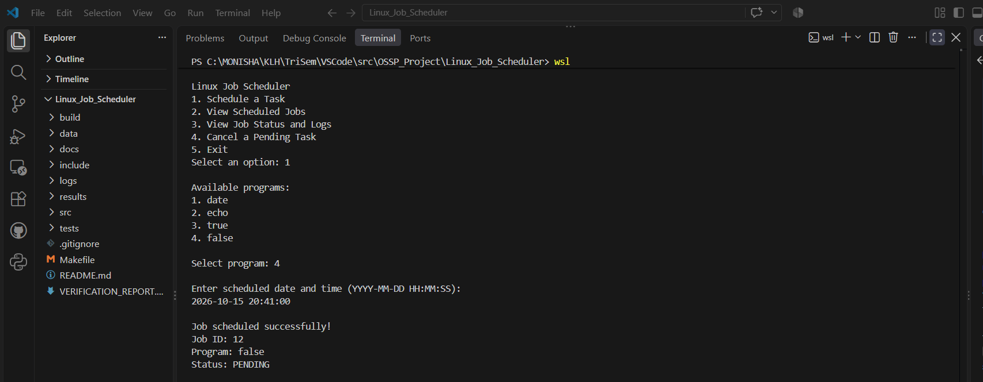
Implementation Demo: Scheduling a Job
Actual screenshot from the supplied project ZIP
Example: scheduling an echo job and receiving a PENDING status.
Linux Job Scheduler and Task Automation System
7

Slide 8
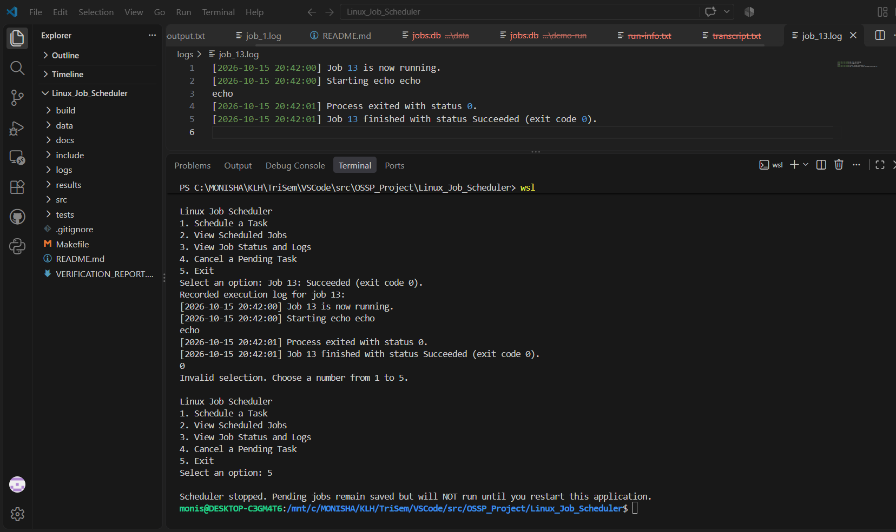
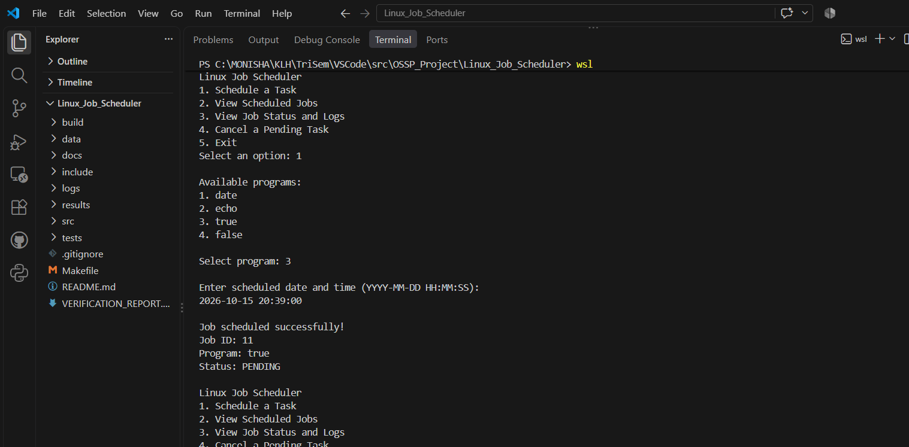
Execution Results & Logging
Real evidence included in the project package
Echo execution • exit code 0
Completion log
Job output and status are recorded for later inspection.
Linux Job Scheduler and Task Automation System
8

Slide 9
Testing & Verification
The ZIP includes automated tests and captured verification evidence
Build verification
Automated tests
Strict compiler flags enabled; build completed with no warnings/errors in the recorded run.
Recorded output: scheduler integration tests and detailed verification tests passed.
Coverage represented in the supplied evidence
• Successful commands: date, echo, true (exit code 0).
• Expected failure case: false (exit code 1; job marked Failed).
• Invalid program/time, cancellation, corrupt records and boundary inputs.
• Restart/persistence, process-failure handling and memory diagnostics.
Test claims are based on the included audit-verification.md and verification-evidence files.
Linux Job Scheduler and Task Automation System
9

Slide 10
Results & Impact
What the project demonstrates
Functional outcome
Learning impact
Safety scope
Schedules approved programs, tracks job states, captures output and stores logs.
Connects C programming with process control, IPC, file I/O, validation and thread lifecycle.
Uses an allowlist instead of arbitrary shell commands; reports real exit results.
Limitations
• One-time jobs only; scheduler must remain open.
• Restricted to date, echo, true and false.
• Does not implement the Linux kernel scheduler or a background daemon.
Linux Job Scheduler and Task Automation System
10

Slide 11
Conclusion & Future Enhancements
The project delivers an educational Linux scheduler prototype that combines scheduled-time checks, process execution, result communication, persistent job records, and logs.
Future enhancements
Thank you
• Background service / daemon support
• Recurring schedules and priorities
• Improved concurrency and notifications
• More user-friendly interface
Questions?
Linux Job Scheduler and Task Automation System • K L (Deemed to be) University
Linux Job Scheduler and Task Automation System
11

