Slide 1


PROJECT PRESENTATION ON TEST AUTOMATION
TEAM NAME : TESTING MANIACS

Slide 2
Team Members
MONISHA M.G
GOWTHAM V
KANEEZ FATIMA KHAN.
ASMITA PATIL
NAVYA H
INSTRUCTOR:
MR. SARAVANAN

Slide 3

ACUNETIX
Security Testing:
This text can be replaced with your own text

Slide 4
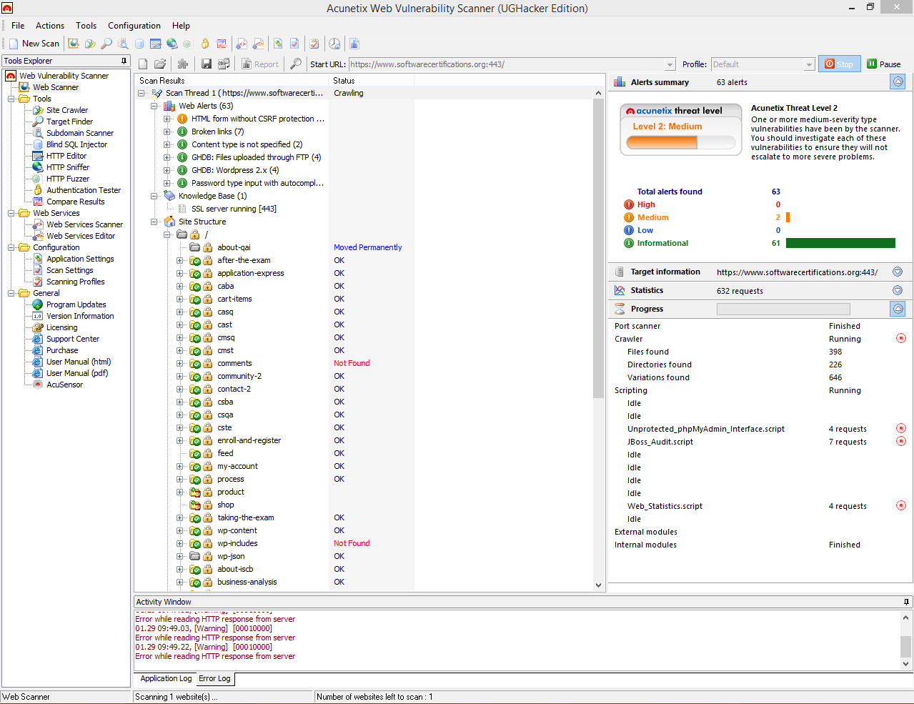

Slide 5
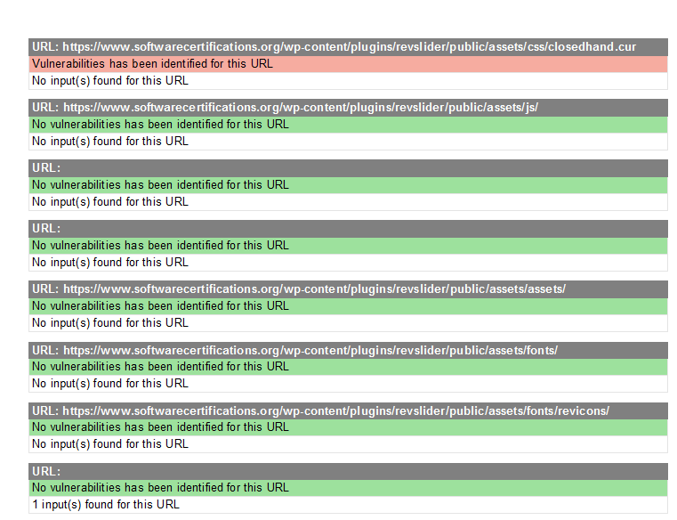
Report :

Slide 6

SOAP UI
This text can be replaced with your own text

Slide 7
AUT Descriptions:
Testing the functionality of web services.
Environment Description:
OS: Windows 8.1
Tool used: SOAP UI
Programming language: Groovy script & XML

Slide 8
Product Features:
Add Employee Details:
In this we get the information from the end user and save it in the server
Get Employee Details:
In this we can get the complete information of the added employee from the server
Delete Employee Details:
In this we can delete the complete information of the added employee from the server

Slide 9
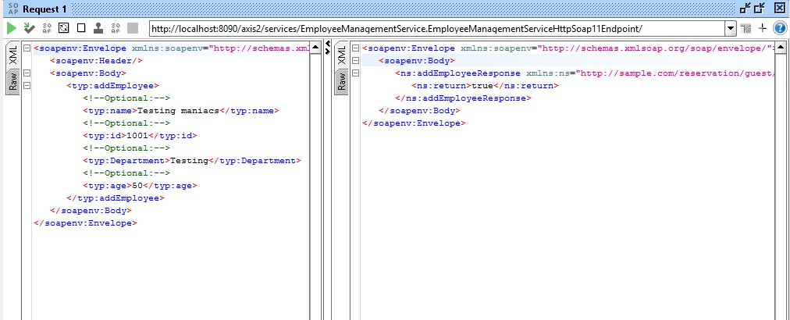
Add Employee Response:

Slide 10
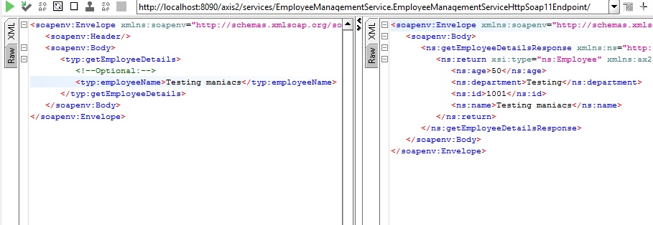
Get Employee Response:

Slide 11
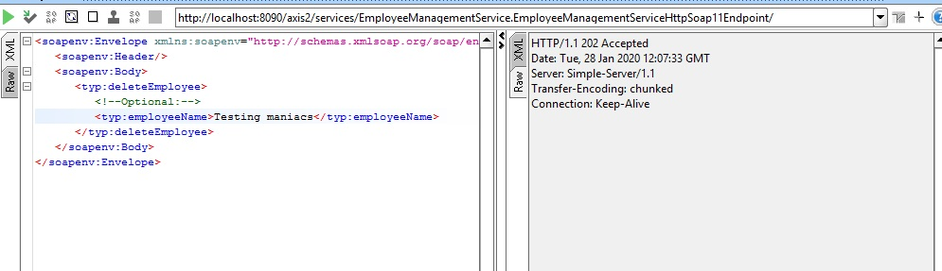
Delete Employee Response:

Slide 12
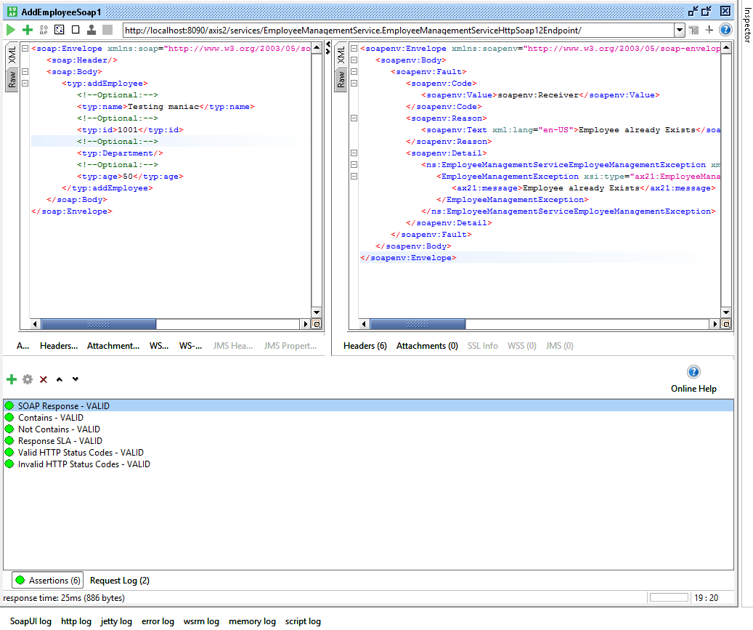
Assertiond used in ADD:

Slide 13
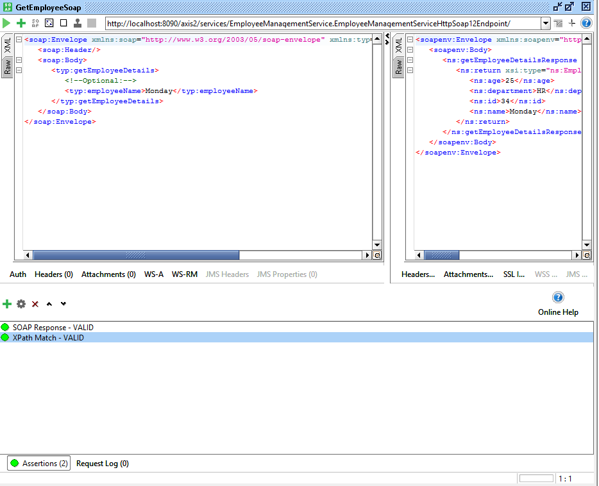
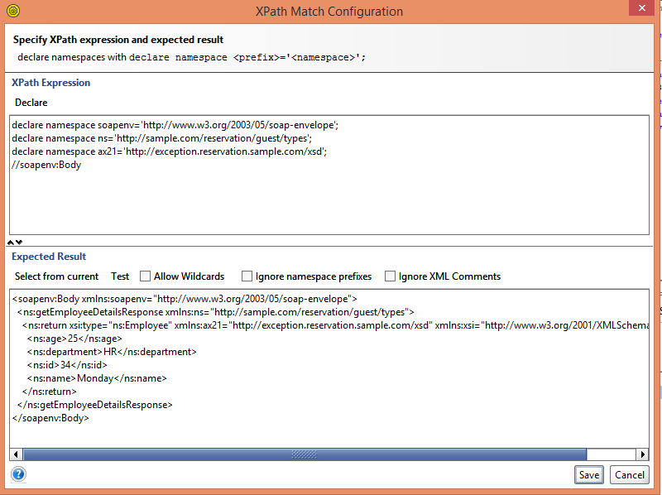
Assertiond used in XPath:

Slide 14
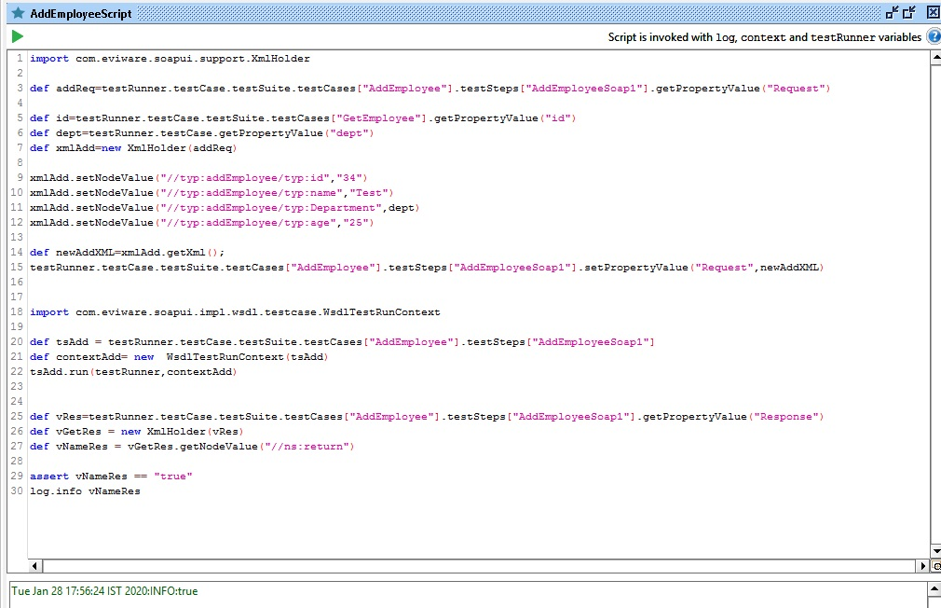
Groovy Script
Add Employee :

Slide 15
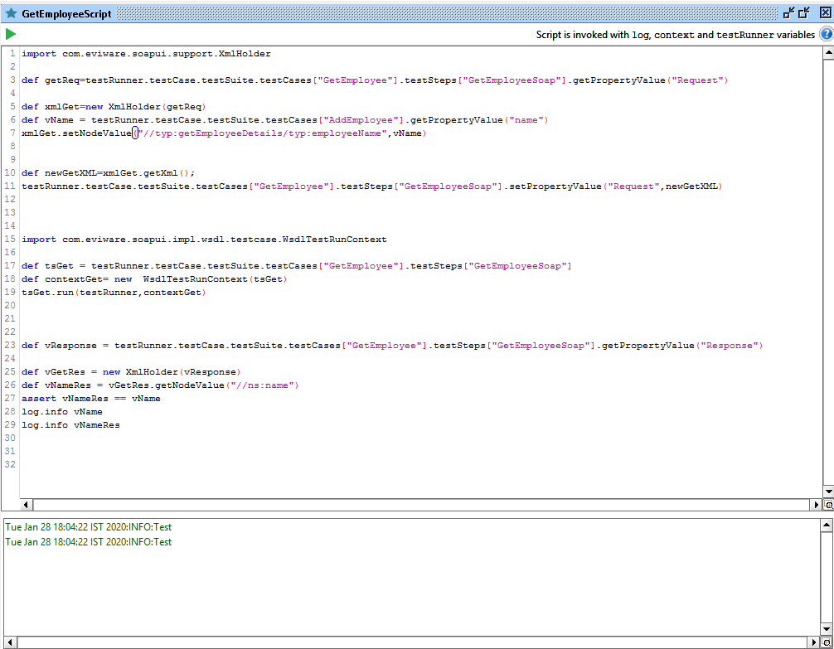
Groovy Script
Get Employee :

Slide 16
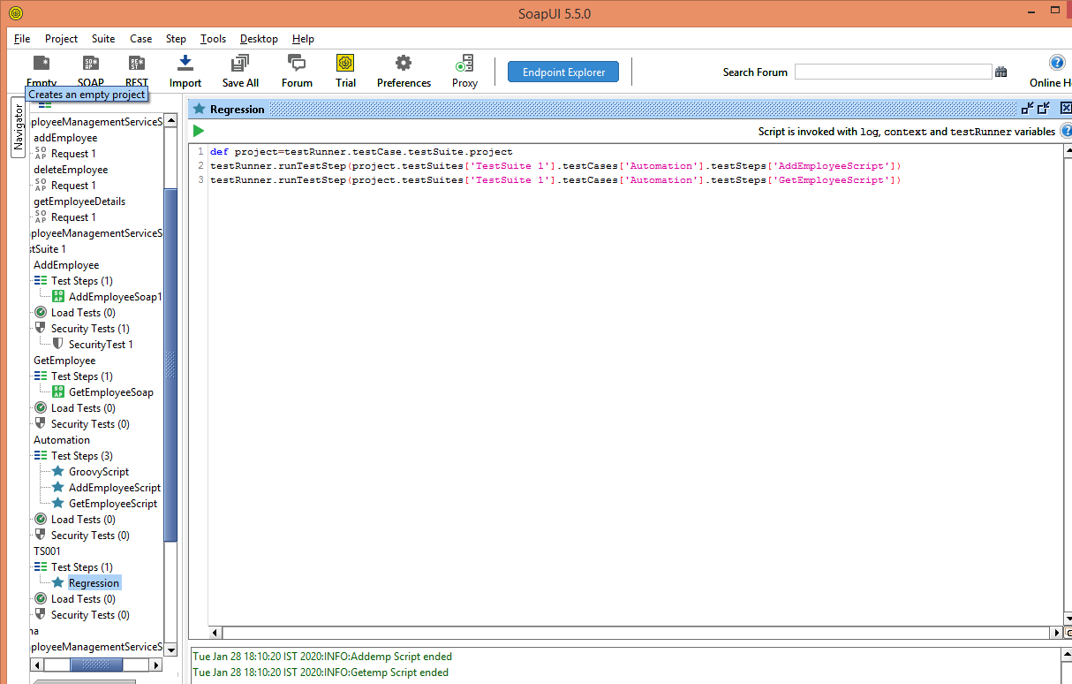
Groovy Script
Regression :

Slide 17
SELENIUM

Slide 18
Project 1:
You Can Deal With It :
Steps:
1.Open You can deal with it website.
2.Mouse over on Borrowers.
3.Click on Calculators and Resources.
4.Click on Calculators
5.Click on Budget Calculators
6.Pass the data using arrays to respective fields
7.Get the result and print the following.
8.Close the website.

Slide 19
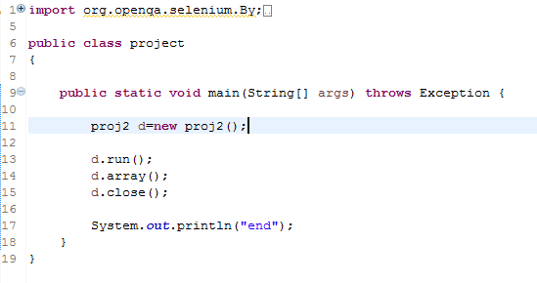
Working Code:

Slide 20
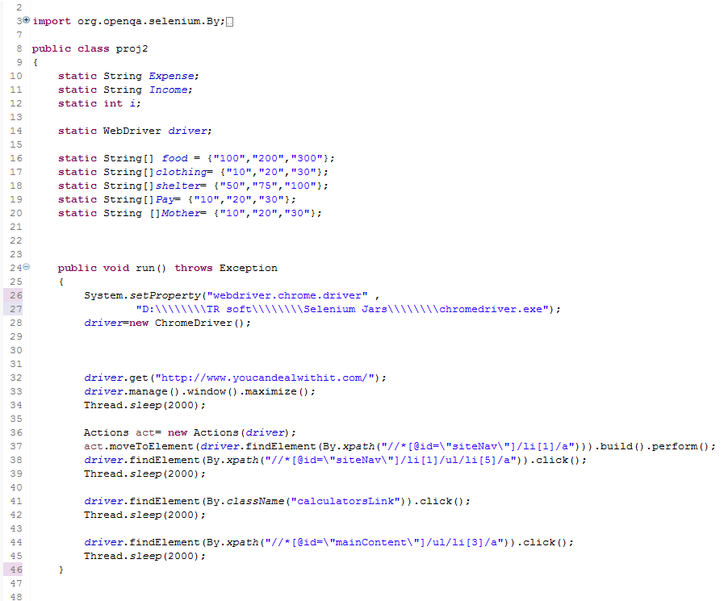

Slide 21
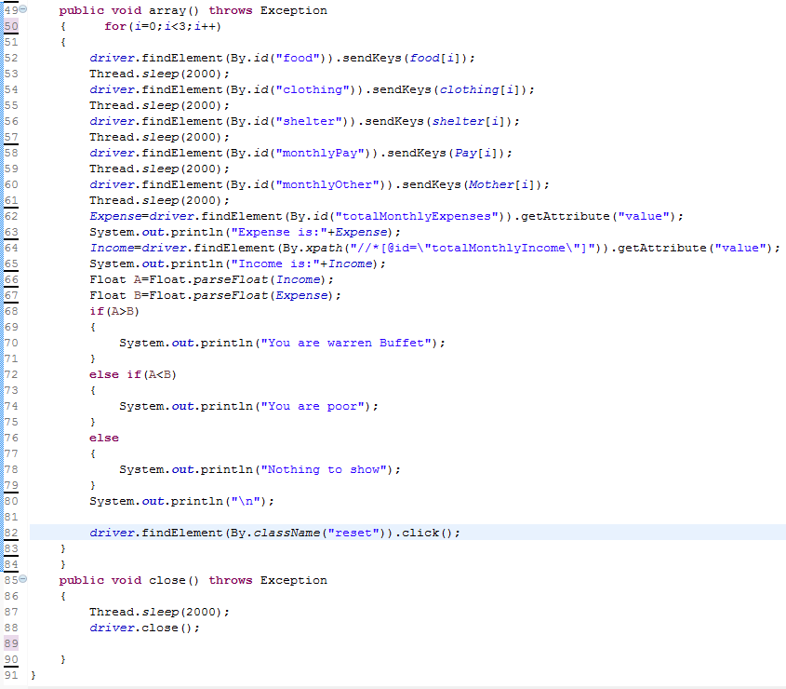

Slide 22
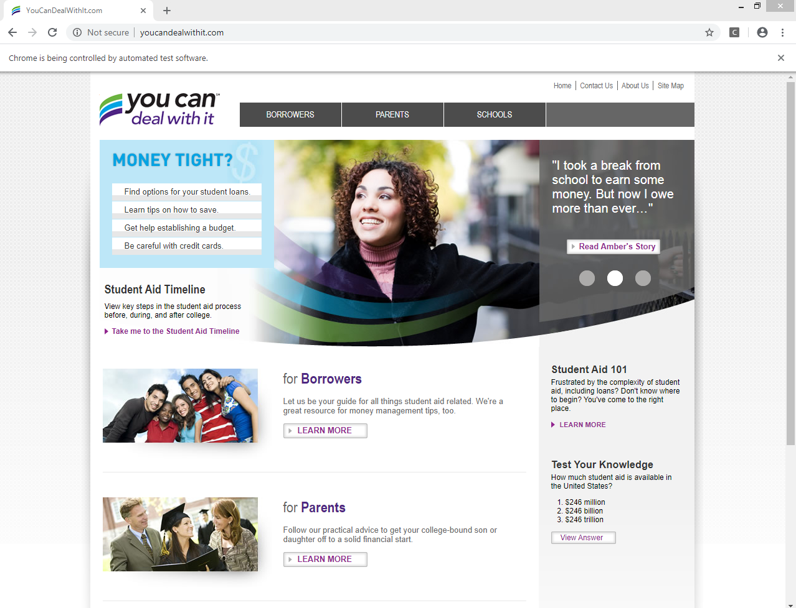
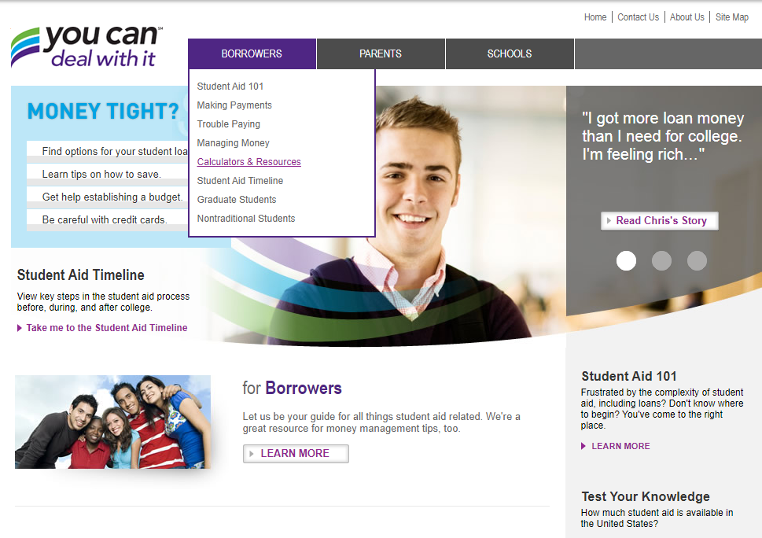
Output:

Slide 23
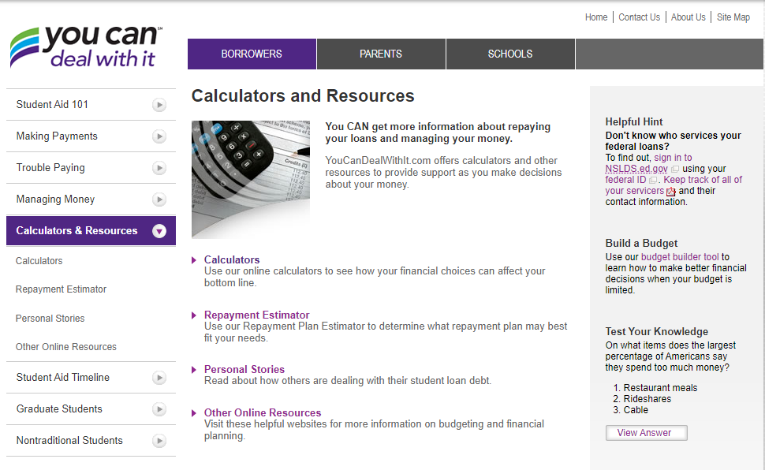
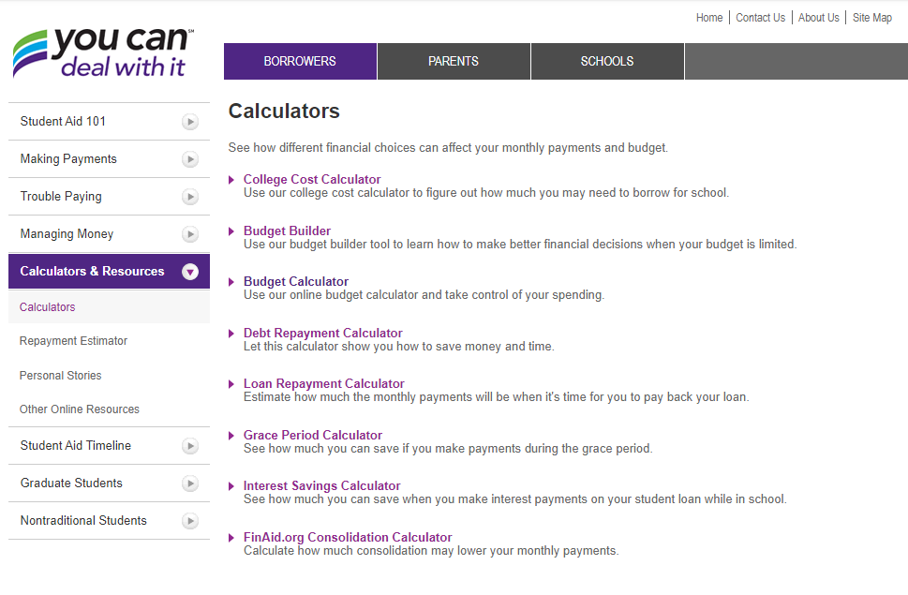

Slide 24
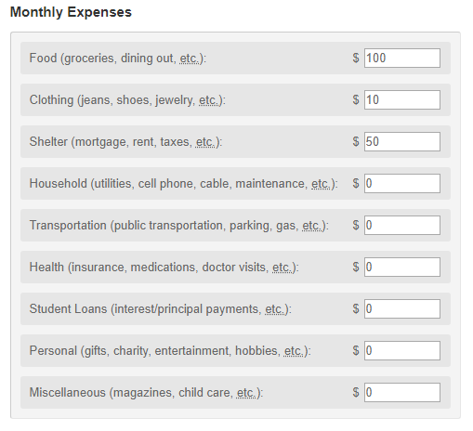
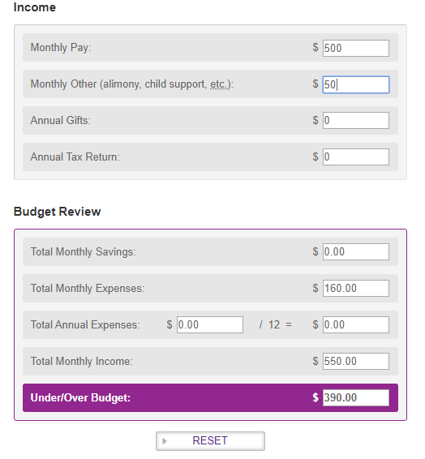

Slide 25
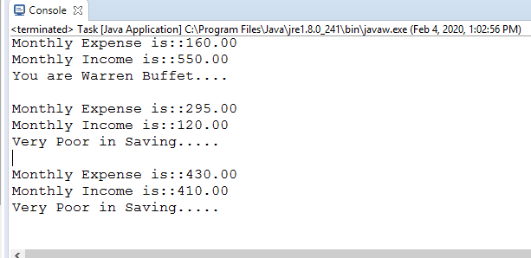
Console output:

Slide 26
Project 2 :
Rediffmail :
Steps:
1.Open rediffmail registration form
2.Auto fill the fields.
3.Click on check box and radio buttons.
4.Select country and city.
5.Select the country code.
6.Close

Slide 27
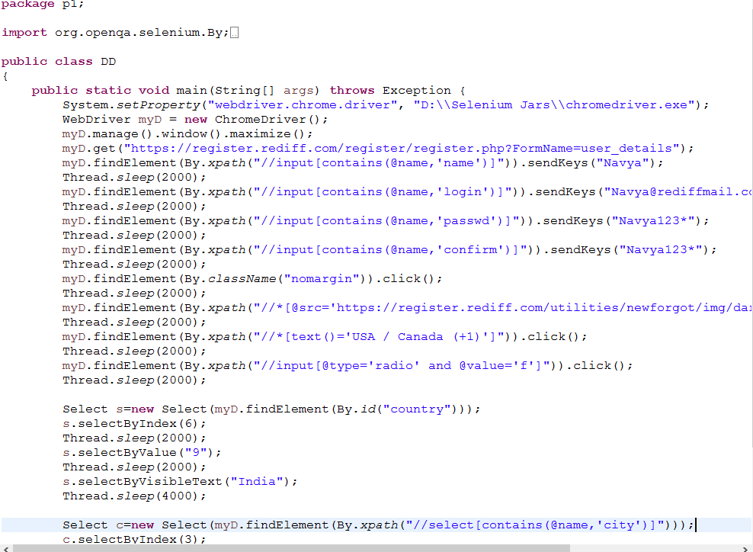
Working code:

Slide 28
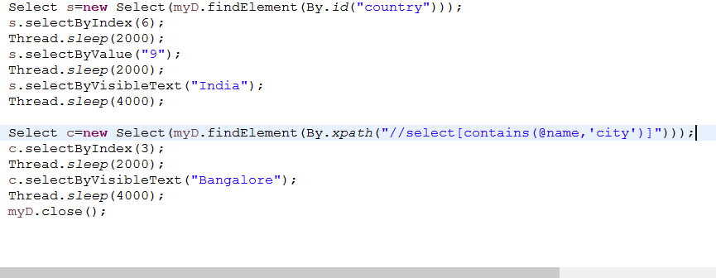

Slide 29
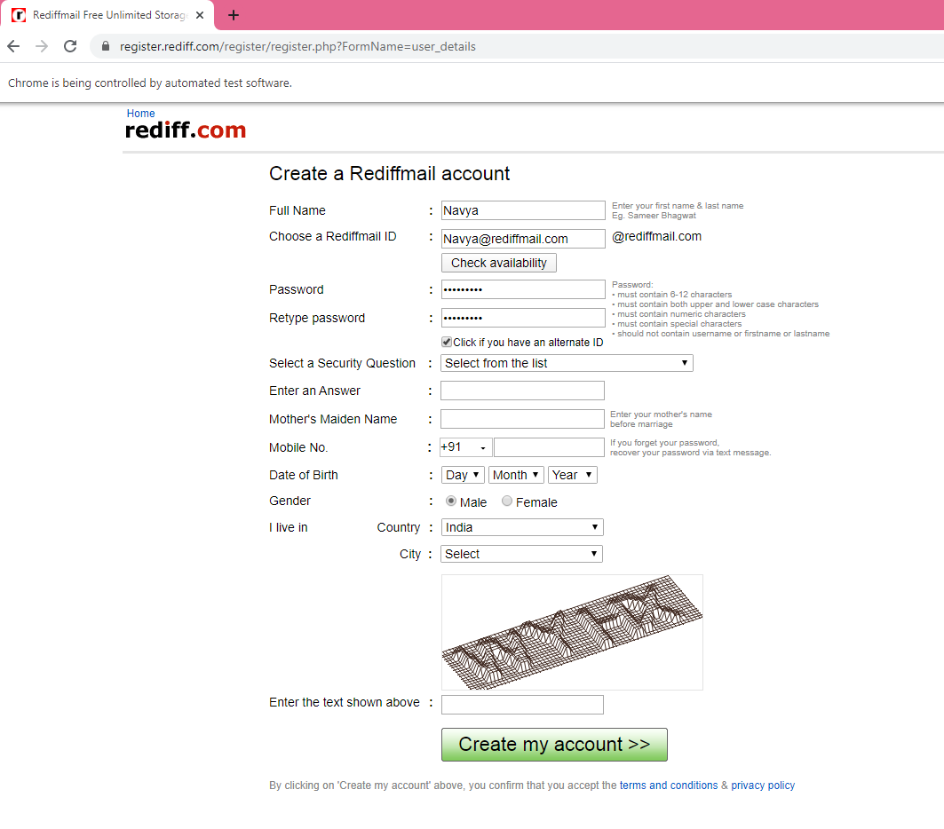
Output :

Slide 30
Project 3 :
Data Driven Framework :
Steps :
1: Go to the https://www.google.com/
2: Read the data from Excel Sheet named "Google.xls" and pass it to search box.
3: Click on the Google Search button.
4: Check the expected and actual result.
5: If the above result matches, it will write status as pass in the excel sheet.
6: If it fails, the it will write the status as fail and take the screenshot of failed case.
7: Store the location of screenshot in the screenshot column.
8: Quit the browser.

Slide 31
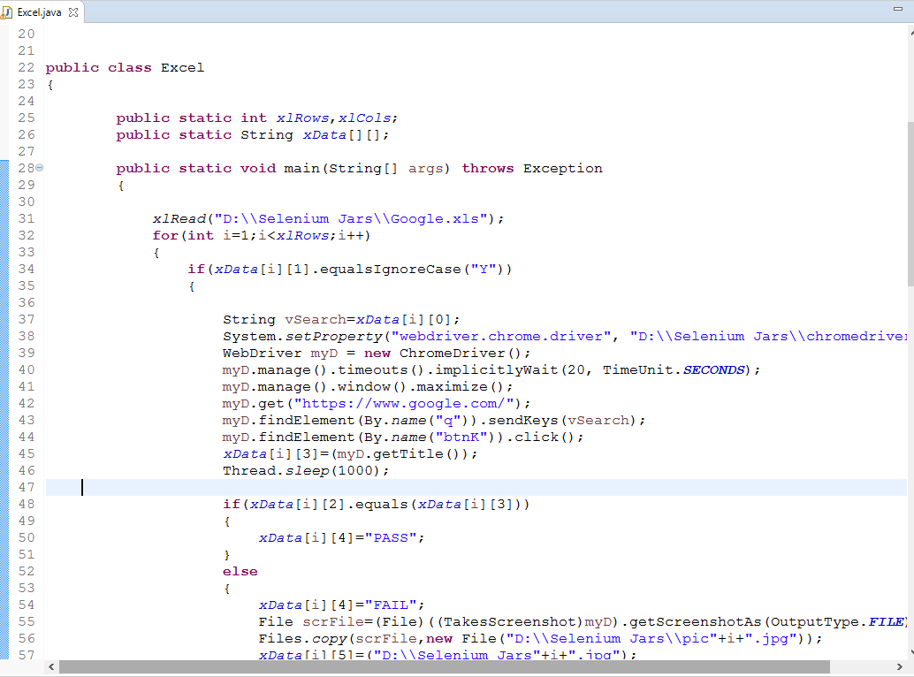
Working Code:

Slide 32
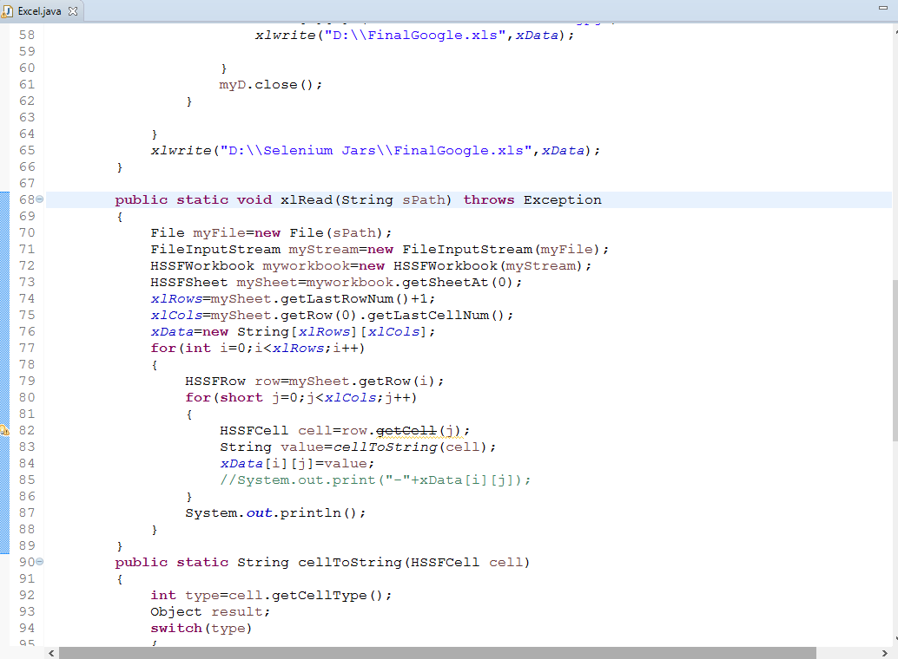

Slide 33
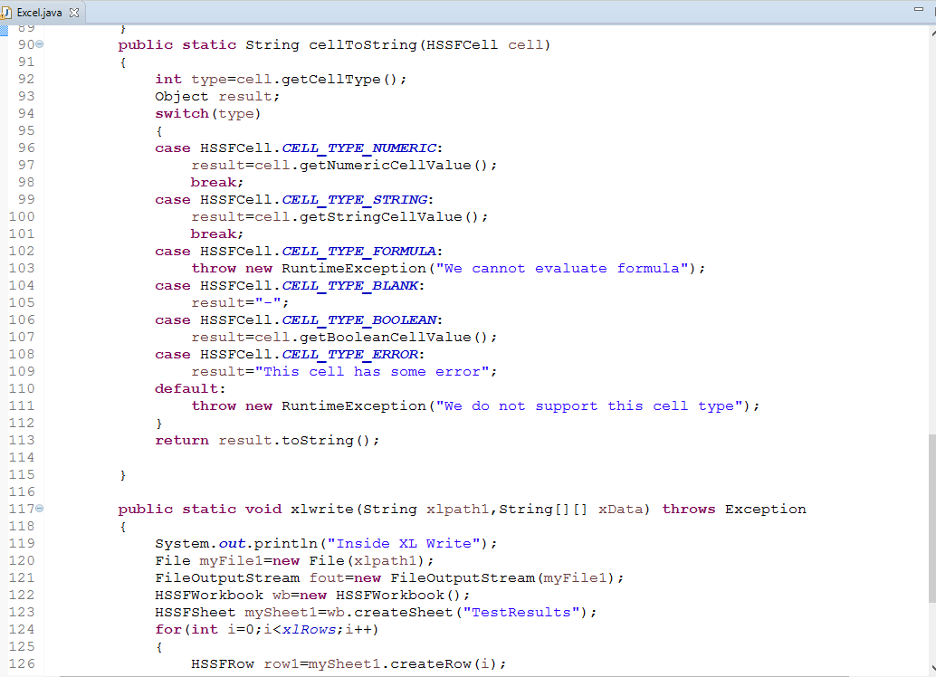

Slide 34
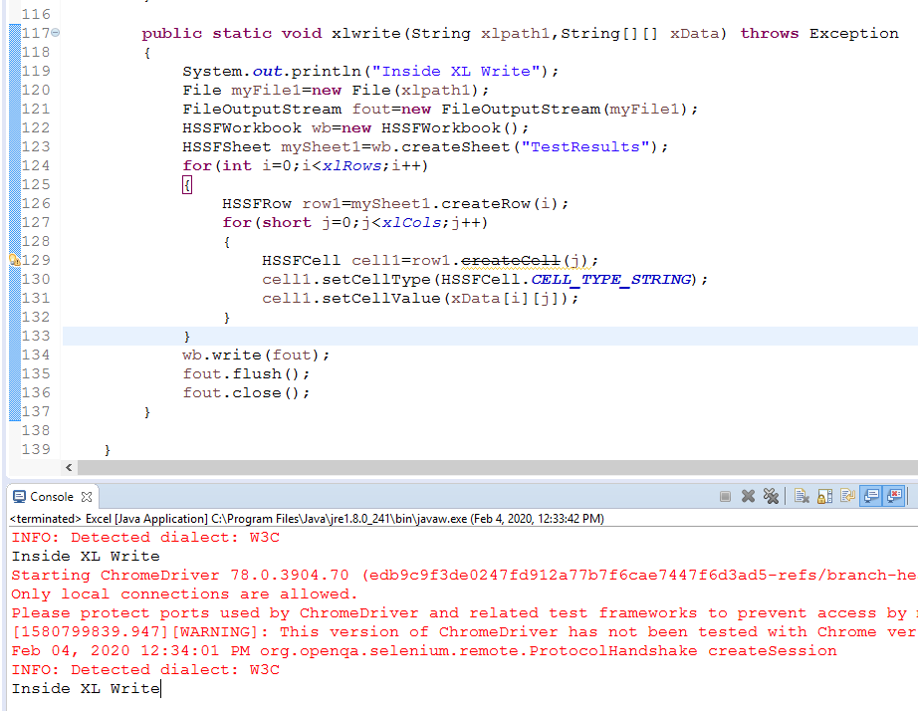

Slide 35
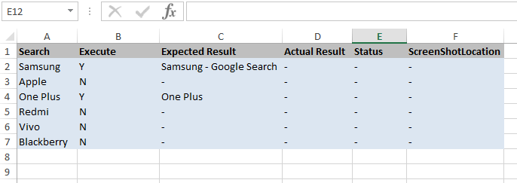
Output :
Before :

Slide 36
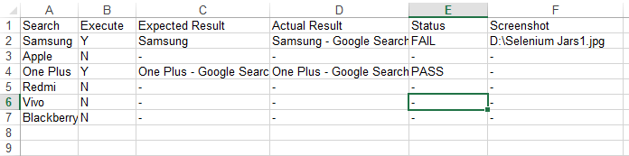
After :

Slide 37
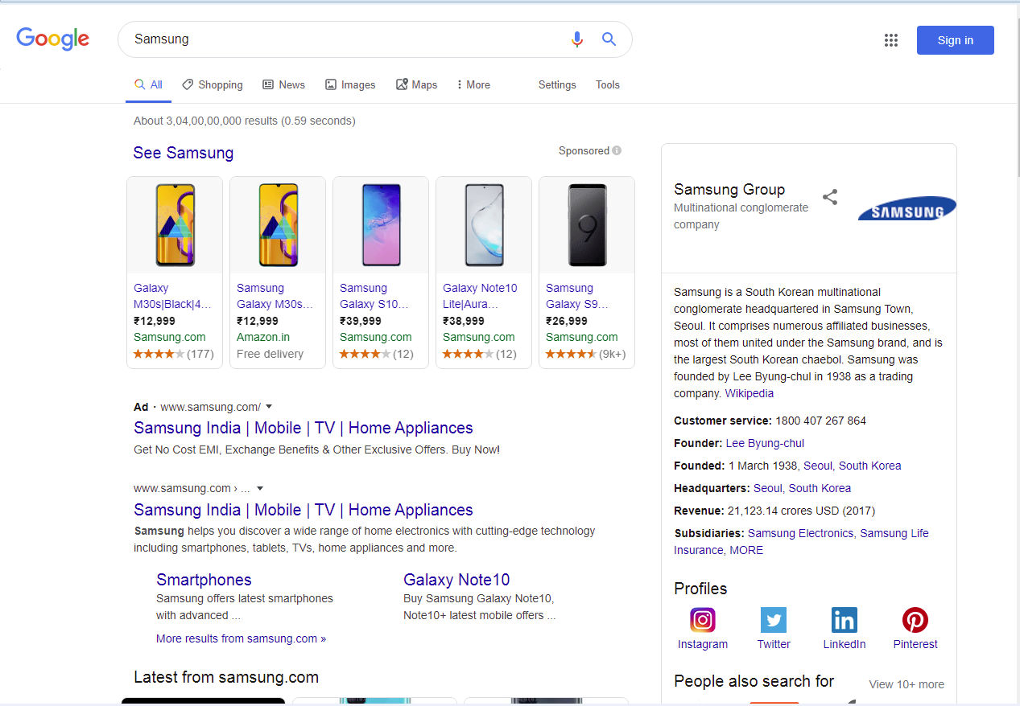
Screenshot :

Slide 38
Github :
https://github.com/monishagirijesh/Monisha-Soap-Selenium
https://github.com/Kaneezkhan/Atomation.git
https://github.com/Navyaghraju/automation.git
https://github.com/Gowtham-VK/Projects.git
https://github.com/AsmitaPatil412/Selenium.git

Slide 39

Thank you

