Slide 1

OTT ANALYISIS – JOTSTAR VS LIOCINEMA

Slide 2
OTT ANALYISIS – JOTSTAR VS LIOCINEMA
Agenda
Project Overview
Problem Statement
Data Model
Primary And Secodary Question Analysis
Dashbaord Overview
Recommendations

Slide 3
Project Overview
Lio, a leading telecom provider, is preparing for a strategic merger with Jotstar, a top streaming platform in India. This project aims to analyze the performance and user behavior of both platforms from January to November 2024,
Major focus on
Subscriber growth
Content consumption patterns
Inactivity behavior
Upgrade/downgrade trends.
Content Library Analysis
By leveraging data from LioCinema and Jotstar, the analysis will provide key insights to optimize merger decisions, enhance user retention, and refine content strategies, ultimately strengthening their competitive position in the Indian digital streaming market.

Slide 4
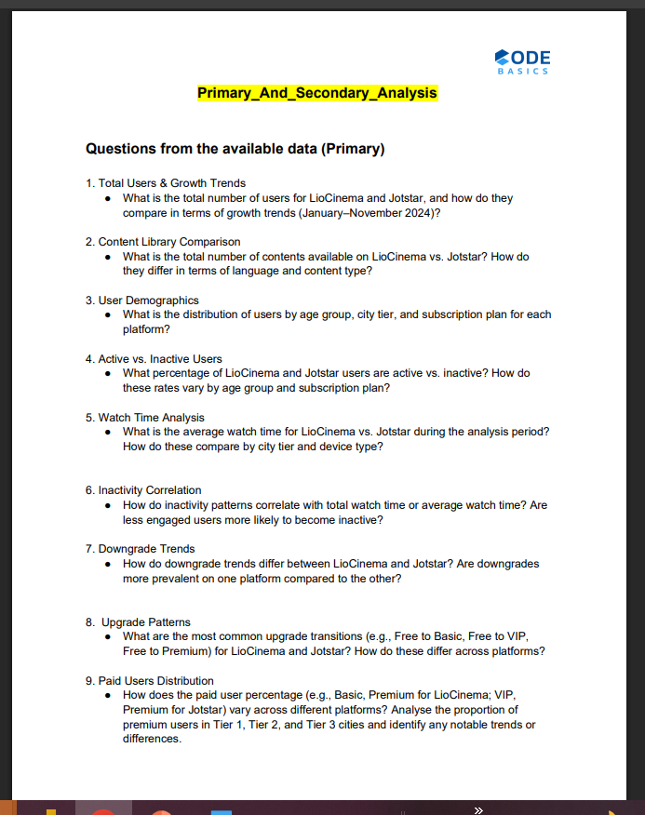
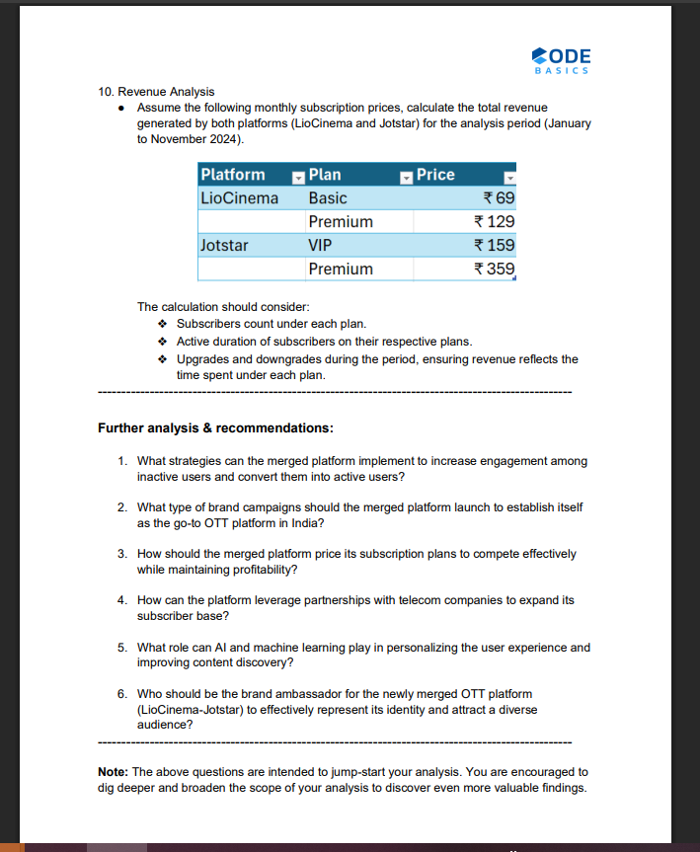
Problem Statement
Primary & Secondary Analysis

Slide 5
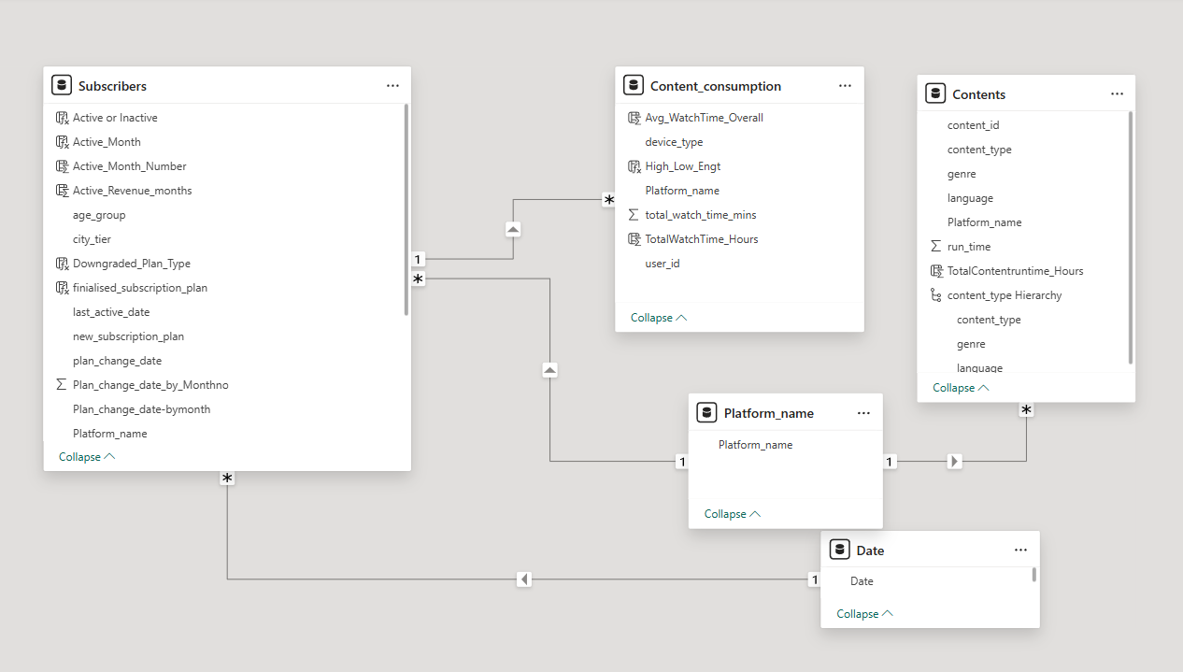
Data Model

Slide 6
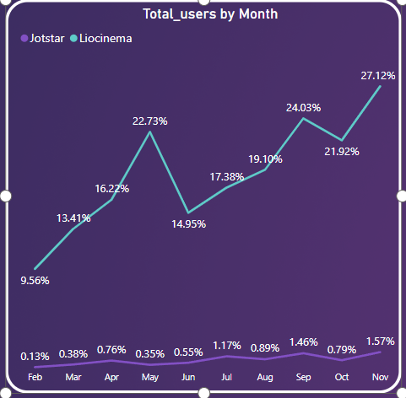
Total Users & Growth Trends
Total Users (November 2024)
Jotstar: 37K users
LioCinema: 4K users (constant across months)
Jotstar’s strong upward trend suggests increasing popularity, successful marketing, or engaging content offerings.
LioCinema’s stagnant growth could indicate low acquisition efforts, lack of competitive content, or limited market expansion.
The merger could help LioCinema leverage Jotstar’s rapid growth while Jotstar could benefit from Lio’s subscriber base and telecom integration.

Slide 7
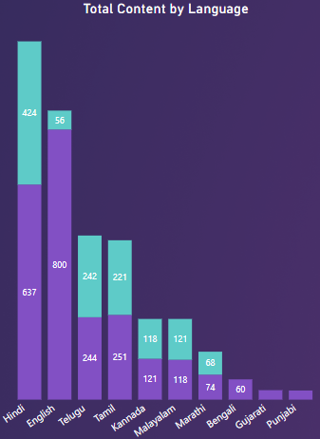
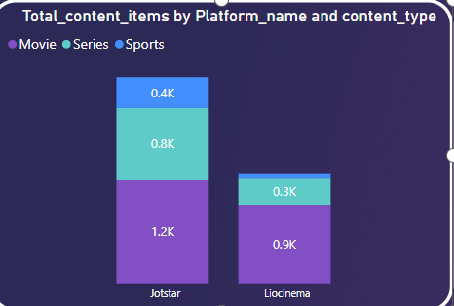
Content Library Comparison
Total Content: Jotstar has 2.4K content items, whereas LioCinema has 1.3K content items.
Content Type: Jotstar has more series (0.8K vs. 0.3K) and sports content (0.4K vs. minimal), while LioCinema focuses more on movies (0.9K vs. 1.2K in Jotstar).
Language Distribution: Jotstar dominates in English content (800 vs. 56), while LioCinema has a stronger presence in Hindi and regional languages.
Genre Breakdown: Both platforms have similar numbers in Drama, Action, and Comedy, but Jotstar has a wider variety, including Live Matches and Sci-Fi.
Content Runtime: Jotstar has higher total content hours (5.67K hrs), with movies contributing the most, followed by sports and series
Develop a content strategy that blends Jotstar’s strong English and sports catalog with LioCinema’s regional and Bollywood dominance, ensuring a diverse library that appeals to both mass and niche audiences across India

Slide 8
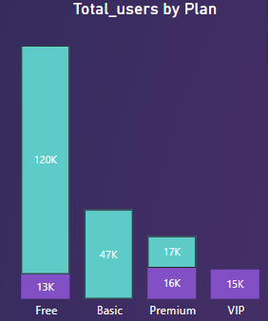
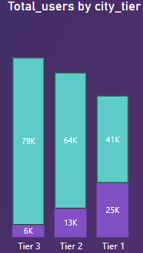
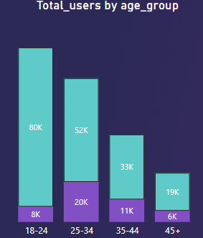
User Demographics
LioCinema has a significantly larger user base (183K) compared to Jotstar (45K).
18-24 age group dominates on LioCinema (80K users), while Jotstar has a stronger presence in the 25-34 segment (20K users).
Tier 3 cities contribute the most users to LioCinema (79K), whereas Jotstar's user base is more evenly spread across tiers.
Both platforms have a majority of free users, but Jotstar has a lower premium and VIP subscriber count compared to LioCinema.
LioCinema shows consistent monthly growth, while Jotstar's growth is relatively stagnant over time.

Slide 9
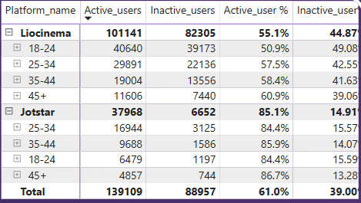
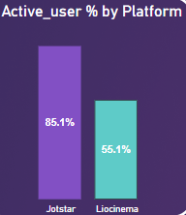
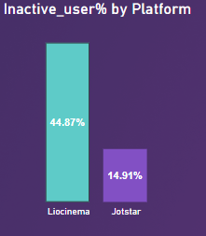
Active /Inactive users
81% of users are active and 14.9% are inactive In jotstar , while 55% are active and 44.8% are in active in Liocinema. overall active user is 61% and inactive user is 39%
Active user (84%– 86%) and inactive users (14% -15%)show similar pattern across age groups for jotstar where as for liocinema age group 45+ are more active and age group18 – 24) are highly inactive
Premium and VIP users are the most engaged, with over 82% active users.
Free plan users have the highest inactivity rate (47.34%), indicating lower retention.
Improve retention strategies for younger and free-tier users.
Offer targeted incentives to boost engagement among inactive users.

Slide 10
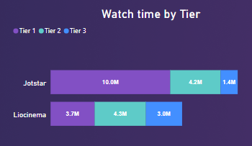
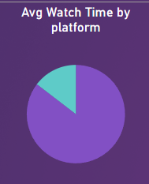
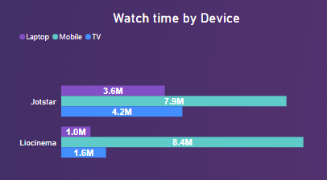
Watch Time Analysis
Jotstar has a higher total watch time (15.69M hours) compared to LioCinema (11.03M hours).
Jotstar users spend more time on mobile devices, while LioCinema has a more balanced distribution across TV and mobile
Jotstar dominates watch time in the 25-34 age group, while LioCinema has lower engagement across all demographics
Jotstar outperforms LioCinema in Tier 1 and Tier 2 cities, while LioCinema has better traction in Tier 3.
Jotstar has significantly higher watch time for Premium (8.1M hrs) and VIP (4.9M hrs) users, whereas LioCinema sees more engagement from Basic (3.8M hrs) and Free (5.3M hrs) users.
LioCinema should enhance content engagement through exclusive shows or personalized recommendations.
LioCinema should target younger users with interactive content, live events, or social media campaigns.
LioCinema should optimize its mobile experience and offer mobile-specific promotions to increase engagement

Slide 11
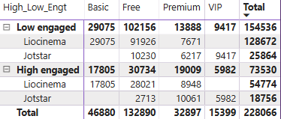
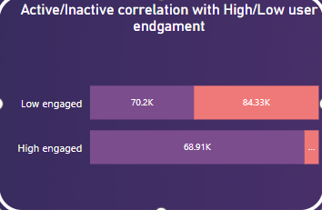
Inactivity Correlation
The data indicates that a significant portion of users fall into the "Low Engaged" category (154.5K out of 228K total users), meaning they contribute less watch time.
A large number of low-engaged users come from the "Free" tier (102K users), suggesting that users without a paid commitment are more likely to become inactive.
Since low-engaged users dominate the inactive user base (84.3K), it indicates a strong correlation between low watch time and potential churn.
Liocinema has a higher share of both low and high-engaged users compared to Jotstar, meaning its audience is more polarized, whereas Jotstar has a relatively smaller but more engaged audience.
Increasing personalized recommendations, exclusive premium content trials, and engagement-driven reward mechanisms could help transition low-engaged users into high-engaged users, reducing inactivity and churn.

Slide 12
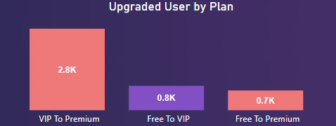
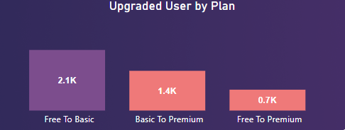
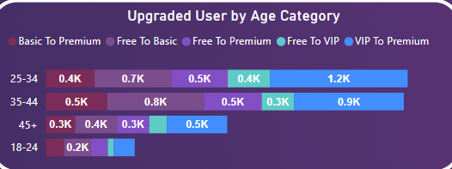
Upgrade Patterns
The highest upgrade transition is Free to Basic with 2.1K users for Liocinema where as VIP to Premium transition is more in jotstar
The 35-44 age group has the highest number of users upgrading from Free to Basic (830 users) for Liocinema and 25-34 age group has the highest number of upgrades in jotstar
The highest upgrade took place in the month of jan,feb in jotstar and liocinema has the upgrade spike in April,July,oct.
The direct jump from Free to Premium is the least frequent transition (0.7K users), suggesting that users prefer upgrading gradually rather than skipping tiers.
Offer limited-time discounts or exclusive content for users upgrading directly from Free to Premium to increase adoption of higher-tier subscriptions.
Since the 18-24 age group has the lowest upgrade rates, provide student discounts or bundled offers to drive conversions.

Slide 13
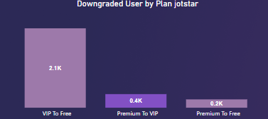
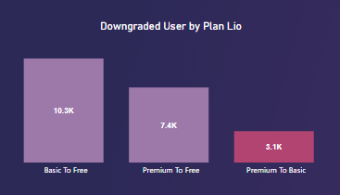
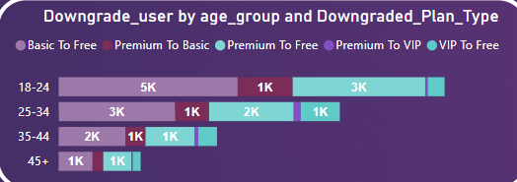
Downgrade Trends
The highest Downgrade transition is basic to Free with 10K users for Liocinema where as VIP to free transition with 2.1K in jotstar
The 18-24 age group has the highest number of users Downgrading from Basic to Free (4.7K users) for Liocinema and 25-34 age group 1K has the highest number of Downgrades in jotstar
The highest Downgrade took place in the month of jan, May in jotstar and liocinema has the Downgrade from July onwards
The jump from Premium to free is the least frequent transition in jotstar and premium to basic in liocinema
Since January and May have peak downgrades in Jotstar, introduce seasonal promotions, referral benefits, or temporary subscription freezes instead of cancellation
Since 10K users downgrade from Basic to Free, introduce loyalty rewards, exclusive Basic-tier perks, or limited-time discounts for Premium upgrades to encourage retention.

Slide 14
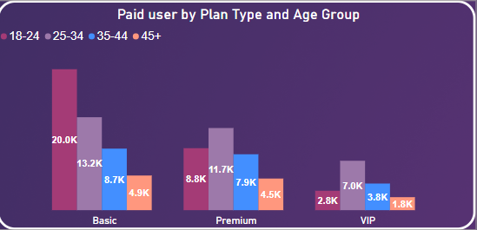
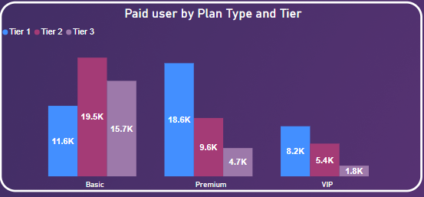
Paid Users Distribution
Jotstar shows steady month-on-month growth in paid users, peaking in November (10.1K) where as LioCinema’s growth is slower but more stable, with a noticeable rise in Premium users over time.
Jotstar’s premium and VIP users are more concentrated in Tier 1 cities, indicating a focus on high-income subscriber where as LioCinema has a strong presence in Tier 2 and Tier 3 cities, suggesting affordability and regional appeal.
Jotstar has a higher number of Premium &VIP users (14K in the 25-34 age group) compared to LioCinema (17.2K in the same age group) and 26.4K users in the age group 18-24

Slide 15
Revenue Analysis
Jotstar dominates premium revenue with $26.7M, whereas LioCinema generates $8M from the same segment. This indicates that Jotstar has a stronger high-end subscriber base willing to pay for premium features.
Jotstar’s revenue is highly concentrated in Tier 1 cities ($31.3M), showing a premium, urban-focused strategy. LioCinema earns a more balanced revenue across Tier 2 ($7.2M) and Tier 3 ($5.2M) cities, indicating strong penetration in smaller cities
LioCinema leads in the Basic plan segment with $9.8M, compared to minimal revenue from Jotstar. This suggests LioCinema attracts more budget-conscious users, making it more affordable for a wider audience.

Slide 16
Recommendations to Minimize Inactive Users
Strategies to Increase Engagement Among Inactive Users
Exclusive Content Previews: Offering inactive users with an early access to trailers, sneak peeks, or limited-time free access to premium content.
Loyalty Rewards: Implementing reward-based systems where users earn points for watching content, referring friends, or engaging with the platform.
Affordable Trial Periods: Introducing discounted or free trial plans to encourage reactivation for a certain period of time (ie:1 Month)
Live Events & Interactive Content: Host live streaming of sports, concerts, and Q&A sessions with stars to bring back disengaged users

Slide 17
Brand Promotion Recommendations
Brand Campaigns to Establish Itself as the Go-To OTT Platform in India
“Entertainment Without Limits” Campaign: Highlighting the extensive content library, including Bollywood, regional films, sports, and originals.
Regional Market Focused Campaigns: Creating multilingual advertisements featuring stars from different film industries (Tamil,Hindi,Telugu),Cricket stars.
360-Degree Marketing Approach: Combining TV commercials, digital ads, influencer collaborations, and strategic placements in theatres and stadiums.
User-Generated Content Contests: Encouraging users to create and share their own reviews, reactions, and memes for a chance to win rewards.

Slide 18
Pricing Recommendations
Pricing Strategy for Competitive Edge and Profitability
Freemium Model: Providing a free tier with ad-supported content and encouraging upgrades to premium plans.
Affordable Entry Plan: Introducing a mobile-only plan at ₹99–₹149 per month to attract budget-conscious users.
Annual Discount Offers: Providing heavy discounts for users who commit to yearly plans instead of monthly renewals.
Bundled Plans: Offering bundled subscriptions plans for telecom providers who are using Lio Telecommuntion plan (ie: Lio Sim Users get a free subscription of 3 Months to the Newly Merged platform)
Family & Group Subscriptions: Introducing cost-effective family plans where multiple users can access content under one account for a limited period of time

Slide 19
Leverage partnerships Recommendations
Leveraging Partnerships with Telecom Companies
Bundled Subscription Offers: Collaborating with Jio, Airtel, and other networks to offer premium subscriptions as part of their recharge packs
Data-Free Streaming: Partner with telecom providers to allow data-free or reduced-data streaming for subscribers.
5G Optimization: Working with telecom companies to provide ultra-HD and 4K streaming experiences leveraging 5G networks.
Retail & Kiosk Marketing: Promoting subscriptions via telecom retail stores and customer service centers.

Slide 20
AI Recommendations
Role of AI & Machine Learning in Personalization and Content Discovery
Hyper-Personalized Recommendations: Using AI to suggest content based on viewing history, user preferences, and watch time
Smart Search & Voice Assistance: Implementing AI-driven search functions and voice assistants to enhance discoverability.
Predictive Analytics for Content Strategy: Using ML models to analyze trends and produce content that aligns with user demand.
Chatbots & AI Customer Support: Deploying AI-powered virtual assistants for resolving user queries and providing real-time support.

Slide 21
Brand Ambassador Recommendations
Ideal Brand Ambassador for the Merged OTT Platform
Pan-India Appeal: The ambassador should resonate with both urban and rural audiences.
Versatile & Relatable Personality: Should have credibility across multiple entertainment genres.
Considering the above 2 factors I would recommend the below Personalities
Shah Rukh Khan – Universal appeal, strong fan base, and OTT presence.
Virat Kohli – Strong brand value, connects with cricket and sports audiences.
Rashmika Mandanna - Play on her "National Crush" title to promote binge-worthy content.

