Slide 1

Crop Production Prediction using ML
Name :- Monisha Munirathnam
Student ID :- 23038629

Slide 2
Introduction & Background
Agriculture is vital to India, employing over 50% of the population and playing a key role in the economy.
Accurate crop yield prediction is essential for food security, resource planning, and informed policy-making.
Traditional forecasting methods are manual, slow, and less adaptive to changing conditions.
With the rise of machine learning and data availability (e.g., weather, NDVI, crop stats), more accurate and timely predictions are possible.
This project uses ML regression models on real agricultural and climate data to estimate crop yields across Indian states.
The goal is to automate yield prediction, support decision-makers, and promote sustainable farming.

Slide 3
Research Question & Objectives
Can ML outperform classic methods in yield prediction?
Select best regression models for production data.
Build and clean a robust agricultural dataset.
Analyze, compare, and report on model performance.

Slide 4
Dataset Overview
The dataset provides comprehensive crop production statistics in India from 1997 to 2023.
Covers all major seasons – Kharif, Rabi, Summer, and Autumn – across all states and districts.
Includes features such as: State, District, Crop, Season, Area (in hectares), Production (in tonnes), Yield (Production/Area)
Sourced from the Indian Government’s APS Database (Ministry of Agriculture & Farmers Welfare)
Kaggle dataset:- https://www.kaggle.com/datasets/nikhilmahajan29/crop-production-statistics-india

Slide 5
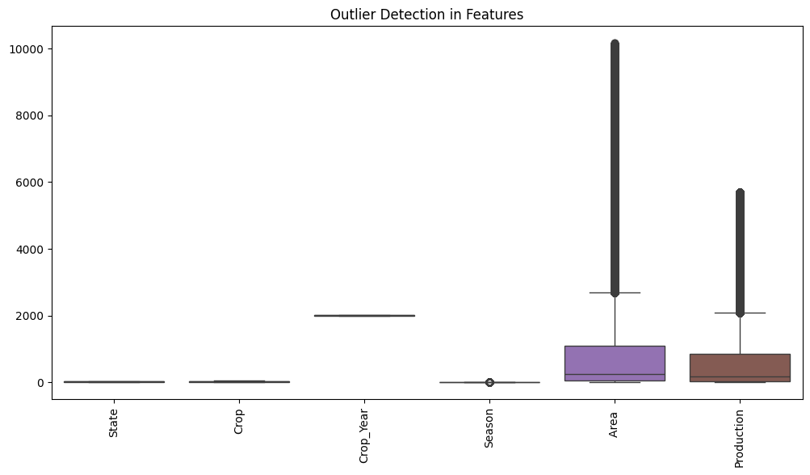
Data Pre-Processing
Missing Value Handling
Production column: filled using mean imputation
Crop column: filled using mode imputation
Categorical fields (State, Crop, Season, etc.): encoded using Label Encoding
Outlier Detection & Removal
Applied Z-score method to detect outliers
Treated outliers using IQR method:
Removed data points outside 1.5×IQR range
Cleaned columns: Area, Production, and others with statistical anomalies

Slide 6
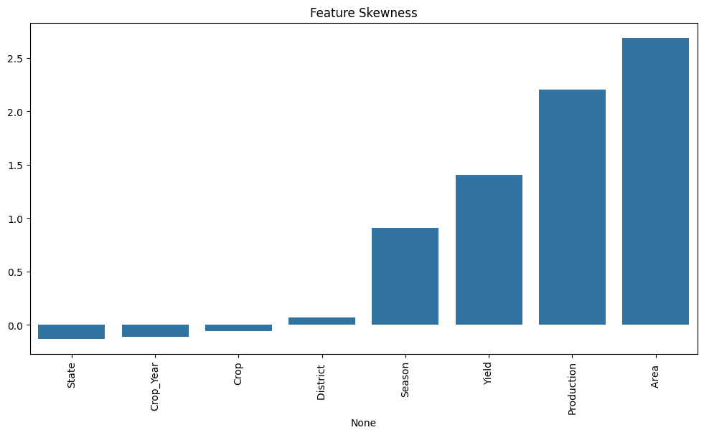
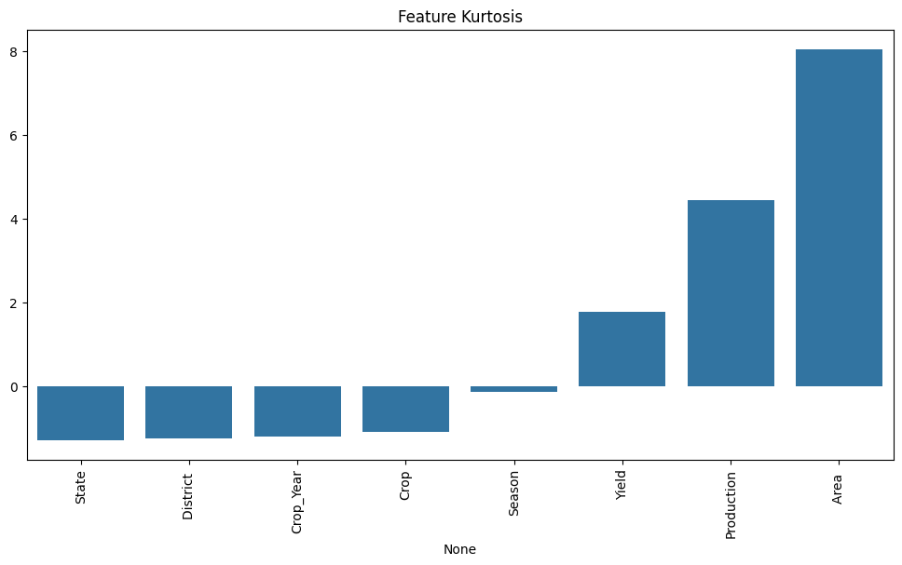
Feature Selection
Dropped uninformative columns: District, Yield (from features)
Applied SelectKBest to identify top features
Selected features based on highest correlation with target (Yield)

Slide 7
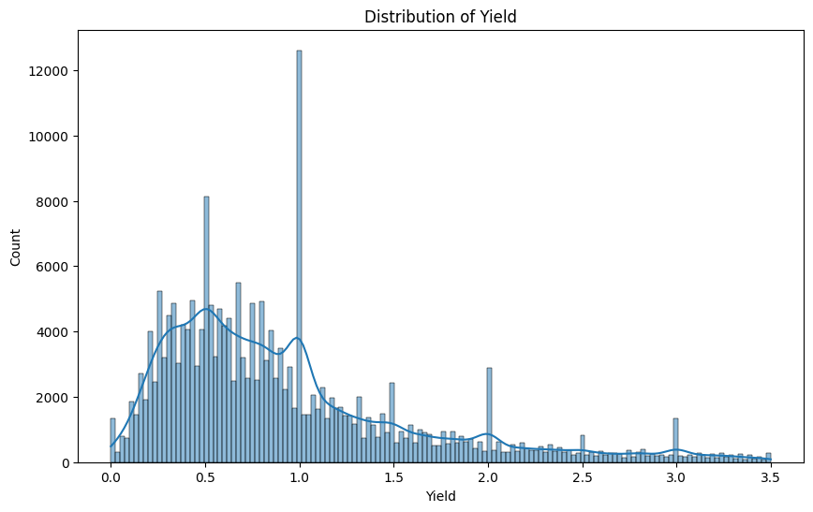
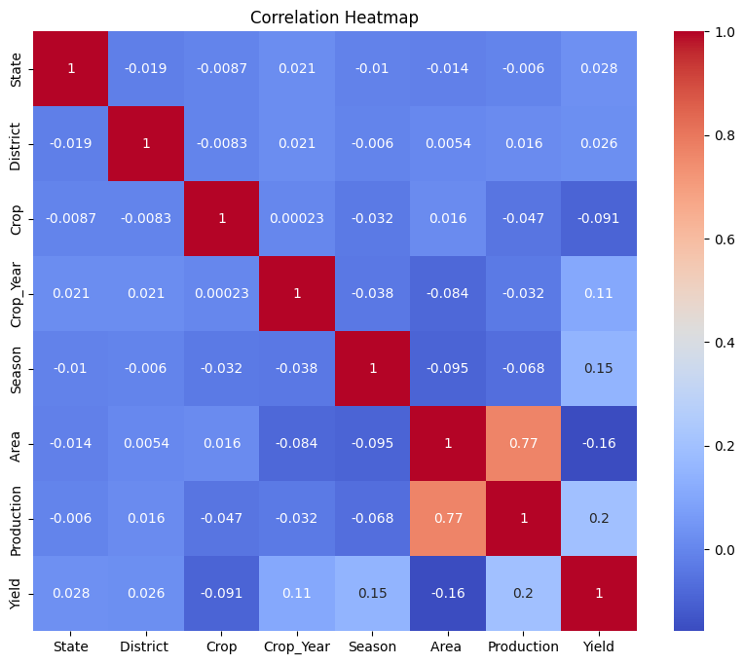
EDA

Slide 8
Methodology
Data loading, exploration, and feature engineering.
Preprocessing: Label encoding and scaling applied.
Trained Random Forest, XGBoost, LightGBM, Extra Trees, HistGradientBoosting.
Cross-validated models for optimal accuracy.

Slide 9
Models
Extra Trees Regressor
This model uses randomized trees to capture complex relationships in agricultural data, such as soil properties and weather patterns, providing robust predictions of crop yield by reducing overfitting.
HistGradientBoosting Regressor
Ideal for large agricultural datasets, it efficiently handles continuous weather and remote sensing features, improving crop yield forecasts by learning from subtle variations in the data.
Random Forest Regressor
By averaging many decision trees, this model manages the variability in agricultural inputs—like rainfall and temperature—offering stable and reliable yield predictions across different regions.
XGBoost Regressor
Well-suited for capturing nonlinear interactions in crop production data, XGBoost balances speed and accuracy, making it effective for predicting yields influenced by multiple climatic and soil factors.
LightGBM Regressor
Designed for fast training on large datasets, LightGBM effectively models agricultural time-series and spatial data, helping to quickly predict crop yields while handling numerous weather and environmental variables

Slide 10
Model Evaluation
Actual vs. Predicted plots for all models created.
Random Forest & XGBoost showed highest accuracy.
Metrics: MAE, RMSE, and R² compared visually.
Graphs reveal close fit and few outliers.
Best model deployed for real-time web prediction.

Slide 11
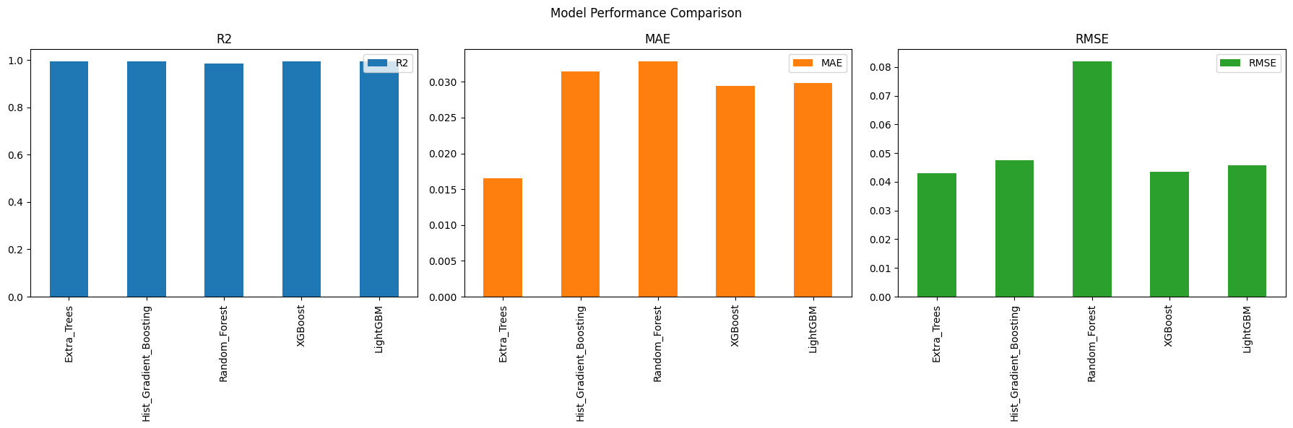
R² Score (Coefficient of Determination):
Measures how well the model explains the variability in crop yield data, with values closer to 1 indicating better fit.
MAE (Mean Absolute Error):
Average absolute difference between predicted and actual yields, showing overall prediction accuracy in original units.
MSE (Mean Squared Error):
Average squared difference between predicted and actual yields, penalizing larger errors more heavily.
RMSE (Root Mean Squared Error):
Square root of MSE, providing error magnitude in the same units as crop yield for intuitive interpretation.
Median Absolute Error:
Median of absolute prediction errors, offering a robust measure less sensitive to outliers in yield data.
MAPE (Mean Absolute Percentage Error):
Average percentage difference between predicted and actual yields, useful for understanding relative prediction accuracy.
Explained Variance Score:
Indicates the proportion of yield variance captured by the model, assessing its effectiveness at representing underlying data patterns.

Slide 12
Feature Importance
Model analysis highlights top predictors.
Area under cultivation is most influential.
Crop type and Season shape production strongly.
Feature importance guides future data focus.
Helps stakeholders understand decision logic.

Slide 13
Sample Input & Output
User enters State, Crop, Year, Season, and Area.
App instantly predicts crop production output.
Simple, intuitive web interface for all users.
Sample: Rice, Kharif, 2019, 1300 hectares → output: 34,000 tons.
Results displayed clearly on the dashboard.

Slide 14
Conclusion & Future Work
ML can revolutionize agricultural forecasting.
System is scalable for more crops and regions.
Adding weather and soil data will boost accuracy.
Potential to add batch uploads and reporting.
Project supports better food security strategies.

Slide 15
References
Government of India. Agricultural Production Statistics (APS) Database. Ministry of Agriculture & Farmers Welfare. https://aps.dac.gov.in
Nikhil Mahajan (2023). Crop Production Statistics – India. Kaggle Dataset. https://www.kaggle.com/datasets/nikhilmahajan29/crop-production-statistics-india
Pedregosa et al. (2011). Scikit-learn: Machine Learning in Python. Journal of Machine Learning Research.
Chen, T. & Guestrin, C. (2016). XGBoost: A Scalable Tree Boosting System. KDD.
Ke, G. et al. (2017). LightGBM: A Highly Efficient Gradient Boosting Decision Tree. NeurIPS.
University of Hertfordshire (2025). 7PAM2002 Data Science Project Guidelines. Lecture 4.

