Slide 1
.NET

Slide 2
Overview
Overview of ADO.NET
ADO.NET Componenets & Architechture
.Net Framework DataProviders
Connected & DisConnected Model
Connected Classes & DisConnected Classes
Connecting and Retriving Data in ADO.NET
Working with Connectionstrings,Commands and DataReaders

Slide 3
ADO.NET
ActiveX Data Object (ADO) is .NET tool.
It enables the .NET Applications to interact with Data Source and perform action like SELECT, INSERT, UPDATE,DELETE.
ADO.NET serializes data using XML.
ADO.NET Supports Disconnected Architecture.
Notes:
ADO.NET is an object-oriented set of libraries that allows you to interact with data sources.
Commonly, the data source is a database, but it could also be a text file, an Excel spreadsheet, or an XML file. For the purposes of this tutorial, we will look at ADO.NET as a way to interact with a data base.
As you are probably aware, there are many different types of databases available
. For example, there is Microsoft SQL Server, Microsoft Access, Oracle, Borland Interbase, and IBM DB2, just to name a few. To further refine the scope of this tutorial, all of the examples will use SQL Server.

Slide 4
Various Connection Architectures
Connected architecture: the application remains connected with the database throughout the processing.
Disconnected architecture: the application automatically connects/disconnects during the processing. The application uses temporary data on the application side called a DataSet.

Slide 5
ADO.NET
ADO .NET
Centralized Database
Client
Notes:
ADO.NET is an object-oriented set of libraries that allows you to interact with data sources.
Commonly, the data source is a database, but it could also be a text file, an Excel spreadsheet, or an XML file. For the purposes of this tutorial, we will look at ADO.NET as a way to interact with a data base.
As you are probably aware, there are many different types of databases available
. For example, there is Microsoft SQL Server, Microsoft Access, Oracle, Borland Interbase, and IBM DB2, just to name a few. To further refine the scope of this tutorial, all of the examples will use SQL Server.

Slide 6
ADO.NET Components
Data Provider
Data Set
Notes:
NET Framework Data Providers
The .NET Framework Data Providers are components that have been explicitly designed for data manipulation and fast, forward-only, read-only access to data. The Connection object provides connectivity to a data source. TheCommand object enables access to database commands to return data, modify data, run stored procedures, and send or retrieve parameter information. The DataReader provides a high-performance stream of data from the data source.
Finally, the DataAdapter provides the bridge between the DataSet object and the data source. TheDataAdapter uses Command objects to execute SQL commands at the data source to both load the DataSet with data and reconcile changes that were made to the data in the DataSet back to the data source. For more information, see .NET Framework Data Providers and Retrieving and Modifying Data in ADO.NET.
The DataSet
The ADO.NET DataSet is explicitly designed for data access independent of any data source. As a result, it can be used with multiple and differing data sources, used with XML data, or used to manage data local to the application.
The DataSet contains a collection of one or more DataTable objects consisting of rows and columns of data, and also primary key, foreign key, constraint, and relation information about the data in the DataTable objects. For more information, see DataSets, DataTables, and DataViews.

Slide 7
Architecture of ADO.NET
Data source
DataProvider
.NET
Application
Dataset

Slide 8
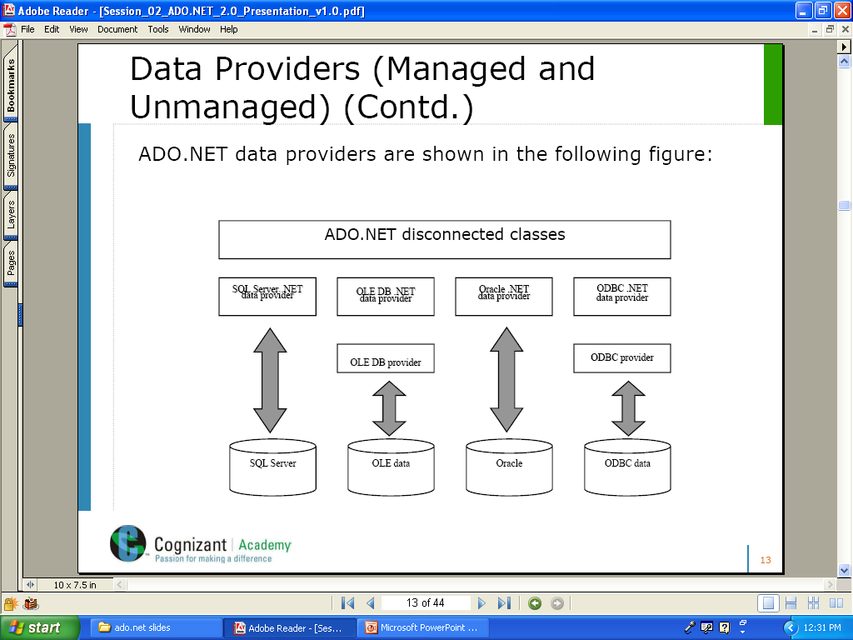
Data Providers
Data Provider is responsible for providing and maintaining the connection with Data sources like SQL, Oracle, OLED and ODBC.
Notes:
NET Framework Data Providers
The .NET Framework Data Providers are components that have been explicitly designed for data manipulation and fast, forward-only, read-only access to data. The Connection object provides connectivity to a data source. TheCommand object enables access to database commands to return data, modify data, run stored procedures, and send or retrieve parameter information. The DataReader provides a high-performance stream of data from the data source.
Finally, the DataAdapter provides the bridge between the DataSet object and the data source. TheDataAdapter uses Command objects to execute SQL commands at the data source to both load the DataSet with data and reconcile changes that were made to the data in the DataSet back to the data source. For more information, see .NET Framework Data Providers and Retrieving and Modifying Data in ADO.NET.

Slide 9
Data Providers
.NET Framework Data Provider for SQL Server
System.Data.SqlClient Namespace
.NET Framework Data Provider for OLEDB
System.Data.Oledb Namespace
.NET Framework Data Provider for ODBC.
System.Data.Odbc Namespace
.NET Framework Data Provider for Oracle.
System.Data.OracleClient Namespace

Slide 10
Classes of Data Provider
Data Provider
Connection
Command
DataReader
DataAdapter
Notes:
Connection
Establishes a connection to a specific data source. The base class for all Connection objects is the DbConnection class.
Command
Executes a command against a data source. Exposes Parameters and can execute in the scope of a Transaction from a Connection. The base class for all Command objects is theDbCommand class.
DataReader
Reads a forward-only, read-only stream of data from a data source. The base class for allDataReader objects is the DbDataReader class.
DataAdapter
Populates a DataSet and resolves updates with the data source. The base class for allDataAdapter objects is the DbDataAdapter class.

Slide 11
ADO.NET object Model
Data Provider
Data source
.NET
Application
Connection
Command
DataReader
Dataset
DataAdapter

Slide 12
Connection Object
SqlConnection objSqlConnection =
new SqlConnection ("server = SQLDB;
uid = sa; pwd = password; database = pubs");
objSqlConnection → Name of the connection object created
SQLDB → Name of the server that stores database “pubs”
uid, pwd → User identity and password
Notes:
Connection Object
The ADO Connection Object is used to create an open connection to a data source. Through this connection, you can access and manipulate a database.
If you want to access a database multiple times, you should establish a connection using the Connection object. You can also make a connection to a database by passing a connection string via a Command or Recordset object. However, this type of connection is only good for one specific, single query.

Slide 13
Connection Object
Methods
Properties
Close()
ConnectionString
Open()
Database
Notes:
Properties
Property Description
Attributes Sets or returns the attributes of a Connection object
CommandTimeout Sets or returns the number of seconds to wait while attempting to execute a command
ConnectionString Sets or returns the details used to create a connection to a data source
ConnectionTimeout Sets or returns the number of seconds to wait for a connection to open
CursorLocation Sets or returns the location of the cursor service
DefaultDatabase Sets or returns the default database name
IsolationLevel Sets or returns the isolation level
Mode Sets or returns the provider access permission
Provider Sets or returns the provider name
State Returns a value describing if the connection is open or closed
Version Returns the ADO version number
Methods
Method Description
BeginTrans Begins a new transaction
Cancel Cancels an execution
Close Closes a connection
CommitTrans Saves any changes and ends the current transaction
Execute Executes a query, statement, procedure or provider specific text
Open Opens a connection
OpenSchema Returns schema information from the provider about the data source
RollbackTrans Cancels any changes in the current transaction and ends the transaction
Events
Note: You cannot handle events using VBScript or JScript (only Visual Basic, Visual C++, and Visual J++ languages can handle events).
Event Description
BeginTransComplete Triggered after the BeginTrans operation
CommitTransComplete Triggered after the CommitTrans operation
ConnectComplete Triggered after a connection starts
Disconnect Triggered after a connection ends
ExecuteComplete Triggered after a command has finished executing
InfoMessage Triggered if a warning occurs during a ConnectionEvent operation
RollbackTransComplete Triggered after the RollbackTrans operation
WillConnect Triggered before a connection starts
WillExecute Triggered before a command is executed
Collections
Collection Description
Errors Contains all the Error objects of the Connection object
Properties Contains all the Property objects of the Connection object

Slide 14
ADO.NET has Two parts
1)DataProvider
Connecting to a database.
Retrieving data.
Storing the data in a dataset
Reading the retrieved data.
Updating the database.
2)Dataset
Is a disconnected, cached set of records that are retrieved from a database.

Slide 15
Connection Class
In ADO.NET, we use these connection classes to connect to the database. These connection classes also manage transactions and connection pooling

Slide 16
Command Class
The Command class provides methods for storing and executing SQL statements and Stored Procedures
ExecuteReader:
Returns data to the client as rows. This would typically be an SQL select statement or a Stored Procedure that contains one or more select statements. This method returns a DataReader object that can be used to fill a DataTable object or used directly for printing reports and so forth.
ExecuteNonQuery:
Executes a command that changes the data in the database, such as an update, delete, or insert statement, or a Stored Procedure that contains one or more of these statements. This method returns an integer that is the number of rows affected by the query.
ExecuteScalar:
This method only returns a single value. This kind of query returns a count of rows or a calculated value.
ExecuteXMLReader:
(SqlClient classes only) Obtains data from an SQL Server 2000 database using an XML stream. Returns an XML Reader object.

Slide 17
Command Object
Retrieving & manipulating data
Database
Command object specifies the
actions to be performed on the database.
Notes:
Command Object
The ADO Command object is used to execute a single query against a database. The query can perform actions like creating, adding, retrieving, deleting or updating records.
If the query is used to retrieve data, the data will be returned as a RecordSet object. This means that the retrieved data can be manipulated by properties, collections, methods, and events of the Recordset object.
The major feature of the Command object is the ability to use stored queries and procedures with parameters.

Slide 18
Command Object
Methods
Properties
CommandText
ExecuteNonQuery()
CommandType
ExecuteScalar()
Connection
ExecuteReader()
Notes:
Properties
Property Description
ActiveConnection Sets or returns a definition for a connection if the connection is closed, or the current Connection object if the connection is open
CommandText Sets or returns a provider command
CommandTimeout Sets or returns the number of seconds to wait while attempting to execute a command
CommandType Sets or returns the type of a Command object
Name Sets or returns the name of a Command object
Prepared Sets or returns a Boolean value that, if set to True, indicates that the command should save a prepared version of the query before the first execution
State Returns a value that describes if the Command object is open, closed, connecting, executing or retrieving data
Methods
Method Description
Cancel Cancels an execution of a method
CreateParameter Creates a new Parameter object
Execute Executes the query, SQL statement or procedure in the CommandText property
Collections
Collection Description
Parameters Contains all the Parameter objects of a Command Object
Properties Contains all the Property objects of a Command Object

Slide 19
DataReader Class
The DataReader is used to retrieve data. It is used in conjunction with the Command class to execute an SQL Select statement and then access the returned rows

Slide 20
Data Reader
Data Reader
Read-only and
forward-only access
DataSource
Need permanent connection
Notes:
DataReader Object
DataReader Object in ADO.NET is a stream-based , forward-only, read-only retrieval of query results from the Data Sources , which do not update the data. The DataReader cannot be created directly from code, they can created only by calling the ExecuteReader method of a Command Object.
SqlDataReader sqlReader = sqlCmd.ExecuteReader();
The DataReader Object provides a connection oriented data access to the Data Sources. A Connection Object can contain only one DataReader at a time and the connection in the DataReader remains open, also it cannot be used for any other purpose while data is being accessed. When we started to read from a DataReader it should always be open and positioned prior to the first record. The Read() method in the DataReader is used to read the rows from DataReader and it always moves forward to a new valid row, if any row exist .
DataReader.Raed();
Usually we are using two types of DataReader in ADO.NET. They are SqlDataReader and the OleDbDataReader . The System.Data.SqlClient and System.Data.OleDb are containing these DataReaders respectively. From the following link you can see in details about these classes in C#.

Slide 21
DISCONNECTED ARCHITECTURE

Slide 22
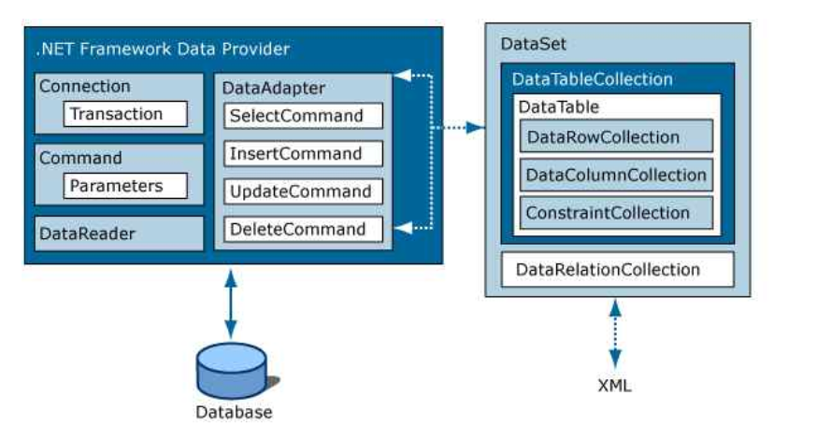

Slide 23
DataAdapter Class
The DataAdapter is used to connect DataSets to databases. The DataAdapter is most useful when using data-bound controls in Windows Forms, but it can also be used to provide an easy way to manage the connection between your application and the underlying database tables, views and Stored Procedures.
Methods of DataAdapter
Fill (DataSet ds,string TableName).
Update (DataSet ds,string TableName)

Slide 24
DataSet Class
The DataSet is the heart of ADO.NET. The DataSet is essentially a collection of DataTable objects. In turn each object contains a collection of DataColumn and DataRow objects. The DataSet also contains a Relations collection that can be used to define relations among Data Table Objects.

Slide 25
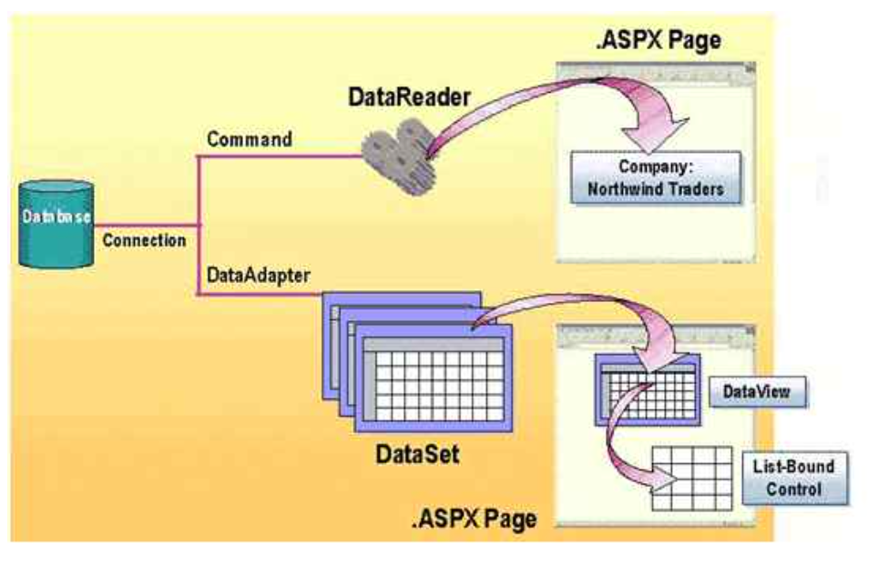

Slide 26
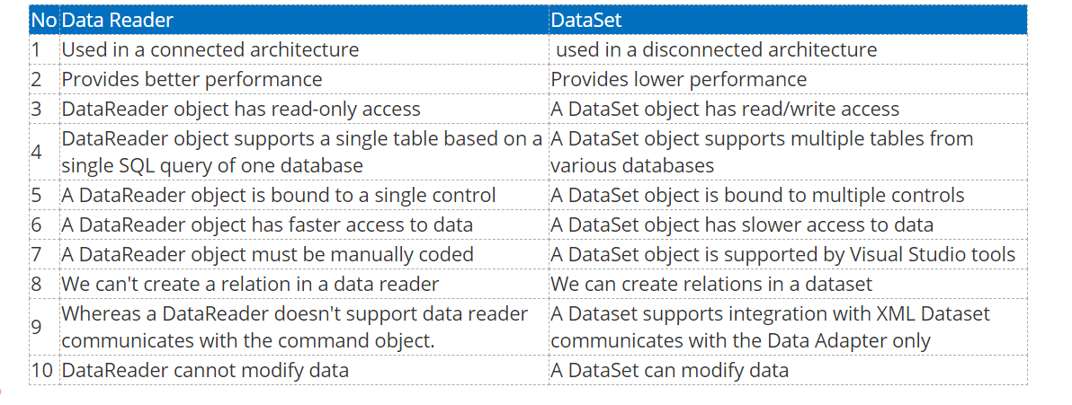

Slide 27


