Slide 1
What is .NET?

Slide 2

What is .NET?
NET is the Microsoft Web services strategy to connect
information
people
systems
devices
through software.

Slide 3
What is a Framework?
A programming infrastructure created by Microsoft for building, deploying, and running applications

Slide 4
What does the framework provide?
NET provides a standardized set of services
Data access and connectivity (ADO.NET)
User Interfaces (WinForms, WPF)
Web Applications (ASP.NET, Silverlight)
Network Communication (WCF), Workflow (WF)

Slide 5
.NET Framework
C++
C#
VB
Perl
J#
…
Visual Studio .NET
Common Language Specification
ASP .NET
Web Forms Web Services
Mobile Internet Toolkit
Windows
Forms
ADO .NET and XML
.NET Framework (Base Class Library)
Common Language Runtime
Operating System

Slide 6
What is CLS?

Slide 7

CLS – Common Language Specification
Provides basic set of features to be implemented
CLS enables language interoperability
Components that adhere to CLS rules are called CLS-compliant
CTS is a subset of CLS

Slide 8
CTS – Common Type System
It defines the rules which Common Language Runtime follows when declaring, using, and managing types
Enables cross language integration
Provides an object oriented model for implementation by many languages
Defines rules that every language must follow under .NET framework

Slide 9
Core of the framework
FCL – Framework Class Library
CLR – Common Language Runtime

Slide 10
Common Language Runtime
Common Language Runtime
Garbage collection
Language integration
Multiple versioning support
(no more DLL hell!)
Integrated security
Managed code and unmanaged code
Managed Code-code that executes under the control of runtime
UnManagedCode –code that runs outside the runtime

Slide 11
Framework Class Library
Framework Class Library
Provides the core functionality:
ASP.NET, Web Services, ADO.NET, Windows Forms, IO, XML, etc.

Slide 12
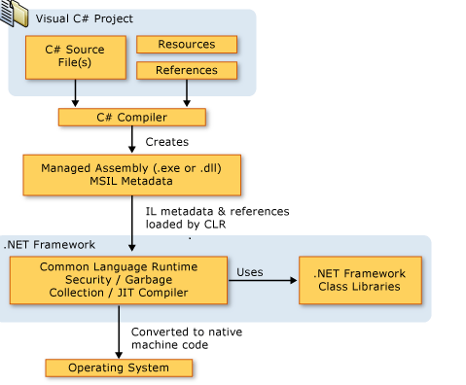
C# Code Compilation

Slide 13

Why .NET? – Points from Suresh
Why should I use .NET for this web app?
.NET is a framework
CLR – Common Language Runtime
FCL – Framework Class Library
Visual Studio
Language Integration

Slide 14
Assemblies
Any .Net Application on compilation gives assembly files(.dll or .exe)
Assemblies are fundamental unit of deployment, version control, reuse and security for a .net application.
Assembly contains – PE Header, CLR Header, Manifest and IL
Manifest files contain metadata
Assemblies can be private or shared
Shared Assemblies are placed in GAC

Slide 15
Assemblies contd….
Some information in the assembly manifest can be modified using attributes
We use ILDASM to peek into the assembly Manifest and IL file. We can use this tool to export the same to a text file.
We use ILASM to reconstruct an assembly from the text file into assembly Manifest and the IL.

Slide 16
Global Assembly Cache
Machine wide central repository of assemblies
Assemblies in GAC must be strongly named
Strong name consists of simple text name, version number, and culture information(if provided), a public key and a digital signature
gacutil / i for installing and / u for uninstalling

