Slide 1
A Project Presentation On ONLINE RESUME MANAGEMENT SYSTEM Group Members: MONISHANKAR NATH,GNIT PRATIK CHATTERJEE,GNIT SANJANA,GNIT SUBHANWITA SAHA,GNIT

Slide 2
CONTENTS ACKNOWLEDGEMENT INTRODUCTION OBJECTIVE SCOPE REQUIREMENT SPECIFICATION ER DIAGRAM WORK FLOW DIAGRAM SNAPSHOTS FUTURE SCOPE OF IMPROVEMENTS CONCLUSION

Slide 3
ACKNOWLEDGEMENT We would like to take this opportunity to express our profound gratitude and deep regards to our project mentor, Mr. Ashok Gupta, for his exemplary guidance, monitoring and constant encouragement throughout the course of this project. The blessing, help and guidance given by him, time to time, shall carry us a long way in the journey of life on which we are about to embark.

Slide 4
INTRODUCTION 1. Our project is aimed at developing an application for the “ONLINE RESUME MANAGEMENT”. The system is an application that can be accessed and effectively used throughout the organization with proper login enabled, both by the companies who provide placement as well as the students who look forward to get placed. 2. Our system can be used as an application to upload company names and details, who offer placements. The companies set a criteria for the students, depending upon which they want to offer jobs to the selected students in their companies. 3. Our system can also be used as an application to manage the student information with regard to placement. Student logging in should be able to upload and edit their personal and educational information in the form of a resume. Unregistered students can register along with uploading their resume to check availability of the jobs according to their qualification.

Slide 5
OBJECTIVE 1. The management of placement and work-integrated learning has long been supported by paper-based systems, databases, spreadsheets and E Mail communications. Unfortunately, in today’s fast-moving world most of these are inflexible to changes and cannot respond quickly enough. They are also staff intensive. This has led to the introduction of an unique online resume management system. 2. Therefore, our primary objective is to provide ease, reduce pressure and complicacy of the students and placement providers by means of our application. 3.Comapnies set a criteria and accordingly our application filters out students who fulfil the criteria, based on grades allotted to them according to their uploaded resume. Hence it is an immensely helpful application to be used by the Training and Placement cells of the colleges.

Slide 6
SCOPE 1. For the purpose of placement of the student in colleges, TPO’s have to collect the information and CV’s of students, manage them manually and arrange them according to various streams. If any modification is required that is also to be also done manually. 2. So, to reduce the job required to manage CVs and the information of various recruiters, a new system is proposed which is processed through computers. 3. Students can access previous information about placement because we store information of all the students in our database. Various companies can access the information i.e. the resume of the registered students and filter among them according to their own criterias.

Slide 7
REQUIREMENT SPECIFICATION Server Side Server : Apache RDBMS : MySQL Client Side Internet Connection and Browser Domain Specification : This project is developed with PHP for frontend and MY SQL for backend.

Slide 8
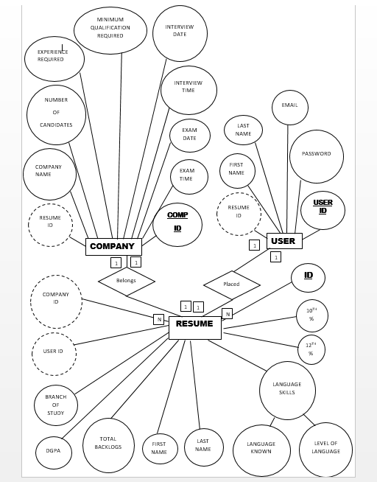
ER DIAGRAM OF OUR APPLICATION

Slide 9
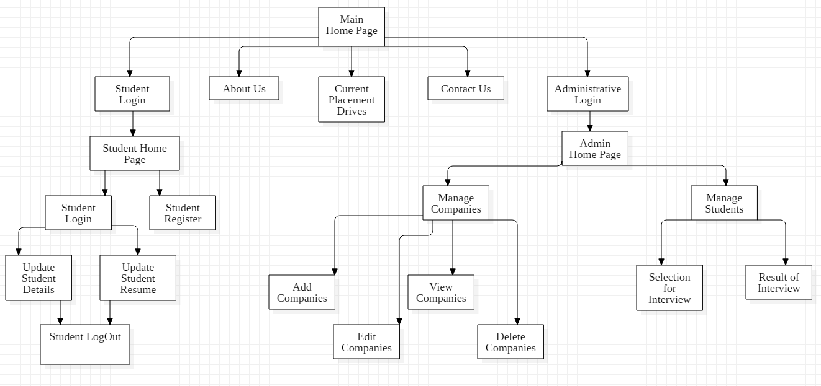
WORK FLOW DIAGRAM OF OUR APPLICATION

Slide 10
SNAPSHOTS OF OUR WEB APPLICATION PAGES

Slide 11
USER SECTION OF OUR APPLICATION

Slide 12
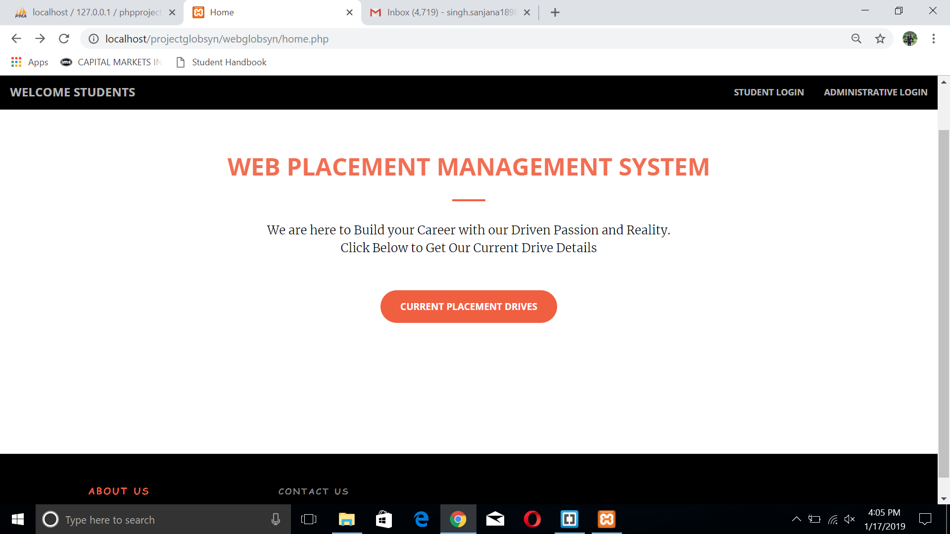
STUDENT HOME PAGE

Slide 13
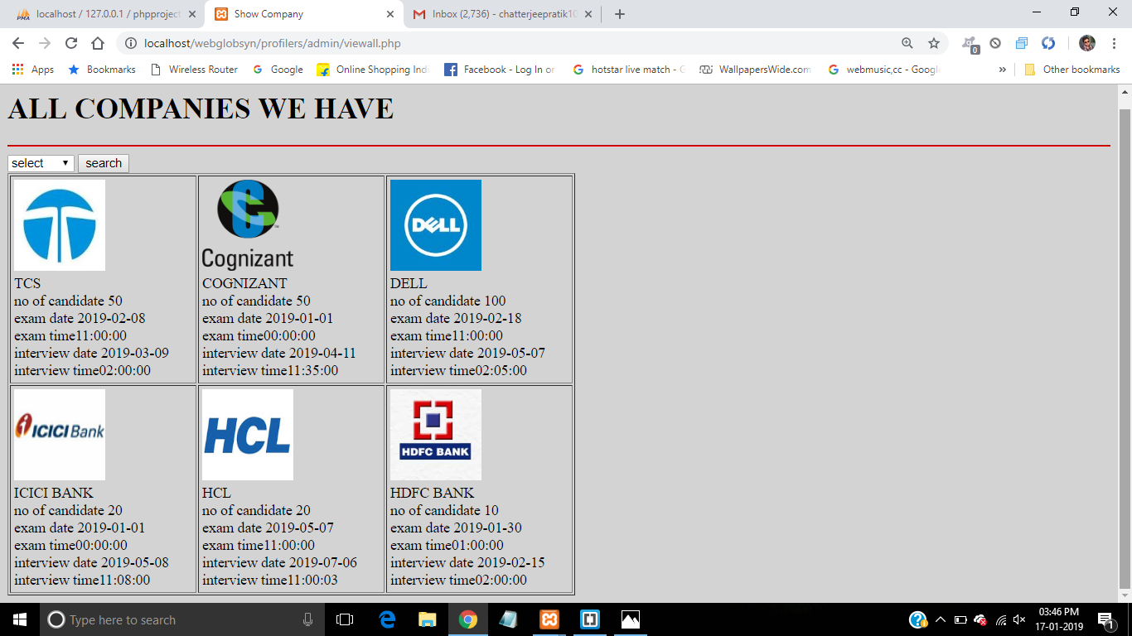
CURRENT PLACEMENT DRIVES - PAGE

Slide 14
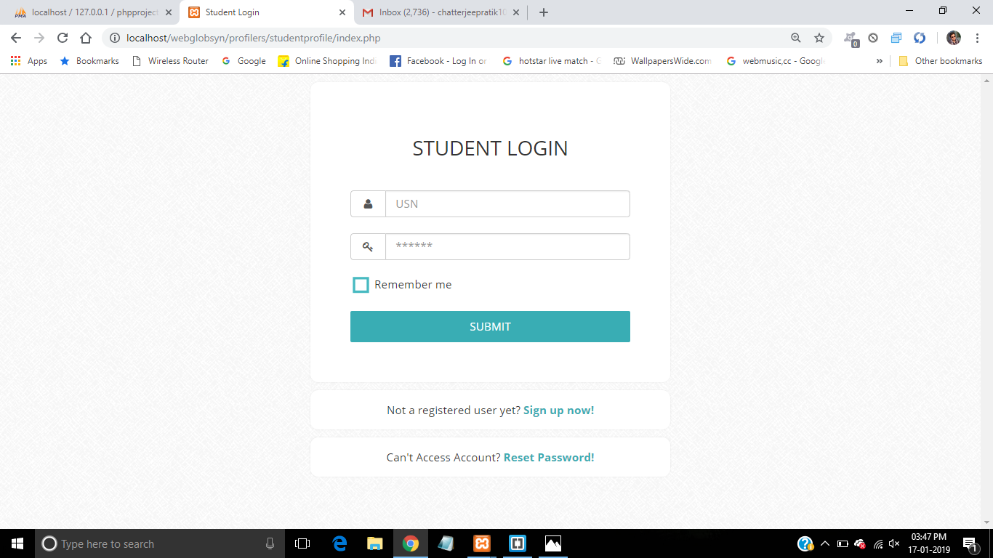
STUDENT LOGIN - PAGE

Slide 15
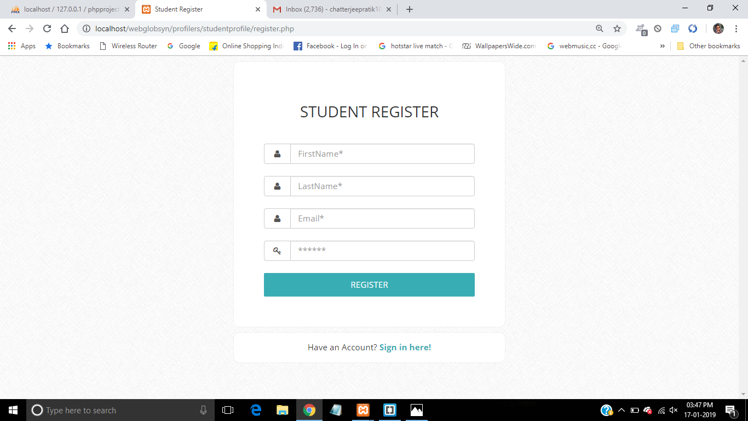
STUDENT REGISTER - PAGE

Slide 16
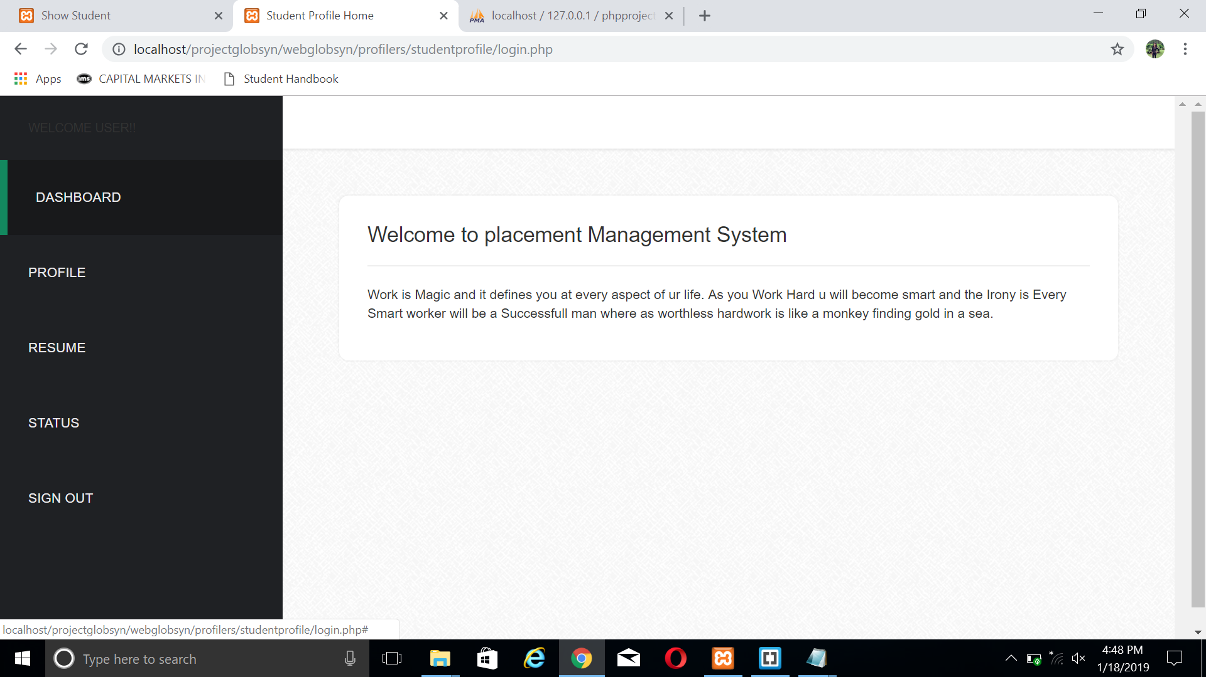
DASHBOARD - PAGE

Slide 17
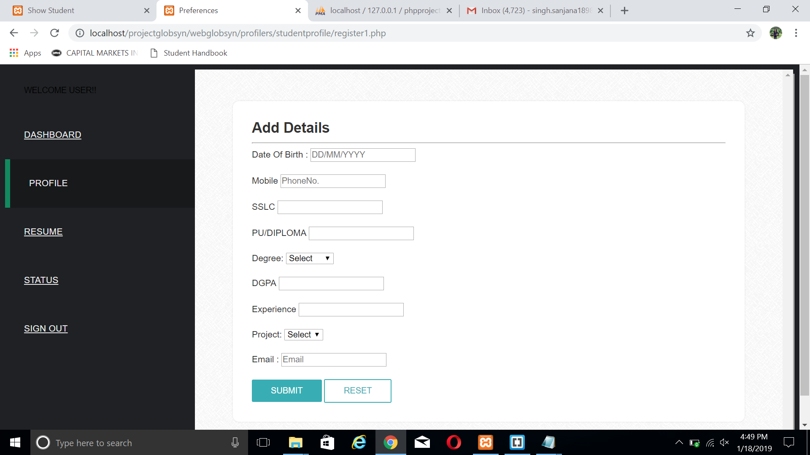
PROFILE - PAGE

Slide 18
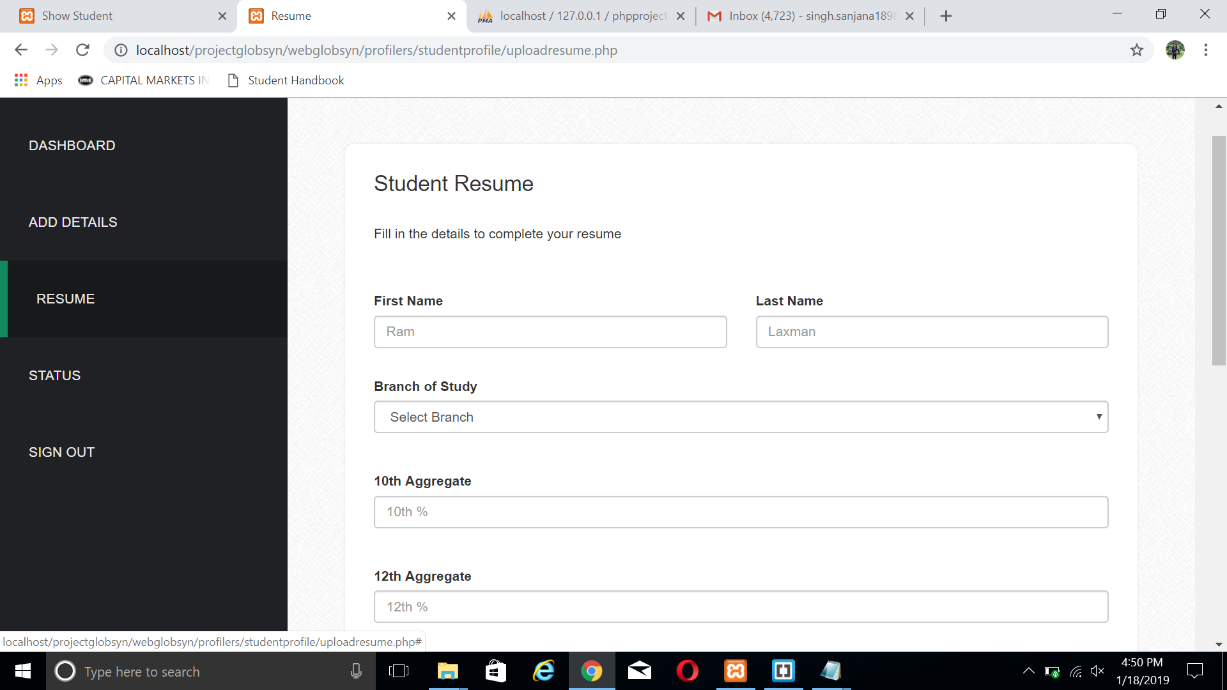
UPDATE RESUME - PAGE

Slide 19
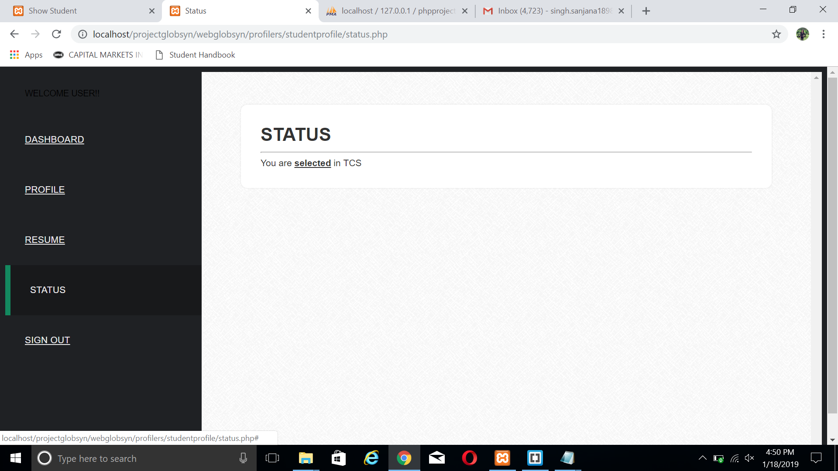
STATUS - PAGE

Slide 20
ADMINISTRATION SECTION OF OUR APPLICATION

Slide 21
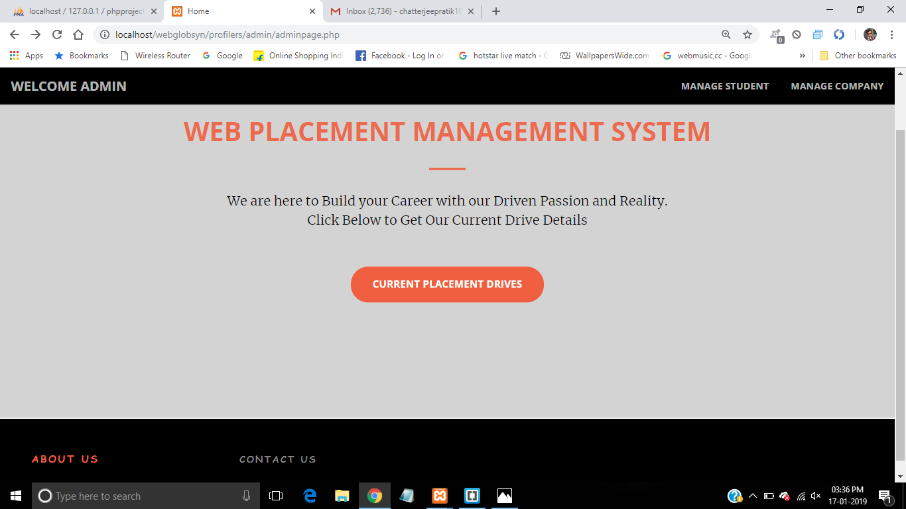
ADMIN HOME PAGE

Slide 22
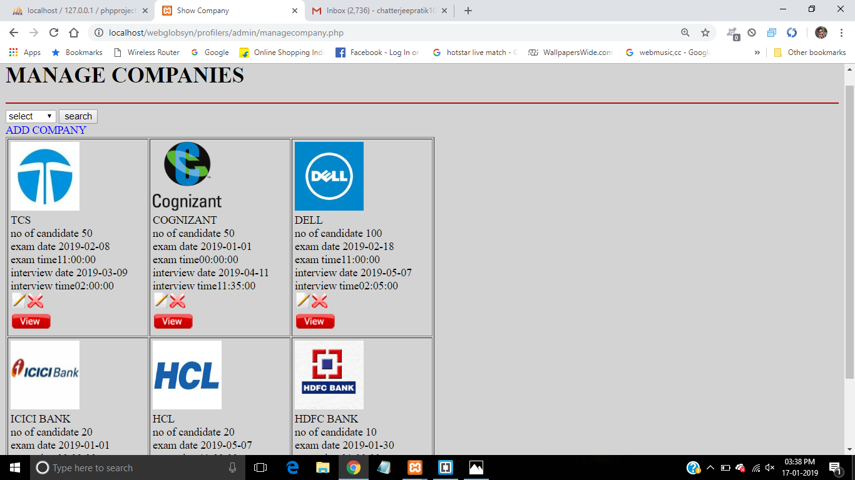
MANAGE COMPANY - PAGE

Slide 23
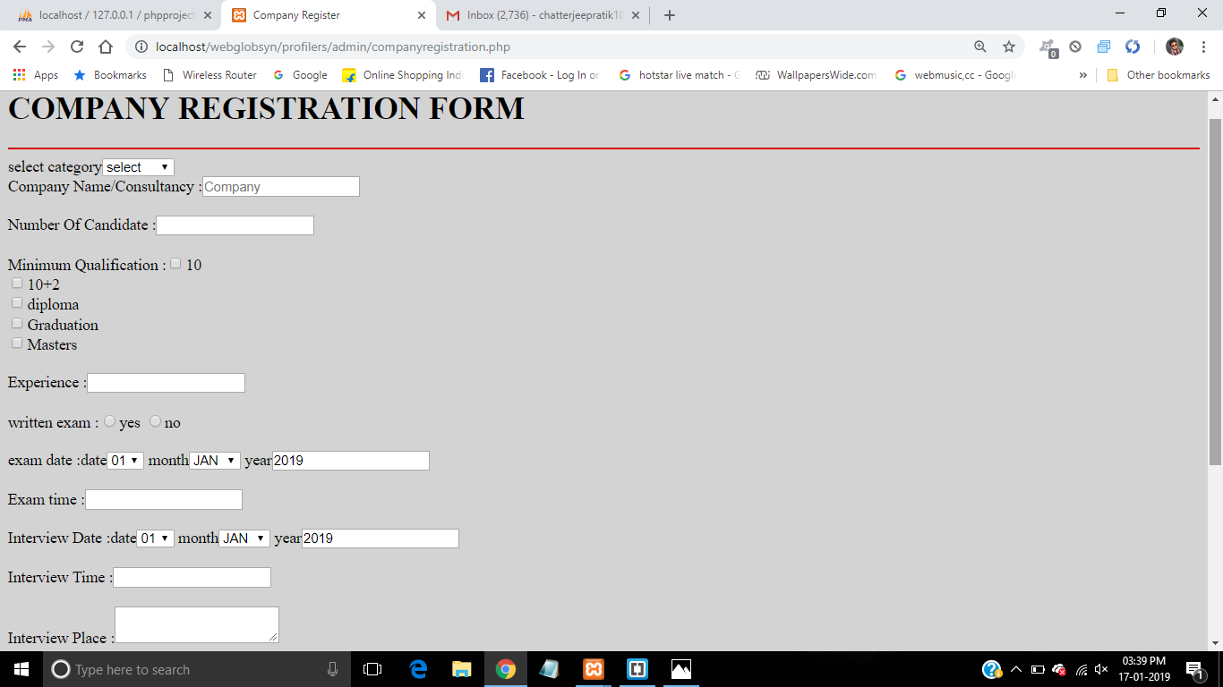
ADD COMPANY - PAGE

Slide 24
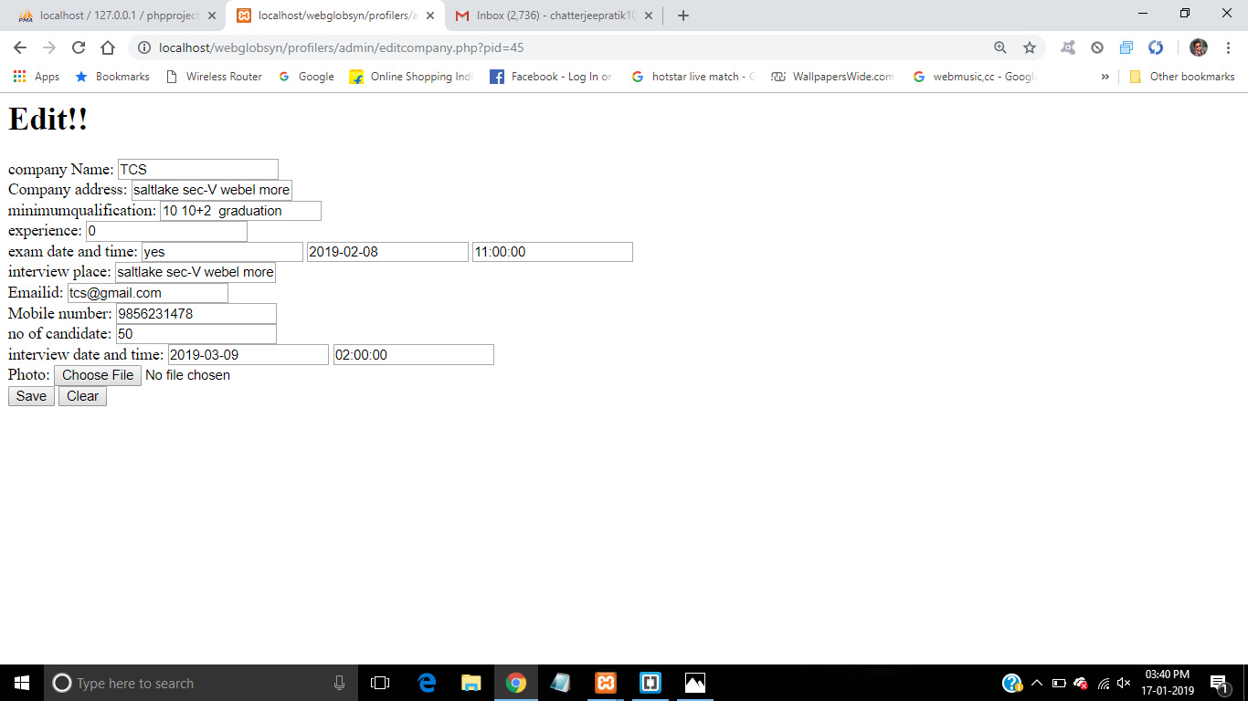
EDIT COMPANY - PAGE

Slide 25
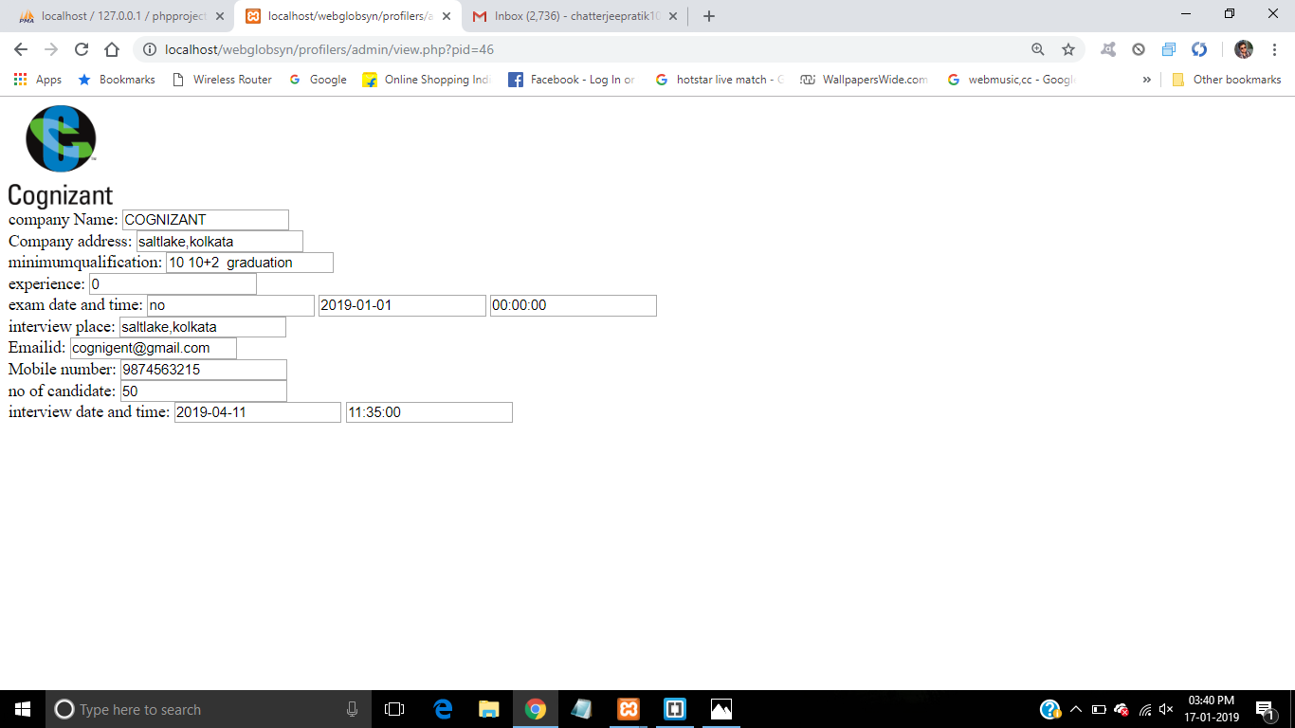
VIEW COMPANY - PAGE

Slide 26
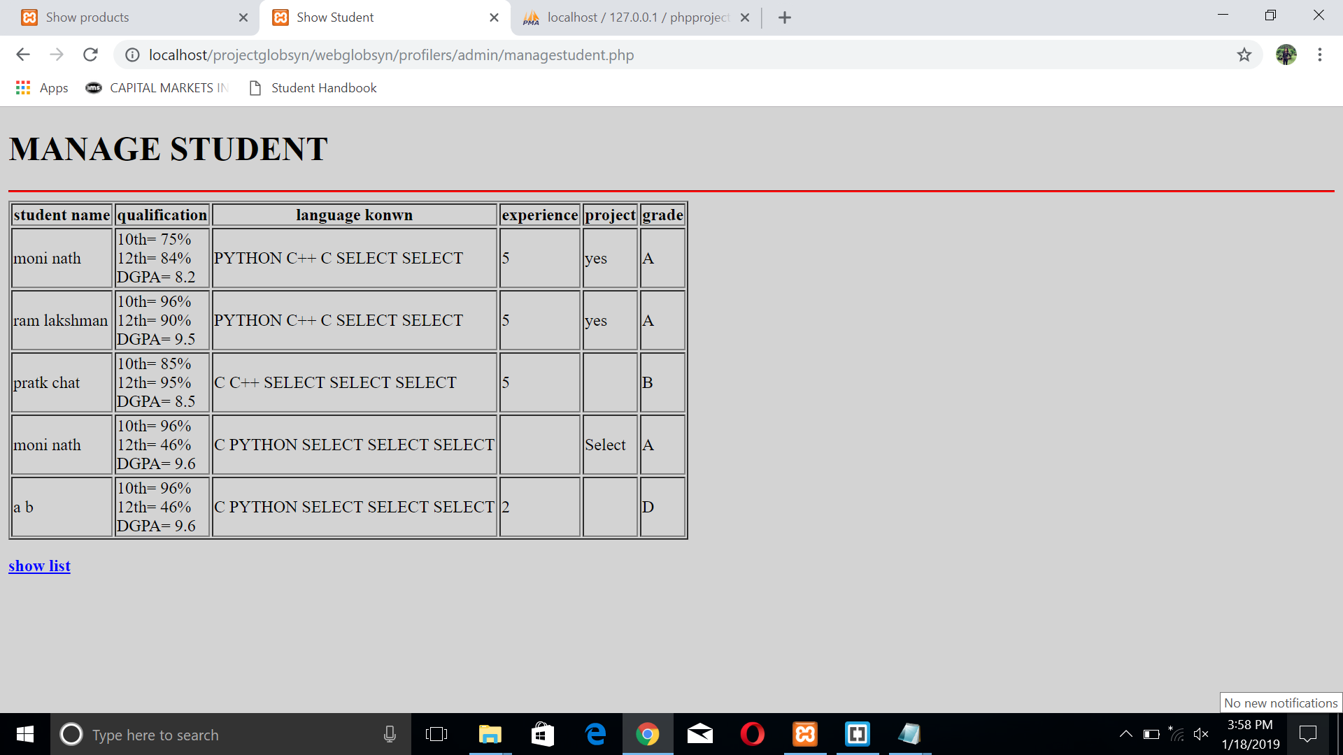
MANAGE STUDENT - PAGE

Slide 27
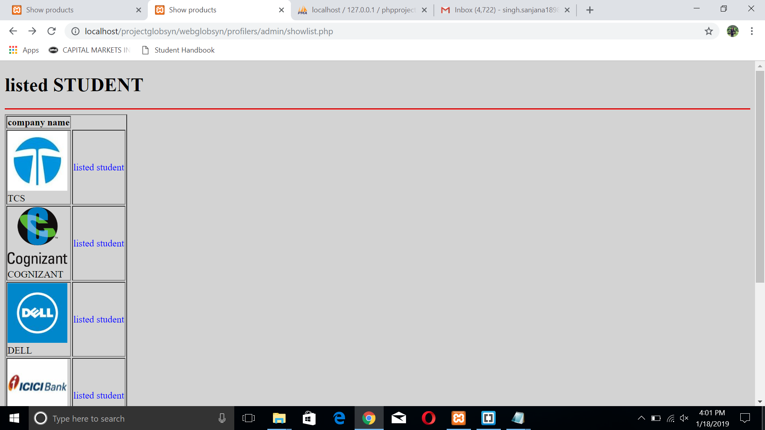
SHOW LIST - PAGE

Slide 28
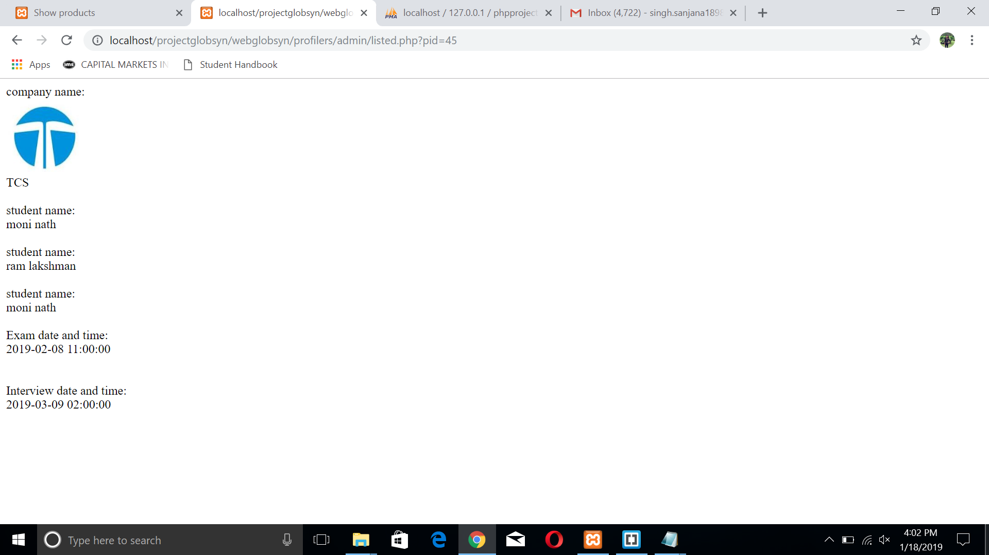
LISTED STUDENTS

Slide 29
FUTURE SCOPE OF IMPROVEMENTS 1. In this case, we can add some more advanced features to this software to make it more reliable. Hence our application continues to add features and include adjustments to its functionality. 2. We should keep the hardware and software requirement of our project as minimum as possible so that it can support maximum user base. 3. The sorting procedure of the students according to their resume and criteria set by companies, should be very efficient and strong. 4. We can modify our project with better approach using more graphics. 5. The backup procedure should be incorporated to make sure of database integrity.

Slide 30
CONCLUSION 1. Generally, college TPOs has to face a lot of trouble to manage all the information and resume of all the students along with the criteria specified by respective companies. There is an immense need to develop a system that can solve the mentioned problem and save a lot of manual work as well as time. 2. Our application comes up with the exact solution. We sought to comply with a range of principles which would improve the experience of all users and enable wider use of the programs. 3. We provide an effective paperless solution for the management of work-integrated learning and the manual labor-work and time required in the whole process of placement management. From a proper analysis of positive points and constraints on the web application, it can be safely concluded that the application is highly efficient and user friendly.

Slide 31
THANK YOU!

