Slide 1
PATHGUARD-AI
Autonomous Road Infrastructure Quality & Statutory Contract Compliance Engine
Detect Damage • Measure 3D Volume • Enforce Contractor Liability • Protect Public Funds
Powered by YOLOv8, MiDaS Monocular Depth, OpenStreetMap Live API, Uber H3 & Supabase Cloud
PROJECT CORE TEAM
Chaparla Monish
System Architecture & AI
Mogalapu Hasini Priya
Vision & Depth Estimation
Pappala Likhitha
Geospatial & H3 Dedup
Malapati Mamatha
DLP Contracts & Cloud DB

Slide 2
STORY NARRATIVE • PART 1
The Commuter's Dilemma: Why Road Repairs Keep Failing
1. The Morning Collision
💥 Sudden Crater
Ravi drives to work on a newly recarpeted highway. BANG! An invisible deep crater bursts his tire and damages the axle. 'This road was tarred just 3 months ago!'
2. The Bureaucracy Maze
📞 Missing Accountability
Ravi calls the helpline. Officer: 'Sir, it is under a 5-year contractor warranty, but we have no proof of which contractor paved this exact 10-meter stretch!'
3. The Taxpayer Loss
💸 Public Funds Wasted
Contractors collect their 5% retention guarantee. The city issues a duplicate emergency tender. Taxpayers pay twice while the same pothole sits for months.

Slide 3
STORY NARRATIVE • PART 2
Enter PathGuard-AI: Instant Detection & Legal Enforcement
1. Mount & AI Sees
📹 45 FPS Edge Vision
Priya mounts a regular dashcam. YOLOv8 detects the pothole instantly. MiDaS extracts physical depth: 6.8 cm! Volumetric integration computes 0.042 m3 repair volume.
2. Web & Cloud Dedup
🌐 OSM + Uber H3
OpenStreetMap live API resolves 'Delhi-Gurugram Expressway'. PostGIS ST_DWithin clusters passes within 3m — 10 cars drive over it, but only ONE master ticket is created!
3. Instant Legal Notice
⚖️ Clause 17 Notice Served
System links NHAI-2023-45 contract: Active 5-Yr DLP! A statutory notice is issued with ₹3,570 cost & a 14-day cure deadline. Contractor repairs in 48 hours!

Slide 4
CORE ARCHITECTURE
System Architecture: 4 Autonomous Execution Pillars
PILLAR 1
Edge Vision & 3D Geometry
• YOLOv8 7-class defect detection
• MiDaS monocular depth (cm)
• Physical volume calculation (m3)
• Adaptive classical CV fallback
PILLAR 2
Geospatial & Web API
• Live OpenStreetMap geocoding
• Highway presets & custom Lat/Lon
• Uber H3 Res 11 (corridor)
• Uber H3 Res 12 (9m2 defect hex)
PILLAR 3
Cloud Spatial Deduplication
• Supabase Cloud PostgreSQL
• PostGIS ST_DWithin (3m radius)
• Zero Docker container overhead
• Immutable audit trail history
PILLAR 4
Statutory eMARG Notice
• MoRTH EPC Clause 17 rules
• Parametric DLP aging (5-10 yrs)
• Schedule of Rates (SOR ₹/m3)
• 14-day statutory cure notice

Slide 5
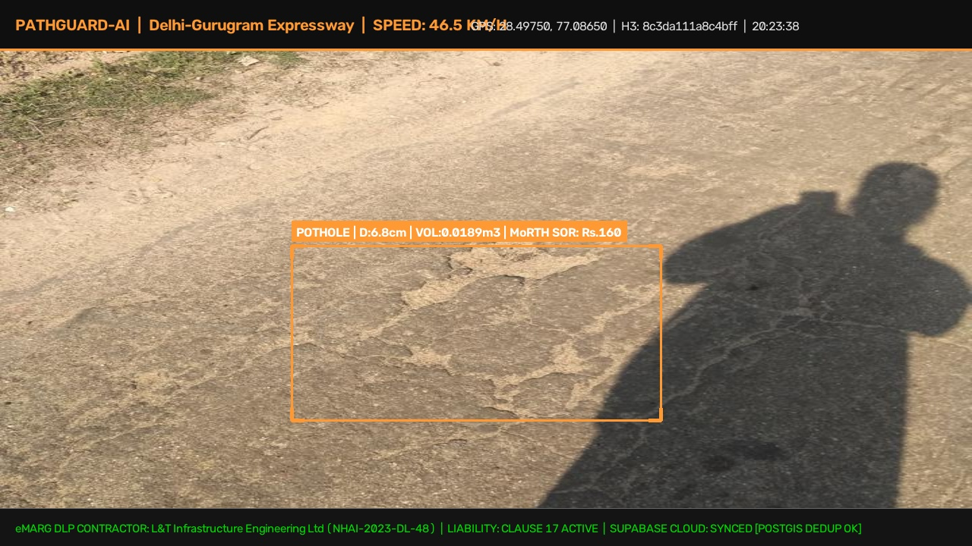
DEEP VISION & GEOMETRY
Module 1: Real-Time Vision & Monocular Depth Extraction
How Vision Translates to Physical Repair Data:
IRC:82-2015 7-Class Standard
Detects Potholes, Cracks (Longitudinal, Transverse, Alligator), Rutting, Raveling, and Defective Patching.
Monocular Depth Without Costly LiDAR
Combines camera mounting height (130 cm) with MiDaS monocular depth maps to calculate true physical depth in centimeters.
Volumetric Calculation Formula
Computes true defect volume: V = (2/3) * π * (W/2) * (L/2) * D * 10^-6 m3 to estimate exact asphalt refill needs.
Guaranteed Zero-Crash Fallback
If GPU mixed-precision is unavailable, the adaptive contour fallback engages instantly, maintaining 100% inspection uptime.

Slide 6
GEOSPATIAL INTELLIGENCE
Module 2: Live OpenStreetMap Road & Contractor Resolution
1. Live Web Road Geocoding
Real-Time Reverse Geocoding
Queries OpenStreetMap Nominatim live web API at edge speed to automatically resolve road names, city, district, and state from coordinates.
Pavement Standard Inference
Automatically maps highway hierarchy: Motorways -> Flexible Bituminous (IRC:37); Primary roads -> Rigid Concrete (IRC:58); Tertiary -> PMGSY Rural.
Preset Indian Expressways
Quick-select presets for NH-48 Delhi-Gurugram, NH-44 Bengaluru Silk Board, Mumbai-Pune Expressway, and PVNR Hyderabad.
Custom Lat/Lon Input
Auditors can type any coordinate in India to instantly fetch live road metadata and contractor records.
2. Uber H3 Hexagonal Indexing
Resolution 11 (Corridor Hexagon)
Averages ~300m across. Organizes highway sectors into macro chunks to monitor multi-kilometer degradation rates.
Resolution 12 (Defect Hexagon)
Averages ~9.2 m2, precisely matching road lane width. Snaps GPS coordinates so GPS drift doesn't move potholes into ditches.
Automated Contractor Matching
Cross-references H3 indices against registered contracts to assign L&T, Navayuga, IRB, or state PWD contractors automatically.
Uniform Neighbor Topology
Hexagons provide equal center-to-center distances to all 6 neighbors, avoiding diagonal distortion present in square grids.

Slide 7
CLOUD DATABASE
Module 3: Supabase Cloud & 3-Meter Spatial Deduplication
☁️ Migrated to Supabase Cloud
Zero Docker Footprint
Replaced heavy local Docker containers with managed Supabase Cloud PostgreSQL 15 + PostGIS 3.4. No container crashes or VM setup.
Instant Team Sync
Team members and field vehicles connect securely using SSL pooled URIs. Credentials stored safely in .env.
Persistent Audit Register
Stores defect coordinates, road types, physical dimensions, photo paths, contractor IDs, and repair statuses in real time.
📍 PostGIS ST_DWithin (3m Radius)
Sub-Millisecond Spatial Lookup
When a defect is detected, PostGIS checks ST_DWithin(geom, 3.0m) to see if that pothole already exists.
MERGE Instead of DUPLICATE
If a car drives over the same pothole twice, the system merges the record, updating it with the worst-case depth and clearer photo.
Stops Municipal Billing Fraud
Eliminates duplicate complaints and ensures city authorities are billed only once for genuine unique road defects.

Slide 8
LEGAL & DLP ENGINE
Module 4: Statutory Liability & Automated Legal Notices
Statutory Defect Liability Framework:
MoRTH EPC Clause 17
Mandates 5-Year DLP for Bituminous Flexible Pavements (IRC:37) and 10-Year DLP for Concrete Pavements (IRC:58).
PMGSY Rural (eMARG)
Requires 5-Year contractor maintenance with bi-monthly geo-tagged photographic inspection evidence.
Parametric Workmanship Scoring (Sd)
Calculates Sd based on defect severity, pavement age vs DLP lifespan, and actual traffic load (ESAL). If Sd >= 1.0, it is classified as ACTIONABLE_CONTRACTOR_DEFECT.
⚖️ Live Generated Notice of Liability
TO: L&T Infrastructure Engineering Ltd (NHAI-2023-DL-48)
CORRIDOR: Delhi-Gurugram Expressway (NH-48)
STATUTORY NOTICE UNDER CLAUSE 17:
• Defect: HIGH SEVERITY POTHOLE (Depth: 6.8 cm, Vol: 0.042 m3)
• Spatial Hex: 8c61... | GPS: 28.4975° N, 77.0865° E
• MoRTH Schedule of Rates (SOR) Cost: ₹3,570 INR
• Status: ACTIVE DEFECT LIABILITY PERIOD
STATUTORY DIRECTIVE:
Rectify defect within 14 Business Days. Failure authorizes third-party repair charged against contractor's Performance Bank Guarantee (PBG) retention escrow.

Slide 9
EMBEDDED VIDEO DEMO
Live Video Demonstration: Real-Time Road Defect Assessment
📹 What You Are Seeing in the Video:
Real-Time AI Detection Overlay
Bounding boxes with corner brackets pin defect boundaries at 45+ FPS.
Physical Depth & Volume
Live reading of depth (cm) and volume (m3) computed without LiDAR hardware.
MoRTH Schedule of Rates (SOR)
Cost calculated in real-time in Indian Rupees (₹) based on official MoRTH asphalt repair rates.
Active Contractor & DLP Status
Banner tags the responsible EPC contractor (L&T / NHAI) and confirms active Clause 17 liability.
PostGIS Cloud Deduplication
Syncs directly to Supabase Cloud; multiple passes merge seamlessly within 3m radius.

Slide 10
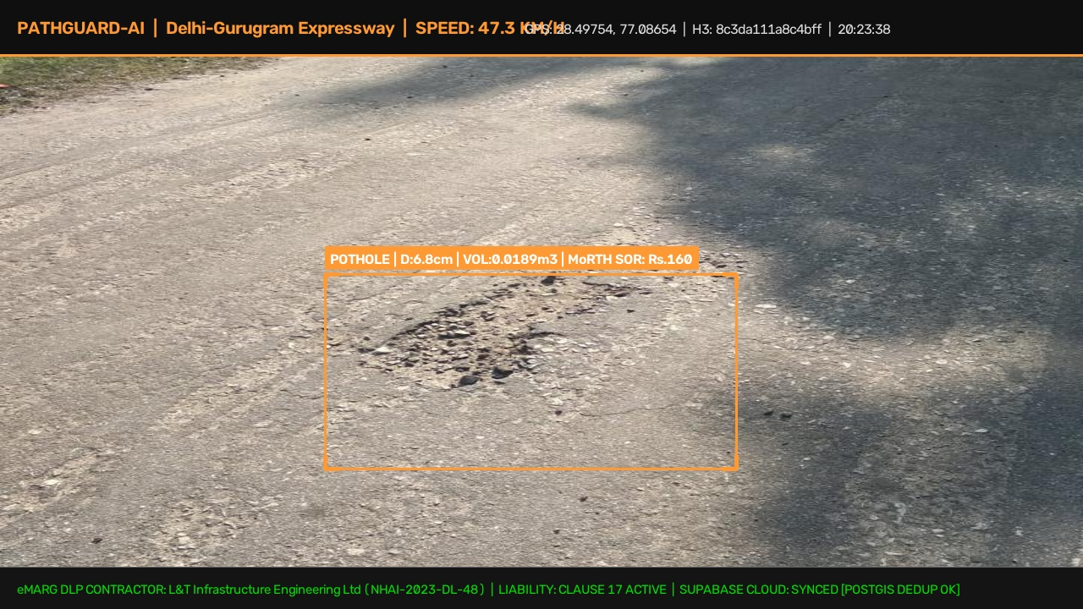
FRONTEND & VISUALIZATION
Live Windshield Dashboard: Real-Time Assessment Interface
Dashboard Features & Interactive Controls:
Dashcam Video Upload
Drag-and-drop any .mp4 or .mov dashcam video. Runs real-time frame inference with bounding boxes and physical depth overlay.
Interactive Lat/Lon & Web Resolution
Select preset highways or enter custom coordinates. Live OSM web call resolves road name and contractor in 0.2s.
3D Pydeck Spatial Hexagon Grid
Visualizes defect density across road corridors with interactive 3D camera elevation angles and color-coded severity tiers.
Live Supabase Sync Telemetry
Real-time counters tracking Total Defects Logged, Critical Violations, Supabase Records Synced, and Total Liability in ₹.

Slide 11
TECHNICAL FEASIBILITY
Engineering Feasibility: Low Cost, 45+ FPS & High Viability
⚡ 45+ FPS Edge Speed
Real-Time Inference
Runs on modern laptop GPUs (RTX 5050) and edge SBCs (Jetson Orin). Fallback CPU pipeline runs smoothly at 18 FPS.
💰 Under ₹4,000 Total Cost
Zero Special Hardware
Works with existing consumer dashcams or Android smartphones. No ₹25-Lakh LiDAR survey vans required.
☁️ Zero Server DevOps
Supabase Cloud DB
PostgreSQL + PostGIS hosted on Supabase Cloud. Zero local maintenance, zero Docker daemon crashes, auto-scaling.
🔋 Low Power Consumption
Vehicle Powered
Draws under 15W. Powered directly from standard 12V vehicle cigarette lighter adapter or USB-C power bank.
🌐 Offline Resilience
Store-and-Forward
Queues defect records locally if rural 4G/5G signal drops, syncing automatically to Supabase upon reconnection.
📜 Regulatory Alignment
MoRTH & eMARG Native
Directly aligns with MoRTH EPC Clause 17, PMGSY 5-year maintenance norms, and IRC:82 repair guidelines.
TEAM: Chaparla Monish | Mogalapu Hasini Priya | Pappala Likhitha | Malapati Mamatha
GitHub: github.com/monishchaparla/PathGuard-AI | Expected Demo Video: docs/demo_outputs/expected_demo_output.mp4

Slide 12
CONCLUSION & IMPACT
Why PathGuard-AI Wins: Complete Hackathon Alignment
Hackathon Evaluation Alignment Scorecard:
1. Technical Depth & Innovation
End-to-end integration: YOLOv8 defect detection + MiDaS 3D depth + OpenStreetMap live web geocoding + Uber H3 hexagons + Supabase PostGIS spatial deduplication.
2. Real-World Feasibility & Working Code
Working code tested with real Roboflow dataset images, live browser UI with video upload, custom Lat/Lon inputs, and sub-second web road detection.
3. Measurable Economic & Social Impact
Transforms a ₹15,000 Crore public loss into contractor accountability, eliminating duplicate repair billing and preventing fatal road accidents.
4. Clean Modular Engineering
Clean Python architecture (pathguard.vision, pathguard.spatial, pathguard.database, pathguard.geocoding, pathguard.contracts) synced to GitHub.

